Slide 1
Chapter 3
Internal Energy, Heat and First Law of Thermodynamics

Slide 2
First law of thermodynamics
First law of thermodynamics is simply the law of conservation of energy
1- Energy can neither be created nor destroyed, only it can be converted from one form to another.
2- The total amount of energy in the Universe remains constant.
3- Whenever a given quantity of energy of one kind disappear, then equivalent amount of energy appears in some other kind.
4- It is not possible for a perpetual motion machine to do work without consuming some form of energy.
5- Total energy of an isolated system remains constant.

Slide 3
There are only two ways of changing the energy of a closed system:
1- By transfer of energy as heat
Heat is a form of energy which flows from one system to another because of different in temperature.
2- By transfer of energy as work

Slide 4
Heat (q)
It is a form of energy which flows from one system to another because of different in temperature. Heat refer to random form of energy.
Units
SI = Joule (J) / Nm
Calorie (cal), 1 cal = 4.184 J – note: kcal = Cal

Slide 5
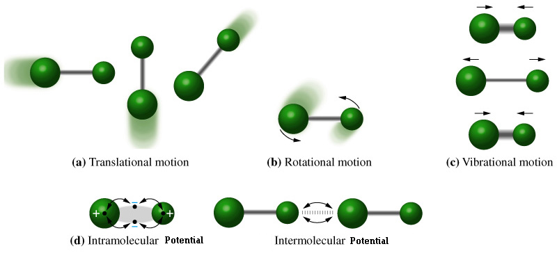
Internal Energy (E) or (U):
The summation of all energy in the system. Every system having some quantity of matter is associated with a definite amount of energy. This energy is called as Internal energy. It is arising from the relative positions (potential energy), interactions between system parts and their motion (kinetic energy) as shown below:

Slide 6
Internal Energy
Potential Energy:
1- Intermolecular energy
2- Intramolecular energy
3- Nuclear Energy/Binding energy
Kinetic Energy:
1- Vibrational energy
2- Rotational energy
3- Translational energy
4- Electronical energy

Slide 7
The Internal Energy for Ideal Gas
U_{internal} = KE_{total}
U_{internal} = 3/2 PV = 3/2 nRT
How can the internal energy be changed?
There are two ways:
1- increasing the KE of the particles by heating the system.
2- Do work on the system (moving the piston).

Slide 8
Characteristic of Internal Energy (U)
1- It is an extensive property
2- It is a state function
3- It is not dependent on path followed
4- There is no change in the internal energy in a cyclic process
5- Internal energy of an ideal gas is a function of temperature only

Slide 9
Mathematical expression of first law of thermodynamics:
Consider an ideal gas in a cylinder which is fitted with weightless and frictionless piston
The system has initial Internal energy U₁ and initial volume V₁. Internal energy can be changed by heating the substance and/or by doing work on the system.
Then the system has final internal energy U₂ and final volume V₂
Surroundings
Surroundings
-q
-w
+q
+w
U
U

Slide 10
The change in the internal energy:
∆U = U₂ – U₁
Internal energy can be changed by heating q the substance and/or by doing work w on the system. Therefore:
∆U = q + w
for small change
dU = đq + đw

Slide 11
Sign Convention
∆U
q
w
Positive
U₂ > U₁
Energy is
absorbed
Negative
U₂ < U₁
Energy is
released
Positive
Energy is
absorbed
Negative
Energy is
released
Compression On the System
Positive
Compression By the System
Negative

Slide 12
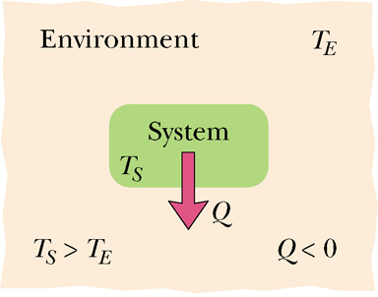
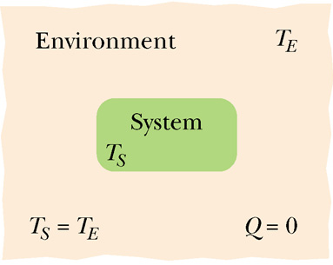
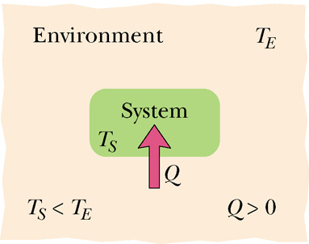
Heat (q)
Heat is the energy transfer between a system S and its environment E (surroundings) because of a temperature difference that exists between them.
q
q < 0
q = 0
q > 0
Heat can be either:
1) at constant volume q_{v}
2) at constant pressure q_{p}

Slide 13
Absorption of Heat
Heat Capacity (C): defined as the amount of energy (q) required to rise the temperature of substance by 1 K or 1 °C
$$q=C∆T=C\left(T_{f}−T_{i}\right)$$
Specific Heat (C_{S}): defined as the amount of energy (q) required to rise the temperature of one gram of a substance by K or 1 °C
$$q=mC_{S}∆T=mC_{S}\left(T_{f}−T_{i}\right)$$
$$C=mC_{S}$$
What are their units?

Slide 14
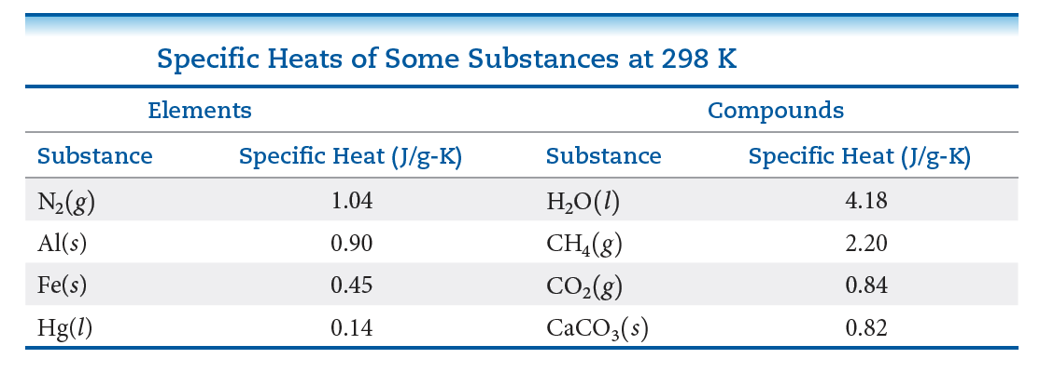

Slide 15
Examples
1- How much heat is given off when an 869 g iron bar cools from 94 ºC to 5 ºC? (Cs of Fe = 0.444 J/g ºC)?
2- (a) How much heat is needed to warm 250 g of water from 22 °C to 98 °C? (b) What is the molar heat capacity of water?
3- What is the specific heat capacity of a metal if addition of 90.0 g of the metal at 17.7 °C to 210.0 g of Cu (Cs = 0.385 J/g °C) at 153.7 °C produces a mixture that reaches thermal equilibrium at 129.1 °C?

Slide 16
4- The temperature of a piece of silver metal is increased from 22.2 ºC to 84.30 ºC by absorbing 365 J of heat. Knowing that the specific heat of silver is 0.235 J/g.°C. What is the mass (in Kg) of this piece of silver?
5- A 454 g block of lead is at an initial temperature of 22.5ºC. What will be the temperature of the lead after it absorbs 4.22 kJ of heat from its surroundings? (Assume that the specific heat capacity of Pb is equal to 0.128 J/g.ºC)

Slide 17
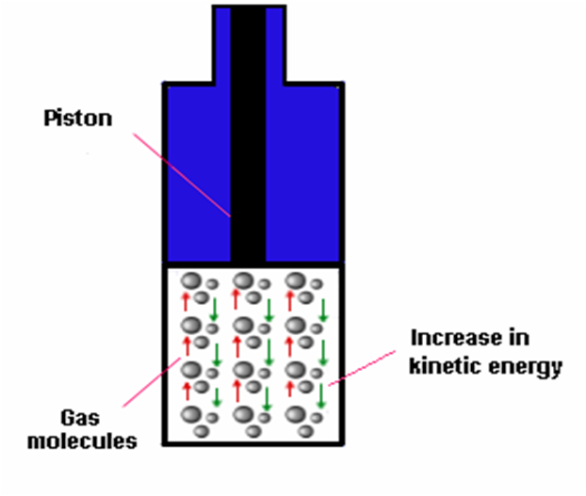
Consider the system shown below:
There is two possible ways:
1- If we fix the piston, then we end with heat capacity at constant volume (C_{V})
2- If we allow the piston to move freely, then we end with heat capacity at constant pressure (C_{P})

Slide 18
Heat capacity (C) can be :
1) at constant volume (C_{V})
2) at constant pressure (C_{P})
If we have C for one mole, then we could say that:
C_{V,m} or $\overline{C_{V}}$ = heat capacity at constant volume for one mole.
C_{P,m} or $\overline{C_{P}}$ = heat capacity at constant pressure for one mole.
in general : $C_{P}=n\overline{C_{P}}$
$$C_{V}=n\overline{C_{V}}$$

Slide 19
at constant volume (C_{V})
$$C_{V}=\frac{q}{∆T}$$
From first law
$$C_{V}=\frac{∆U−w}{∆T}$$
Because the piston is fixed so w = 0
$$C_{V}=\frac{∆U}{∆T}$$
U = KE and $KE=\frac{3}{2}PV$and PV = nRT therefore $U=\frac{3}{2}nR∆T$

Slide 20
Therefore
$$C_{V}=\frac{\frac{3}{2}nR∆T}{∆T}=\frac{3}{2}nR$$
$$C_{V}=\frac{3}{2}nR$$
$$\overline{C_{V}}=\frac{3}{2}R$$

Slide 21
2) at constant pressure (C_{P})
$$C_{P}=\frac{q}{∆T}=\frac{∆U−w}{∆T}$$
w = -P∆V
$$C_{P}=\frac{∆U−w}{∆T}=\frac{\frac{3}{2}nR∆T+P∆V}{∆T}=\frac{\frac{3}{2}nR∆T+nR∆T}{∆T}=\frac{5}{2}nR$$
$$C_{P}=\frac{5}{2}nR$$
$$\overline{C_{P}}=\frac{5}{2}R$$

Slide 22
Relationship between C_{P} and C_{V}
$$C_{P}−C_{V}=\frac{5}{2}nR−\frac{3}{2}nR=nR$$
$$\overline{C_{P}}−\overline{C_{V}}=R$$
Always:
$$C_{P}>C_{V} and {C_{P}}/{C_{V}}>1$$

Slide 23
Examples
6- When 178 J of energy is supplied as heat to 1.9 mol of gas molecules at constant pressure, the temperature of the sample increases by 1.78 K.
Calculate the molar heat capacities at constant volume and constant pressure
of the gas.
7- 1 mole of krypton (Kr) is placed in the cylinder with a piston at a constant pressure (5 atm); 416 J energy expends on its heating. What is the values of ΔT in the process of krypton expansion? (C_{v,m} of Krypton equals to 12.47 J/mol.K)

Slide 24
Heat Capacity Ratio (γ) (for adiabatic process)
Capacity ratio or adiabatic index or ratio specific heats or Poisson constant, is the ratio of the heat capacity at constant pressure (C_{P}) to heat capacity at constant volume (C_{V}). It is sometimes Known as the isentropic expansion factor and is denoted by (γ)
For the reversible adiabatic expansion of a perfect gas, pressure and volume are related by an expression that depends on the ratio of heat capacities
$$γ=\frac{C_{P}}{C_{V}}$$
MORE DETAILS WILL BE LATER THIS PART 3

Slide 25
For an ideal gas, the heat capacity is constant with temperature. Accordingly, we can express the enthalpy as H = C_{P}T and the internal energy as U = C_{V}T. Thus, it can also be said that the heat capacity ratio is the ratio between the enthalpy to the internal energy:
$$γ=\frac{H}{U}$$
Furthermore, the heat capacities can be expressed in terms of heat capacity ratio (γ) and the gas constant (R):
$C_{P}=\frac{γnR}{γ−1}$ and $C_{V}=\frac{nR}{γ−1}$
Where n is the amount of substance in moles

Slide 26
For a monatomic gas, the degree of freedom is three, and the heat capacity ratio (γ) has been observed that is equal to:
$$γ=\frac{5}{3}=1.6666$$
While for a diatomic gas, the degree of freedom (at room temperature) is five, three translation and two rotational degrees of freedom. Note that the vibrational degree of freedom is not involved except at high temperature
$$γ=\frac{7}{5}=1.4$$

Slide 27
Changes in Internal Energy
The change in internal energy, ∆U, is the final energy of the system minus the initial energy of the system.
$$∆U=U_{final}−U_{initial}$$
And $∆U=q+w$
1- Isothermal Process
2- Adiabatic Process
3- Isobaric Process
4- Isochoric Process

Slide 28
1- Isothermal Process
The process in which temperature of the system remain constant
∆T = 0 then ∆U = 0
So 0 = q + w
q = -w and w = -q
MORE DETAILS WILL BE LATER THIS PART 3

Slide 29
2- Adiabatic Process
A process in which heats not allowed enter or leave the system, because the system is thermally insulated
q = 0
∆U = q + w
∆U = 0 + w
∆U = w
MORE DETAILS WILL BE LATER THIS PART 3

Slide 30
3- Isobaric Process
A process in which pressure remains constant
∆P = 0
∆U = q_{P} + w
w = -P∆V
∆U = q_{P} - P∆V
q_{P} = ∆U + P∆V

Slide 31
4- Isochoric Process
∆V = 0
∆U = q_{V} + w
∆U = q_{V} + (-P∆V)
∆U = q_{V} + 0
∆U = q_{V}
Note: no PV work in the system at constant V

Slide 32
Changes in Internal Energy U
If U change with Changing (V, T) then:
$$U=f\left(T, V\right)=f(V, T)$$
$dU={\left(\frac{∂U}{∂T}\right)}_{V}dT+{\left(\frac{∂U}{∂V}\right)}_{T}dV$ and $C_{V}=\frac{∆U}{∆T}$
Therefore $dU=C_{V}dT+{\left(\frac{∂U}{∂V}\right)}_{T}dV$
For ideal gas, there is no interaction between gas molecules, as a result the internal energy at constant temperature is 0
$$dU=C_{V}dT$$

Slide 33
Modified form of First Law of Thermodynamics
Total mass and energy of an isolated system remains constant
Drawbacks of First Law of Thermodynamics
1- It does not explain the mass – energy relationship
2- It does not tell about the direction of flow of energy
3- It does not tell the spontaneity of the process

Slide 34
Examples
8- Consider a mixture of air and gasoline vapor in a cylinder with a piston. The original volume is 40. cm³. If the combustion of this mixture releases 950 J of energy, to what volume will the gases expand against a constant pressure of 650 torr if all the energy of combustion is converted into work to push back the piston?
9- A piston performs work of 210 L atm on the surroundings, while the cylinder in which it is placed expands from 10 L to 25 L. At the same time, 45 J of heat is transferred from the surroundings to the system. Against what pressure was the piston working?

Slide 35
10- As a system increases in volume, it absorbs 52.5 J of energy in the form of heat from the surroundings. The piston is working against a pressure of 0.500 atm. The final volume of the system is 58.0 L. What was the initial volume of the system if the internal energy of the system decreased by 102.5 J?

Slide 36
Enthalpy (H)
Enthalpy (H) or heat content of the system, is the total heat content used or released in system at constant pressure.
Also, enthalpy can be defined as the sum of the internal energy of the system and the energy arises due to its pressure and volume
H = U + PV
Enthalpy is a state Function and extensive property
State function is the properties of the system which depends only on initial and final state
Extensive properties that depends on quantity of matter

Slide 37
Expression in Enthalpy change
State Function Initial State Final State
H = U + PV H₁ = U₁ + P₁V₁ H₂ = U₂ + P₂V₂
∆H = H₂ – H₁
= U₂ + P₂V₂ - U₁ + P₁V₁
= U₂ – U₁ + P₂V₂ - P₁V₁
= ∆U + ∆ (PV)
Suppose the reaction is done at constant pressure
∆H = ∆U + P ∆V = q_{P} (at constant P)
Most system are occurred at constant pressure, so ∆H is more important than ∆U (constant V)

Slide 38
Sign convention of ∆H
Heat Absorbed: ∆H is positive
Heat Released (Evolved): ∆H is negative
Examples
11- When 1 mole of methane (CH₄) is burned at constant pressure, 890 kJ of energy is released as heat. Calculate ΔH for a process in which a 5.8 g sample of methane is burned at constant pressure.

Slide 39
12- How much heat is evolved when 266 g of white phosphorus (P₄) burns in air?
P₄ (s) + 5O₂ P₄O₁₀ (s) ∆H = -3013 kJ
13- When 2.0 mol CO₂ is heated at a constant pressure of 1.25 atm, its temperature increases from 250 K to 277 K. Given that the molar heat capacity of CO₂(g) at constant pressure is 37.11 J K⁻¹ mol⁻¹, calculate q, ΔH, and ΔU

Slide 40
Expression in Enthalpy change (∆H): ∆U + P∆V
For Solids, Liquids, Gases:
For Solid, there is negligible change in volume at constant pressure
∆V = 0 then P∆V = 0
∆H = ∆U (For solids)
For Liquids, there is negligible change in volume at constant pressure
∆V = 0 then P∆V = 0
∆H = ∆U (For liquids)

Slide 41
For gases, there is considerable change in volume at constant pressure
∆H = ∆U + P∆V
∆H = ∆U + P (V₂ – V₁) = ∆U + PV₂ – PV₁
PV₂ = n₂RT
PV₁ = n₁RT
∆H = ∆U + n₂RT – n₁RT = ∆U + RT (n₂ – n₁)
∆H = ∆U + ∆n_{g}RT
Therefore : w = - P ∆V becomes w = - ∆n_{g}RT

Slide 42
Determination of work (By the system or On the system)
W = - ∆n_{g}RT
 | Case I | Case II | Case III
Value of ∆n_{g} | n₂ = n₁ ∆n_{g} = 0 | n₂ > n₁ ∆n_{g} = Positive | n₂ < n₁ ∆n_{g} = Negative
Value of work | Zero | Negative | Positive
Nature of work | No Work done | work is done by the system | work is done on the system

Slide 43
Note:
H = U + PV
∆H = ∆U + ∆PV At ANY pressure and volume
∆H = ∆U + P∆V At constant pressure
∆H = ∆U For Solids and liquids
∆H = ∆U + ∆n_{g}RT For gases

Slide 44
Changes in Enthalpy H
If H change with Changing (P, T) then:
$$H=f\left(T, P\right)=f(P, T)$$
$dH={\left(\frac{∂H}{∂T}\right)}_{P}dT+{\left(\frac{∂H}{∂P}\right)}_{T}dP$ and $C_{P}=\frac{∆H}{∆T}$
Therefore $dH=C_{P}dT+{\left(\frac{∂H}{∂P}\right)}_{T}dP$
The change in enthalpy with respect to change the pressure is zero for ideal gas.
${\left(\frac{∂H}{∂P}\right)}_{T}dP=0$ therefore $dH=C_{P}dT$

Slide 45
Examples
14- Olive oils is completely burned in oxygen at 100.3 ºC according to:
C₅₇H₁₀₄O₆ (l) + 80O₂ (g) 57CO₂ (g) + 52H₂O (g)
∆H= -31150 kJ
Calculate the change in the internal energy ∆U (in kJ) for this combustion process.
15- Calculate the work done when 50 g of iron reacts with hydrochloric acid in:
A closed vessel of fixed volume.
An open beaker at 25 ºC

Slide 46
Calculations in first law (∆U, ∆H, q and w)
First: For Ideal gas: (PV = nRT)
Isothermal process (expansion process) | reversible
 | Irreversible | free expansion
 |  | intermediate expansion
Adiabatic process (expansion process) | reversible | relation between V, T
 |  | relation between P, V
 |  | relation between P, T
 | Irreversible | free expansion
 |  | intermediate expansion
comparison between Isothermal Reversible and Adiabatic Reversible expansion

Slide 47
Isothermal process (expansion process) | reversible
 | Irreversible | free expansion
 |  | intermediate expansion
∆U = 0
∆H = ∆U + P∆V = ∆U + nR∆T = 0 + 0 = 0
q = -w and w = -q
From previous chapter:

Slide 48
The total work in the entire expansion from volume V₁ to V₂ will be the sum of all steps. The total amount work can be obtained by integrating equation:
$$đw=−PdV$$
$$\int_{1}^{2}{đw=−\int_{V_{1}}^{V_{2}}{PdV}}$$
$$w_{max}=−\int_{V_{1}}^{V_{2}}{PdV}$$
This work is maximum work because the expansion is reversible

Slide 49
The ideal gas equation for n mole of a gas is PV= nRT
Therefore
$$P=\frac{nRT}{V}$$
$$w_{max}=−\int_{V_{1}}^{V_{2}}{\frac{nRT}{V}dV}$$
$$w_{max}=−nRT\int_{V_{1}}^{V_{2}}{\frac{1}{V}dV}$$
$$w_{max}=−nRT\ln{(V)_{V_{1}}^{V_{2}}}$$

Slide 50
$$w_{max}=−nRT\ln{(V)_{V_{1}}^{V_{2}}}$$
$$w_{max}=−nRT(ln{V_{2}−\ln{V_{1})}}$$
$$w=−nRT\ln{\frac{V_{2}}{V_{1}}} and q=nRT\ln{\frac{V_{2}}{V_{1}}}$$
$$\frac{V_{2}}{V_{1}}=\frac{P_{1}}{P_{2}}$$
According to Boyle’s Law P₁V₁ = P₂V₂
$w=−nRT\ln{\frac{P_{1}}{P_{2}}}$ and $q=nRT\ln{\frac{P_{1}}{P_{2}}}$
Therefore

Slide 51
Isothermal process (expansion process) | reversible
 | Irreversible | free expansion
 |  | intermediate expansion
The free expansion occurs when the expansion happened against no pressure, P_{ex} = 0 (vacuum)
w = 0
In the iso thermal process ∆U = 0, then q = 0
∆H = ∆U + P∆V = 0 + 0 = 0

Slide 52
Isothermal process (expansion process) | reversible
 | Irreversible | free expansion
 |  | intermediate expansion
Intermediate expansion occurs when the opposite pressure is constant and:
0 $<$ P $≤$ P₂
Here the work less than in reversible expansion therefore it absorbs less amount of energy in the irreversible expansion
$$w=−PdV$$
$$w=−P(V_{2}−V_{1})$$

Slide 53
The expansion was against P which is P = P₂
$$V_{1}=\frac{nRT}{P_{1}}$$
$$V_{2}=\frac{nRT}{P_{2}}$$
and
$w=−P_{2}(\frac{nRT}{P_{2}}−\frac{nRT}{P_{1}}$)
$w=−nRT(1−\frac{P_{2}}{P_{1}}$)
therefore
$q=nRT(1−\frac{P_{2}}{P_{1}}$)
For isothermal process ∆H = ∆U = 0

Slide 54
Adiabatic process (expansion process) | reversible | relation between V, T
$$∆U=n\overline{C_{V}}∆T$$
$$q=0 for adiabatic process therefore ∆U=w$$
$$w=n\overline{C_{V}}∆T$$
$$∆H=n\overline{C_{P}}∆T$$

Slide 55
Adiabatic process (expansion process) | reversible | relation between V, T
Relation between V, T
As we’ve previously discussed that for adiabatic process the ratio of heat capacities
$$\frac{C_{P}}{C_{V}}=γ$$
$$C_{P}−C_{V}=nR$$
$C_{P}=\frac{γnR}{γ−1}$ and $C_{V}=\frac{nR}{γ−1}$

Slide 56
For the reversible adiabatic expansion of a perfect gas, temperature and volume are related by an expression that depends on the ratio of heat capacities γ
$$TV^{γ−1}=constant$$
$$T_{1}V_{1}^{γ−1}=T_{2}V_{2}^{γ−1}$$
$$T_{2}=T_{1}{\left(\frac{V_{1}}{V_{2}}\right)}^{γ−1}$$

Slide 57
Example
16- Calculate the final temperature of a sample of carbon dioxide of mass 16.0 g that is expanded reversibly and adiabatically from 500 cm³ at 298.15 K to 2.00 dm³. Take γ = 1.4
17- Consider the adiabatic, reversible expansion of 0.02 mol of Ar, initially at 25 °C, from 0.50 dm³ to 1.00 dm³ and the molar heat capacity of argon at constant volume is 12.48 J K⁻¹ mol⁻¹. Calculate the final temperature and the work done by system.

Slide 58
Adiabatic process (expansion process) | reversible | relation between P, V
For the reversible adiabatic expansion of a perfect gas, pressure and volume are related by an expression that depends on the ratio of heat capacities γ
$$PV^{γ}=constant$$
$$P_{1}V_{1}^{γ}=P_{2}V_{2}^{γ}$$

Slide 59
Example
18- When a sample of argon (for which γ = 5/3) at 100 kPa expands reversibly and adiabatically to twice its initial volume. What is the final pressure?
19- Calculate the final pressure of a sample of water vapour that expands reversibly and adiabatically from 87.3 torr and 500 cm³ to a final volume of 3.0 dm³.
Take γ = 1.3.

Slide 60
Adiabatic process (expansion process) | reversible | relation between P, T
For the reversible adiabatic expansion of a perfect gas, pressure and temperature are related by an expression that depends on the ratio of heat capacities γ
$$\frac{P^{γ−1}}{T^{γ}}=constant$$
$$\frac{P_{1}^{γ−1}}{T_{1}^{γ}}=\frac{P_{2}^{γ−1}}{T_{2}^{γ}}$$

Slide 61
Example
20- Calculate the temperature after adiabatic compression of a gas to 10.0 atmospheres pressure from initial conditions of 1 atmosphere and 300K
for air (γ = 1.4)
(b) for helium (γ = 5/3)
(assume the gases are ideal)

Slide 62
Adiabatic process (expansion process) | Irreversible | free expansion
 |  | intermediate expansion
q = 0 , w = 0 , ∆U = 0 , ∆H = 0
Adiabatic process (expansion process) | Irreversible | free expansion
 |  | intermediate expansion
Similar to the reversible adiabatic process:
$$∆U=n\overline{C_{V}}∆T , q=0 , ∆U=w$$
$$w=n\overline{C_{V}}∆T , ∆H=n\overline{C_{P}}∆T$$

Slide 63
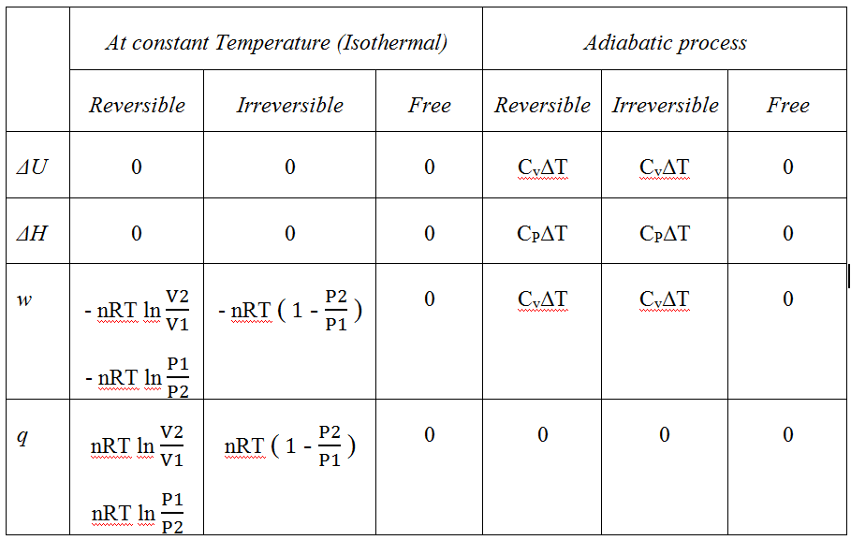

Slide 64
For the reversible and irreversible adiabatic expansion of a perfect gas, work are related by an expression that depends on the ratio of heat capacities γ
$$∆U=w=n\overline{C_{V}}∆T$$
$$w=−\int_{V_{2}}^{V_{1}}{PdV}$$
$$p=\frac{constant}{V^{γ}}$$
$$PV^{γ}=constant$$
$$w=−\int_{V_{2}}^{V_{1}}{\frac{constant}{V^{γ}}dV=−\frac{constant}{−γ+1}\left(\frac{1}{V_{2}^{γ−1}}−\frac{1}{V_{1}^{γ−1}}\right)}=\frac{PV^{γ}}{γ−1}\left(V_{2}^{1−γ}−V_{1}^{1−γ}\right)$$
$$w_{ad}=\frac{P_{2}V_{2}−P_{1}V_{1}}{γ−1}$$

Slide 65
Example
21- A sample of nitrogen of mass 3.12 g at 23.0°C is allowed to expand reversibly and adiabatically from 400 cm³ to 2.00 dm³. What is the work done by the gas?
If we know that C_{P} of N₂ is 29.125 J/mol K
If we Know that for diatomic gas γ = 7/5 = 1.4

Slide 66
22- A sample consisting of 1.5 mol of perfect gas molecules with C_{p} = 20.8 J K⁻¹ mol⁻¹ is initially at 230 kPa and 315 K. It undergoes reversible adiabatic expansion until its pressure reaches 170 kPa. Calculate the final volume and temperature and the work done.
23- Prove that (R / C_{v}) = (γ-1)

