Slide 1
Chapter 2
Fundamental concepts, The Zeroth Law, Thermodynamic processes, Work

Slide 2
Fundamental concepts

Slide 3
Thermodynamics is concerned with the study of the energy Transformation
Thermo Thermal energy
Dynamics Science of Change
Definition
It is the branch of science that deals with the different forms of energy.
The quantitative relation between them
And
The energy changes that occurs in physical and chemical process

Slide 4
Scope of Thermodynamic
1- Provides the information regarding the feasibility or chemical reaction.
2- Tells whether a particular reaction is possible under given sets of condition
3- Also tells the direction in which the reaction tends to occur.
4- Study of energy transformation in chemical reaction.

Slide 5
Limitations of Thermodynamics
1- No information regarding the rates at which physical and chemical process occur.
2- It only considers initial and final states of the system. (i.e. It does not tells about the mechanism of the process)
3- It deals with only macroscopic properties of the system.
Macroscopic properties (quantities): pressure, temperature)
Microscopic properties (quantities): kinetic motion of atoms and their velocity etc.

Slide 6
The Thermodynamics Laws:
1- Zeroth law
2- First Law
3- Second Law
4- Third Law

Slide 7
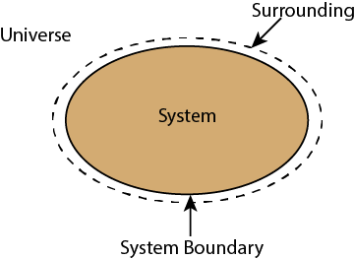
Some Important Terms:
System: is that part of the Universe which is under thermodynamic consideration.
Surroundings: are all the other part of the Universe outside the system from where the observation are made.
Universe: consist of the system and its surroundings, or is everything.
Boundary: the surface between system and surrounding.

Slide 8
Different types of boundary:
1- Real or Imaginary boundary
2- Rigid boundary: It is a wall whose shape and position are fixed.
3- non-rigid
4- Impermeable: It is a wall that prevents the passage of the matter but permits the passage of energy.
5- Permeable boundary: It is a wall that permits the passage of matter and energy.
6- Adiabatic boundary: It is a wall that prevents the passage of mass and energy.
7- Diathermic boundary: It is a wall that allows the passage of energy but prevents the passage of matter. That is, a diathermic boundary is impermeable but not adiabatic.
System + Surrounding together constitutes the universe

Slide 9
Some Important Symbols:
w work
q heat
T temperature
U internal energy
H enthalpy
S entropy
G Gibbs free energy
A Helmholtz free energy
C_{P} heat capacity at constant pressure
C_{V} heat capacity at constant volume
C_{S} specific heat
P pressure
V volume
γ the ratio of heat capacity

Slide 10
Types of System:
1- Based on Boundary
2- Based on phase
1- Based on Boundary:
Open system: can exchange both matter as well as energy from its surrounding.
B) Close system: can exchange energy but not matter from its surrounding.
C) Isolated system: exchange neither matter nor energy.

Slide 11
2- Based on phase:
Homogeneous system: contains single phase or has completely uniform composition throughout it.
Heterogeneous system: contains more than one phase.

Slide 12
Properties of System:
1- Extensive property
2- Intensive property
1- Extensive Property or Extrinsic property:
Certain properties of the system whose magnitude depends on the quantity of matter present
Examples: mass, volume, surface area, internal energy, free energy, enthalpy, entropy

Slide 13
2- Intensive Property or Intrinsic Property:
Certain properties of the system whose magnitude does not depends on the quantity of matter present.
Examples: temperature, pressure, density, viscosity, refractive index, molar heat capacity, melting and boiling point

Slide 14
Note:
1- Extensive properties + Intensive properties = Extensive properties
2- Extensive properties × Intensive properties = Extensive properties
3- Ratio of two Extensive properties is an Intensive property
$$Density (intensive property)=\frac{mass (extensive property)}{volume (extensive property)}$$
$$Molarity (intensive property)=\frac{Mole of the solute (extensive property)}{volume (extensive property)}$$

Slide 15
State Variables (Thermodynamic Variables):
Every system has certain thermodynamic properties such as temperature, pressure and volume. They could be independent or dependent
Independent variables: a variable (often denoted by x ) whose variation does not depend on that of another.
y = f(x)
V = f(P, n, T)
Dependent variables: a variable (often denoted by y ) whose value depends on that of another.
State of the system:
A known set of state variable describes the condition of the system. This condition is determined by specifying the value state variables is called state of the system

Slide 16
Change of State:
P₁
V₁
T₁
n
P₂
V₂
T₂
n
Initial State
Final State

Slide 17
State Function:
Every property of a system whose value depends on the current state of the system and is independent of the path followed to reach that state is called state function.
When the state of the system is changed, the change in any state function depends only the initial and final states of system and not on how the change is accomplished.
And their differentials is Exact.
In cyclic process:

Slide 18
Examples of State functions:
∆H, ∆E, ∆G, ∆S, ∆P, ∆V, ∆T
Path Function:
The property of a system whose value depends on the path use to reach a particular state is called Path function.
And their differentials is Inexact. Examples: heat and work

Slide 19
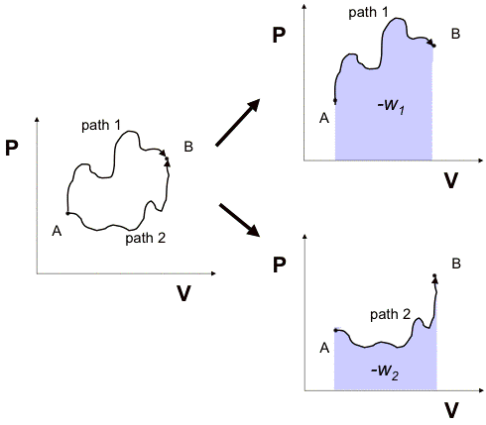
Note:
W = -PV

Slide 20
The Zeroth Law and thermometers

Slide 21
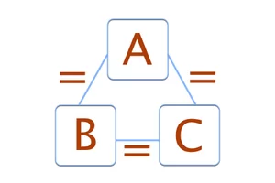
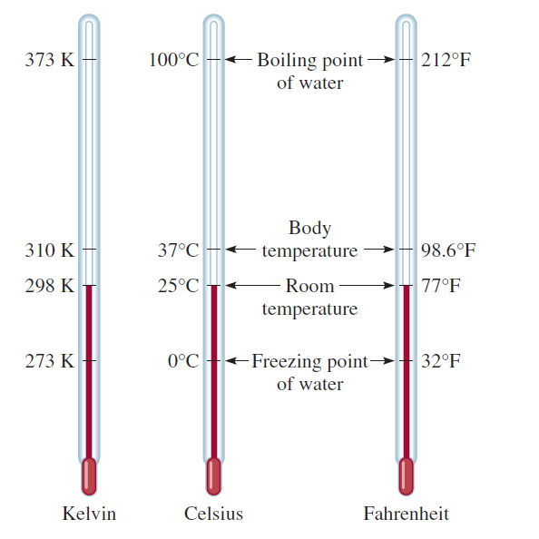
The Zeroth Law
If A is in thermal equilibrium with B, and B is in thermal with C, then C will be in thermal equilibrium with A
The zeroth law is the basis of the existence of a thermometer

Slide 22
Concept of Thermometers
Operational definition of temperature (T)
You need:
(1) Substance (like Hg)
(2) Property that depends on T (like Hg)
(3) Reference points (like boiling point of water)
(4) Interpolation scheme between ref.pts. (linear increase/decrease)
Temperature can be measured using:
Degree Celsius: using mercury as substance, the reference points are water freezing and boiling, and the interpolation is linear.
(2) Fahrenheit scale: using alcohol as substance, the reference points are the freezing solution of brine and the average human body temperature, and the interpolation is linear.

Slide 23
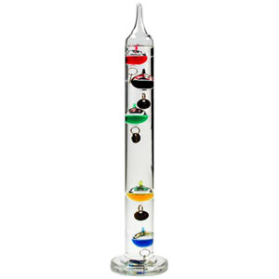
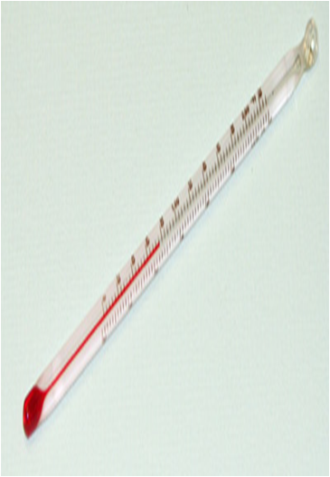
Thermometer Design
1- Galilean Thermoscope
1593 Galileo discovers that when heated, liquids expand (i.e. density decreases)
Thermoscope: As temperature rises, the graduated weights will sink, one by one
2- Liquid Thermometers
The smallest markings easiest to read are about ∆h = 1 mm apart. Suppose we want to measure to nearest ΔT=0.2 °C.
Video: https://www.youtube.com/watch?v=W_xc-6662f8

Slide 24
This is how the two liquids used in thermometers, alcohol and mercury compare:
alcohol
transparent, must be used with a dye
heat conduction poor
sticks to glass - concave meniscus
temperature range ~ 150 ºC ... -114.9 ºC
mercury
opaque
is a metal and therefore a good heat conductor
does not stick to glass - convex meniscus
temperature range ~ 356 ºC ... -39 ºC

Slide 25
The temperature on a liquid in glass thermometers can be calculated by making certain measurements. And using liquid in glass thermometer equation
l₁₀₀
l₀
θ⁰C
100⁰C
l_{θ}
0⁰C
$$θ=\frac{l_{θ}−l_{0}}{l_{100}−l_{0}}×100$$

Slide 26
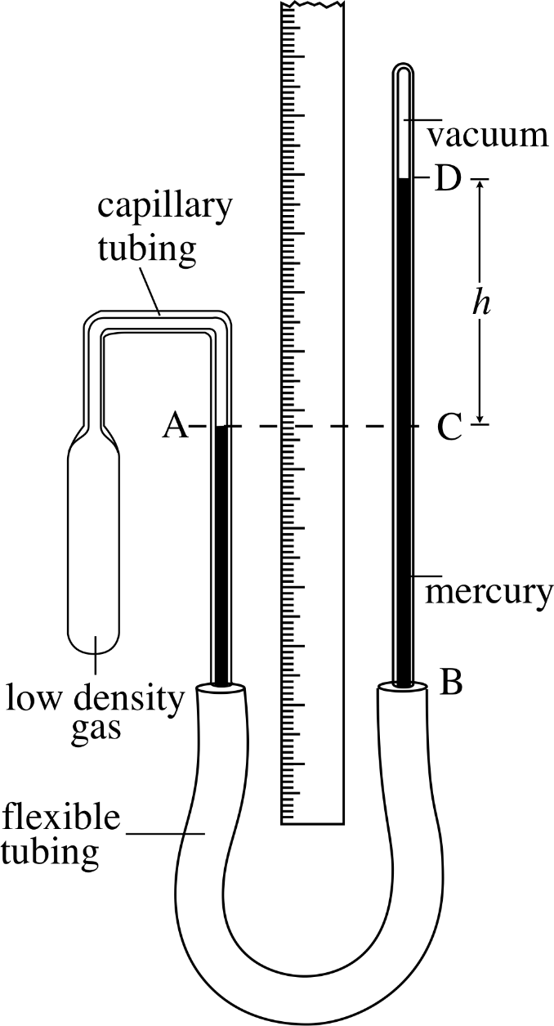
3- Gas Thermometers
Amontons’ Law (1702) at constant volume, change in pressure is proportional to change in temperature, or:
∆P α ∆T
Lambert (1779) extrapolated this data to propose “absolute zero” where pressure is zero (note this is 69 years earlier than Kelvin)

Slide 27
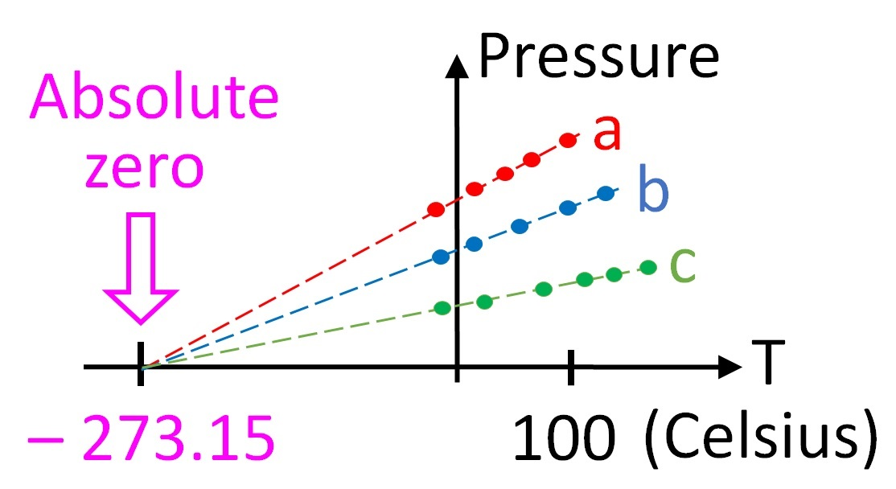
constant-volume gas thermometer

Slide 28
Thermodynamic Processes

Slide 29
Thermodynamic Processes:
1- Isothermal Process: temperature is constant during change of state
2- Isobaric Process: pressure is constant during change of state
3- Isochoric Process: volume is constant during change of state
4- Adiabatic Process: there is no heat flow at the boundary of system during change of state
5- Cyclic Process: the process reach its initial state

Slide 30
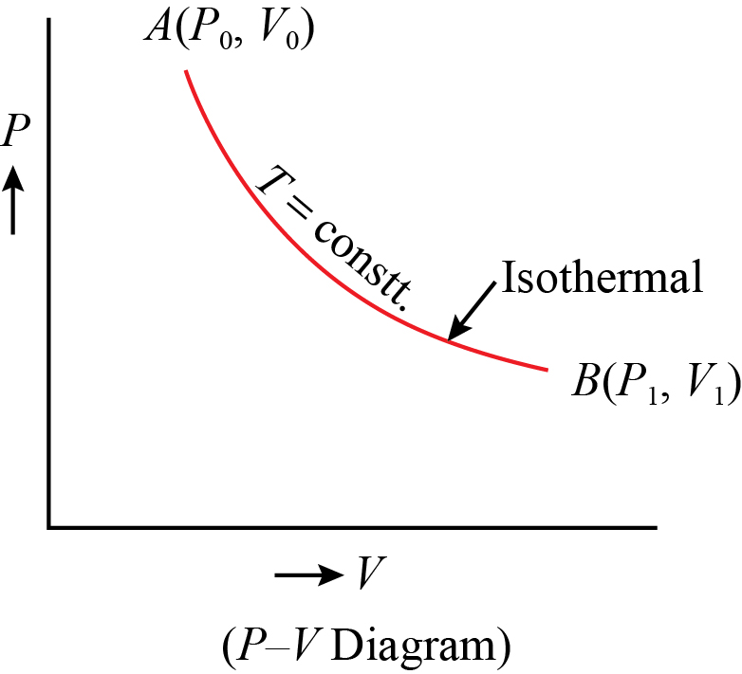
1- Isothermal Process:
A process in which the temperature of the system remains constant throughout. There is no change in the temperature before and after the reaction.
∆T = 0
No change in temperature means no Change in internal energy (∆U = 0)
Note: Most of reactions in the lab are isothermal.

Slide 31
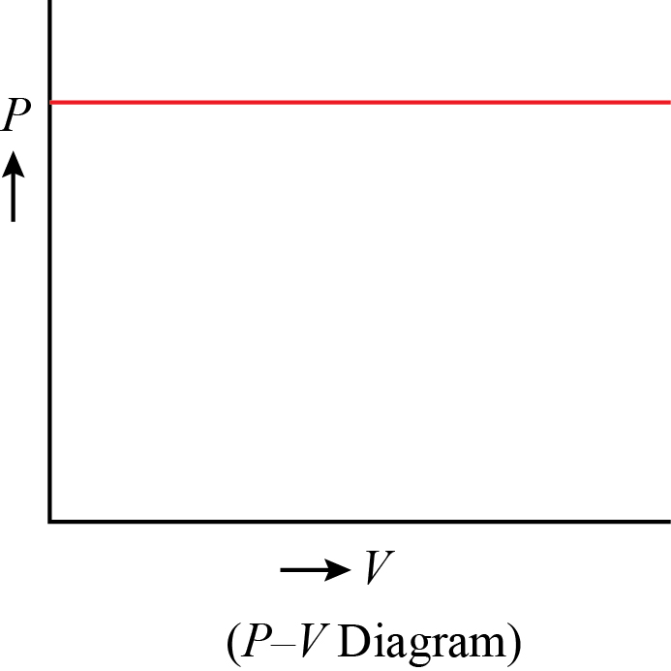
2- Isobaric Process:
A process in which the pressure of the system remains constant throughout.
There is no change in the pressure before and after the reaction.
∆P = 0
Note: also all reaction carried out in lab are at constant P

Slide 32
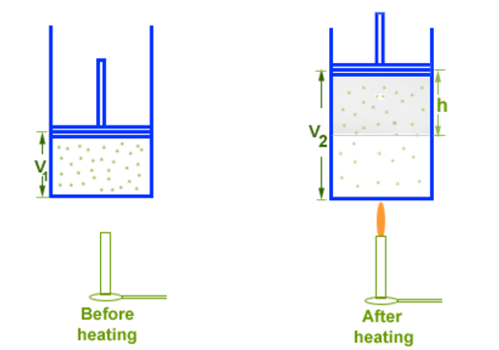
Example:
A cylinder with a piston is being lifted by a quantity of gas as the gas get hotter
The volume of the gas is changing, but the pressure constant.

Slide 33
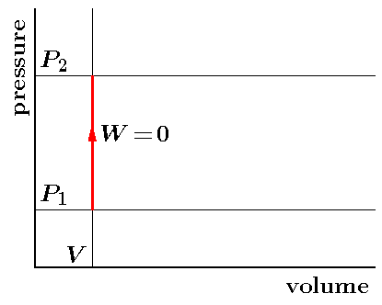
3- Isochoric Process:
A process in which the volume of the system remains constant throughout.
∆V = 0
Example:
When we heat any closed empty container, the air inside gains internal energy, which can be felt due to increase in pressure and temperature.
Note: there is no work

Slide 34
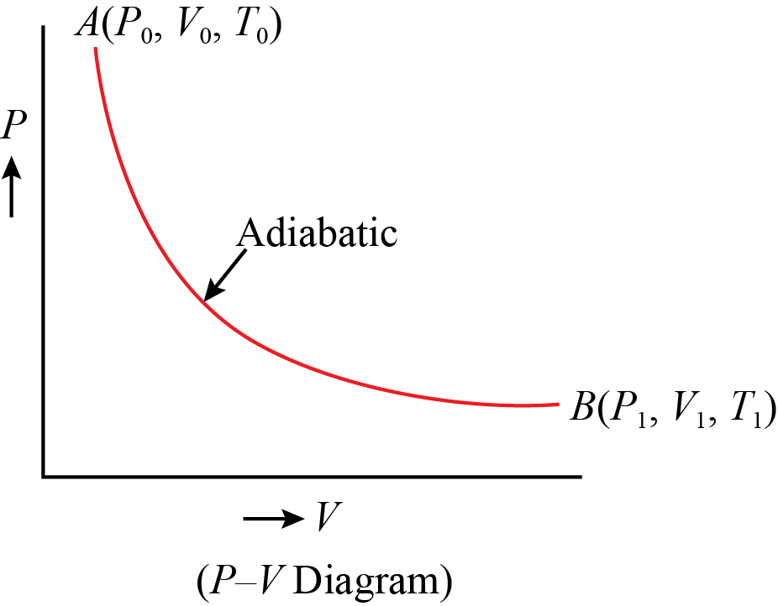
4- Adiabatic Process:
A process in which there is no exchange of heat between the system and its surroundings.
q = 0 , ∆T ≠ 0 , ∆U ≠ 0

Slide 35
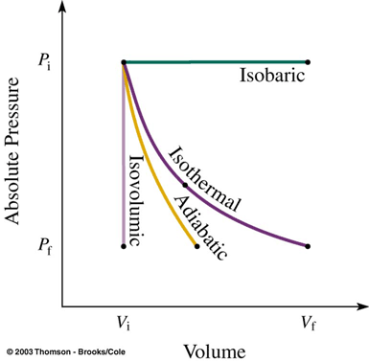
Example:
Reaction carried out in thermas flask.
i.e. Boiling of water in thermally insulated container.
Comparison between four processes:

Slide 36
5- Cyclic Process:
a system undergoes a series of processes and finally reaches its initial state.
In cyclic process, all change in state functions (U, H, P, V …) are zero. (Initial state = Final state)
But: the path functions (q, w) are not zero.

Slide 37
Isothermal | ∆T = 0
Isobaric | ∆P = 0
Isochoric | ∆V = 0
Adiabatic | q = 0 , ∆T ≠ 0
Cyclic | q ≠ 0

Slide 38
Thermodynamic Equilibrium:
A system is said to be in thermodynamic equilibrium when its properties like Temperature, Pressure, Volume, Composition remains constant throughout.
1- Thermal Equilibrium: Temperature constant
2- Chemical Equilibrium: Composition constant
3- Mechanical Equilibrium: Pressure and volume constant

Slide 39
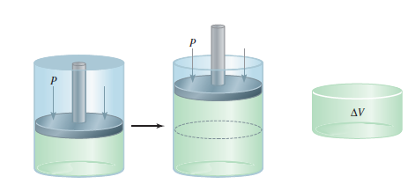
Example:
Consider cylinder with weightless and frictionless piston
As long as piston is motionless properties remain constant (Equilibrium Sate)
As long as piston is in motion (Non-Equilibrium State)

Slide 40
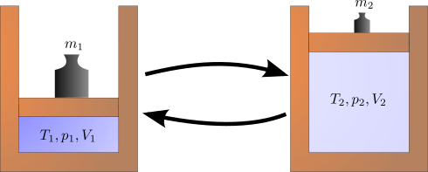
Types of Process:
1- Reversible Process
2- Irreversible Process
1- Reversible Process:
The process that is reversed by an infinitesimal modification of the conditions in the surroundings.

Slide 41
Features of Reversible Process:
1- System and surroundings always in equilibrium
2- It is a quasi-static process (very slow process)
3- Hypothetical, ideal, non-spontaneous process
4- Maximum work is obtained

Slide 42
2- Irreversible Process:
The process that cannot return the system and the surroundings to their original conditions.
Features of Irreversible Process:
1- System and surroundings are in equilibrium only in the initial and final state
2- Fast process and requires finite time for completion
3- Real and spontaneous process
4- Maximum work is not obtained

Slide 43
Reversible Process | Irreversible Process
The process is carried out infinitesimally slowly | It is carried out rapidly
At any stage, the equilibrium is not disturbed | Equilibrium may exist only after completion of the process
It takes infinite time for completion | It takes a finite time for completion
Work obtained in this process is maximum | Work obtained in this process is not maximum

Slide 44
Work

Slide 45
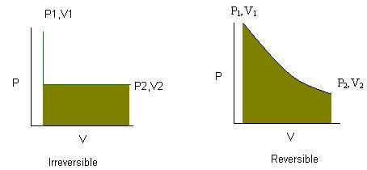
W = - P∆V
W_{irrev} = - P₂(V₂ – V₁)
W_{rev} = - ∫ P dV
Real process
Hypothetical process

Slide 46
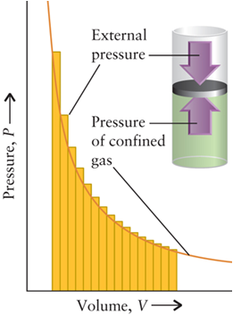
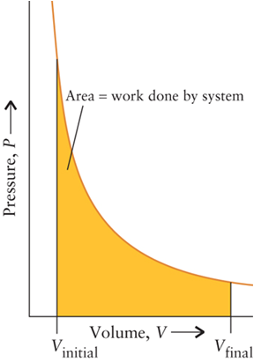
Work of reversible process

Slide 47
Work (w)
Work is one of the form by which a system can exchange energy with its surrounding. Work refer to organized form of energy
Units: SI = Joule (J) / Nm
Calorie (cal) and L . atom
Conversions: 1 cal = 4.184 J
1 L.atm = 101.3 J

Slide 48
Types of Work
Mechanical work
1- Pressure volume work (PV work)
2- Force distance work
Non-mechanical work
3- Gravitational work
4- Electrical work
5- Surface work
6- Magnetic work

Slide 49
Type of Work | Intensity factor | Capacity factor | Definition
Mechanical | Pressure (P) | Change in volume (dV) | w = PdV
 | Force (F) | Change in distance (dh) | w = Fdh
Gravitational (potential) | Gravitational potential (g.h) | Mass (m) | w = mgh
Electrical | Potential differential (E) | Quantity of electricity (nF) | w = E dQ = E I dt w = nF E
Surface | Surface tension (γ) | Change in area (dA) | w = γdA
Magnetic | Field strength (H) | Increase in magnetic (dM) | w = HdM

Slide 50
Sign of Work (w)
Surroundings
Surroundings
system
-w
system
+w
w | - means work done by system | + means work done on system

Slide 51
Pressure – Volume Work (PV):
The work that is done to the expansion or compression of a gas against an external opposing pressure (P)
$$PV=\frac{F}{A}×V$$
$$PV=\frac{F}{d^{2}}×V$$
$$PV=\frac{F}{d^{2}}×d^{3}$$
$$PV=F×d$$
$$PV=Work (w)$$

Slide 52
Pressure – Volume Work (PV):
1- Expression for Isothermal Irreversible Work
2- Expression for Isothermal Reversible work

Slide 53
1- Expression for Isothermal Irreversible Work
Consider an ideal gas in a cylinder which is fitted with weightless and frictionless piston, having P₁ and V₁ and at constant temperature (T)
In the case of Expansion
Suppose as the gas expands, It pushes the piston upward against opposing pressure P_{opp}, which in this case is the external pressure P_{ex} through distance (d). And The volume will change
P_{opp} or P_{ex}
d
V₂
P₁
V₁
P₁

Slide 54
$$Work (w) = − F × d$$
$$Work (w) = − Pex × A × d$$
$$Work (w) = −Pex × (V2 – V1)$$
$$Work (w) = −Pex × ∆V$$
$$đw=−P_{ex}dV$$
$$w=−\int_{1}^{2}{P_{opp}}dV=−\int_{1}^{2}{P_{ex}}dV$$

Slide 55
In the case of Compression
Suppose as the gas contract (shrink), It pushes the piston downward against opposing pressure P_{opp}, which in this case is the internal or system pressure P_{int} or P_{sys} through distance (d). And The volume will change
d
P_{opp}
P_{int}
V₁
P₂
V₂
$$w=−\int_{1}^{2}{P_{opp}}dV=−\int_{1}^{2}{P_{int}}dV=−\int_{1}^{2}{P_{sys}}dV$$

Slide 56
In the case of dV = 0 (Isochoric Process)
In this case there is no work (w = 0), such as the reactants or products material in solid or liquid state.
In the case of P_{ex} = 0 (vacuum)
In this case the compression in impossible. The expansion happened but against no pressure. Therefore there is no work (w = 0). This case called Free expansion

Slide 57
In the case of constant pressure
(∆P = 0) Isobaric process
w = -P∆V
P
P
w = -P∆V
V
In the case of cyclic process
V₁
V₂
P
Remember
work is path function!
B
A
$$w=−\int_{A}^{B}{PdV−\int_{B}^{A}{PdV}}$$
V

Slide 58
Examples
1- 3 mole of Ar was heated by 5 °C in closed reactor with volume 1 m³.What is the work in this process?
2- Calculate the work (J) associated with the expansion of a gas from 46 L to 64 L at a constant external pressure of 15903 kPa?
3- A sample of an ideal gas at 15.0 atm and 10.0 L is allowed to expand against a constant external pressure of 2.00 atm at a constant temperature. Calculate the work in units of kJ for the gas expansion

Slide 59
4- A chemical reaction takes place in a container of cross-sectional area 50.0 cm². As a result of the reaction, a piston is pushed out through 15 cm against an external pressure of 121 kPa. Calculate the work done (in J) by the system.
5- A piece of zinc of mass 5.0 g is placed in a beaker of dilute hydrochloric acid. Calculate the work done by the system as a result of the reaction. The atmospheric pressure is 1.1 atm and the temperature 23°C.

Slide 60
2- Expression for Isothermal Reversible Work
Consider n mole of an ideal gas in a cylinder which is fitted with weightless and frictionless piston at constant temperature. In the case of expansion against external pressure, the pressure of the gas inside the system is slightly higher than the external pressure.
Initial volume V₁ Final volume V₂
Initial pressure P Final pressure P-dP
$$w= −Pex × ∆V$$
$$đw=−P_{ex}dV$$

Slide 61
But P_{ex} = P – dP
$$đw=−P_{ex}dV$$
$$đw=−(P−dP)dV$$
$$đw=−PdV+dPdV$$
$$dPdV≈0$$
$$đw=−PdV$$
$$\int_{1}^{2}{đw=−\int_{V_{1}}^{V_{2}}{PdV}}$$

Slide 62
The total work in the entire expansion from volume V₁ to V₂ will be the sum of all steps. The total amount work can be obtained by integrating equation:
$$đw=−PdV$$
$$\int_{1}^{2}{đw=−\int_{V_{1}}^{V_{2}}{PdV}}$$
$$w_{max}=−\int_{V_{1}}^{V_{2}}{PdV}$$
This work is maximum work because the expansion is reversible

Slide 63
The ideal gas equation for n mole of a gas is PV= nRT
Therefore
$$P=\frac{nRT}{V}$$
$$w_{max}=−\int_{V_{1}}^{V_{2}}{\frac{nRT}{V}dV}$$
$$w_{max}=−nRT\int_{V_{1}}^{V_{2}}{\frac{1}{V}dV}$$
$$w_{max}=−nRT\ln{(V)_{V_{1}}^{V_{2}}}$$

Slide 64
$$w_{max}=−nRT\ln{(V)_{V_{1}}^{V_{2}}}$$
$$w_{max}=−nRT(ln{V_{2}−\ln{V_{1})}}$$
$$w_{max}=−nRT\ln{\frac{V_{2}}{V_{1}}}$$
According to Boyle’s Law P₁V₁ = P₂V₂
$$\frac{V_{2}}{V_{1}}=\frac{P_{1}}{P_{2}}$$
$$w_{max}=−nRT\ln{\frac{P_{1}}{P_{2}}}$$
Therefore

Slide 65
Graphical Explanation of Maximum Work
For Isothermal Irreversible process, the work P_{ex} = P_{final} = P₂
$$w=−\int_{1}^{2}{P_{ex}}dV=−P_{2}∆V$$
P
A (P₁, V₁)
P₁
B (P₂, V₂)
P₂
$$w=−P_{2}∆V$$
V
V₁
V₂

Slide 66
For Isothermal Reversible process, the work
$$w_{max}=−\int_{V_{1}}^{V_{2}}{PdV}=Area under the curve$$
P
A (P₁, V₁)
B (P₂, V₂)
V
V₁
V₂

Slide 67
Condition for Maximum Work
Maximum work is obtainable from a system when:
1- Any change taking place in it, is thermodynamically reversible.
2- It takes place in an infinite number of steps.
3- The system is in mechanical equilibrium with its surroundings.

