Slide 1
Part 7 Adsorption and heterogeneous catalysis

Slide 2
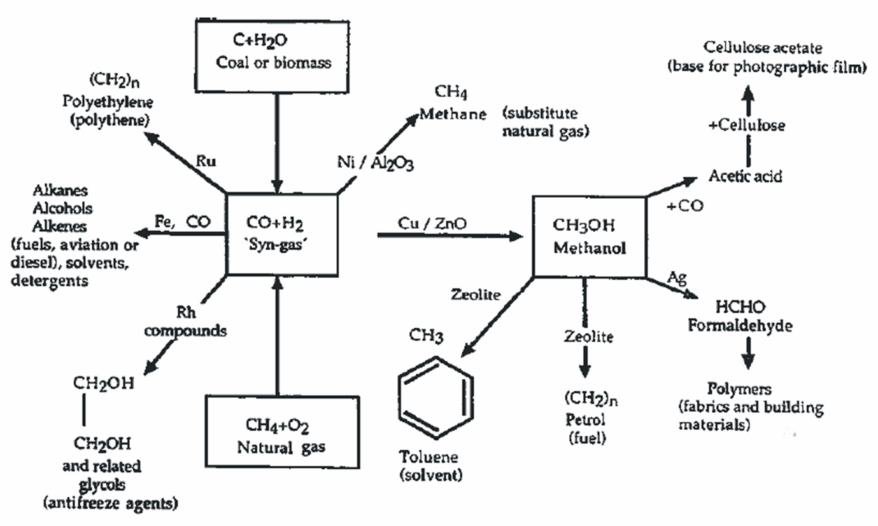
Importance of Catalysts

Slide 3
What is a “Catalyst”
A catalyst (Greek: καταλύτης, catalytēs) is a substance that accelerates the rate of a chemical reaction without itself being transformed or consumed by the reaction.
k(T) = k₀e^{-Ea/RT}
E_{a}′ < E_{a}
k₀′ > k₀
k′ > k
ΔG = ΔG
E_{a}
E_{a}′
A + B
A + B +
catalyst
ΔG
ΔG
C
C + catalyst
uncatalyzed
catalyzed

Slide 4
Catalysts Open Up New Reaction Pathways
‡
H
O
H₂C
C
O
CH₃
OH
C
C
CH₃
CH₃
‡
CH₂
CH₃
propanone
propenol
propenol
propanone

Slide 5
Catalysts Open Up New Reaction Pathways
O⁻
C
+ H₂O
CH₂
CH₃
OH⁻
−OH⁻
Base catalyzed
O
OH
rate = k[OH⁻][acetone]
C
C
CH₃
CH₃
CH₂
CH₃
propanone
‡
‡
propenol
propenol
intermediate
propanone

Slide 6
Catalysts Open Up New Reaction Pathways
‡
‡
propenol
different
intermediate
propanone
propenol
O
OH
propanone
rate = k[H₃O⁺][acetone]
C
C
CH₃
CH₃
Acid catalyzed
CH₂
CH₃
H₃O⁺
−H₃O⁺
OH
C
CH₃
+
CH₃
+ H₂O

Slide 7
Catalyst the Basics: Activity and Selectivity
A material that increases the rate of a chemical reaction while itself not undergoing any permanent change
Complete oxidation example (nonselective)
The adsorption of C₂H₄ and O₂ onto the catalyst Pt provides a chemical shortcut → reaction at lower temperatures
Partial oxidation example (selective)
(aldehyde)
Both the net enthalpy (△H) and net free energy (△G) are unaffected by the presence of the catalyst. (and consequently the equilibrium constant (Ke))

Slide 8
Types of catalysts and definitions
Biocatalysis
Using enzymes to catalyse a reaction.
Heterogeneous catalysis ('surface catalysis’)
Reagents are in a different phase from the catalyst - usually the reagents are gases (or liquids) and are passed over a solid catalyst (e.g. catalytic convertors in car exhausts).
Homogeneous catalysis
Reagents and catalyst are all in the same phase (typically all are in solution).

Slide 9
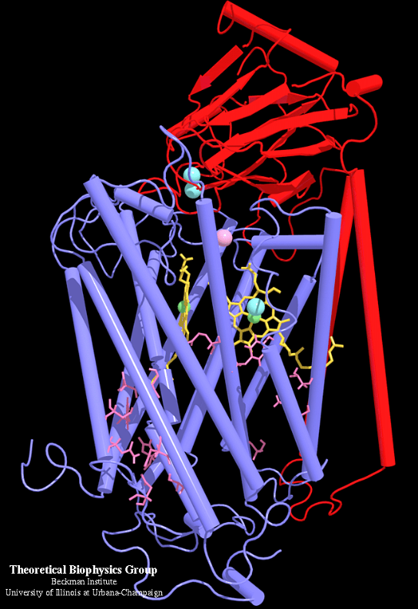
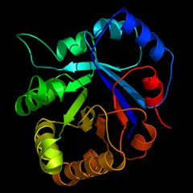
Biocatalysis - Enzymes
The “Gold Standard” of catalysts
Highly specific
Highly selective
Highly efficient
Catalyze very difficult reactions
N₂ → NH₃
CO₂ + H₂O → C₆H₁₂O₆
Works better in a cell than in a 100000 l reactor
Triosephosphateisomerase
“TIM”
Cytochrome C Oxidase
Highly tailored “active sites”
Often contain metal atoms

Slide 10
Heterogeneous Catalysis
Used in refining / bulk chemical syntheses much more than in fine chemicals and pharmaceuticals (which tend to use homogeneous catalysis).
Seven stages of surface catalysis:
Diffusion of the substrate(s) towards the surface.
Physisorption - i.e. physical absorption via weak interactions, e.g. van der Waals, adhering the substrate(s) to the surface.
Chemisorption - formation of chemical bonds between the surface and the substrate(s).
Migration of the bound substrate(s) to the active catalytic site - also known as surface diffusion.
Reaction.
Desorption of product(s) from the surface.
Diffusion away from the surface.

Slide 11
Heterogeneous Catalysts
Stage 4: Surface diffusion
Stage 3: Chemisorption
Stage 2: Physisorption
Stage 6: Desorption
Stage 1: Diffusion
Stage 5: Reaction
Stage 7: Diffusion
A
B
C
C
A
C
B
C
M
Surface

Slide 12
Heterogeneous Catalysts
Active sites
are in pores
M
Surface

Slide 13
Heterogeneous Catalysts
Typical features:
Metal or metal oxide impregnated onto a support (typically silica and / or alumina).
Three dimensional highly porous structure with very high surface area
A
B
Reactants
Products
C
C
A
C
Diffusion to surface
Physisorption
Chemisorption
B
C
1-3
1-3
6,7
4,5
6. Desorption
7. Diffusion out of pore
M
4. Surface diffusion
5. Reaction
porous support

Slide 14
Adsorption and Reaction at Solid Surfaces
Physisorption: weak van der Waals attraction of a fluid (like N₂ gas) for any surface
E_{ads} ~10 – 40 kJ/mol
Low temperature phenomenon
Exploited in measuring gross surface area
Chemisorption: chemical bond formation between a fluid molecule (like CO or ethylene) and a surface site
E_{ads} ~ 100 – 500 kJ/mol
Essential element of catalytic activity
Exploited in measuring catalytically active sites

Slide 15
Heterogeneous acid-base catalysis
ca. 130 industrial process use solid acid-base catalysts
Mainly found in bulk/ petrochemicals production e.g. dehydration, condensation, alkylation, esterification etc.
Most are acid-catalysed processes.
ca. 180 different catalysts employed
74 of these are zeolites, ZSM-5 is the largest group.
Second largest group are oxides of Al , Si , Ti , Zr.

Slide 16
Zeolites - crystalline, hydrated aluminosilicates
Crystalline inorganic polymer comprising SiO₄ and AlO₄⁻ tetrahedra (formally derived from Si(OH)₄ and Al(OH)₄⁻ with metal ions balancing the negative charge).
Lattice consists of interconnected cage-like structures featuring a mixture of pore (channel) sizes depending upon the Al : Si ratio, the counter-cation employed, the level of hydration, the synthetic conditions etc.
Hydrated nature of zeolites allows them to behave as Brønsted acids

Slide 17
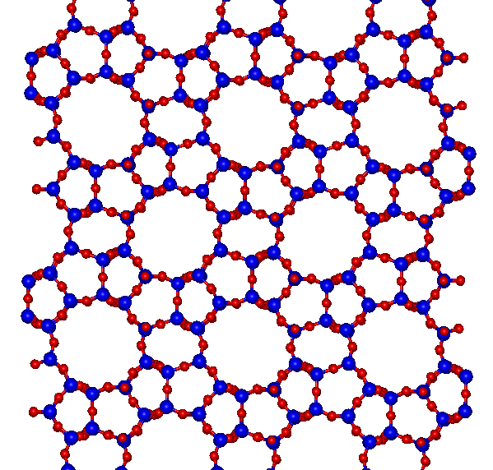
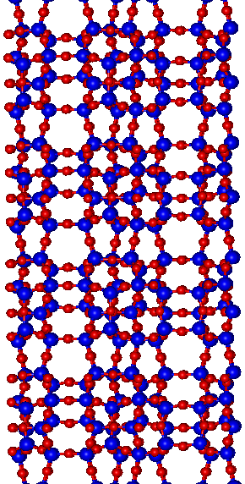
e.g. ZSM-5
Td
Channels cross in three dimensions
- a highly porous material
Top-view
Side-view
● = Si / Al
● = O
NB: Cations
not shown!
5.5 Å

Slide 18
Zeolites - Asahi Cyclohexanol process
Traditional synthesis
225 °C
10 atm
For selectivity reasons, the reaction is run at low conversions (approx 6% per tank) and the hot cyclohexane stream is continuously recycled.
Zeolite catalysed process:
98 % selectivity
100 °C

Slide 19
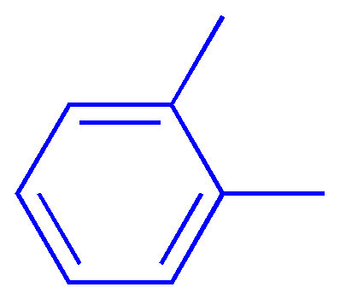
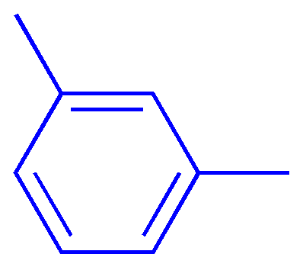
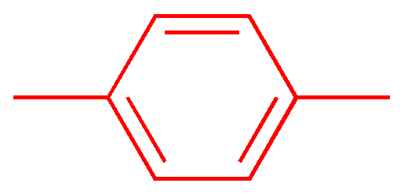
Zeolites - shape selective alkylation of toluene
H-ZSM-5 catalyses:
toluene alkylation
xylene isomerisation
H-ZSM-5
(acidic ZSM-5)
Channel size only allows para-xylene to emerge
Only para-xylene is required for PET synthesis:
poly(ethylene terephthlate) - PET

Slide 20
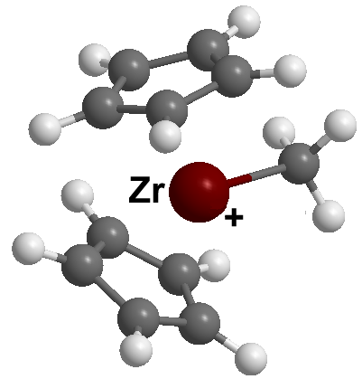
Homogeneous catalysis - principles
Well-defined active site allows rational catalyst development.
Typical single-site catalyst:
L_{n}
X
M
sterically bulky ligand(s)
controls stereochemistry
e.g. Cp₂ZrMe⁺ for the
polymerisation of ethene
substrate approaches
vacant coordination site
and may then react with X

Slide 21
Homogeneous asymmetric catalysis
Most of the industrially important homogeneous catalysed processes are found in asymmetric syntheses - e.g. pharmaceuticals.
e.g. Monsanto synthesis of L-DOPA (Parkinson's disease):
L* =
28 % e.e.
60 % e.e.
85 % e.e.
95 % e.e.
0.1% catalyst loading; Rh readily recovered (some L* is lost)

Slide 22
Heterogeneous versus Homogeneous
General features:
Heterogeneous
Homogeneous
Readily separated ✓
Readily recycled / regenerated ✓
Long-lived ✓
Cheap ✓
Lower rates (diffusion limited) ✗
Sensitive to poisons ✗
Lower selectivity ✗
High energy process ✗
Poor mechanistic understanding ✗
Difficult to separate ✗
Difficult to recover ✗
Short service life ✗
Expensive ✗
Very high rates ✓
Robust to poisons ✓
Highly selective ✓
Mild conditions ✓
Mechanisms often known ✓

