Slide 1
Urography Procedures
Meaad AL-Musined

Slide 2
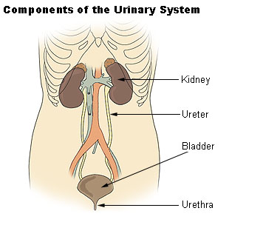
Anatomy

Slide 3
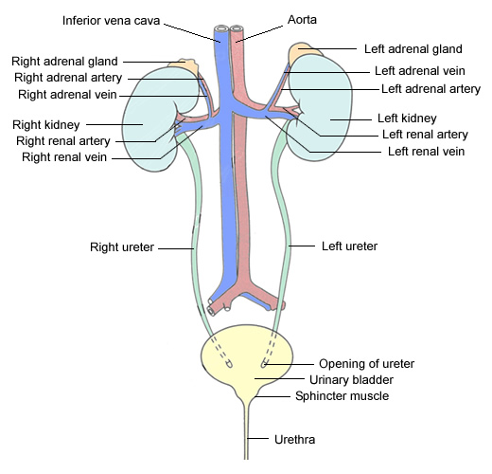
Anatomy
Uretrovesical
Junction

Slide 4
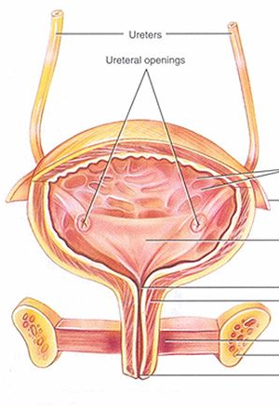
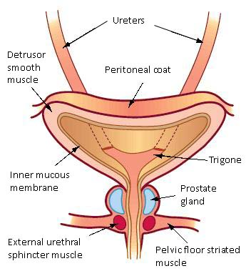
The trigone is a smooth triangular region of the internal urinary bladder formed by the two ureteral orifices and the internal urethral orifice.

Slide 5
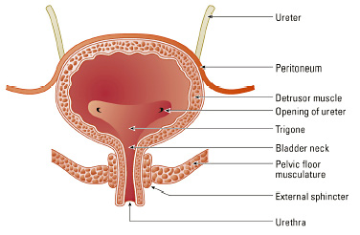
Anatomy

Slide 6
1
Retrograde Cystography (Cystogram)
2
MCUG Micturating Cystourethrography

Slide 7
Retrograde Cystography (Cystogram)
Definition
Is a Non Functional radiographic examination of the urinary bladder after injection of CM via urethral catheter
CM
Urographine

Slide 8
MCUG Micturating Cystourethrography
Definition
Is a Functional radiographic examination of the urinary bladder and urethra to evaluate the patient’s ability to urinate.
CM
Urographine

Slide 9
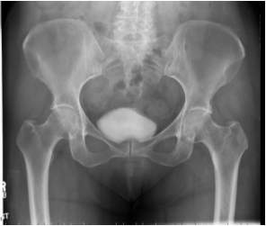
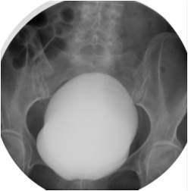
Cystography

Slide 10
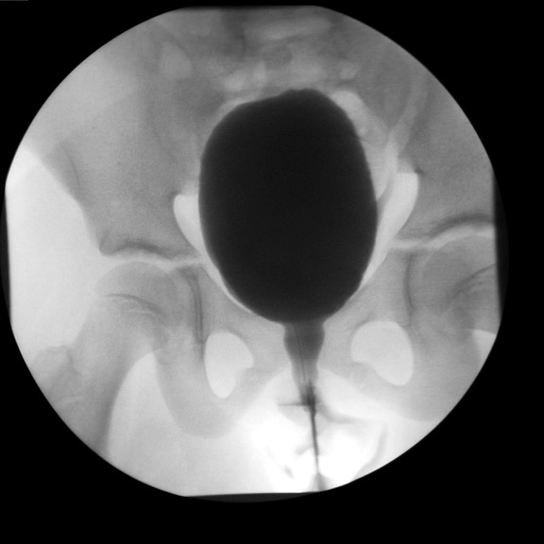
MCUG

Slide 11
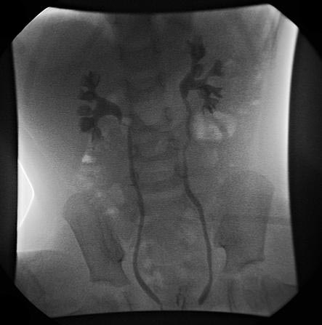
Vesicouretral Reflux

