Slide 1
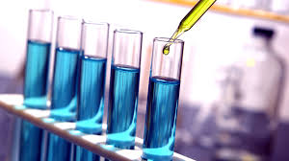
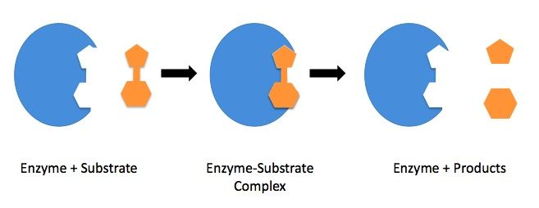
Some Factors Affecting Polyphenol Oxidase Activity
[BCH 322]

Slide 2
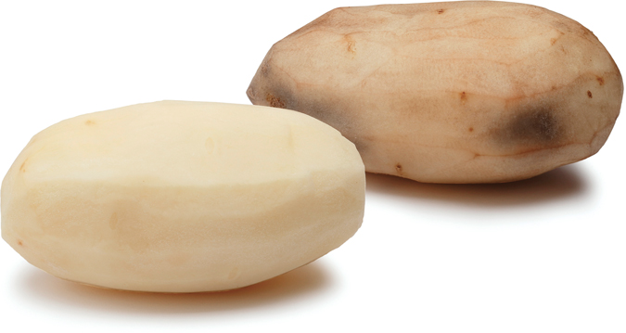
Polyphenol Oxidase (PPO):
Is a copper-containing enzyme with an optimum pH of 6.7.
It catalyzes the oxidation of di- and tri- hydroxyl phenol to the corresponding quinine.
This oxidation-reduction reaction is accompanied by a color change
This reaction commonly occurs in nature and accounts for the "browning" of peeled potatoes and bruised fruits.

Slide 3
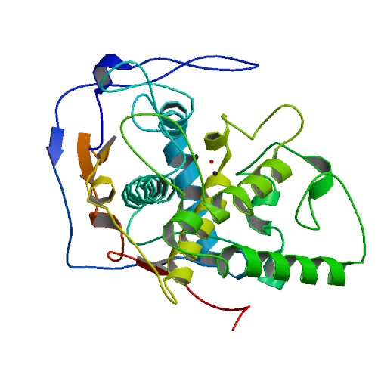
Objectives:
To demonstrate activity of the enzyme polyphenol oxidase in crude extract prepared from potato.
To demonstrate the chemical nature of the enzyme.
To investigate the substrate specificity of the enzyme.
To investigate the effects of various temperatures on the activity of the enzyme.
**All test done in this experiment are qualitative**

Slide 4
Exp.1- Test tube enzymatic activity:
Principle:
In this reaction we are looking for enzyme substrate reaction in general
In this experiment you will notice the change qualitatively (change in the color).
The intensity of this color (brown) will be proportional to the enzyme’s activity in the tube under observation.
S + E ES P + E
enzyme-substrate complex

Slide 5
Method:
Label three clean test tubes A, B and C.
Prepare each tube as follows:
c. Place all three tubes in a water bath at 37 ºC.
d. Shake each tube every 5 minutes to aerate, thereby adding oxygen to the solution.
e. Every 5 minutes, after shaking, hold the tubes up to the light and examine.
→Record the color in each tube in the table. Continue for 25 minutes.
Tube | Addition
TUBE A | 15 drops of enzyme extract. 15 drops of 0.01M catechol solution
TUBE B | 15 drops of enzyme extract. 15 drops of distilled water.
TUBE C | 15 drops of 0.0M catechol solution. 15 drops of distilled water

Slide 6
Degree of color intensity symbol
^{No color change (colorless) −}
Faint color (just detectable) +
^{Definite color ++}
^{Dark (deep) color +++}
Results:
Incubation time (minutes) | Degree of color intensity (Symbol: −, +, ++ or +++)
 | TUBE A | TUBE B | TUBE C
0
5
10
15
20
25

Slide 7
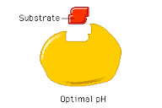
Important notes:
There are 3 terms for an enzymatic reaction to happen:
Presence of enzyme
Presence of substrate
Availability of appropriate conditions ( 37 C, pH 6.7)
→ If any of these terms are absent there will be no enzymatic reaction.
Enzyme
Optimal pH and Temperature

Slide 8
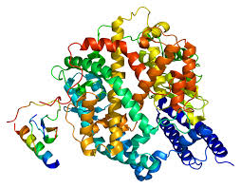
Exp. 2- Chemical nature of PPO:
Principle:
As we all know majority of enzymes are proteins. Some are made of RNA
They are high molecular weight compounds made up principally of chains of amino acids linked together by peptide bonds.
It will be examined the nature of polyphenol oxidase wither is it protein or not
Protein (Enzyme)
RNA(catalytic)

Slide 9
a. Label four clean test tubes A, B, C and D.
b. Prepare, and teat, each tube as follows:
Tube | (1) | (2) | (3)
TUBE A (control) | Add10 drops of : enzyme extract. 0.01M catechol | Shake tube and place in water bath at 37 ºC for 10 minutes.
TUBE B | Add 10 drops of: enzyme extract. 5% trichloroacetic acid (TCA). | Shake tube thoroughly and wait 5 minutes. | Add 10 drops of 0.01M catechol solution. Place in water bath at 37 ºC for 10 minutes
TUBE C | Add 10 drops of enzyme extract. Add a few crystals of phenylthiourea
Method
c. Examine and compare with tube A, and record your observations in the table.

Slide 10
Degree of color intensity symbol
^{No color change (colorless) −}
Faint color (just detectable) +
^{Definite color ++}
^{Dark (deep) color +++}
Results:
Tube | Treatment | Degree of color intensity (Symbol: −, +, ++ or +++)
A | Control
B | TCA
C | Phenylthiourea

Slide 11
Important notes
TCA is an analogue of acetic acid widely used in biochemistry for precipitation of macromolecules, such as proteins, DNA, and RNA .
It will effect the PPO activity by altering the pH of solution leading to denatured and inactivated enzyme.
TCA treatments proves that the chemical nature of PPO is protein.
Phenylthiourea has a very strong chemical affinity for the element copper (Cu⁺²). It is able to bind with Cu⁺², even when the copper is attached to other chemical substances, as in the active site of PPO.
This shows that copper is a cofactor for PPO.
Question:
If we treated the enzyme with trypsin before adding the catechol, will the reaction happen or not? And WHY?
No, the reaction will not happen. Because trypsin is a proteolytic enzyme in other words it hydrolyses the peptide bonds which link the amino acid residues to denature and precipitate proteins, including enzymes.

Slide 12
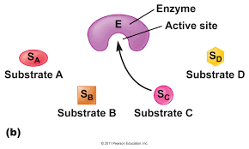
Types of Enzyme Specificity
There are four distinct types of specificity:
Absolute specificity - the enzyme will catalyze only one reaction.
Group specificity - the enzyme will act only on molecules that have specific functional groups, such as amino, phosphate and methyl groups.
Linkage specificity - the enzyme will act on a particular type of chemical bond regardless of the rest of the molecular structure.
Stereochemical specificity - the enzyme will act on a particular steric or optical isomer.

Slide 13
Exp. 3- Specificity of Enzymes:
Principle:
The three compounds used as substrates in this part of the experiment are structurally related (mono-, di-, and tri- hydroxyl phenol)
Phenol is a mono-hydroxyl phenol, and the enzyme only works on di- or tri- hydroxyl phenol.
Hydroquinone is a di-hydroxyl phenol that can slightly change the active site configuration depending on “induced fit model” and gives a fait color reacting with PPO.
Question:
What type of specificity does PPO have?
Group Specificity
Main substrate ( highly specific)

Slide 14
Method:
Label three clean test tubes A, B and C.
Shake the tubes gently and place them in a water bath at 37 ºC.
Examine the tubes after 5 minutes and after 10 minutes. Record the color in each tube, in the table.
Tube | (1) | (2)
A | 15 drops of enzyme extract. | Add 15 drops of 0.01M catechol solution
B |  | Add 15 drops of 0.01M phenol solution
C |  | 15 drops of 0.01M hydroquinone

Slide 15
Degree of color intensity symbol
^{No color change (colorless) −}
Faint color (just detectable) +
^{Definite color ++}
^{Dark (deep) color +++}
Results:
Substrate | Degree of color intensity (Symbol: −, +, ++ or +++)
 | 5 minutes | 10 minutes
Catechol
Phenol
Hydroquinone

Slide 16
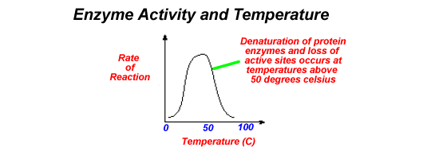
Exp. 4-Temperature and enzymatic activity:
Principle:
*
Low activity < Optimum Tm
Optimum Tm*:
is that Tm at which the activity of the enzyme is maximum

Slide 17
Method
Label three clean test tubes A, B and C.
Shake each tube gently and quickly return it to its proper temperature condition.
Wait for 15 minutes. After this time, examine each tube, without removing it from its temperature condition, and record the color in each tube in the table.
Tube | (1) | (2) Incubate for 10 min at: | (3)
A | Add 15 drops of enzyme | 0 ºC | Add 15 drops of 0.01M catechol
B |  | 37 ºC.
C |  | 70 ºC.

Slide 18
Degree of color intensity symbol
^{No color change (colorless) −}
Faint color (just detectable) +
^{Definite color ++}
^{Dark (deep) color +++}
Results:
Temperature (ºC) | Degree of color intensity (Symbol: −, +, ++ or +++)
0
37
70

