Slide 1
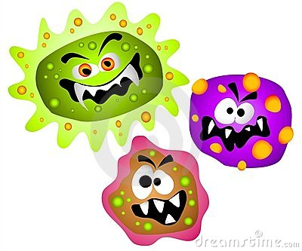
King Saud University
College of Applied Medical Sciences
Department of clinical laboratory Sciences
Introduction to Microbiology

Slide 2
Safety rules in the lab
Always wear lab coat and gloves inside the lab.
Cover any minor cuts on your body.
Never eat, drink or smoke in the lab.
Never mouth-pipette.
Report any accident to your supervisor.
Never take any culture out of the lab.
Always wash your hands before leaving the lab.

Slide 3
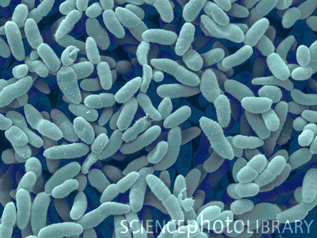
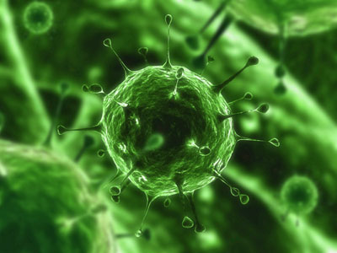
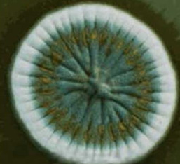
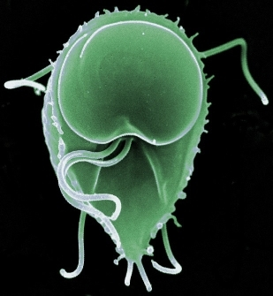
Microbiology
The study of small organisms.
Such as Bacteria, viruses, fungi and parasites.
Found in:
Air, soil, water and in our bodies.

Slide 4
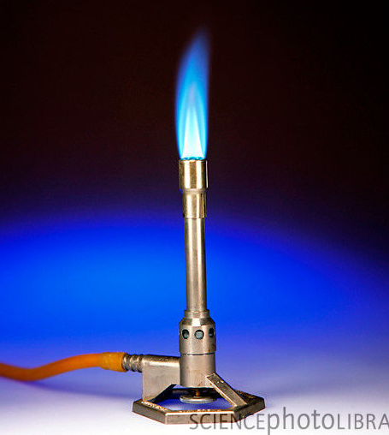
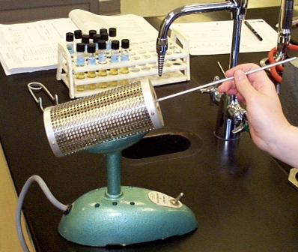
Name and function of common items used in the lab
Burner:
To provide area almost free of organism.
Bunsen burner:
Flame heating.
Bacti burner:
Eelectrical heating.

Slide 5
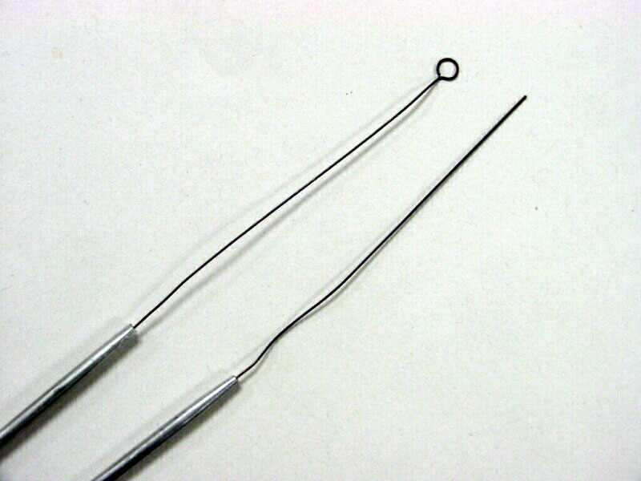
Loops:
For inoculation and to transfer organism from one place to another ( e.g. from culture to the slide).
Wire loop:
Large amount.
Straight loop:
Small amount.
The loops are made up of special material called (Nichrome). Which get heat and cool rapidly.

Slide 6
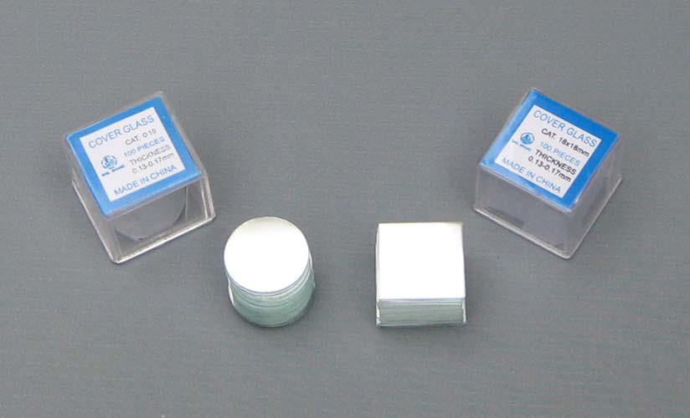
Slide:
To place the organism on top of it to examine it under the microscope.
Plain slide.
Frosted end slide.
Cover slip:
Used to cover the stained slide to protect it from scratch and to save it for a long time.

Slide 7
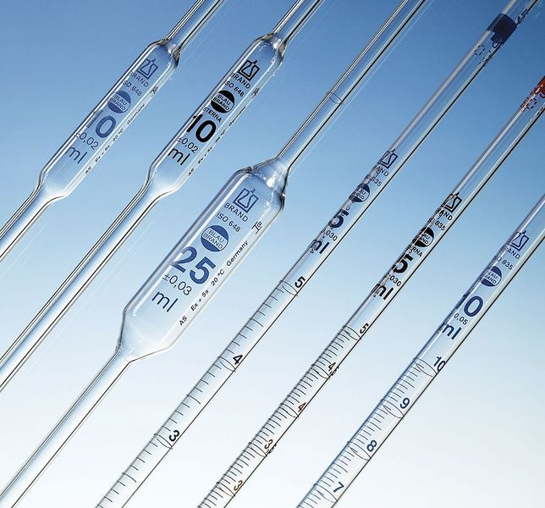
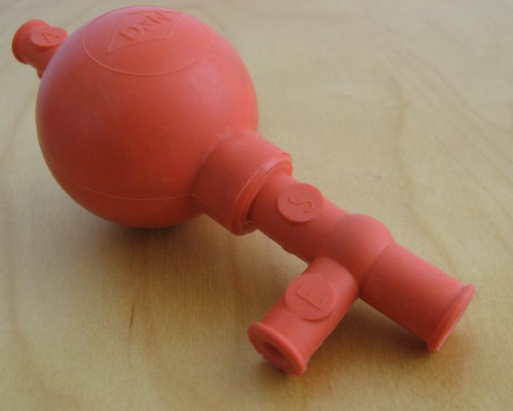
Pipettes:
Used to transfer solution from one place to another.
Graduated pipette: to transfer specific amount of solution.
Use pipette-pump with it.
Pasteur pipette: to transfer non specific amount of solution.

Slide 8
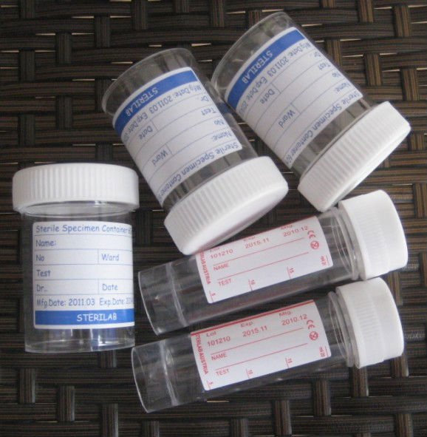
Container:
Use it to collect sample from the patient.
It should be sterile.
Universal container:
25 ml. Use to collect large amount of sample. Like urine, sputum.
Bijou bottle:
5ml. Use to collect small amount of sample. Like CFS, gland fluid.

Slide 9
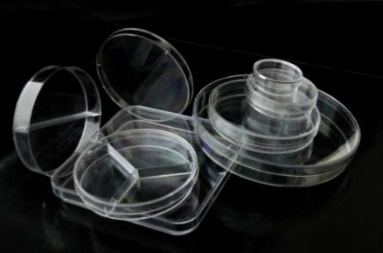
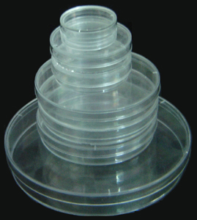
Petri dish:
Use as a media container for culturing.
It should be sterile.

Slide 10
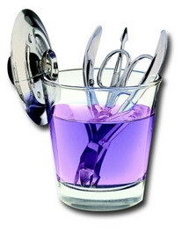
Disinfectant jar:
For disposal of some used items. E.g. Slides, cover slips and pipettes.
Disinfectant:
A chemical substance that kills or inhibits the growth of micro organisms.

Slide 11
Incubator:
Is a device used to grow and maintain micro-organisms. The incubator maintains optimal temperature, humidity and other conditions.
37º C is a good temperature for most bacteria which is close to the body temperature.

Slide 12
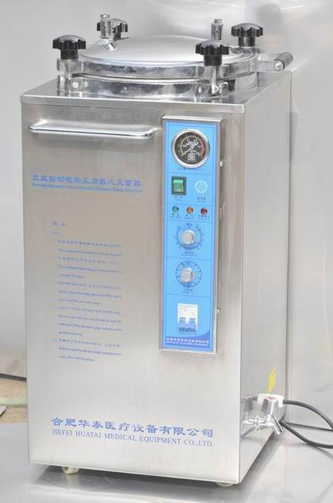
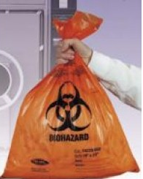
Autoclave:
An instrument used to sterilize equipment and supplies by expose them to high pressure and temperature at 121 °C for around 15–20 minutes under 15 atm.
Autoclave bag:
Made of material that tolerates high temperature.

Slide 13
Normal Saline
It is a sodium chloride solution 0.9% NaCl (0.9 g of NaCl dissolved in 100 ml of water).
Function:
Preserve the intact morphology of the cell of the bacteria by regulating the osmotic pressure.

Slide 14
Disposal of used items
Trash bag: for non infectious material. ( e.g. Tissues, plastic covers).
Disinfectant jar.
Autoclave.
Autoclave bag: for disposable items (Petri dish, container, gloves…).

Slide 15
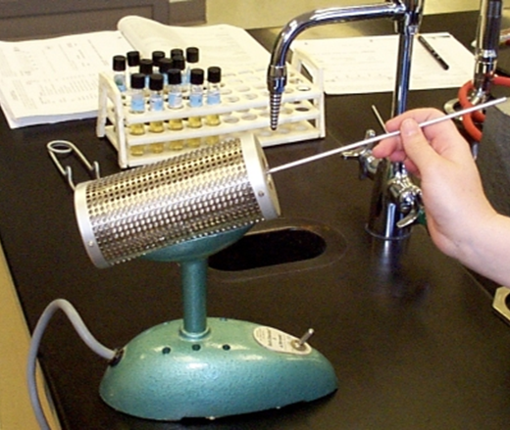

Slide 16
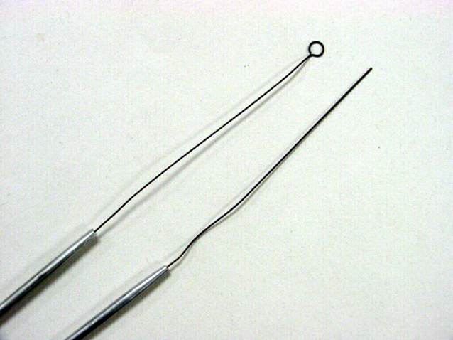

Slide 17
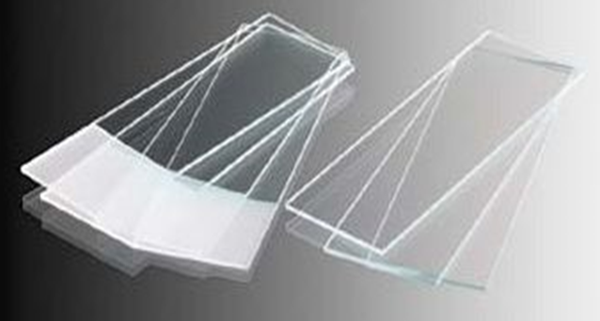

Slide 19
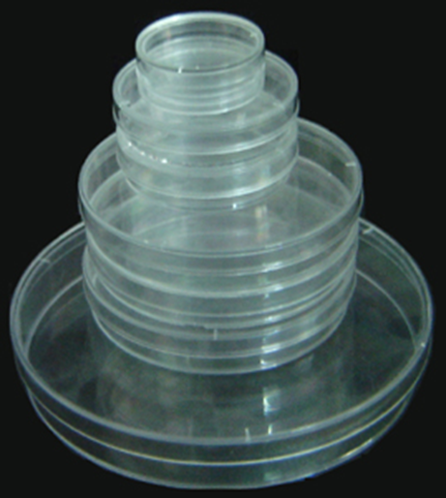

Slide 20
