Slide 1
Mohammed TA, Omar
Rehabilitation Health Science Department
CAMS-KSU
Introduction to Outcome Measurement in Clinical Practice and Research
Momarar@ksu.edu.sa Dr.taher_m@yahoo.com 0542115404

Slide 2
Lecture Outline
Terminology related to outcome measures in clinical practice (e.g. Assessment , Examination Evaluation, &
outcome measurements ).

Slide 3
Physical Therapist Patient/Client Management Model
The physical therapist integrates the five elements of patient/client management in a manner designed to optimize outcomes.
(The Interactive Guide to Physical Therapist Practice with Catalog of Tests and Measures (2002)
Examination,
Evaluation,
Diagnosis,
Prognosis,
Intervention
Outcome

Slide 4
Assessment
Assessment is the overall process of selecting and using
multiple data-collection tools and various sources of information
Outcome measurements
Evaluation
Assessment
Examination
It involves interpreting information
collected to make clinical decisions
(analysis and synthesis) related to the needs of the person and the appropriateness & nature of their therapy.
Notes:
Assessment is a dynamic process includes evaluation and measurement of outcomes, and examination of individuals or groups with actual or potential impairments, functional limitations, disabilities, or other conditions of health by history taking, screening and the use of specific tests and measures and evaluation of the results of the examination through analysis and synthesis within a process of clinical reasoning.

Slide 5
Examination
Comprehensive screening and specific testing process leading to identifying potential and existing movement-related disorders, diagnostic classification and/or, as appropriate, to a referral to another practitioner
Component of examination
History
Tests & measures
Systems review
Notes:
An examination process is performed by PT for all patients/clients prior to all intervention and includes taking the individual's history, conducting a standardized systems review, and performing selected tests and measures to identify potential and existing movement-related disorders
Physiotherapist will initially conduct a
subjective examination (interview) of a patient’s medical history [guided by the presenting system and complaint], and then go on to the The objective exam will then use certain quantifiable measurements to both guide diagnosis and for progress monitoring. These depend upon the system (and area) being managed.

Slide 6
Evaluation
Evaluation is a component of assessment process
Evaluation is based on the data gathered from the examination(e.g. history, systems review, and tests and measures) and synthesizes all of these findings to establish the
diagnosis, prognosis, and plan of care.
Evaluation involves the collection of data to enable the therapist to make a judgment about the amount of a specific construct of interest
Notes:
Evaluation involves the collection of data to enable the therapist to make a judgment about the amount of a specific construct of interest (such as degree of range of movement or level of independence in an activity of daily living) or to make a judgment about the value of an intervention for delivering the desired outcome for a person or the value of a service for delivering outcomes of relevance to the client population
Evaluation is a thought process that may not include formal documentation. It may include documentation of the assessment of the data collected in the examination and identification of problems pertinent to patient/client management.
Evaluation often involves data being collected at two time points in order to measure effect and also can involve the translation of observations to numerical scores.

Slide 7
Measurement
measurement
A measurement is the data obtained by measuring.
A measurement
is obtained by applying a standard scale/tools/equipment to variables, thus translating direct observations or client/proxy reports to a numerical scoring system.

Slide 8
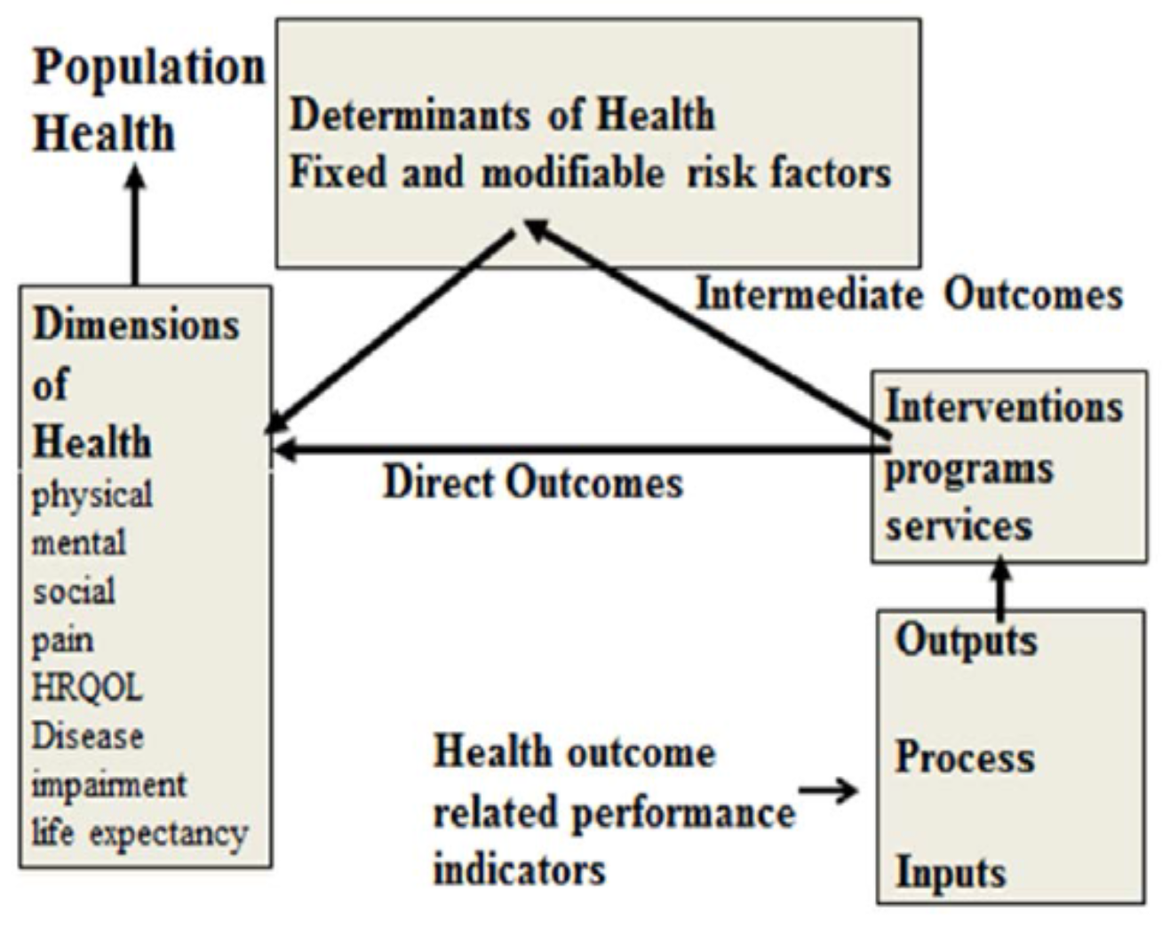
Health Outcome Measurements
A health outcome is a change in the health of an individual, or a group of people or population, which is wholly or partially attributable to an intervention or series of interventions. (AHMAC February 1993; Modified by NHIMG 1996)
Health Outcomes Framework

Slide 9
Outcome measurement
Outcome measurement is a process undertaken to establish the effects of an intervention on an individual or the effectiveness of a service on a defined aspect of the health or well-being of a specified population
Notes:
Primary outcome should be:
 Clinically relevant and Interpretable
 Sensitive to the effects of intervention
 Practical /Affordable to measure
 Measurable in an unbiased manner

Slide 10
OUTCOMES
Outcomes Assessment
Collection and recording of information relative to health processes
Outcomes Management
Using information in a way that enhances patient care

Slide 11
Primary versus Secondary OM
Outcomes
Primary
Secondary
Variable providing the most
relevant and convincing evidence related to the main objective of
the research.
Supportive measurements of the
primary objective or measurements
of effects related to other secondary objectives.
Notes:
Primary outcome should be:
 Clinically relevant and Interpretable
 Sensitive to the effects of intervention
 Practical /Affordable to measure
 Measurable in an unbiased manner

Slide 12
Generic versus Specific OMs
 | Generic | Diseases-specific
Purpose | Assess overall health status across a broad spectrum of norms /and or diseases | Gather information about the impact of a specific health condition
Population | General population (healthy and non-healthy) Applicable across individuals with differing condition health conditions | Used for patients with a specific health
Benefit | Allow comparison to normative populations | More sensitive & provides insight into the relationships among body function/structure impairments, activity limitations, and participation
Limitation | Ceiling and floor effects more likely | Does not allow comparisons across different groups of patients
Example | Functional Independence Measure | Clinical indicators and physiological measures Patient-reported disease specific measures
Notes:
Primary outcome should be:
 Clinically relevant and Interpretable
 Sensitive to the effects of intervention
 Practical /Affordable to measure
 Measurable in an unbiased manner

Slide 13
Performance-Based Measures versus Self-report OMs
 | Performance based | Self report
Purpose | Assess actual performance in a particular environment at a specific point in time Determine current level of function | Collect information on patients opinions/perceptions of the impact of the health condition
Data collection Methods | Timing, distance, force , power , strength, Observation of performance Rating level of independence/difficulty | Interview Questionnaire
Benefit | Allows observation of task performance Less likely to have missing data | Can assess constructs not observed during performance (e.g., fear of falling) Can assess activities not observed clinically
Limitation | Equipment required, environmental factors, fatigue, motivation, and learning effects, measure inaccuracy | Cognitive and communication ability Language and educational level Patient may miss or misinterpret items or over-/underestimate ability
Example | Functional Independence Measure , Gross motor function measure 10-meter walking test, Time up and go test | 36-short form health questionnaire Seattle Angina Questionnaire (SAQ) Child Health Questionnaire (CHQ)
Notes:
Primary outcome should be:
 Clinically relevant and Interpretable
 Sensitive to the effects of intervention
 Practical /Affordable to measure
 Measurable in an unbiased manner

Slide 14
Patient-reported outcomes (PROs)
A PRO is any report of the status of a patient’s health condition that comes directly from the patient, without interpretation of the patient’s response by a clinician or anyone else. (Food and Drug Administration, 2009)
Patient satisfaction and perception
Physical functioning
Signs and symptoms
Treatment adherence
Health-related Quality of Life (HRQoL)
Applied ======Prior to, during and after their treatment
Using =========standardized and validated questionnaires
Notes:
“An instrument, scale, or single-item measure that gathers information directly from patients about how they are feeling, their symptoms, and any effects of prescribed treatment.”
PROMs usually focus on outcomes of care and may include for example,
patients reporting on their symptoms,
functional status and HRQoL prior to, during and after their treatment through the completion of standardised and validated questionnaires.
Health-related Quality of Life (HRQoL)
Represents the patient’s evaluation of a health condition, and its treatment on their daily life including:
physical function, • psychological function,
social function, • role function,
emotional function, • well-being,
vitality, • health status etc.
Patient satisfaction:
evaluation of treatments,
patient’s preference,
healthcare delivery systems and professionals,
patient education programs,
and medical devices.
Physical functioning
Physical limitations and activity restrictions, including:
walking,
mobility,
sleep,
self-care,
sex, and
disability.
Signs and symptoms
Reports of physical and psychological symptoms or sensations not directly observable, including:
energy,
fatigue,
nausea, and
irritability.

Slide 15
Health, Health Status,
Quality of life (QoL),
Health realted quality of life(HRQoL)

Slide 16
Health
Health is “an individual's level of function”, where “optimum function” is judged in comparison to “society's standards of physical and mental well-being”.
Health A state of complete physical, mental and social well-being, and not merely the absence of disease or injury (WHO, 1981).

Slide 17
Quality of life (QoL)
QoL An individual’s perception of his/her position in life in the context of the
culture and value systems in which he/she lives, and in relation to his/her goals,
expectations, standards and concerns.
QOL is the general well-being of individuals and societies, outlining negative and positive features of life
health;
social well-being;
economic well-being;
life satisfaction;
spiritual or existential well-being; and
other characteristics valued by humans.

Slide 18
What is health-related quality of life?
HRQoL can be defined as “how well a person functions in their life and his or her perceived wellbeing in physical, mental, and social domains of health”
HRQoL Its part of a person’s overall quality of life that “ represents the
functional effect of an illness and its consequent therapy upon a patient, as
perceived by the patient .
On the individual level
Includes physical and mental health perceptions correlating with health risks and conditions, functional status, social support, and socioeconomic status 
At the community level
Community-level resources, conditions, policies, and practices that influence a population’s health perceptions and functional status
Notes:
The concept have evolved since the 1980s
Quality of life and health related quality of life – is there a difference?
◆ Quality of life and HRQoL are used interchangeably in the literature but each has its own meaning. 
QoL is a broader concept which covers all aspects of life
◆ HRQoL has a focus on the effects of illness and specifically on the impact treatment may have on QoL
◆ QoL is therefore broader than HRQoL because it includes evaluation of non-health related features of life whereas HRQoL is connected to an individual’s health or disease status
HRQoL can help us understand the distinction between aspects of life related to health. 
QoL can help us understand those aspects of life that extend beyond health such as education and the social environment

Slide 19
Health related Quality of Life
HRQoL can be defined as “how well a person functions in their life and his or her perceived wellbeing in physical, mental, and social domains of health”
Health-related Quality of Life
Encompasses several aspects of health that are directly
experienced by the person
including physical functioning,
Social and role function
Mental and general health
Perception
Physical function
Notes:
Health  A state of complete physical, mental, and social well-being not merely the absence of disease
QoL is a broader concept which covers all aspects of life
HRQoL has a focus on the effects of illness and specifically on the impact treatment may have on QoL
QoL is therefore broader than HRQoL because it includes evaluation of non-health related features of life whereas HRQoL is connected to an individual’s health or disease status
HRQoL can help us understand the distinction between aspects of life related to health.
QoL can help us understand those aspects of life that extend beyond health such as education and the social environment

Slide 20
Questions and answers

