Slide 1
Identification of the common laboratory glassware, pipettes and instruments .
BCH 312 [PRACTICAL]

Slide 2
Objective:
-To be familiar with most used tools in biochemistry labs.

Slide 3
(1)Identification of the common laboratory glassware :
Conical flasks and beakers.
Graduated cylinders [measuring cylinder ].
Volumetric flasks.
Burettes.
Pipettes.

Slide 4
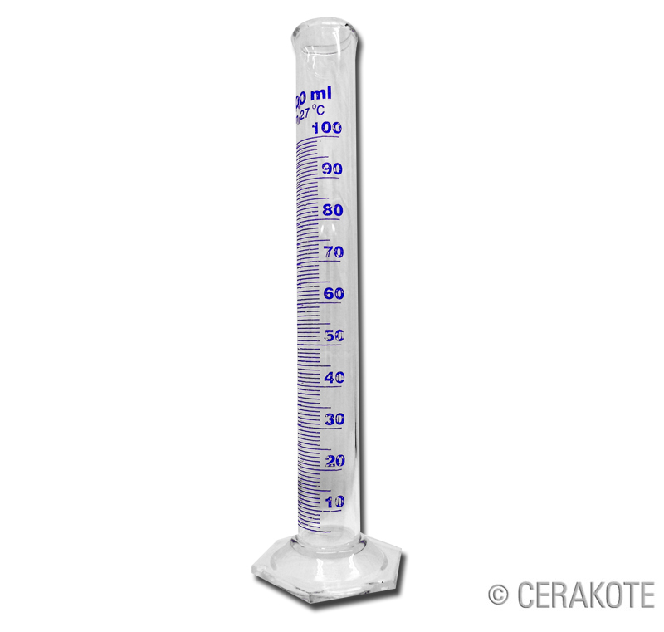
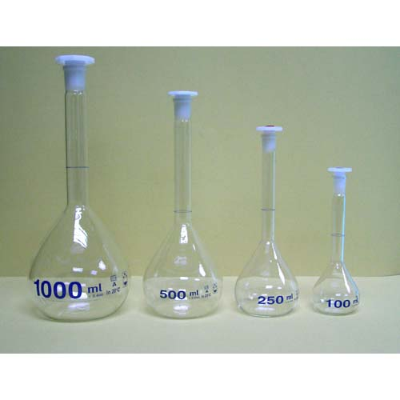
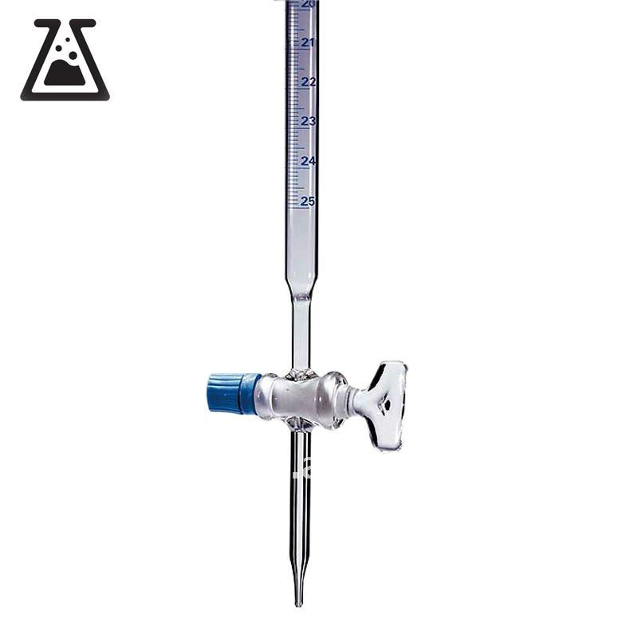
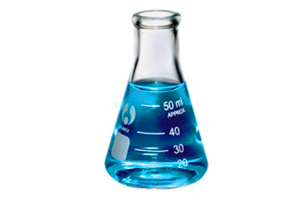
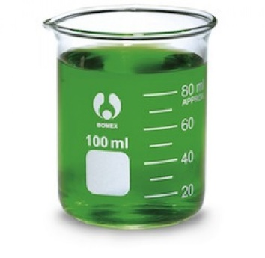
Glassware
Conical flasks and beakers
Graduated cylinders
Volumetric flasks
Burettes
Conical flasks
-Erlenmeyer-
Beakers
(least accuracy)

Slide 5
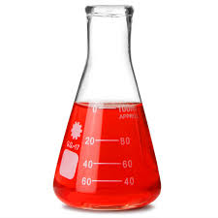
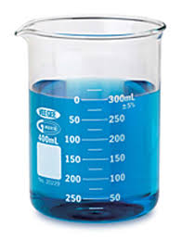
(1)Identification of the common laboratory glassware :
A- Conical flasks and beakers:
They are used for mixing, transporting and reacting, but not for accurate volume measurements.
Conical flasks
[Ehrlenmeyer]
Beaker

Slide 6
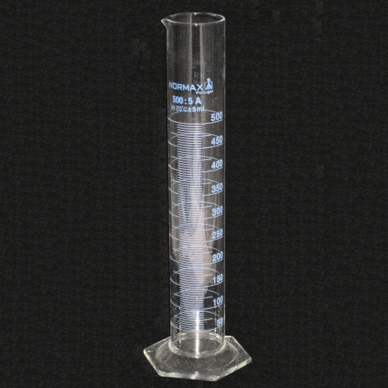
B- Graduated cylinders [measuring cylinder ]:
-Used to measure the volume of a liquid. Graduated cylinders are generally more accurate and precise than laboratory flasks and beakers.
-If greater accuracy is needed, use a pipet or volumetric flask.
Graduated cylinders

Slide 7

C- Volumetric flasks:
It is used to make up a solution of fixed volume very accurately.
Volumetric flasks

Slide 8
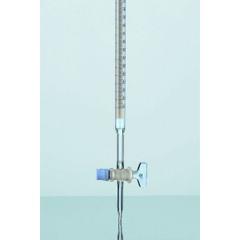
D- Burettes :
A burette delivers measured volumes of liquid. Burettes are used primarily for titration.
Burette

Slide 9
E- Pipettes:
Are Tools commonly used to transport a measured volume of liquid. Pipettes come in several designs for various purposes with differing levels of accuracy and precision.
There are three main type of pipettes are used in biochemical laboratory:
(a) Volumetric or transfer pipettes.
(b) Graduated or measuring pipettes.
(c) Micropipettes.

Slide 10
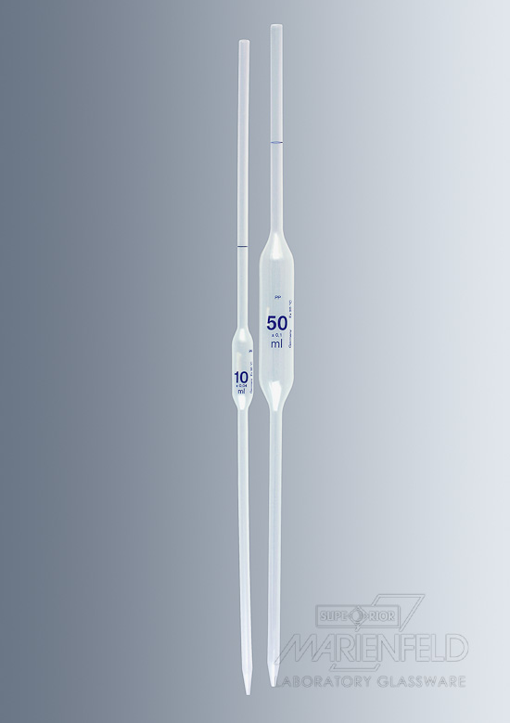
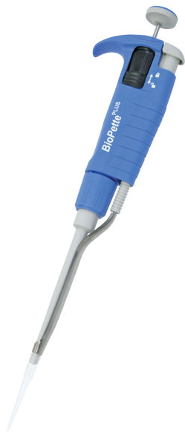
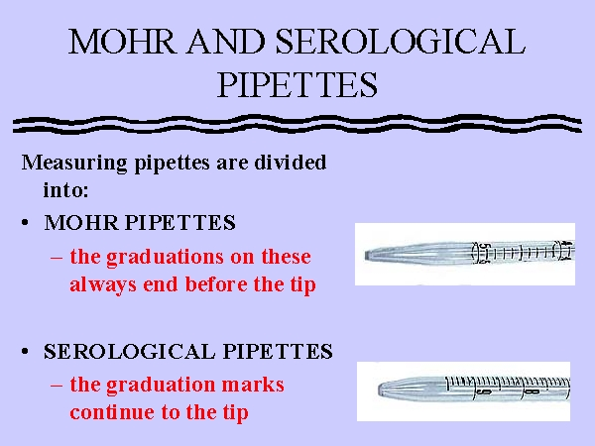
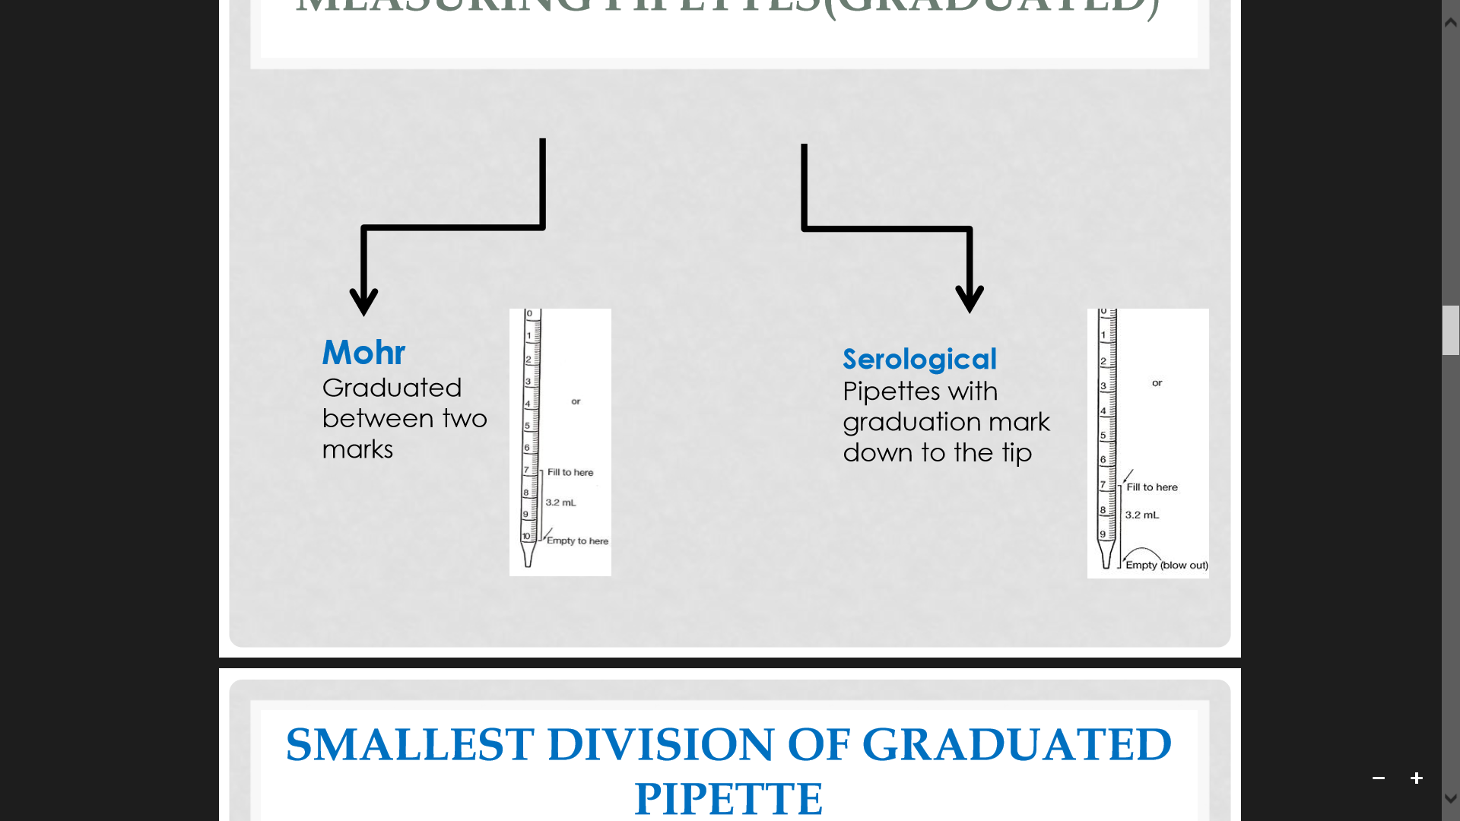
Types of pipettes
Volumetric pipettes
Graduated pipettes
Micropipettes
Mohr Pipettes
Serological Pipettes
(Graduated between two marks(
(Graduation mark down to the tip)

Slide 11
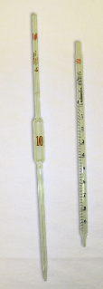
Comparison between types of pipettes
Volumetric pipettes | Graduated pipettes
Transfer (designed to deliver accurately fixed volume of liquid) | Measuring
Not graduated | Graduated
More accurate | Less accurate
Non-blown out | Some are blown out
Consists of a cylindrical bulb joined at both ends to narrowed glass tubing. | Don’t contain a cylindrical bulb
Notes:
1- http://faculty.smcm.edu/wihatch/courses/436web/436appendicies/measuringLiquid.html
2-http://www.harpercollege.edu/tm-ps/chm/100/dgodambe/thedisk/labtech/volume.htm
* Serological or blow out pipette are calibrated so that the least drop of liquid needs to be blown out of the tip to deliver the full volume of the pipette (if you are not trying to deliver the full volume you may not have to blow these out)

Slide 12
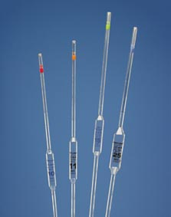
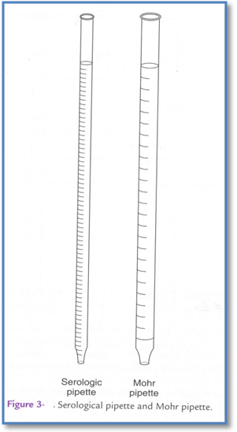
Serological pipette
Mohr pipette
(a)Volumetric pipettes. [transfer ]
(b)Graduated pipettes. [measuring]

Slide 13
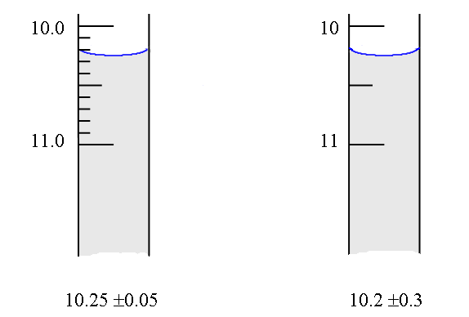
Smallest division of graduated pipette:
1ml
10
1 ml
2
= 0.1 ml
= 0.5 ml

Slide 14
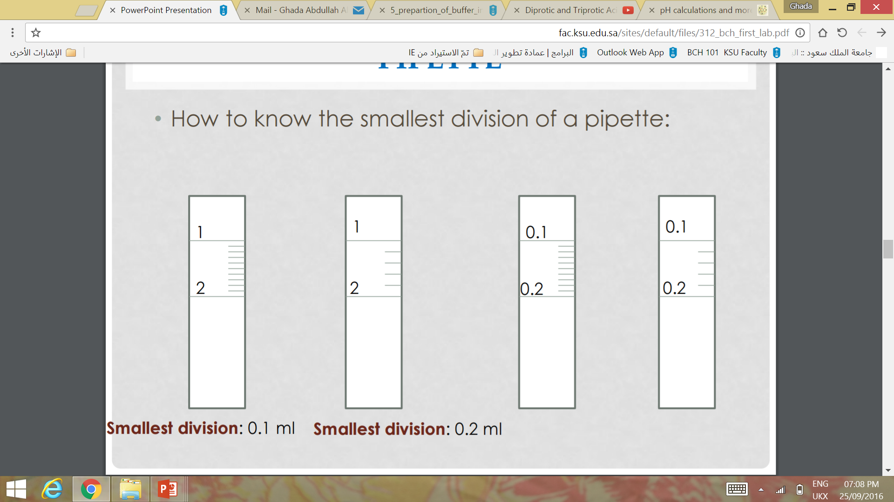
Smallest division of graduated pipette:
1ml
1ml
0.1ml
0.1ml
1ml
10
= 0.1 ml
1ml
5
= 0.2 ml
0.1ml
10
= 0.01 ml
0.1ml
5
= 0.02 ml
Notes:
1- http://faculty.smcm.edu/wihatch/courses/436web/436appendicies/measuringLiquid.html
2-http://www.harpercollege.edu/tm-ps/chm/100/dgodambe/thedisk/labtech/volume.htm

Slide 15
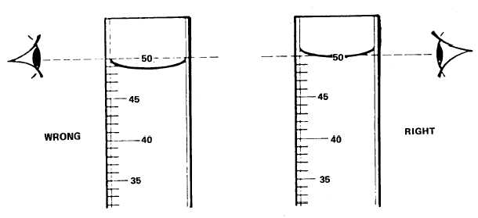
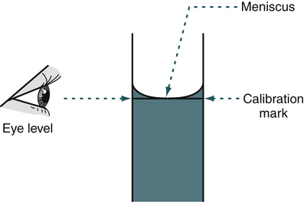
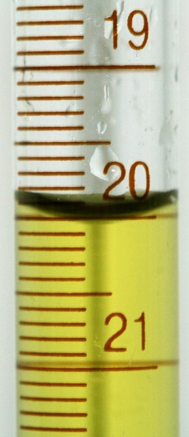
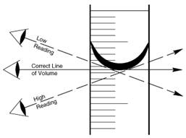
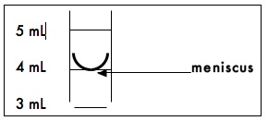
Reading the meniscus:
Notes:
1- http://faculty.smcm.edu/wihatch/courses/436web/436appendicies/measuringLiquid.html
2-http://www.harpercollege.edu/tm-ps/chm/100/dgodambe/thedisk/labtech/volume.htm

Slide 16
Steps of the Use of the pipettes:
1- Press the pipette into the pump with a slight twisting motion.
2- The pipette is first washed with water ,then rinsed several times with a little of the solution.
3- The pipette then filled to just above the mark , the liquid is allowed to fall to the mark .
4- The solution is allowed to drain into the appropriate vessel with the jet of the pipette touching the wall of the vessel .
5- After the flow of the liquid has stopped, the jet is held against the wall for some times and then removed.
Note:
-For serological pipette, some are of the blown out type; the last drop being blown out against the vessel wall.
-For volumetric pipette a certain amount of liquid will remain at the tip and this must not be "blown out".
Notes:
1- http://faculty.smcm.edu/wihatch/courses/436web/436appendicies/measuringLiquid.html
2-http://www.harpercollege.edu/tm-ps/chm/100/dgodambe/thedisk/labtech/volume.htm

Slide 17
Accuracy:
1- Volumetric flasks and volumetric pipettes ➔ most accurate.
2- Burettes and graduated pipets.
3- Graduated cylinders.
4- Beakers and conical flasks. ➔ least accuracy - used only when a rough estimation of volume is required-
Notes:
1- http://faculty.smcm.edu/wihatch/courses/436web/436appendicies/measuringLiquid.html
2-http://www.harpercollege.edu/tm-ps/chm/100/dgodambe/thedisk/labtech/volume.htm

Slide 18
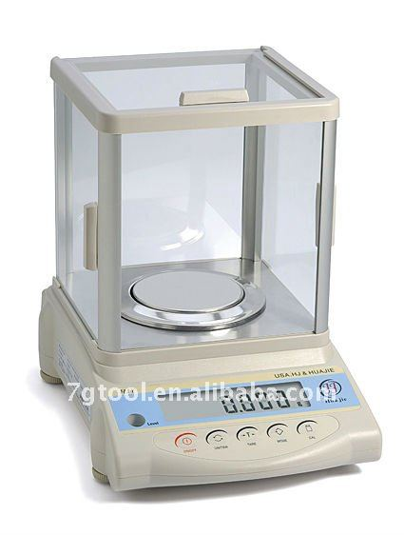
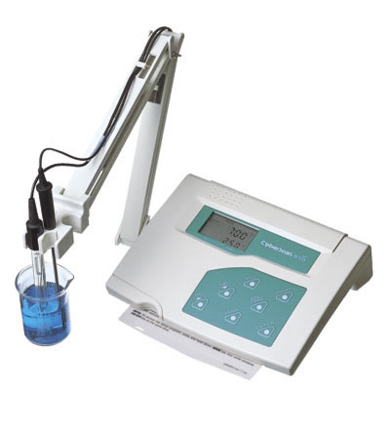
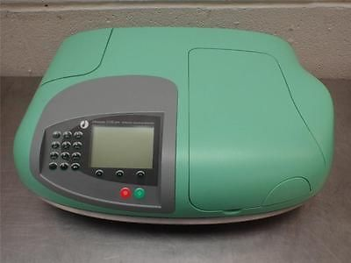
(2) Identification of the common laboratory Equipment:
(A)Balance.
(B) pH meter.
(C) Spectrophotometer.

Slide 19
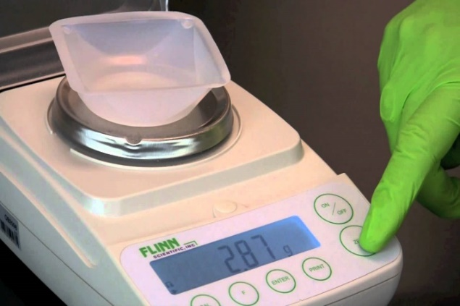
(A) Electronic Balance:
Electronic Balance is a device used to find accurate measurements of weight.
It provide the results digitally, making them an easy tool for use.
The weight can be displayed by different unites.
Before waiting any substance, you should (Zero) the balance.
➔ What does mean zeroing of the electronic balance?
(mass of paper + substance) - (mass of paper) = (mass of substance)
https://www.youtube.com/watch?v=0UymyTJATLc

Slide 20
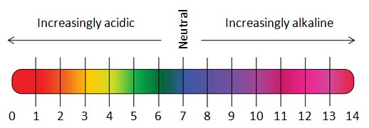
(B) pH meter:
• A pH meter is an electronic device used for measuring the pH (acidity or alkalinity) of a liquid.
•Hydrogen ion concentration of many solution is low and difficult to measure accurately.
•So, the term pH introduced as a way of expressing hydrogen ion concentration .
•PH define as the negative logarithm of the hydrogen ion concentration .
•PH = - log10 [H+]
•Since the PH determines many important aspects of the structure and activity of biological macromolecules and thus of the behavior of the cell and organisms .
• Note: PH range value (0 - 14) ,, the higher PH number , the lower the hydrogen ion concentration and vice versa..

Slide 21
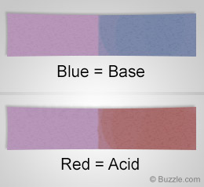
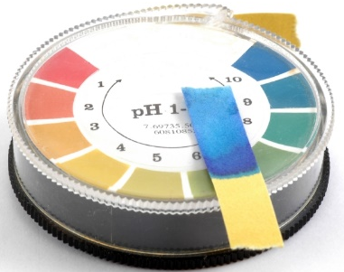
There are many ways in biochemical laboratory to measure pH value such as :
litmus paper.
Test strips.
3. pH meter ➔ The most accurate and reliable method.

Slide 22
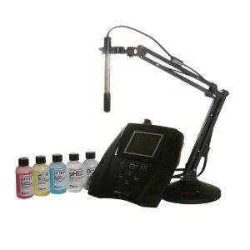
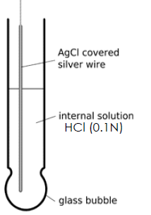
Note: before use it needs to be calibrated
pH meter contain glass electrode which is very sensitive and readily responds to changes in hydrogen ion concentration .
The glass electrode
A nice video show you how to use the pH meter: https://www.youtube.com/watch?v=vwY-xWMam7o

Slide 23
(C) Spectrophotometer
• Spectrophotometer is instrument used to measure the intensity of light at a given wavelength that is transmitted or absorbed by a sample.
• Wavelength in this instrument divided into:
-Invisible range(ultraviolet) from 100 to 380 nm [Quartz cuvette are used].
-Visible range (above 400 nm -700 nm) [Glass or plastic cuvette are used]
• Blank : contain everything except the compound to be measure.

Slide 24
The spectrophotometer: it can be used to measure the amount of light absorbed by a solution.
-By using the spectrophotometer, we can quantitatively measure absorbance, and this information can be used to determine the concentration of the absorbing molecule.
-More concentrated solution will absorb more light and transmits less.
So, the more concentrated solution → high absorbance value.
And Less concentrated solution → less absorbance value.

Slide 25
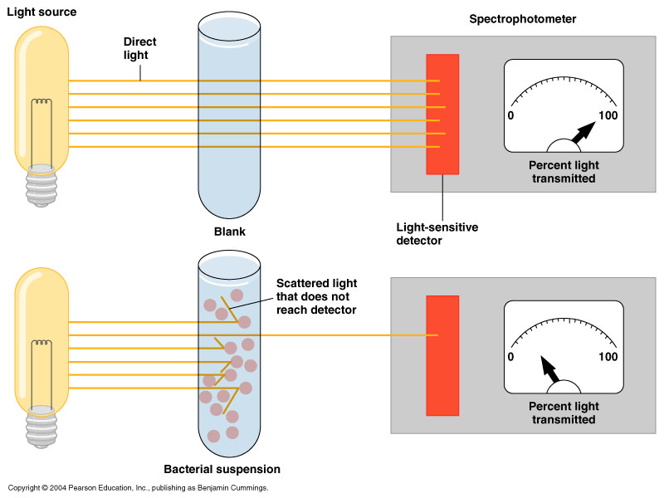
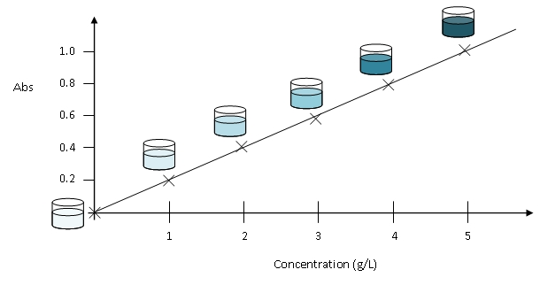
Indirect relationship
-transmittance-
transmission
Direct relationship
-absorbance-

Slide 26
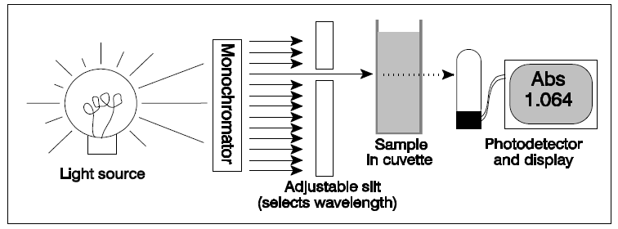
How a spectrophotometer works

Slide 27
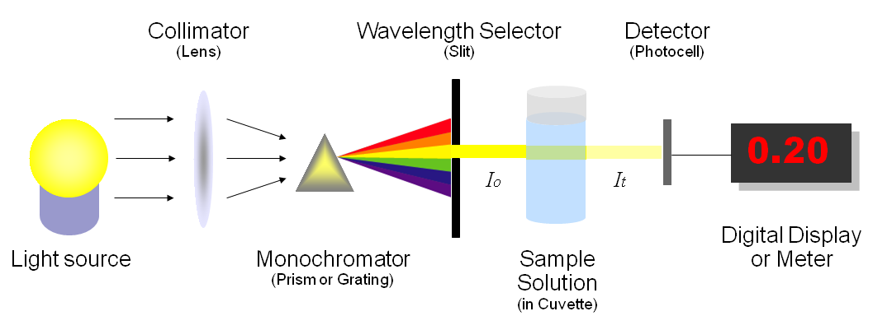
How a spectrophotometer works

Slide 28

How does a spectrophotometer work?
http://www.youtube.com/watch?v=pxC6F7bK8CU

