Slide 1
CLS 223
Reem Alkhamis
Email: ralkhamis@ksu.edu.sa
3rd floor/ office # 125

Slide 2
Lecture # 10
Infection
Fever

Slide 3
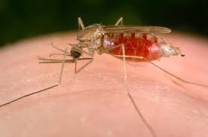
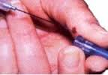
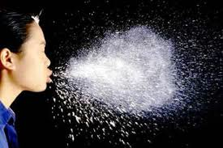
Infection
Routes of transmission:
Insects: e.g. malaria
Contaminated blood: e.g. AIDS
Droplet contact (respiratory route) e.g. Tuberculosis, Influenza
Fecal-oral transmission: e.g. Cholera, Hepatitis A, Salmonella
Sexual transmission: e.g. Gonorrhea, Syphilis, AIDS
Notes:
Fecal-oral transmission: foodstuffs or water become contaminated (by people not washing their hands before preparing food, or untreated sewage being released into a drinking water supply, or insects that feed on fecal waste and transfer microbes to the food) and the people who eat and drink them become infected.
Contaminated blood: e.g. Sharing used syringe needles contaminated with infected blood.

Slide 4
Factors influencing the establishment of infection
In the host:
Susceptible host: is a person who is unable to resist infection.
Defect in physical barrier.
Defect in secretions.
Exposure to chemical materials.
In the micro-organism:
Virulence: Refers to the degree of strength of that organism in its ability to produce disease.
Dose (quantity): There must me a high enough number of microorganism present to overwhelm the body’s defense mechanism.

Slide 5
Course of infectious diseases:
Infection
Incubation period
Prodormal stage
Acute stage (period of illness)
Convalescent stage
Resolution stage

Slide 6
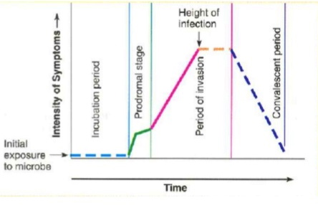
Incubation Period: It is the duration between the entry of the infection and the start of the clinical picture.
Prodormal Stage: It is the stage in which the patient has general manifestations, not specific for the disease.
Convalescent stage: It is the stage in which there is disappearance of the symptoms, but the patient is not in a condition of complete cure and he has low immunity.
Resolution stage: It is the stage of complete cure of the patient.

Slide 7
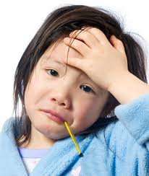
Fever
Increase in body temperature
Causes:
Infection
Hypersensitivity
Tumor
Haemolysis
Dehydration
Metabolic disorders
Pyrogens:
These are fever producing substances released from bacteria, parasites, leucocytes, and damaged tissue.

Slide 8
Regulation of body temperature
Heat production + Heat loss = body temp.
The mechanism of regulation of body temperature is depending mainly on the hypothalamus
Hypothalamus set point: It is a certain temperature (35.6-37.8 C).
Blood temperature is not warmer nor cooler than this hypothalamic set point.
By metabolism
Through the skin

Slide 9
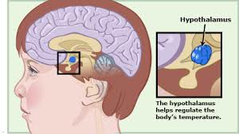

Slide 10
Increase body temperature
During exercises or in hot climate, blood becomes warmer then the hypothalamic set point → activation of heat loss center in the hypothalamus
→1) Dilation of skin blood vessels → heat radiates from skin surface.
→2) sweat glands activate and perspiration.
→ Return of body temperature to the normal level.

Slide 11
Decrease in body temperature
In cold climate blood becomes cooler than the hypothalamic set point → activation of the heat promoting center in the hypothalamus →
→ 1) contraction of skin blood vessels → heat loss from skin surface minimize
→ 2) skeletal muscle activation and shivering.
→ Return of the body temperature to the normal level

