Slide 1
10. SEEPAGE

Slide 2
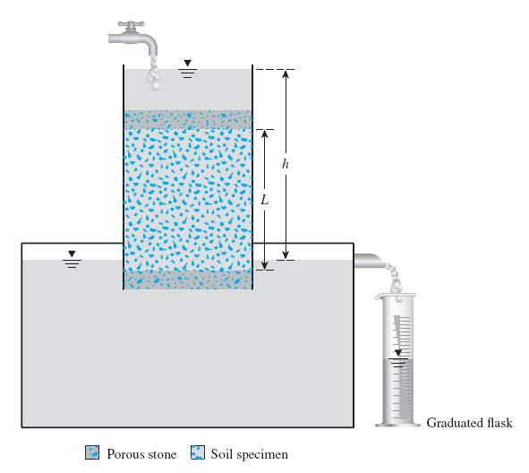
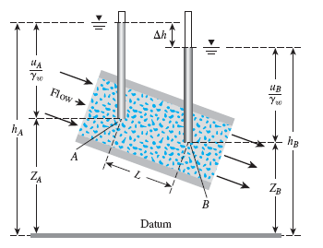
One-dimensional flow
INTRODUCTION
Flow Rate = q = v. A = k . i . A = k (h/L). A

Slide 3


One-dimensional flow
Water In
Head Loss or
Head Difference or Energy Loss
$$\frac{u_{A}}{γ_{w}}$$
h =h_{A} - h_{B}
h_{A}
i = Hydraulic Gradient
$$\frac{u_{B}}{γ_{w}}$$
Pressure Head
(q)
Water
out
Total Head
A
h_{B}
Soil
Pressure Head
B
Total Head
Z_{A}
Elevation Head
L = Drainage Path
Z_{B}
Elevation Head
Datum

Slide 4
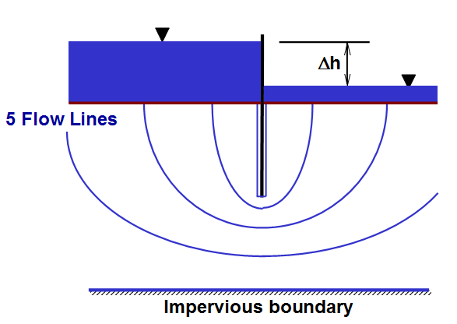
Two-dimensional flow
INTRODUCTION
In reality, the flow of water through soil is not in one direction only, nor is it uniform over the entire area perpendicular to the flow.
4

Slide 5
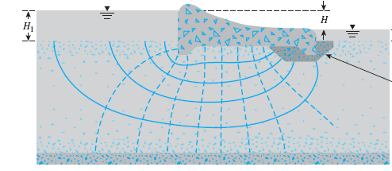
Two-dimensional flow
INTRODUCTION

Slide 6
INTRODUCTION
In the preceding chapter the flow of water for simple 1-D is calculated through direct application of Darcy's law as already we did in the case of the permeability tests.
As engineers, we will wish to examine and calculate the leakage below the sheet pile or through or beneath the dam and find the distribution of pore water pressure (p.w.p) and effective stress throughout the soil.
If the structure (sheet pile, dam, …etc.) is very long, we may neglect the component of flow in the 3rd dimension and consider only the flow through a slice of unit thickness.
This corresponds to plane or two-dimensional flow and we will consider only this case.

Slide 7
If p.w.p varies with time the flow will be time-dependent. This is what is so-called non-steady state flow or TRANSIENT SEEPAGE. This may be due to:
External cause like change in the head difference between inlet or outlet due to any reason.
Internal cause like deformation of soil during the process of seepage.
In the second case there is a complex interrelationships between p.w.p, seepage, and deformation. This time-dependent process is known as consolidation and is considered in CE 481 Geotechnical Engineering II.
If p.w.p do not vary with time, the rate of flow will be constant and the flow is known as STEADY-STATE-SEEPAGE.

Slide 8
During steady state seepage, p.w.p remains constant and no soil deformation occur. Hence we will consider TWO-DIMENSIONAL STEADY-STATE SEEPAGE.
The soil may therefore be regarded as RIGID and stationary with a steady flow of water through the pore spaces.
Also in this course we will only consider the simple case of CONFINED flow, where the seepage is confined between two impervious surfaces.
REQUIREMENTS FOR STEADY STATE FLOW
The soil is fully saturated
The pressure (and hence total) gradient is unchanging
Soil mass is constant
Flow rate is constant

Slide 9
TWO-DIMENSIONAL SEEPAGE FLOW THEORY
The hydrodynamics steady-state fluid flow through porous media follows the same basic laws as the problems of steady-state:
Heat flow
Current flow
In a continuous contactors
All can be represented by LAPLACE EQUATION.
In flow problems Laplace equation is the combination of the equation of continuity and Darcy’s law.

Slide 10
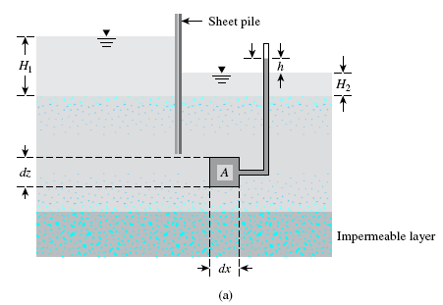

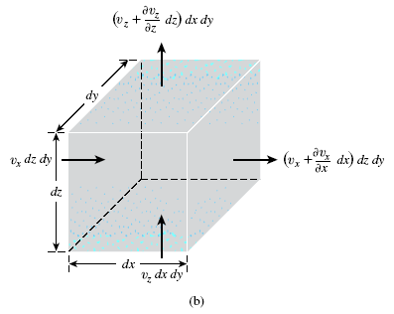


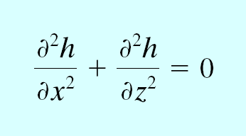
Laplace’s Equation of Continuity
In flow
Out flow
(horizontal direction)
Total rate of inflow = Total rate of outflow
y
z
Note: Assuming k_{x}= k_{z}
x
This equation governs the steady flow condition for a given point in the soil mass

Slide 11
Solution of Laplace’s Equation
Laplace’s equation can be solved using different methods including:
Separation of variables
Laplace transform
Fourier transform
Analytical Methods
Numerical Methods
Finite element
Finite difference
Hydraulic models
Sand models
Viscous fluid models
Electric analogy
Models
Finite element
Finite difference
Trial-and-error sketching
Graphical method
Flow nets

Slide 12
The analytical methods are exact, however they are complicated and solutions are available only for simple boundary conditions. Therefore they are less practical.
Numerical methods vastly developed in the presence of digital computer and a number of solutions are now available.
Graphical method termed FLOW NET is preferred by many because it is very versatile and simple.
In this course we will limit ourselves to flow net through trial-and-error sketching.
By constructing the flow net we can know the values of head at any point in the soil and also find the flow.

Slide 13
Intuition basis of flow nets
Consider flow through the constant head permeameter shown below:
We can see that there are two families of lines:
Vertical lines which represent the direction of flow of water particles.
Horizontal lines which represent lines of constant head.
Note: As the water progress through the sample, head is lost at constant rate (but we deal only with steady state, i.e. h is constant)

Slide 14
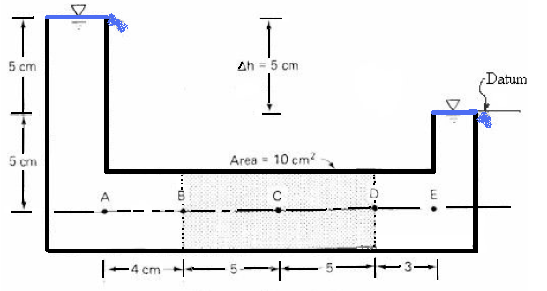
Consider the other way around (i.e. flow is horizontal)
We can see also that there are TWO families of lines:
Horizontal lines which represent the direction of flow of water particles.
Vertical lines which represent lines of constant total head.

Slide 15
Theoretical Basis of Flow Nets
The governing equation is a 2nd order homogeneous, partial differential equation with constant coefficients.
The solution of this equation is represented by two functions which both satisfies the equation and any relevant boundary conditions.
These functions are the potential function Φ (x,z) and the flow function ψ(x,z). These functions represent a family of equipotential lines and a family of flow lines constituting what is referred to as a FLOW NET.
These lines are proved to be orthogonal.

Slide 16
What we actually do, we by following specific rules find the FLOW Net by which we reach the solution of Laplace’s equation.
In other word flow net is actually a graphical solution of Laplace’s Equation in 2-D.

Slide 17
FLOW NET CONSTRUCTION
There are a number of procedures available by which an engineer may DRAW a flow net for the solution of a seepage problem. Among these are:
Mathematical solution
Electrical analogy
Physical models
Method of fragments
Trial sketching method
We will consider only the last one.

Slide 18
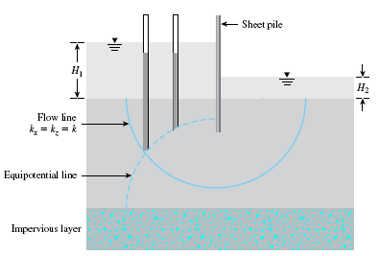
FUNDAMENTAL DEFINITIONS
A line along which a water particle will travel from upstream to the down stream side in the permeable soil medium is called a FLOW LINE (OR STREAM LINE).
A line along which the TOTAL HEAD at all points is the same is called EQUIPOTENTIAL line.
If piezometers are placed at different points along an equipotential line, the water level will rise to the same elevation in all of them.
Different pressure heads but equal total heads
Datum

Slide 19
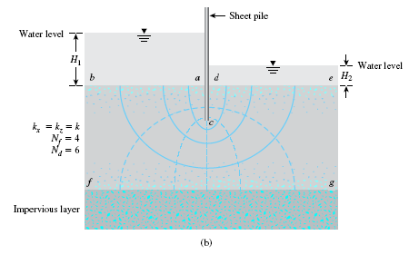
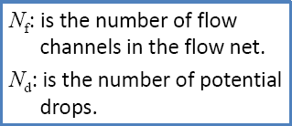
The space between any two adjacent flow lines is called FLOW PATH, FLOW TUBE, or FLOW CHANNEL.
The space between any two equipotential lines is called EQUIPOTENTIAL SPACE .
The mesh made by a number of flow lines and equipotential lines is called a FLOW NET.
The “Phreatic surface” is the top flow line
Flow channel
Flow line
Equipotential line

Slide 20
Illustration

Slide 21
Illustration
FLOW LINES

Slide 22
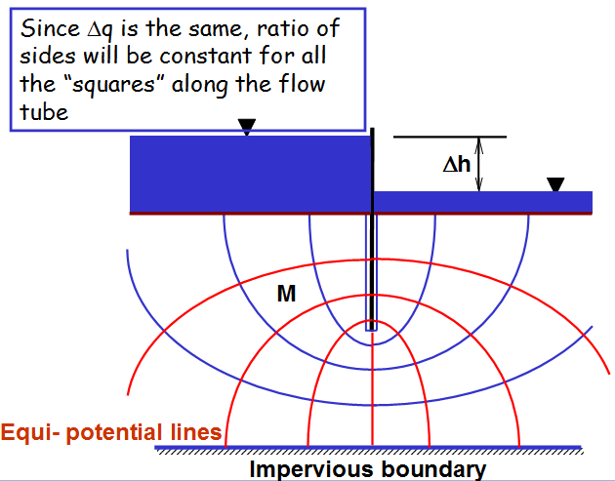
Illustration

Slide 23
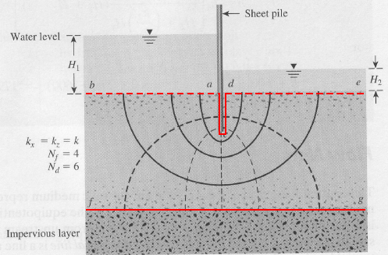
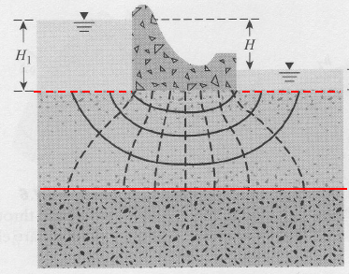
Illustration
Boundary Conditions
23

Slide 24
Illustration
H
H
0
H-Δh
H-5Δh
H-2Δh
H-3Δh
H-4Δh
24

Slide 25
Rules Followed in Sketching Flow Nets
Flow lines and equipotential lines must intersect at right angles.
Constant head boundaries represent initial or final equipotentials.
Impermeable (no-flow) boundaries are flow lines.
Adjacent equipotentials have equal head loss (=h/Nd)
The same quantity of seepage flows between pairs of flow lines (i.e. equal flow channels).

Slide 26
Geometric figures formed by pairs of flow lines and equipotential lines must be essentially squares. This is the case when we have a true flow net. In more practical case involving curvilinear flow, the figures cannot be true squares. However they must have right angles at the corners and the two median dimensions of each figure must be equal.
Note:
Drawing of square elements is convenient but not always necessary

Slide 27
STEPS IN CONSTRUCTING FLOW NETS
Step 1: Draw to a convenient scale a cross-section of the medium and its boundaries.
Step 2: Establish the two boundary flow lines and the two boundary equipotential lines..
Step 3: By trial and error sketch a network of flow lines and equipotential lines, observing the right-angle intersection and the space figures rules.
Where flow direction is a straight line, flow lines are an equal distance apart and parallel.
Step 4: At first attempt certainly there will be some inconsistencies. Successive trials are made until the net is reasonably consistent throughout.

Slide 28
GENERAL SUGGESTIONS AND TIPS FOR THE CONSTRUCTION OF FLOW NETS
Use as few flow lines (and resulting equipotential lines) as possible. Generally THREE to FIVE lines will be sufficient.
Be practical in selecting a scale for the drawing. A scale that is too large waste time and eraser.
Before starting the sketch a flow net look for important boundary conditions.
Always watch the appearance of the entire flow net. Do not make fine detail adjustments until the entire flow net is approximately correct.
Try to keep the number of flow channels to a whole number.
Remember, flow lines do not intersect the lower boundary since itself is a flow line.
Obtaining results from a rough flow net is considered adequate. The error committed is relatively small in comparison to the accuracy we obtain for the coefficient of permeability.

Slide 30
SEEPAGE CALCULATION FROM FLOW NETS
Let us first consider the case of straight flow and equipotential lines (i.e. perfect squares) as shown in the figure below.
In a flow net, the strip between any two adjacent flow lines is called a flow channel.
The drop in the total head between any two adjacent equipotential lines is called the potential drop.
Δh
h
Soil
s
l

Slide 31
Applying Darcy’s law, the flow in each flow channel is
Since the figures are squares (as must be the case in general) s/l =1, and hence
Since the potential drop between any two adjacent equipotential lines is the same, then
Where N_{d} is the number of potential drops.
If the number of flow channels is N_{f}, then the total discharge q per unit depth (perpendicular to the paper) is

Slide 32
Remarks
Equation (*) is the basic equation for computation of seepage quantities from flow net.
The ratio N_{f}/N_{d} is called the shape factor.
Equation (*) for the case when the width of the cross-section of the channel normal to the page is UNITY. If it is not we have to multiply it by the given value of the width, or
Eq. (**)

Slide 33
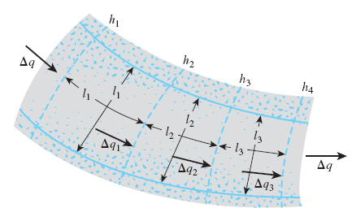
CURVILINEAR FLOW AND EQUIPOTENTIAL LINES
Now consider the case of curvilinear flow and equipotential lines (hence curved flow channel) as shown in the figure across.
Flow element
Case I: Square Elements (medians are equal)
1. Because there is no flow across the flow line, rate of flow through the flow channel per unit width perpendicular to the flow direction is the same, or
Δq₁ = Δq₂ = Δq₃ = Δq
2. The potential drop is the same and equal to:
Where h: head difference between the upstream and downstream sides.
N_{d}: number of potential drops.

Slide 34
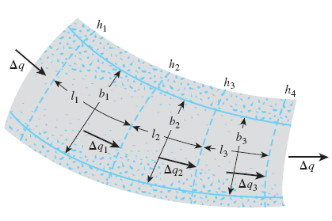
From Darcy’s Law, the rate of flow is equal to:
Note: Here we took the median lengths, for perfect square we have side lengths
If the number of flow channels in a flow net is equal to N_{f}, the total rate of flow through all the channels per unit length can be given by:
Eq. (***) ….same as Eq. (*)
Instead of thinking of perfect square, we always consider the most general curvilinear case and assuming equal median lengths.

Slide 35
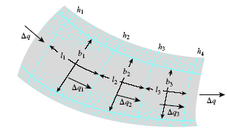

Case II: Rectangular Elements
Drawing of square elements is convenient but not always necessary
Alternatively, one can draw a rectangular mesh for a flow channel provided that the width-to-length ratios for all the rectangular elements in the flow net are the same
In this case the rate of flow through the channel is expressed as

Slide 36
SUMMARY
Case of unit depth (perpendicular to the paper)
Case when the width of the cross-section of the channel normal to the page is not UNITY.
Case of Square Elements (medians are equal)
Case of Rectangular Elements (medians are not equal)
. b

Slide 37
Example 1
If the horizontal cylinder of soil shown below has a coefficient of permeability of 0.01 cm/sec. Calculate the amount of flow through the soil.
According to rule of square mesh the height of the soil must equal 5 cm .and hence in the 3rd direction 2 cm

Slide 38
Example 2
If k = 10⁻⁷ m/sec, what would be the flow per day over a 100 m length of wall?
Solution
N_{f} = 5
N_{d} = 14
Δh = 45 m
k = 10⁻⁷ m/sec
q = 10⁻⁷ x 45x(5/14)x 100
= 0.000161 m³/sec
= 13.9 m³/day

Slide 39
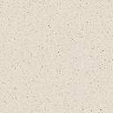
Calculation of Heads
Consider Point X
Total head = h - # of drops from upstream x Δh
Elevation head = -z
Pressure head = Total head – Elevation head
+ve
h
datum
concrete dam
H_{T} = 0
z
-ve
Δh
X
impervious strata

Slide 40
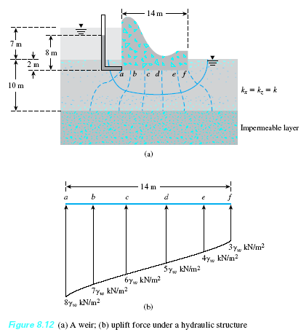

Example 3
Uplift pressure under hydraulic structures
N_{d} = 7 h = 7 m
Head Loss at each equipotential line = 7/7 = 1 m
Datum
h_{(a)} = 6 m, h_{(b)} = 5 m, ……h_{(f)} = 1m
Recall

Slide 41
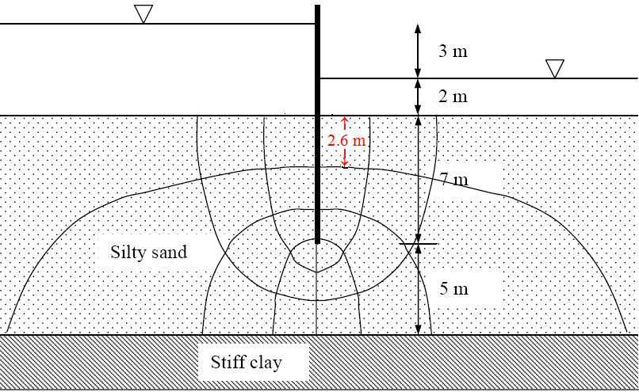
Example 4
A stiff clay layer underlies a 12 m thick silty sand deposit. A sheet pile is driven into the sand to a depth of 7 m, and the upstream and downstream water levels are as shown in the figure below.
k = 8.6x 10⁻⁶cm/sec
e =0.72
G_{s}= 2.65
Estimate
a) The seepage beneath the sheet pile in m³/day per meter.
b) What is the pore water pressure at the tip of the sheet pile?
c) Is the arrangement safe against piping? We will come back to this later.

Slide 42
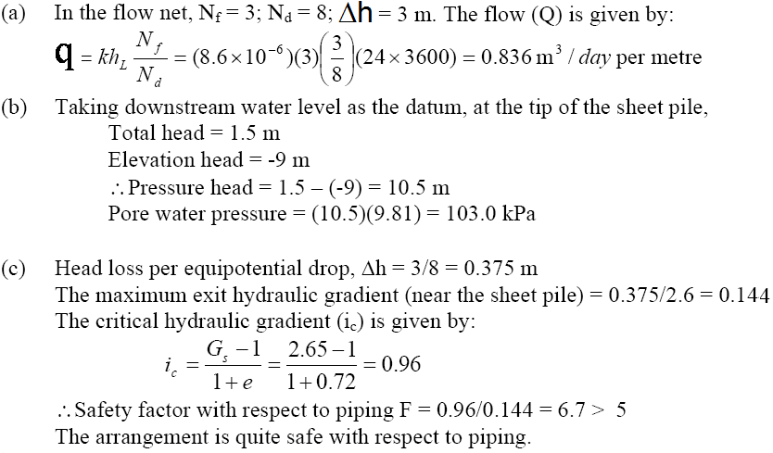
Solution
Let us try and take the datum at the bottom of the layer
Total head at the tip = 17-4x3/8 =15.5 m
Elevation head = 5 m

Slide 43
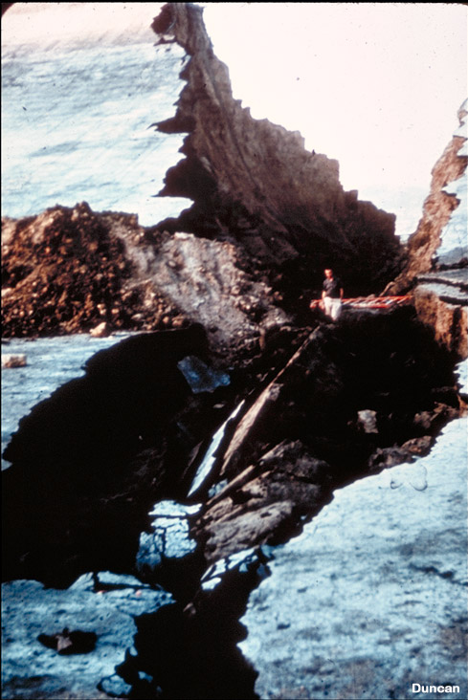
Piping Failures
Example
Baldwin Hills Dam was constructed between 1947 and 1951 and failed by piping in 1963.
The failure occurred when a concentrated leak developed along a crack in the embankment, eroding the embankment fill and forming this crevasse.
An alarm was raised about four hours before the failure and thousands of people were evacuated from the area below the dam.
The flood that resulted when the dam failed and the reservoir was released caused several millions of dollars in damage.

Slide 44
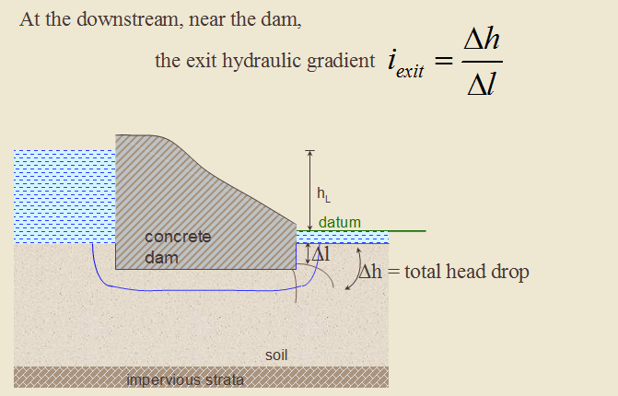

Exit hydraulic gradient, i_{exit}
Critical hydraulic gradient, i_{c}
The value of i for which the effective stress in the saturated system becomes ZERO!
The critical hydraulic gradient (i_{c}), is given by (See next Chapter)
Consequences:
no stress to hold granular soils together
∴ soil may flow ⇒
“boiling” or “piping” = EROSION

Slide 45
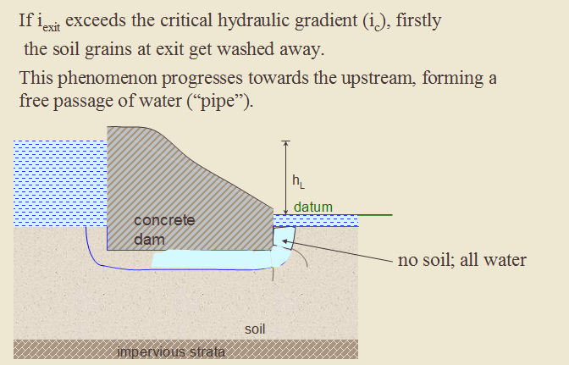
Typically 5 to 6
Factor against piping
Note: we use high value for the factor of safety because of the disastrous consequences of failure.

Slide 46
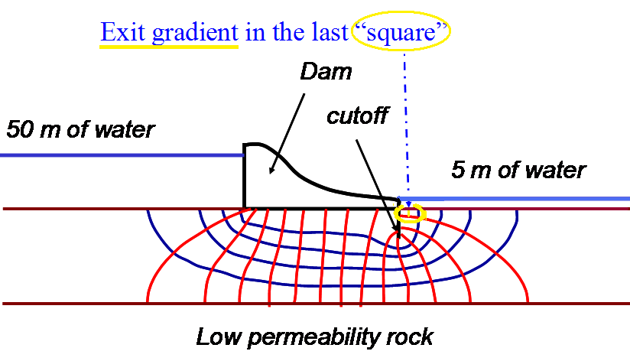
Example 2 (again)
Is the arrangement safe against piping?
[h / Nd] = 45/14 = 3.2 m head per drop
Average length of flow is about 3 m
I_{exit} = 3.2/3 ≈ 1.1
Recall
For most soils 0.9 < i_{c} < 1.1 with an average of 1.0.
F_{piping} = 1/1.1 ≈ 0.9
Very dangerous

Slide 47
Example 4 (again)
A stiff clay layer underlies a 12 m thick silty sand deposit. A sheet pile is driven into the sand to a depth of 7 m, and the upstream and downstream water levels are as shown in the figure below.
k = 8.6x 10⁻⁶cm/sec
e =0.72
G_{s}= 2.65
Required
c) Is the arrangement safe against piping?

Slide 48
Solution

Slide 49
Filter Design
As mentioned previously, piping and erosion are a possibility if, somewhere in the porous medium, the gradient exceeded the critical gradient.
Piping can occur any place in the system, but usually it occurs where the flow is concentrated.
When seepage water flows from a soil with relatively fine grains into coarser material, there is danger that the fine soil particles may wash a way into the coarse material.
Over a period of time, this process may clog the void spaces in the coarser material. Hence the grain-size distribution of the coarser material should be properly manipulated to avoid this situation.

Slide 50
There are several methods to control seepage and to prevent erosion and piping, one of which is to use a protective filter.
A properly designed coarser material is called a FILTER.
A filter consists of one or more layers of free-draining granular materials placed in less pervious foundation or base materials to prevent the movement of soil particles that are susceptible to piping while at the same time allowing the seepage water to escape with relatively little head loss.

Slide 51
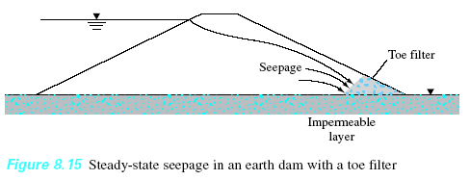
Filters used for:
  Facilitating drainage
  preventing fines from being washed away
Used in:
Filter Materials:
Earth dams
Granular soils
Retaining walls
Geotextiles

Slide 52
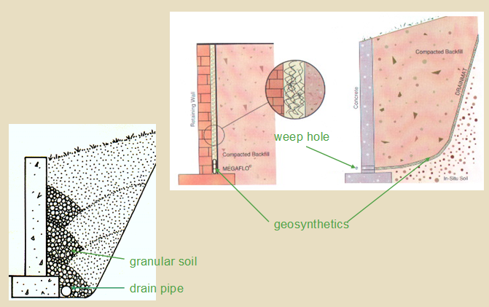
Drainage Provisions in Retaining Walls

Slide 53
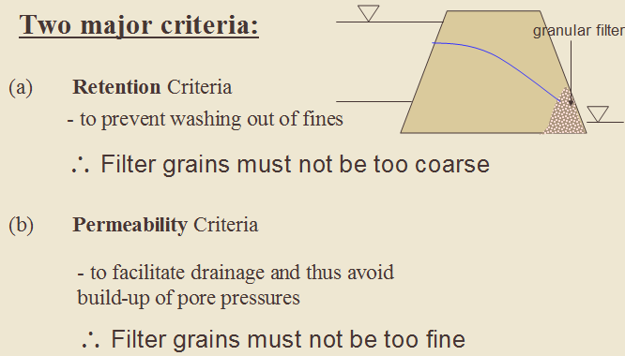

Slide 54

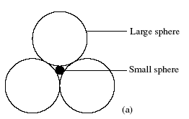
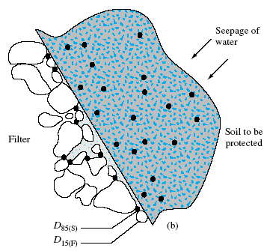


In selecting filter materials, two conditions shall be kept in mind:
The small sphere can move through the void spaces of the larger one
Terzaghi and Peck (1948)

Slide 55

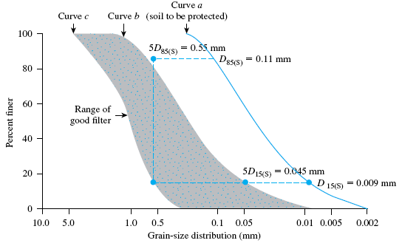

Slide 56
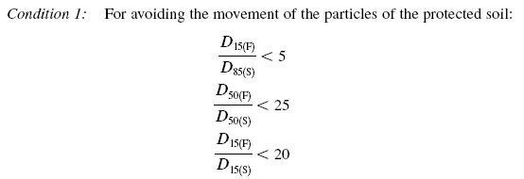


The US Navy (1948)
The following conditions are required for the design of filters:

Slide 57
