Slide 1
Introduction to Organic Chemistry
Course Number and Symbol:
108 Chem
Credit hours: (3+1)

Slide 2
What is Organic Chemistry?
Organic chemistry is defined as the study of carbons/ hydrogen containing compounds and their derivatives (containing other elements such as O, X and N).
Importance of Organic Compounds
The chemical substances that make up our bodies; are organic.
DNA: the giant molecules that contain all the genetic information for a given species.
proteins: blood, muscle, and skin.
Enzymes: catalyze the reactions that occur in our bodies.
Petroleum: furnish the energy that sustains life.
Polymers: Cloths, cars, plastic, kitchen appliances.
Medicine.

Slide 3
Chemical Bonds
When two atoms with large different electronegativity values:
Ionic Bonding
Ionic bonds form from the electrostatic attraction between oppositely charged ions.
Atoms become ionic by losing or gaining electrons from the atom it is bonding with.
Example: NaCl

Slide 4
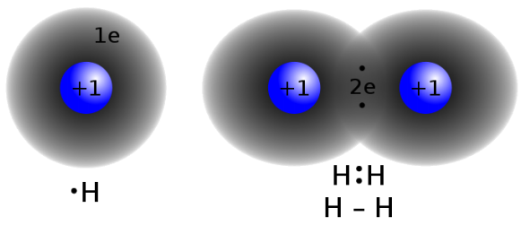
When two atoms with similar electronegativity values:
1) Covalent Bonding
A covalent bond is a form of chemical bonding that is characterized by the sharing of pairs of electrons between atoms
Example: H₂

Slide 5
When two atoms with different electronegativity values:
Polar Covalent Bonding
A polar covalent bond is one in which one atom has a greater attraction for the electrons than the other atom.
The electron cloud in a σ-bond between two unlike atoms is not uniform and is slightly displaced towards the more electronegative of the two atoms.
Example: HCl

Slide 6
Coordinate Covalent Bonding
There are molecules in which one atom supplies both electrons to another atom in the formation of covalent bond.
Example: Ammonium ion NH₄⁺

Slide 7
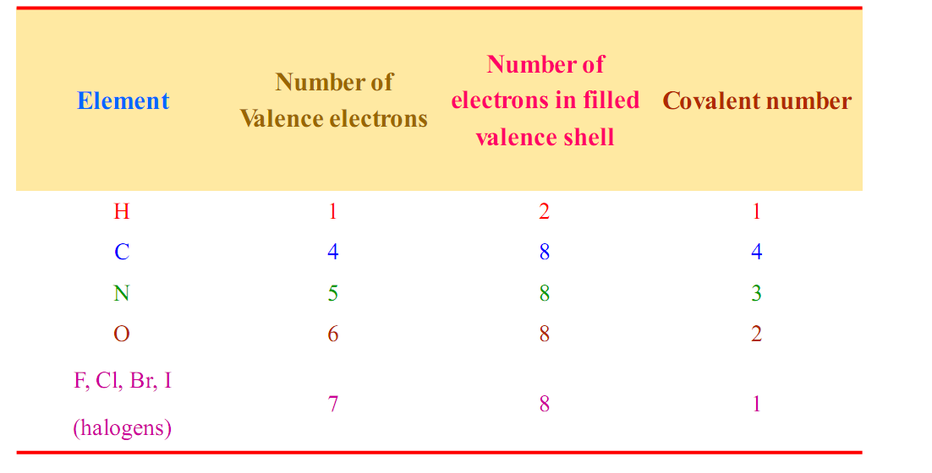
How Many Bonds to an Atoms?
Covalence Numbers of Typical Elements in Organic Compounds

Slide 8
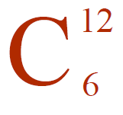
The Uniqueness of Carbon:
Carbon is unique among the elements for its ability
to bond with itself to form compounds of various sizes
and shapes as well as to bond with. many other elements
Carbon atom can form multiple bonds, long chains, side chains and cyclic chains.

Slide 9
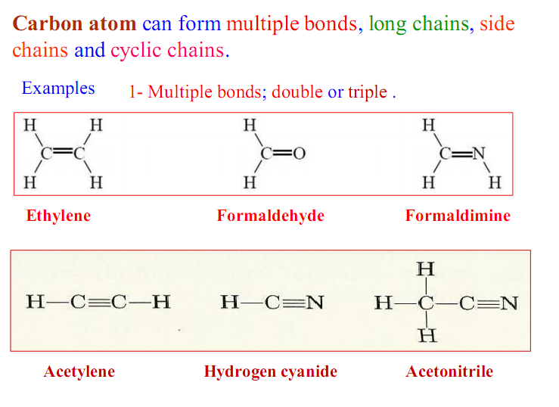
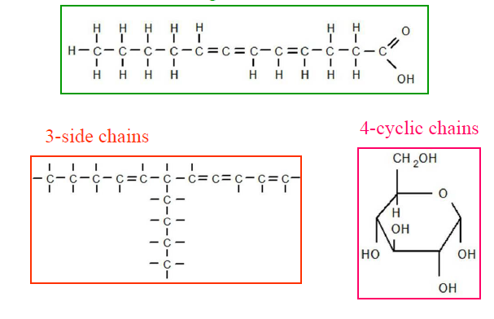
Examples:

Slide 10
Formula and Diagrams:
1- Molecular Formula
Examples:
The molecular formula of alkyne
The molecular formula of carboxylic acids

Slide 11
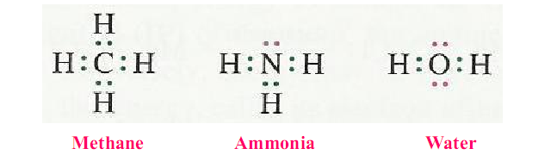
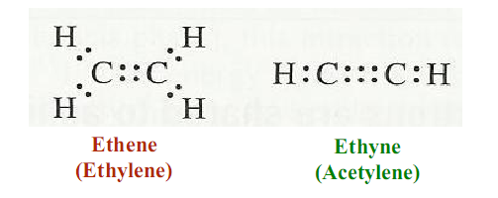
2- Electron Dot Diagrams (Lewis structure)
Examples

Slide 12
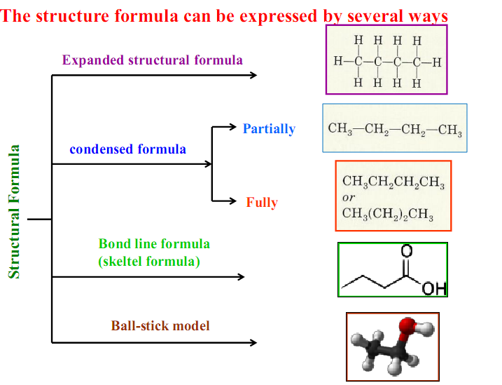
3- Structural Formula

Slide 13
Atomic Orbitals and their Shapes

Slide 14
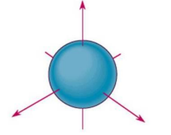
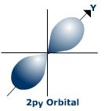
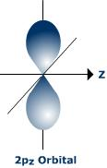
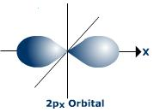
S-Orbital
P-Orbital

Slide 15
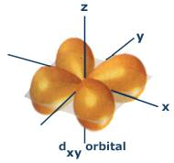
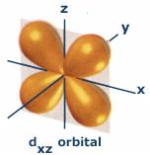
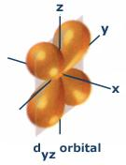
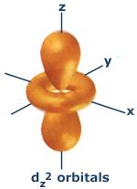
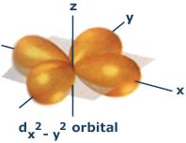
d-Orbital

Slide 16
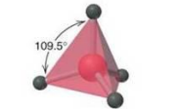
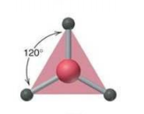
Molecular Orbital
A molecular orbital is formed when two atomic orbitals overlap
to generate a bond.
Types of Hybridization
Tetrahedral
sp²
Trigonal Planar
sp
Linear
sp³

Slide 17
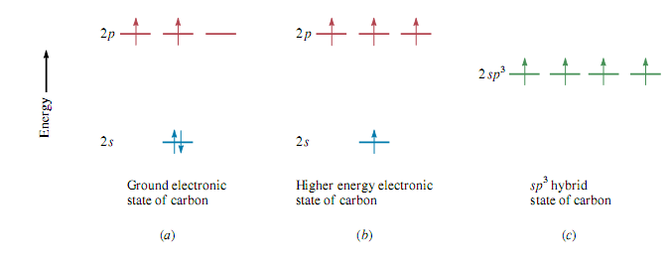
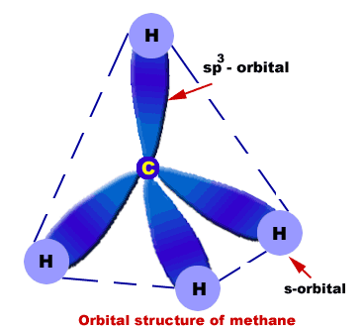
sp³ hybridization in Methane

Slide 18
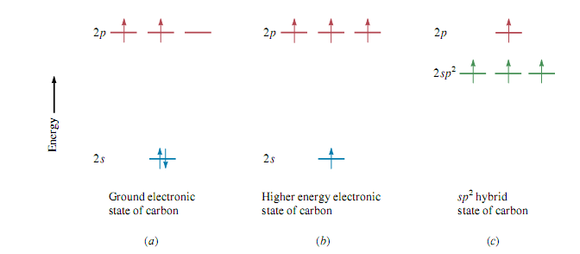
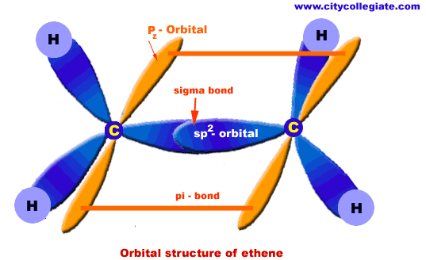
sp² hybridization in Ethene

Slide 19
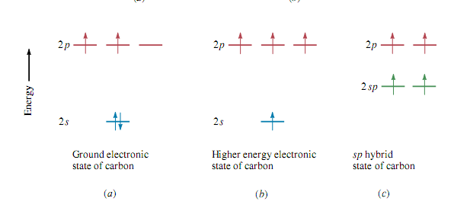
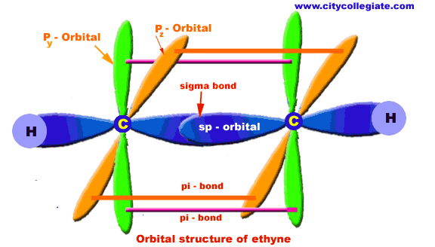
sp hybridization in Ethyne

Slide 20
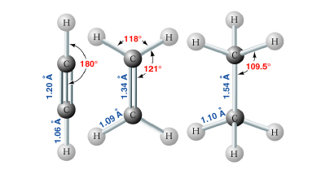
Bond lengths of Ethyne, Ethene, and Ethane

Slide 21
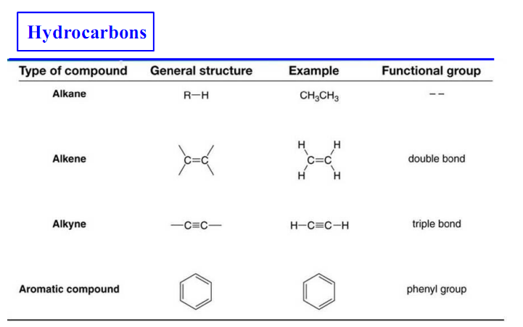
Functional Groups
Functional groups – special groups of reactive atoms that carry out chemical reactions in many organic compounds.

Slide 24
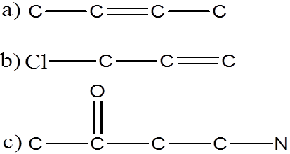
Homework
1- Given the skeletal structure, and assuming that only hydrogen atoms are missing, draw the correct expanded structural formula, condensed structural, and molecular formula for each of the following.
2- Draw the structural formula for the following:
C₂H₆ C₂H₄ C₂H₂ C₆H₆
3- a) One alcohol and one ether correspond to C₂H₆O. Draw their structures.
b) One carboxylic acid and one ester correspond to C₂H₄O₂. Draw their structures.
c) One aldehyde and one ketone correspond to C₃H₆O. Draw their structures.

