Slide 1
Chem. 108
Unsaturated Hydrocarbons II:
Dienes and Alkynes
Chapter 4

Slide 2
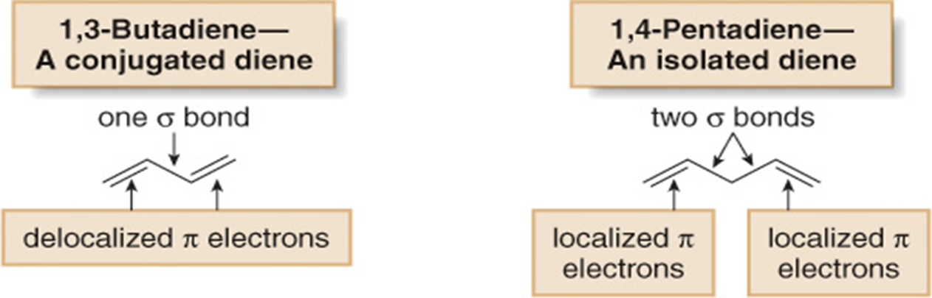
Dienes
Structure and Nomenclature of Dienes
ene
adiene
1,2-Butadiene
A cumulted diene
An allene

Slide 3
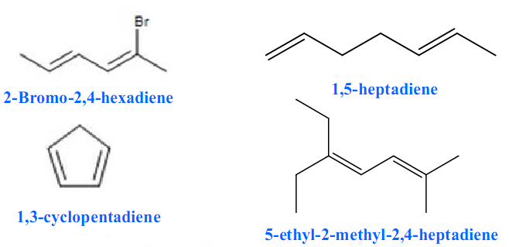
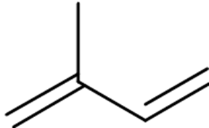
Examples:
2-methyl-1,3-butadiene (isoprene)

Slide 4
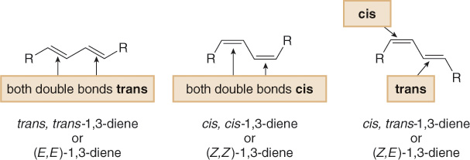
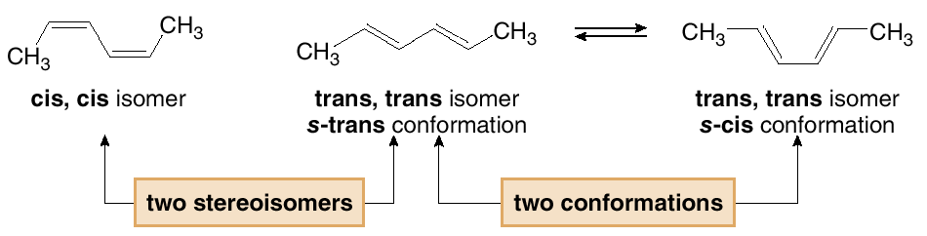
Geometric Isomerism in Diene

Slide 5
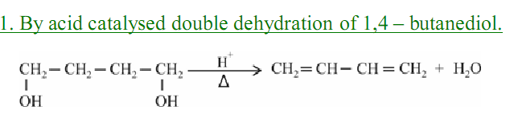
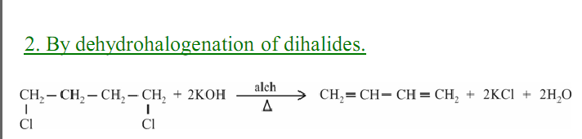
Preparation of Dienes
1- By acid catalyzed double dehydration
2- By dehydrohalogenation of dihalides

Slide 6
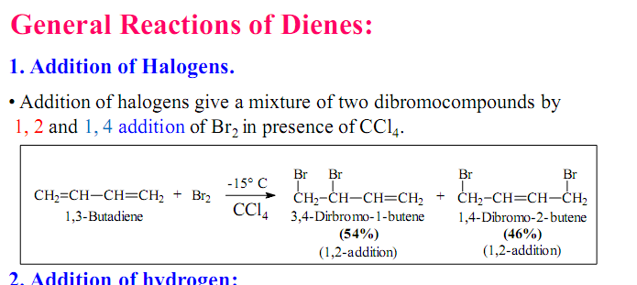


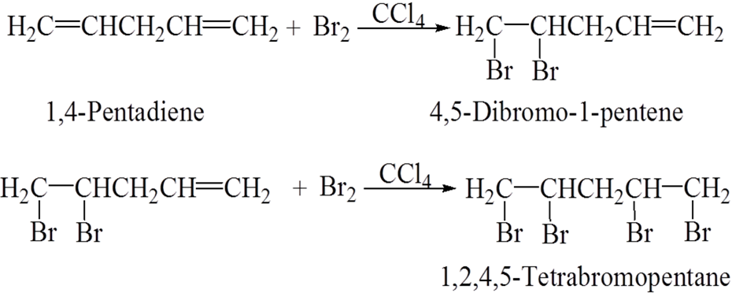
Reactions of Dienes
1- Addition of Halogens

Slide 7
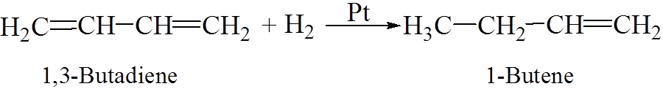
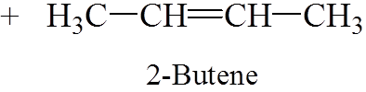
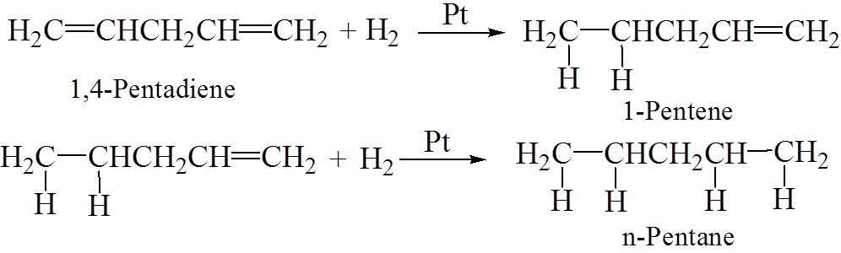
2- Addition of Hydrogen

Slide 8
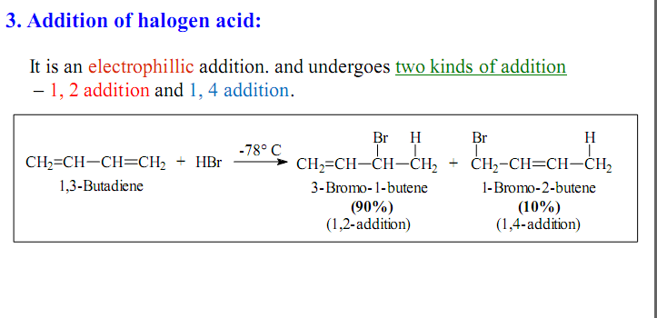
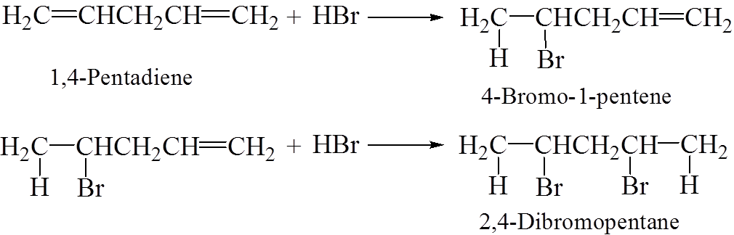
3- Addition of halogen acid

Slide 9
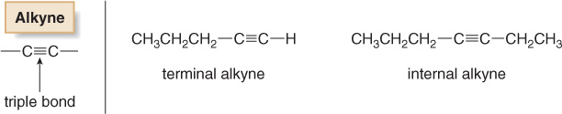
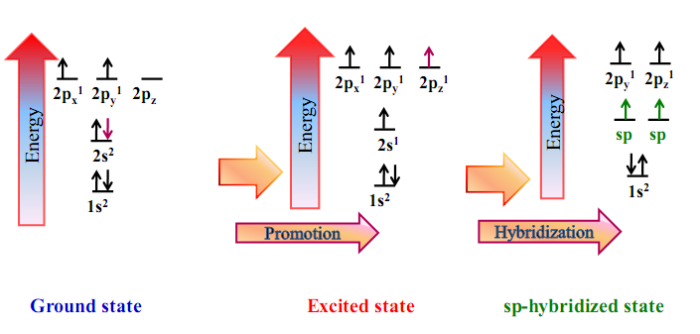
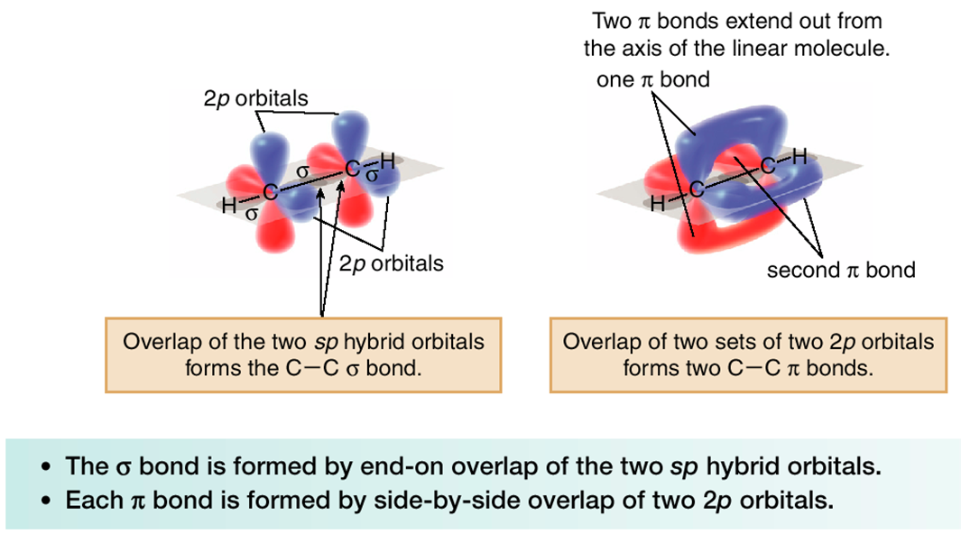
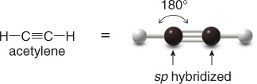
Alkynes
C_{n}H_{2n-2}
Crabon-carbon triple bond
Hybridization in Alkynes:
=

Slide 10
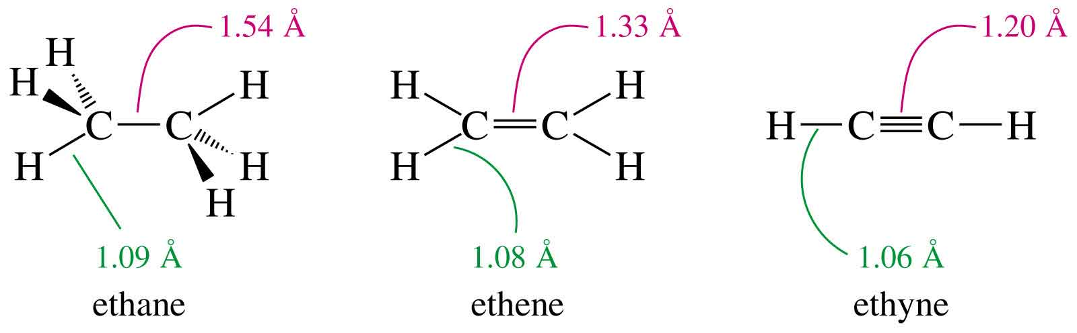
The comparative between alkane, alkene and alkyne:
109.5°
120°
180°
sp³
sp²
sp
Tetrahedral
Trigonal planar
Linear

Slide 11
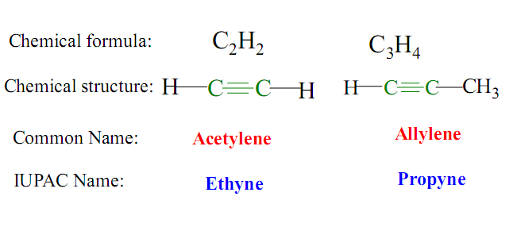
Nomenclature of Alkynes
ane
yne
The simplest alkyne:
Common Names: Named as substituted acetylene.
Methylacetylene
Isobutylisopropylacetylene

Slide 12
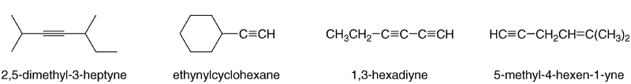
Examples:
4-methyl-1-hexen-5-yne
The two-carbon alkyl group derived from acetylene is called an ethynyl group.

Slide 13
Terminal and Internal alkynes
Physical Properties
C₁-C₄
gases
C₅-C₁₈
liquids
More than C₁₈
solids
Alkynes are nonpolar compounds. Thus alkynes are soluble in
the nonpolar solvents such as carbon tetrachloride (CCl₄) and
benzene (C₆H₆), but they are insoluble in polar solvents such as water.

Slide 14
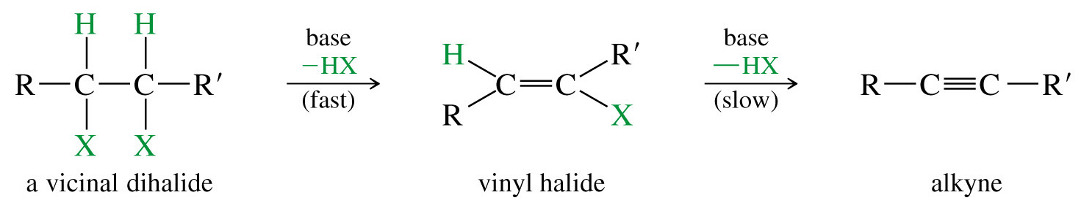
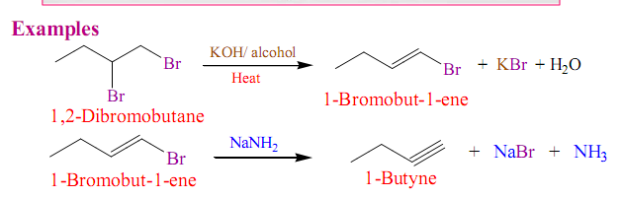
Preparation of Alkynes
1- Dehydrohalogenation of Alkyl Dihalides
Example:

Slide 15
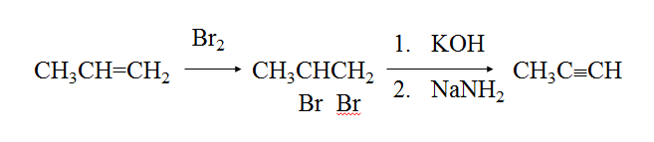
X₂
1. KOH
alkene
vicinal dihalide
alkyne
2. NaNH₂
Example:

Slide 16
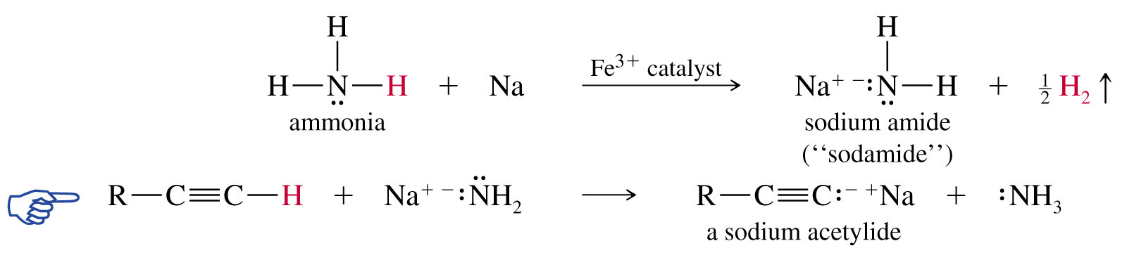
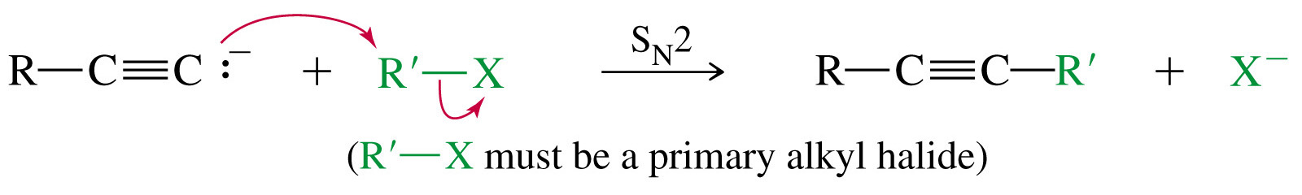
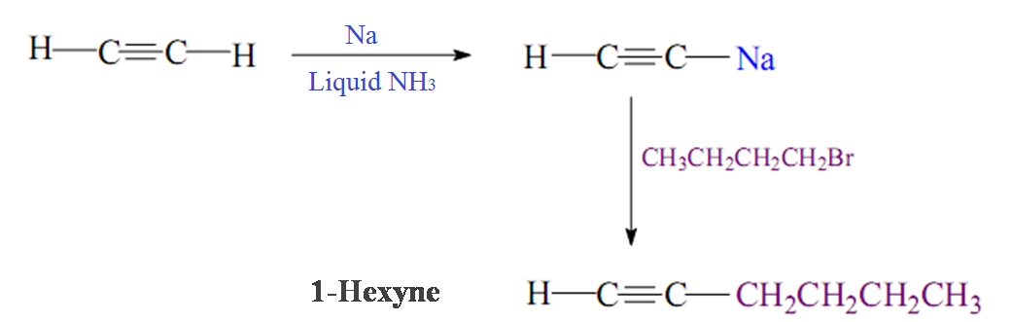
2- Reaction of Sodium Acetylide with Primary Alkyl Halides
Example:

Slide 17
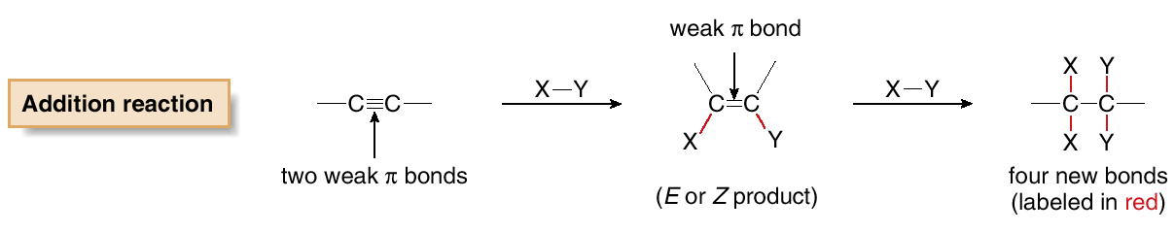
Reactions of Alkynes
Addition Reaction

Slide 18
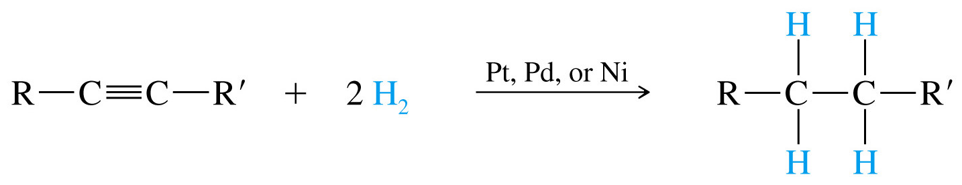
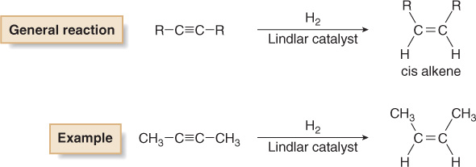
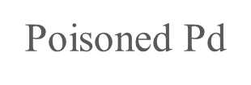
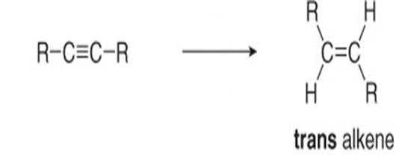


1- Addition of Hydrogen (Reduction)
A)
B)
C)

Slide 19
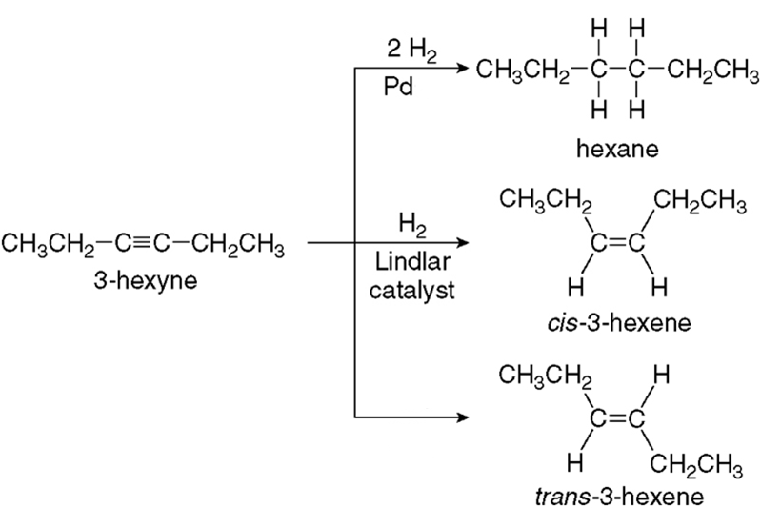
Examples:

Slide 20
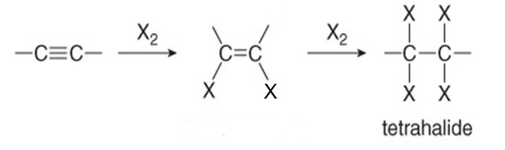
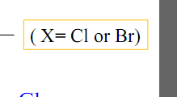
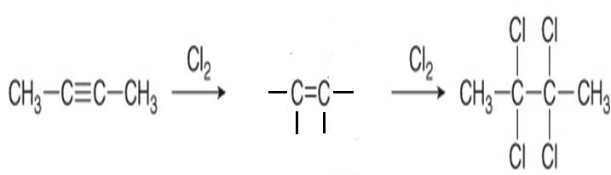


2- Addition of Halogen: Halogenation
Examples:

Slide 21
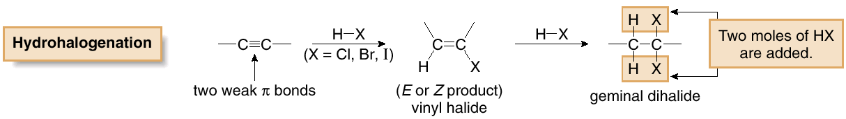
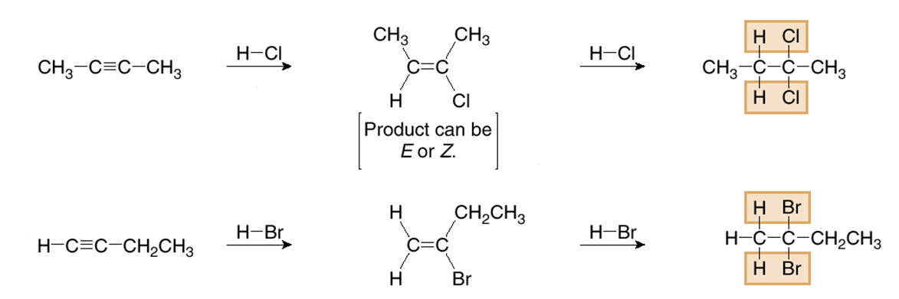
3- Addition of Hydrogen Halide: Hydrohalogenation
HX = HI, HBr, HCl
Markovnikov addition
Examples:

Slide 22
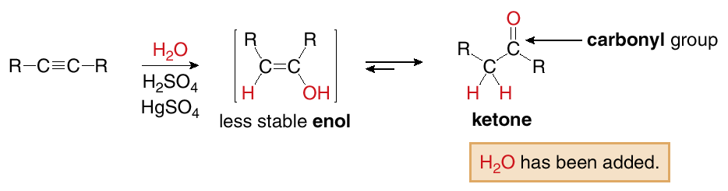
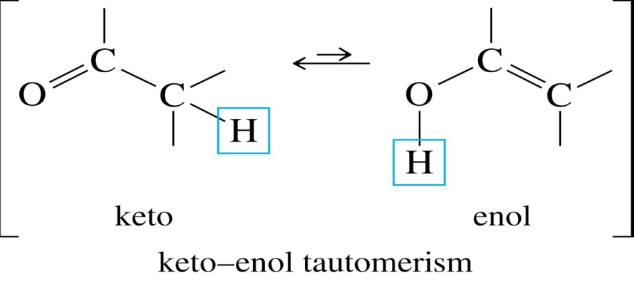

4- Addition of Water : Hydration
Markovnikov addition

Slide 23
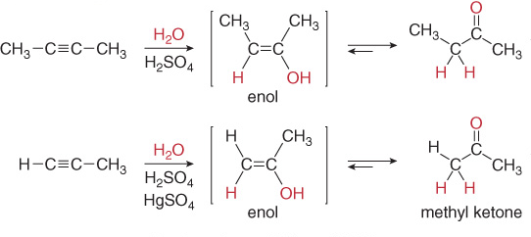
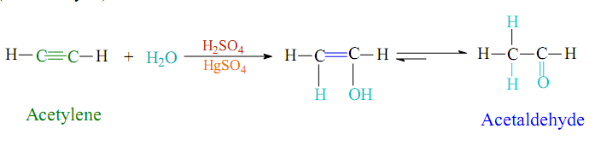
Examples:

Slide 24
Homework
1- Write the structures of the following compounds.
2-Methyl-2,5-heptadiene
2-Methyl-1,3-cyclopentadiene
3,3-Dimethyl-1-butyne
4-Bromo-1-hexen-5-yne
2- Name the following compounds.
3- Draw the structures of the product(s) for each reaction.
a) Br₂ in CCl₄ to 2,4-hexadiene
b) H₂O, H⁺ to 2,4-hexadiene
c) HCl to 1,4-cyclohexadiene
d) H₂O, H₂SO₄, HgSO₄ to 1-pentyne (Draw the enol and keto forms)

Slide 25
4- starting with 1-pentene, show how you would synthesize 1-pentyne.
5- starting with acetylene, show how you would synthesize the following compounds.
a) 2-Pentyne
b) Ethane
c) cis-3-hexene
d) 2,2-Dibromobutane

