Slide 1
Non Communicable Diseases
Osama A Samarkandi, PhD, RN
EMS 313; Public Health for EMS Professionals

Slide 2
Non Communicable Disease (NCD)
A non-communicable disease, or NCD, is a medical condition or disease which by definition is non-infectious and non-transmissible among people.
Noncommunicable diseases (NCDs), also known as ‘diseases of the riches’ or chronic diseases. They are of long duration and generally slow progression.
The four main types of noncommunicable diseases are cardiovascular diseases (like heart attacks and stroke), cancers, chronic respiratory diseases (such as chronic obstructed pulmonary disease and asthma) and diabetes.

Slide 3
Types of Non Communicable Diseases (1 of 2)
Type
Causes/Risk Factors
Examples
Present since birth (Inherited)
Diseases that are caused by hereditary factors or that result from problems during a baby’s development or birth
Cystic fibrosis
Sickle-cell anemia
Cerebral palsy
Behavioral
Diseases to which unhealthful behavior choices often contribute (i.e., eating high-fat foods; being physically inactive; using tobacco, alcohol, or other drugs; failing to manage stress properly)
Many types of heart disease
Most cases of lung cancer
Cirrhosis of the liver

Slide 4
Types of Non Communicable Diseases (2 of 2)
Type
Causes/Risk Factors
Examples
Diseases that are caused by exposure to specific substances in the environment or to environmental hazards, such as pollution, toxic wastes, and secondhand smoke
Some types of allergies
Lung cancer caused by breathing in asbestos particles
Respiratory diseases caused by breathing in certain substances in polluted air
Environmental
Unknown
Diseases whose causes are unknown
Alzheimer’s disease
Rheumatoid arthritis
Chronic fatigue syndrome

Slide 5
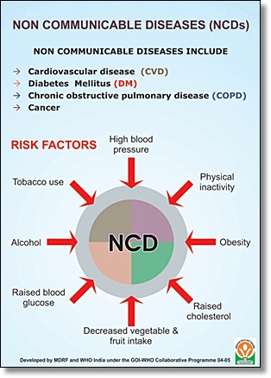

Slide 6
Non Communicable Diseases
1- NCDs account for 63% of all deaths.
2- 80% of NCDs deaths occur in low- and middle-income countries.
3- More than nine million of all deaths attributed to noncommunicable diseases (NCDs) occur before the age of 60.
4- Around the world, NCDs affect women and men almost equally
5- NCDs are largely preventable by means of effective interventions that tackle shared risk factors, namely: tobacco use, unhealthy diet, physical inactivity and harmful use of alcohol.
6- NCDs are not only a health problem but a development challenge as well.
7- One and a half billion adults, 20 and older, were overweight in 2008.
8- Nearly 43 million children under five years old were overweight in 2010.
9- Tobacco use kills nearly six million people a year.
10- Eliminating major risks could prevent most NCDs.

Slide 7
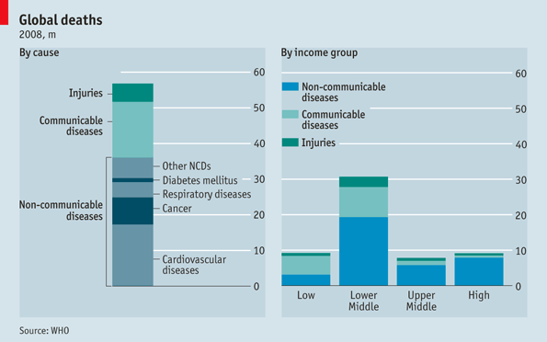
Global Statistics

Slide 8
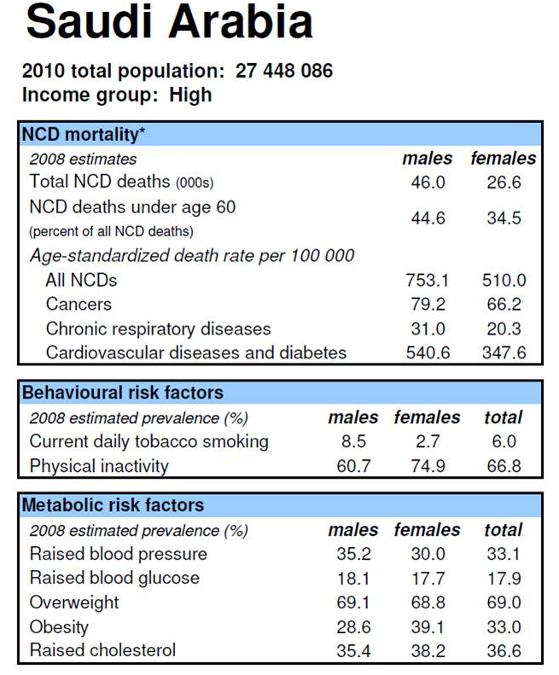
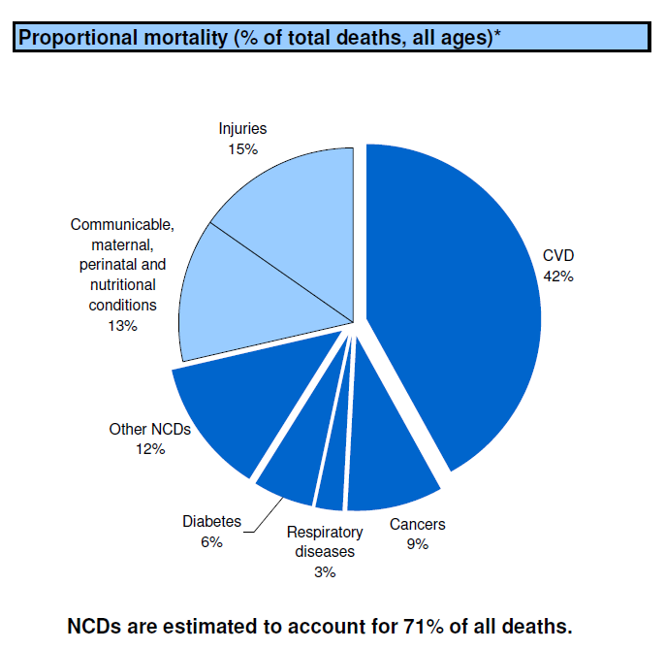

Slide 9
WHO
“By 2020 it is estimated that
non-communicable disease will account for 73% of all deaths”

Slide 10
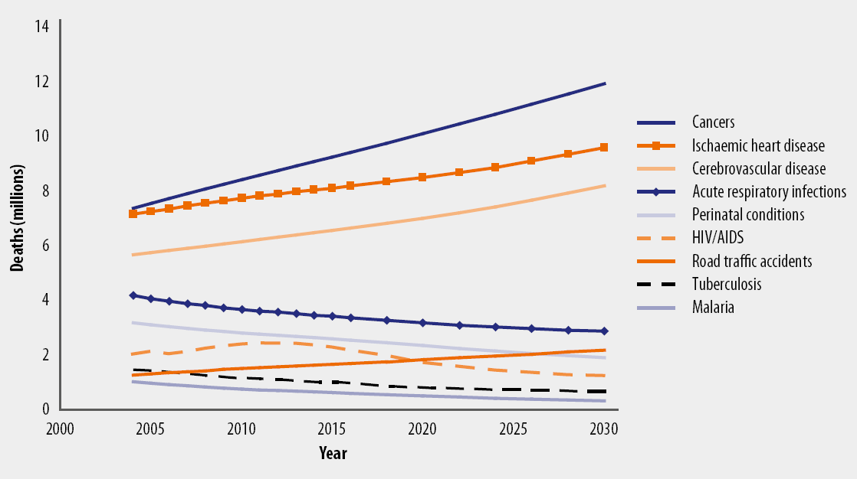
Projected global deaths for selected causes, 2004–2030

Slide 11
Decline in proportion of total mortality due to infectious diseases England & Wales, 1911-94, by age
Males
Females
1-14
25-44
45-64
65-74
Notes:
Here we see the decline over time in the proportion of mortality at different ages attributable to infections ranging from tuberculosis to diuphtheria, measles and gastro-intestinal infections.
The downward spike in 1918 is because most excess deaths were from pneumonia rather than “influenza”. Rates of pneumonia were much lower than those for infectious diseases either side of the 1918 Spanish flu – making up less than 10% of all deaths among those aged
The sharp decline mid-century is not well understood and is under-researched. The precise role of the introduction and use of anti-biotics is important question.. Mackenbach’s work suggesting that this played a role in the Netherlands at least.
With the decline of infectious diseases life-expectancy in particular becomes more strongly related to the influence of individual behaviours. This is apparent with the widening gap in male to female life-expectancy over the 20th Century which rose from 4 years in 1900 to a peak of just over 6 years in the late 1960s.

Slide 12
General Directorate of NCD in KSA (1 of 2)
In Saudi Arabia the system for NCD risk factor Surveillance has been planned as a cooperative program between Ministry of Health (represented by General directorate of NCD, and Field Epidemiology Program), King Faisal Specialist Hospital & Research Center and WHO.

Slide 13
General Directorate of NCD in KSA (2of 2)
The system consists of three major parts: community based data collection on major risk factors, data base infrastructure and data analysis work force. The system is now well in place and data collection and data entry is almost finished. Data analysis will be carried out within a few months and data can be fed into the WHO global InfoBase in the near future.

Slide 14
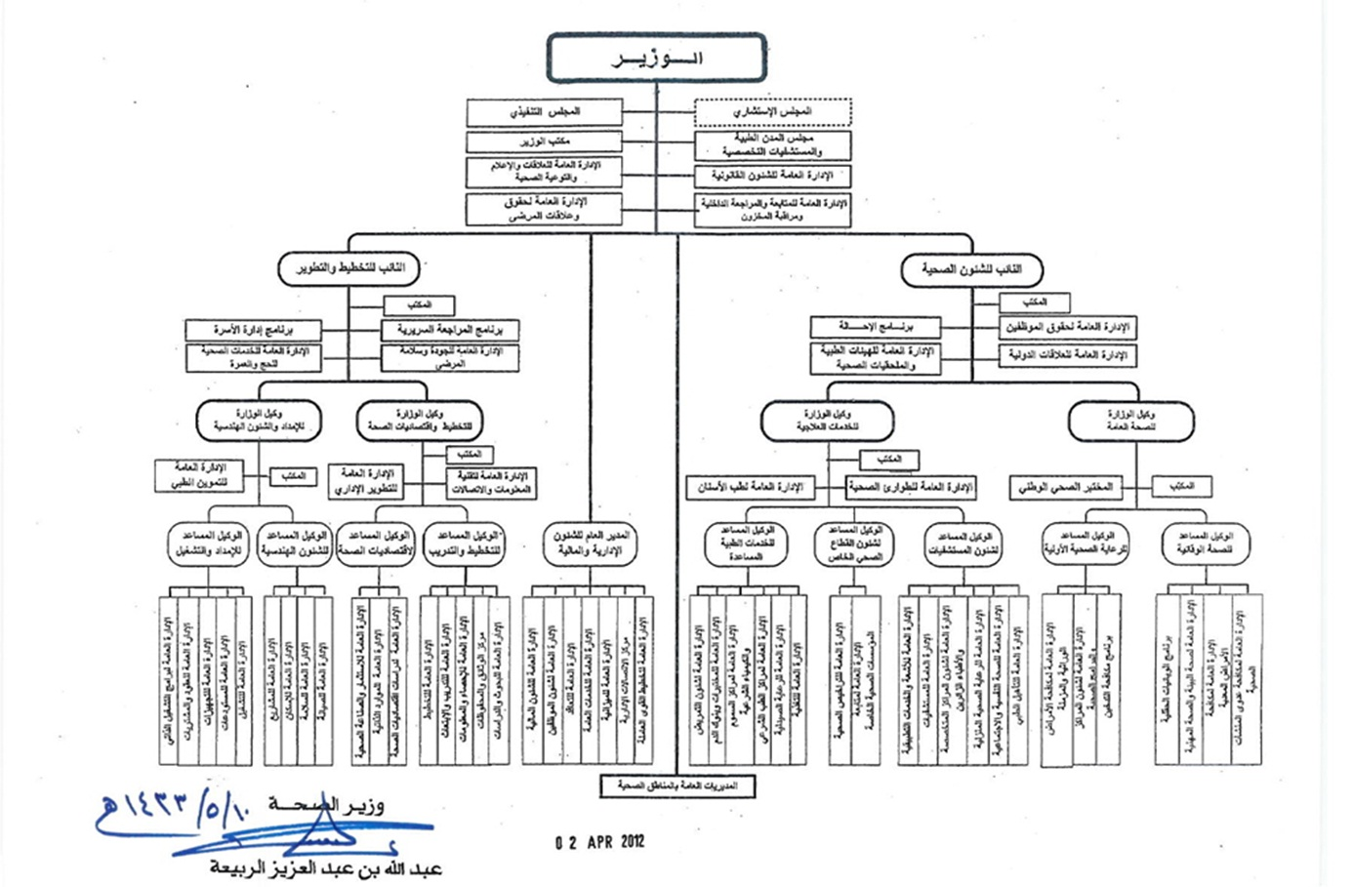
Establishment of Directorate of Non Communicable Disease under Assistant Deputy Minister for Preventive Medicine

Slide 15
NCDs Strategic Objectives & Responsibilities
Primary and Secondary Prevention of NCDs
Planning NCDs policies and control measures
Stakeholders Collaboration
Patient Empowerment Programs
Capacity Building for Health Professionals
Surveillance of NCDs
Research and Information Systems
Health Promotion: Enhancement of Community Participation

Slide 16
Prioritization of NCDs Programs
Most Prevalent Diseases that poses a Public Health Problem
Diabetes
Cardiovascular Disease
Cost Effectiveness
Preventable diseases with proved measures in other countries
Curable diseases by early detection

Slide 17
Non Communicable Disease Prevention Programs in Kingdom of Saudi Arabia
Diabetes Control and Prevention Program
Cancer Prevention Program
Food and Physical Activity Program
Cardiovascular Diseases Prevention Program
The Healthy Marriage Program
Early Screening Program for the New Born
The Crown’ Health Prevention Program
The Prevention of Accidents and Injuries
Prevention of Chronic Respiratory Diseases
Osteoporosis Program
Blindness Program

Slide 18
Mile Stones of the NCDs Directorate during 2012 - 2013
Completion of WHO – Steps Survey 2012 - 2013
Diet and Physical Activities (DPAs) by integration of Stakeholders collaboration
Implementation of related legislations (Prohibition of Smoking in Closed Areas)
Improving early detection of NCDs by national screening programs (diabetes, cancer, osteoporosis e.t.c)
Integrated Electronic Information System for NCDs

Slide 19
Questions
?

