Slide 1
Behavior Change: Patient to Patience
Osama A Samarkandi, PhD, RN
EMS 313; Public Health for EMS Professionals

Slide 2
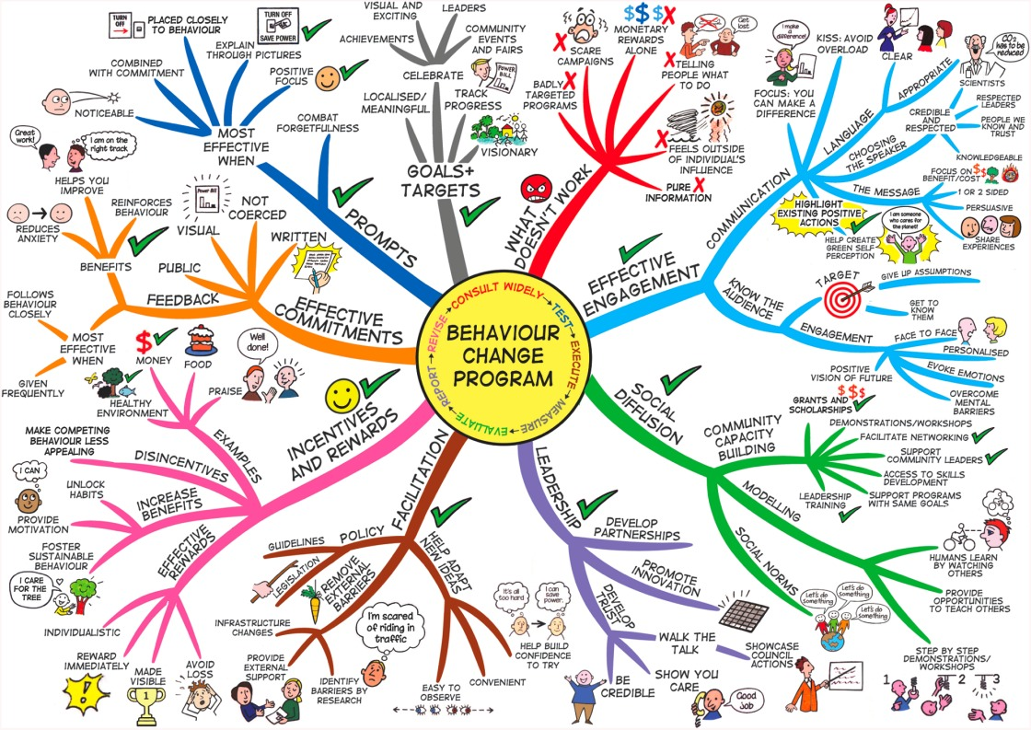

Slide 3
Outline of Presentation
Behaviour Change
Behavior and public health
Determinants of behavior
Stages of behaviour change
Behaviour change process
Enabling factors
Channels of communication
Myths and facts regarding behaviour change
Conclusions

Slide 4
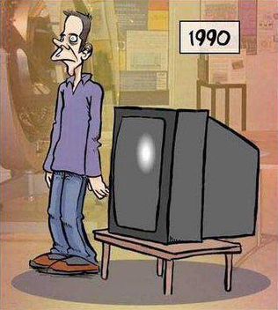
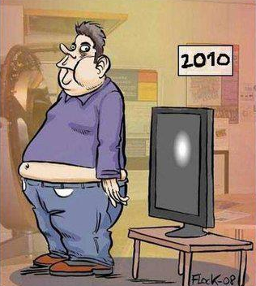
Behavior Change …1
List the important changes in the pictures ???

Slide 5
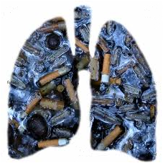
Behavior Change…2
Today its me, because of u... Tomorrow its u, because of me...
Fully burnt Cigarette ASH
Smokers Lung
Quit smoking... Tar the roads... NOT your LUNGS!

Slide 6
Behavior Change…3
Increased interest of behaviour change in different fields with the hope that understanding it will improve the services offered
Health
Education
Criminology
Energy
International development
Behavioral change theories have gained recognition in health for their possible effectiveness in explaining health-related behaviors and providing insight into methods that would encourage individuals to develop and maintain healthy lifestyles

Slide 7
Behavior Change…4
Different terms used for behaviour change
Strategic Behavioral Communication (SBC)
Information, Education, Communication (IEC)
Communication for Social Change (CSC)
Behaviour change communication (BCC)

Slide 8
Behavior Change …5
Many theories exist for Behaviour change, the most prevalent are
Learning theories
Social Cognitive Theory
Theories of Reasoned Action and Planned Behaviour
Trans-theoretical Model
Health Action Process Approach

Slide 9
Outline of Presentation
Behaviour Change
Behavior and public health
Determinants of behavior
Stages of behaviour change
Behaviour change process
Enabling factors
Channels of communication
Myths and facts regarding behaviour change
Conclusions

Slide 10
Behavior Public Health
Fortunately, human beings have, in theory, control over their conduct
Smoking
Non communicable diseases such as (NCDs)
Diabetes
Obesity
Hypertension,
Cancers, etc.
Alcohol
Dietary
Behaviours
Diseases
Physical Activity
Behaviour Change
Sexual Activity
HIV, STD, Hepatitis
Healthy life
Substance abuse
Mental Disorders
Rash Driving
Road Traffic Accidents
Health-compromising behaviors can be eliminated by self-regulatory efforts, and by adopting health-enhancing behaviors

Slide 11
Outline of Presentation
Behaviour Change
Behavior and public health
Determinants of behavior
Stages of behaviour change
Behaviour change process
Enabling factors
Channels of communication
Myths and facts regarding behaviour change
Conclusions

Slide 12
Determinants of health related behavior
Individual
Family
Gender Roles
Culture religion
Income
Social Status
Community
Media
Services
Policy

Slide 13
Outline of Presentation
Behaviour Change
Behavior and public health
Determinants of behaviour
Stages of behaviour change
Behaviour change process
Enabling factors
Channels of communication
Myths and facts regarding behaviour change
Conclusions

Slide 14
How to change behaviour ??? Five stages of behaviour change
Stage 5
Maintenance
Stage 1
Precontemplation
Stage 4
Action
Stage 2
Contemplation
Stage 3
Preparation

Slide 15
Stages of Behavior change… Diabetes
Stage 1
Precontemplation
Stage 2
Contemplation
Stage 3
Preparation
Stage 4
Action
Stage 5
Maintenance
I don’t have disease …..
I am no more Happy… I am worried… I am having Diabetes
I am ready to change
I am doing…
I will continue to do….
Why should
I change ????
I want to LIVE... I will save myself
Prevention is better then cure
Learn regarding healthy practices
Filter facts from Myths
Doctor calling
Dietary changes
Physical activity
Regular medicines
Positive re-enforcement, Negative re-enforcement and awarding
Opinion leader

Slide 16
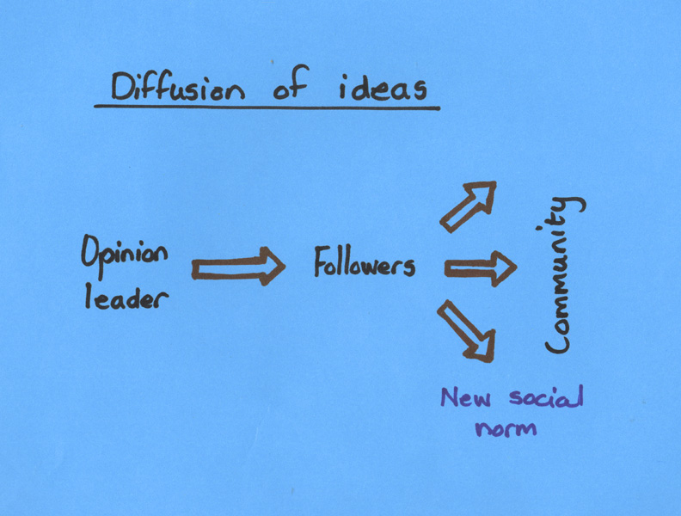
Diffusion of Ideas Model
People are more likely to adopt a new behavior when someone they respect or admire endorses the behavior:
Opinion leaders influence an initial group
New social norm is established
Rest of community follows (Social conformation)

Slide 17
Outline of Presentation
Behavior Change
Behavior and public health
Determinants of behavior
Stages of behaviour change
Behaviour change process
Enabling factors
Channels of communication
Myths and facts regarding behaviour change
Conclusions

Slide 18
Behavior Change Process
Stages of change continuum
Channels
Enabling factors
Unaware
Aware
Concerned
Knowledgeable
Motivated to change
Trial behaviour change
Sustained behaviour change
Mass media
Community networks and traditional media
Interpersonal/group communication
Effective communication
Enabling environment
User friendly services and accessible commodities

Slide 19
Outline of Presentation
Behaviour Change
Behavior and public health
Determinants of behavior
Stages of behaviour change
Behaviour change process
Enabling factors
Channels of communication
Myths and facts regarding behaviour change
Conclusions

Slide 20
Myths and facts about behavior change
Myths
Facts
Change is motivated by fear
People go into denial of the bad things that might happen to them
Crisis is a powerful impetus for change
To achieve sustainable results, it takes time.
Regular reinforcements are needed
We can't change because our brains become "hardwired" early in life
Majority of patients don't sustain changes in the unhealthy lifestyles that worsen their disease
Change for better is always difficult to make
Behaviour change methods don’t yield adequate results
We can continue learning complex new things throughout our lives
Change in behavior is not sustained
Behaviour addressed should be the “felt need” of the people targeted
Community involvement is important for success of any change process

Slide 21
Behavior change is a continuous process
It involves strong community participation
Refutes myths and corrects misunderstanding
Social norms and public policies influence behavior change. A strategic shift must be also be attempted simultaneously.
BCC often complements and supports other prevention strategies and approaches

Slide 22
Outline of Presentation
Behaviour Change
Behavior and public health
Determinants of behavior
Stages of behaviour change
Behaviour change process
Enabling factors
Channels of communication
Myths and facts regarding behaviour change
Conclusions

Slide 23
Stepped approach to change
A journey of a thousand miles begins with a single step

Slide 24
Questions
?

