Slide 1
Environmental Health
Osama A Samarkandi, PhD, RN
EMS 313; Public Health for EMS Professionals

Slide 2
Overview
What is an Industrial Hygienist?
What is OSHA?
Why is the Young Worker Special?
Applying OSHA: Office Health & Safety
Questions?

Slide 3
What is an Industrial Hygienist?
A highly qualified, science-oriented professional who anticipates, recognizes, evaluates, and controls hazardous exposures
These exposures can occur in work and home-related environments
Industrial hygiene is also an art that involves judgment, creativity, and human interaction

Slide 4
Introduction to OSHA
Occupational Safety and Health Administration
Created in 1970 by Occupational Safety and Health Act to ensure “safe and healthy work environment”
Intended to help employers and employees reduce job-related injuries, illnesses, and deaths

Slide 5
Without OSHA, Prior to 1970
More than 14,000 worker deaths annually
2.5 million workers disabled by work-related injuries
Estimated 300,000 cases of work-related illness

Slide 6
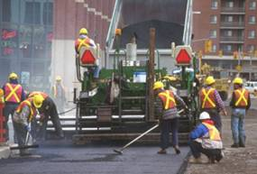
OSHA Success
Since 1970
Work-related fatalities cut by more than 60 percent
Overall injury and illness rate down by 42 percent

Slide 7
OSHA’s Inspection Priorities
Imminent danger (prevents accident occurring from “likely danger”)
Fatalities and catastrophes (controls damage after accident )
Complaints and referrals (addresses potential “near-misses”)
Programmed inspections (ensures proactive compliance)
Follow-up inspections (ensures safeguard previously omitted in place)

Slide 8
Special Considerations Regarding the Young Worker
What Makes the Young Worker Different?

Slide 9
Young Workers Get Hurt When:
They don’t have appropriate supervision
They perform jobs for which they are not trained – sometimes without being asked
They work with dangerous tools or equipment
They are required to perform tasks that violate youth employment laws
Notes:
Young workers are often eager to please and will attempt to perform tasks for which they have not received training, or even been asked to do.
Young workers may seem confident and responsible, and therefore not supervised as closely as they need to be.
On the other hand they may be asked or required to work with dangerous tools or equipment, performing tasks that violate child labor provisions of the Fair Labor Standards Acts

Slide 10
Some NYS Teen Prohibited Jobs
What jobs are workers under 18 not permitted to do?
Work in wrecking, demolition, excavation, roofing
Work in meat-packing or slaughtering
Operate powered equipment (saws, slicers, compactors)
Work where there is exposure to radiation
Work in mining, logging, or a sawmill
www.labor.state.ny.us/workerprotection/laborstandards/workprot/stprhboc.shtm
Notes:
Let’s look at a portion of the Child Labor Provisions of the Fair Labor Standards Act for Nonagricultural Occupations for some examples of what is not allowed….
Hazardous occupations include roofing, coal mining, driving motor vehicles at work are not allowed for anyone under age 18.
For the worker under ages 14 & 15, work is never never allowed during school hours and limited to no more than 3 hours per day.
Prohibited tasks include operation of power driven hoisting equipment, i.e., forklifts, power driven meat slicers, including those used in restaurants or delicatessens, power driven woodworking machines for all workers under age 18. Driving is not allowed, except in strictly limited circumstances, and then only if the worker is at least 17 years of age.
Employers may be under the mistaken belief that compliance with OSHA regulations is all they need to worry about, especially if young workers are rare in the work setting
According to the Institute of Medicine Report : Protecting Youth at Work, state and federal regulators report that ignorance of child labor laws is common among employers, as well as health care providers who treat adolescents.
Several studies suggest that illegal work may be a contributing factor to the large numbers of teens injured or killed on the job (Castillo, Davis, Wegman, 1999). One review of fatalities found this to be the case in 80% of the cases (Dunn & Runyan, 1993 as cited by Rowlett, Fairchild, & Rowlett, 2001)
References:
Castillo, D. N., Davis, L. & Wegman, D. H. (1999). Young workers. Occupational Medicine: State of the Art Reviews, Vol. 14, No. 3, July-September 1999.
Rowlett, J. D., Fairchild, V. R., & Rowlett, J. D. (2001). Adolescents and the workplace. Adolescent Medicine, vol. 12, No. 3, October 2001.

Slide 11
Some NYS Teen Prohibited Jobs
What jobs are workers under 18 not permitted to do?
Drive a motor vehicle
Work operating a freight or passenger elevator
Work where explosives are manufactured or used
Operate a forklift
www.labor.state.ny.us/workerprotection/laborstandards/workprot/stprhboc.shtm
Notes:
Let’s look at a portion of the Child Labor Provisions of the Fair Labor Standards Act for Nonagricultural Occupations for some examples of what is not allowed….
Hazardous occupations include roofing, coal mining, driving motor vehicles at work are not allowed for anyone under age 18.
For the worker under ages 14 & 15, work is never never allowed during school hours and limited to no more than 3 hours per day.
Prohibited tasks include operation of power driven hoisting equipment, i.e., forklifts, power driven meat slicers, including those used in restaurants or delicatessens, power driven woodworking machines for all workers under age 18. Driving is not allowed, except in strictly limited circumstances, and then only if the worker is at least 17 years of age.
Employers may be under the mistaken belief that compliance with OSHA regulations is all they need to worry about, especially if young workers are rare in the work setting
According to the Institute of Medicine Report : Protecting Youth at Work, state and federal regulators report that ignorance of child labor laws is common among employers, as well as health care providers who treat adolescents.
Several studies suggest that illegal work may be a contributing factor to the large numbers of teens injured or killed on the job (Castillo, Davis, Wegman, 1999). One review of fatalities found this to be the case in 80% of the cases (Dunn & Runyan, 1993 as cited by Rowlett, Fairchild, & Rowlett, 2001)
References:
Castillo, D. N., Davis, L. & Wegman, D. H. (1999). Young workers. Occupational Medicine: State of the Art Reviews, Vol. 14, No. 3, July-September 1999.
Rowlett, J. D., Fairchild, V. R., & Rowlett, J. D. (2001). Adolescents and the workplace. Adolescent Medicine, vol. 12, No. 3, October 2001.

Slide 12
Some NYS Teen Prohibited Jobs
What jobs are teen workers (14 or 15) not permitted to do?
Operate power-driven equipment except non-hazardous equipment (office equipment)
Any occupation in or in connection with a factory (except delivery/clerical work)
Notes:
Let’s look at a portion of the Child Labor Provisions of the Fair Labor Standards Act for Nonagricultural Occupations for some examples of what is not allowed….
Hazardous occupations include roofing, coal mining, driving motor vehicles at work are not allowed for anyone under age 18.
For the worker under ages 14 & 15, work is never never allowed during school hours and limited to no more than 3 hours per day.
Prohibited tasks include operation of power driven hoisting equipment, i.e., forklifts, power driven meat slicers, including those used in restaurants or delicatessens, power driven woodworking machines for all workers under age 18. Driving is not allowed, except in strictly limited circumstances, and then only if the worker is at least 17 years of age.
Employers may be under the mistaken belief that compliance with OSHA regulations is all they need to worry about, especially if young workers are rare in the work setting
According to the Institute of Medicine Report : Protecting Youth at Work, state and federal regulators report that ignorance of child labor laws is common among employers, as well as health care providers who treat adolescents.
Several studies suggest that illegal work may be a contributing factor to the large numbers of teens injured or killed on the job (Castillo, Davis, Wegman, 1999). One review of fatalities found this to be the case in 80% of the cases (Dunn & Runyan, 1993 as cited by Rowlett, Fairchild, & Rowlett, 2001)
References:
Castillo, D. N., Davis, L. & Wegman, D. H. (1999). Young workers. Occupational Medicine: State of the Art Reviews, Vol. 14, No. 3, July-September 1999.
Rowlett, J. D., Fairchild, V. R., & Rowlett, J. D. (2001). Adolescents and the workplace. Adolescent Medicine, vol. 12, No. 3, October 2001.

Slide 13
Some NYS Teen Prohibited Jobs
What jobs are teen workers (14 or 15) not permitted to do?
Painting or exterior cleaning in connection with building maintenance/structure
Work in Department of Mental Health institutions
Notes:
Let’s look at a portion of the Child Labor Provisions of the Fair Labor Standards Act for Nonagricultural Occupations for some examples of what is not allowed….
Hazardous occupations include roofing, coal mining, driving motor vehicles at work are not allowed for anyone under age 18.
For the worker under ages 14 & 15, work is never never allowed during school hours and limited to no more than 3 hours per day.
Prohibited tasks include operation of power driven hoisting equipment, i.e., forklifts, power driven meat slicers, including those used in restaurants or delicatessens, power driven woodworking machines for all workers under age 18. Driving is not allowed, except in strictly limited circumstances, and then only if the worker is at least 17 years of age.
Employers may be under the mistaken belief that compliance with OSHA regulations is all they need to worry about, especially if young workers are rare in the work setting
According to the Institute of Medicine Report : Protecting Youth at Work, state and federal regulators report that ignorance of child labor laws is common among employers, as well as health care providers who treat adolescents.
Several studies suggest that illegal work may be a contributing factor to the large numbers of teens injured or killed on the job (Castillo, Davis, Wegman, 1999). One review of fatalities found this to be the case in 80% of the cases (Dunn & Runyan, 1993 as cited by Rowlett, Fairchild, & Rowlett, 2001)
References:
Castillo, D. N., Davis, L. & Wegman, D. H. (1999). Young workers. Occupational Medicine: State of the Art Reviews, Vol. 14, No. 3, July-September 1999.
Rowlett, J. D., Fairchild, V. R., & Rowlett, J. D. (2001). Adolescents and the workplace. Adolescent Medicine, vol. 12, No. 3, October 2001.

Slide 14
General NYS Teen Prohibited Hours
Ages 14-15
During school hours
>3 hours school day
>8 hours weekend
>18 hours / week
>6 days / week
Ages 16-17
During school hours
>4 hours pre-school day
>8 hours “off-day”
>28 hours / week
>6 days / week

Slide 15
What are your responsibilities?
Follow your employer’s safety and health rules and wear or use all required gear and equipment
Follow safe work practices for your job, as directed by your employer / supervisor
Ask questions!
Tell your supervisor, boss, parent, or other adult if you feel threatened or endangered at work

Slide 16
What are your responsibilities?
Be aware of your environment at all times
Be involved in establishing or improving your worksite safety and health program
Trust your instincts

Slide 17
Health & Safety Teen Resources: OSHA (Occupational Safety and Health Administration)
http://www.osha.gov/SLTC/teenworkers/index.html

Slide 18
Health & Safety Teen Resources: DOL (Department of Labor)
http://www.youthrules.dol.gov/index.htm

Slide 19
Health & Safety Teen Resources: NYCOSH (NY Committee Occupational Safety & Health)
http://www.nycosh.org/young_workers/youth-factsheets.html

Slide 20
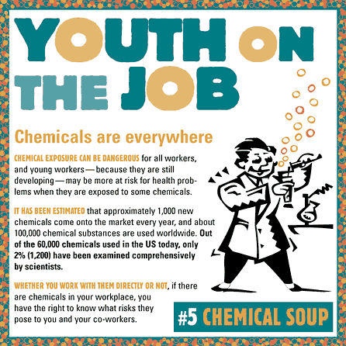
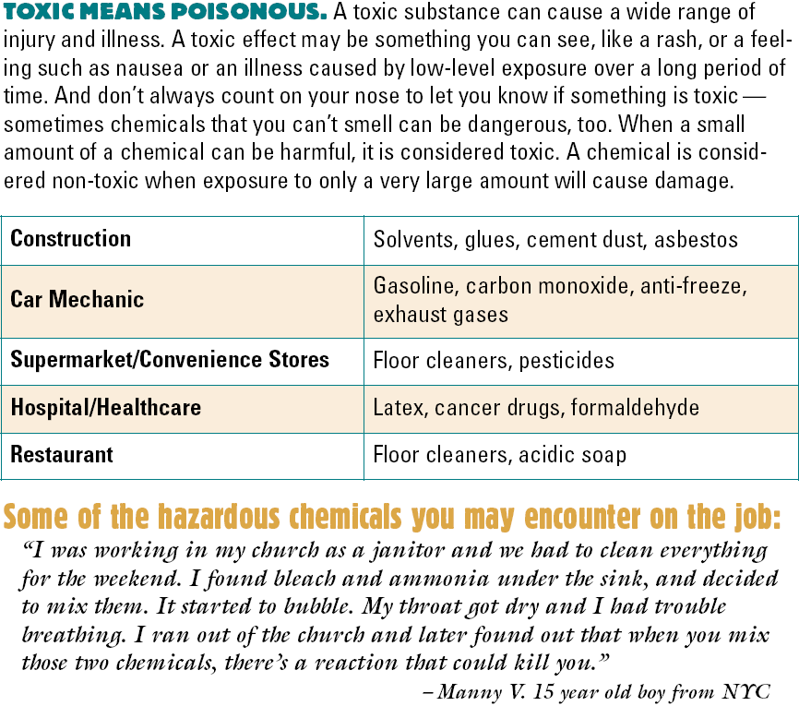
NYCOSH Health & Safety Teen Resources
NYCOSH Youth Worker Fact Sheet Booklets

Slide 21
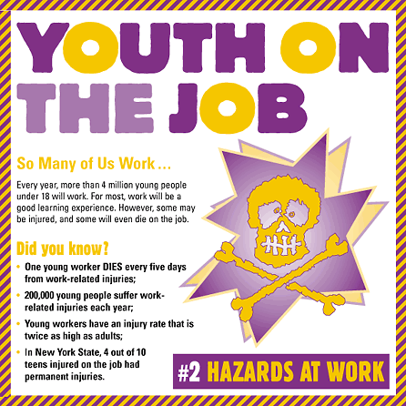
NYCOSH Health & Safety Teen Resources
NYCOSH Youth Worker Fact Sheet Booklets

Slide 22
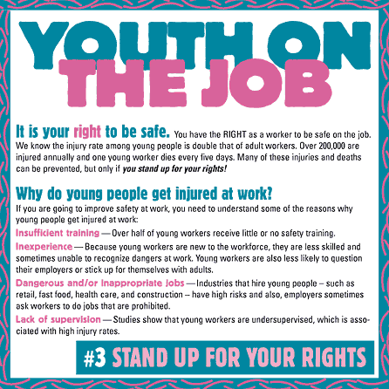
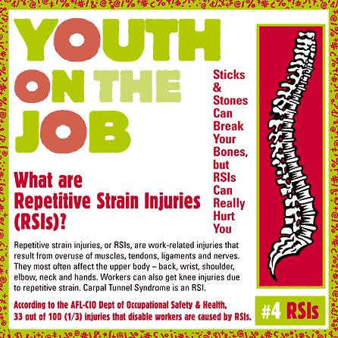
NYCOSH Health & Safety Teen Resources
NYCOSH Youth Worker Fact Sheet Booklets

Slide 23
NYCOSH Health & Safety Teen Resources
NYCOSH Youth Worker Fact Sheet Booklets

Slide 24
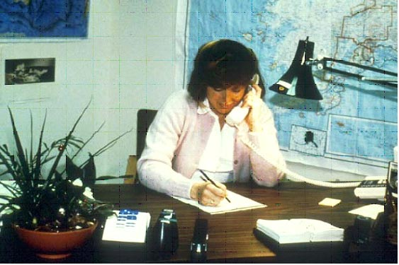
Applying OSHA Concepts:Office Safety and Health

Slide 25
Common Office Safety and Health Hazards
Physical layout and housekeeping
Exits and egress
Fire hazards
Handling and storage

Slide 26
Common Office Safety and Health Hazards
Office furniture
Electrical equipment
Office machinery/tools
Video Display Terminals

Slide 27
Common Office Safety and Health Hazards
Ventilation
Illumination
Noise
Stress

Slide 28
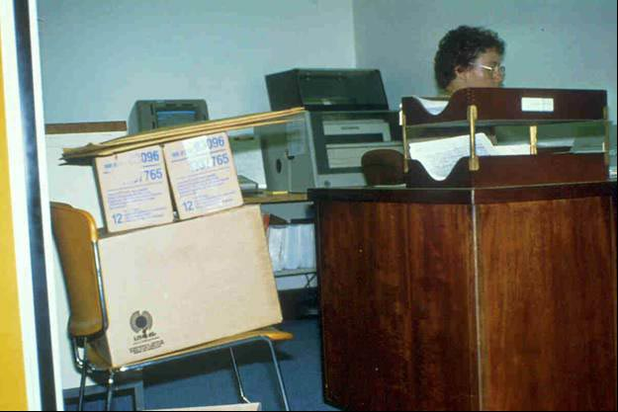
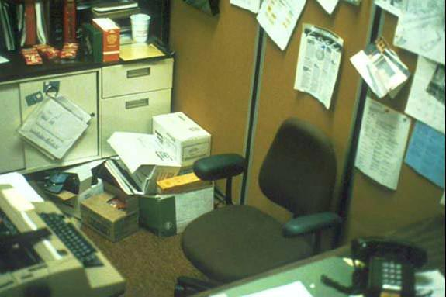
Common Office Safety and Health Hazards
What’s Wrong Here?

Slide 29
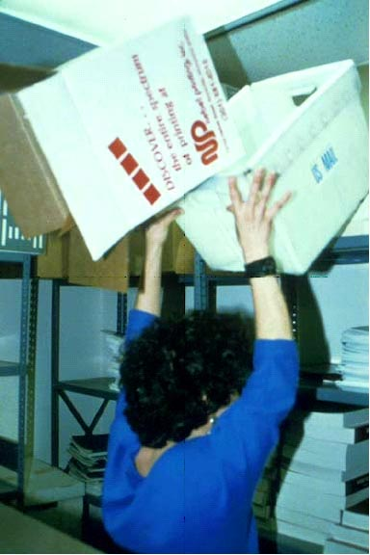
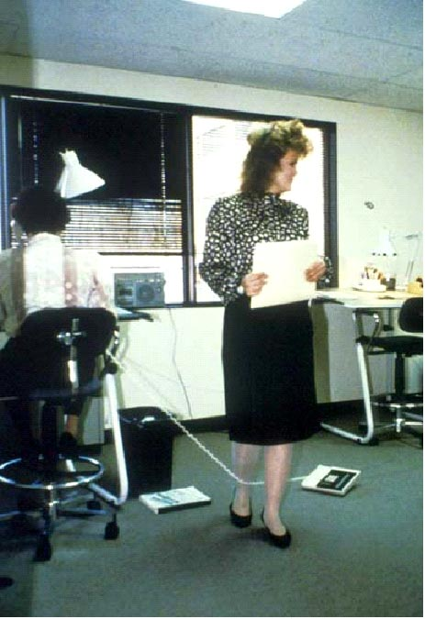
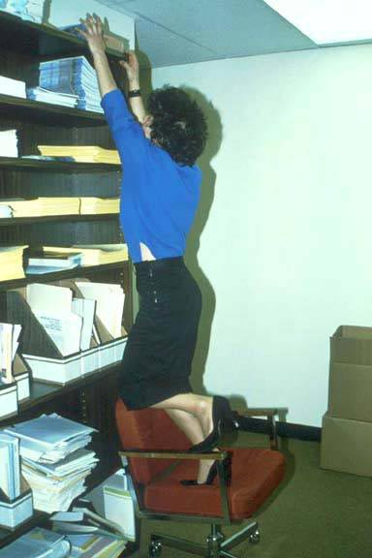
Common Office Safety and Health Hazards
What’s Wrong Here?

Slide 30
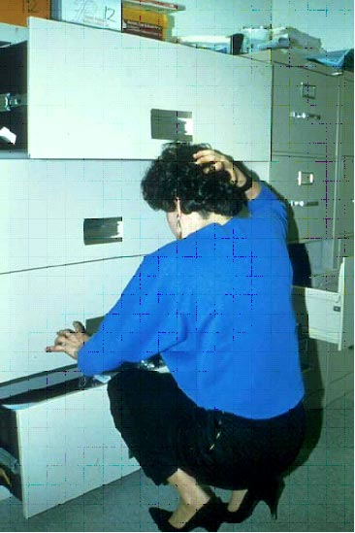
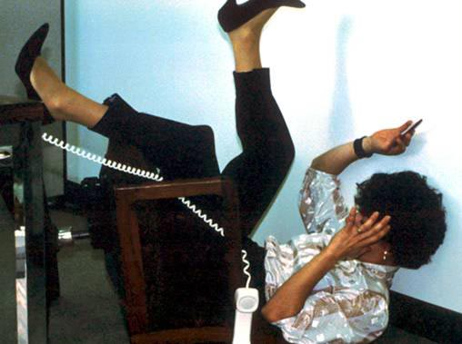
Common Office Safety and Health Hazards
What’s Wrong Here?

Slide 31
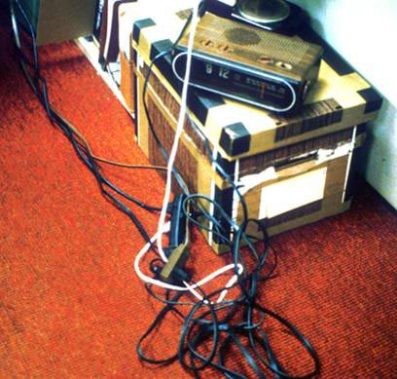
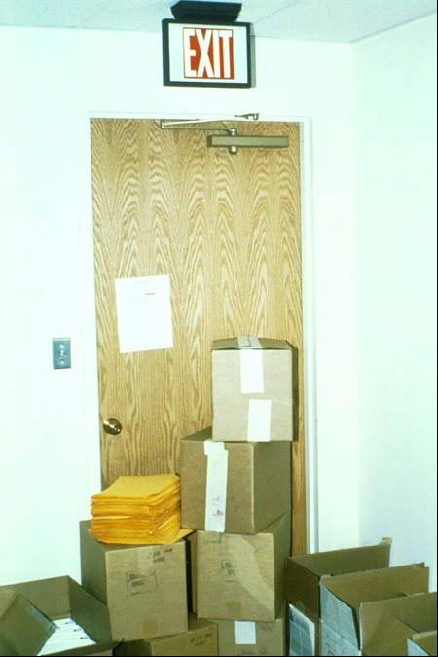
Common Office Safety and Health Hazards
What’s Wrong Here?

Slide 32
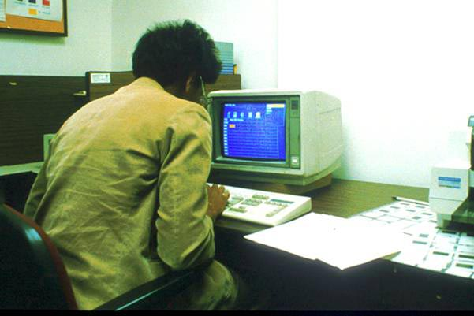
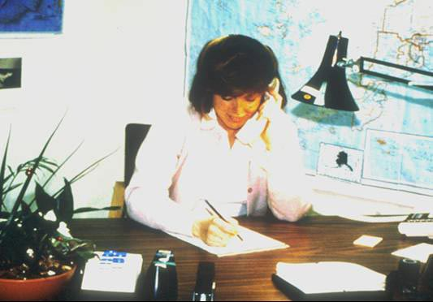
Common Office Safety and Health Hazards
What’s Wrong Here?

Slide 33
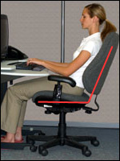
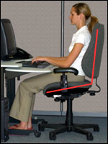
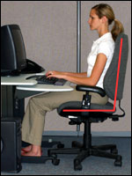
VDT Work Positions in Office
The following are important considerations when attempting to maintain neutral body postures while working at the computer workstation:
Hands, wrists, and forearms are straight, in-line and roughly parallel to the floor. Head is level, or bent slightly forward, forward facing, and balanced. Generally it is in-line with the torso.
Shoulders are relaxed and upper arms hang normally at the side of the body.
Elbows stay in close to the body and are bent between 90 and 120 degrees.

Slide 34
VDT Work Positions in Office
The following are important considerations when attempting to maintain neutral body postures while working at the computer workstation:
Feet are fully supported by floor or footrest.
Back is fully supported with appropriate lumbar support when sitting vertical or leaning back slightly.
Thighs and hips are supported by a well-padded seat and generally parallel to the floor.
Knees are about the same height as the hips with the feet slightly forward.

Slide 35
Questions
?

