Slide 1
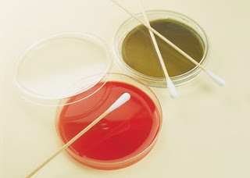
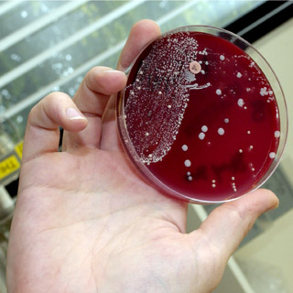
بسم الله الرحمن الرحيم
140 Micro
Lab 4: Isolation of microbes from different environments

Slide 2
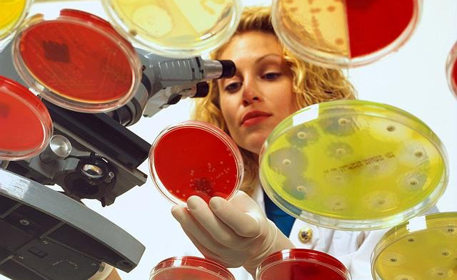
The Aim
Isolation of micro organisms from various environments

Slide 3
The five steps :
Isolation –separating one species from another.
Inoculation – introduction of a sample into a container of media to produce a culture of observable growth.
Incubation – conditions that allow growth eg., temperature ,humidity etc..
Inspection.
Identification.

Slide 4
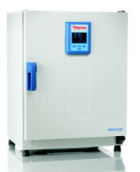
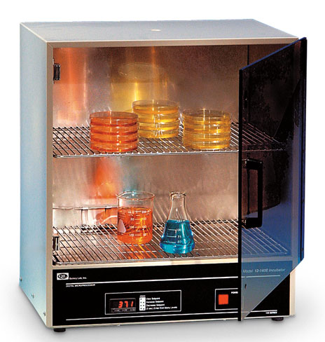
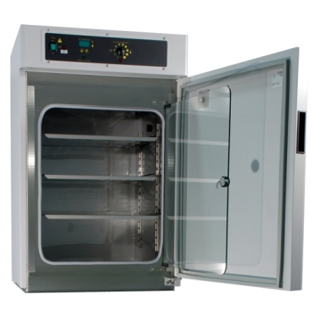
Incubator
In biology, an incubator is a device used to grow and maintain microbiological cultures or cell cultures. The incubator maintains optimal temperature, humidity and other conditions such as the carbon dioxide (CO2) and oxygen content of the atmosphere inside.

Slide 5
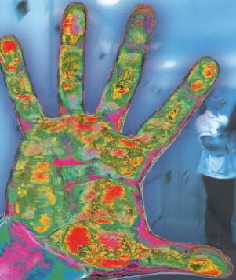
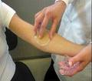
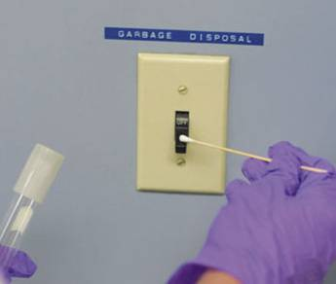
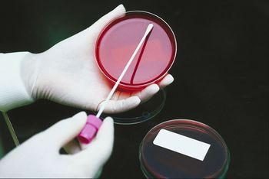
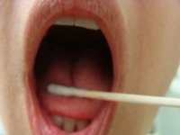
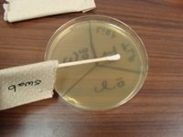
Samples
Environmental Sample
Normal Flora Samples
Surface samples are normally
taken using sterile swabs
Applying oral sample to surface of agar

Slide 6
Experiment

Slide 7
Requirement
Petri plates with media
Soil
Rotten fruit
Yoghurt
Mouth swab etc
Incubator……

Slide 8
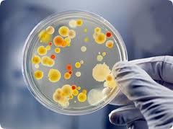
Various sources of isolation of :
Bacteria
Fungi

Slide 9
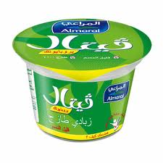
Isolation of Bacteria
Put a drop of diluted yoghurt on the
solid media plate of bacteria .
Incubate at 37 °C for 1 day.
Yoghurt
Mouth
Take some saliva with the help of
a cotton swab.
Inoculate it on the media and incubate.
Hand
Touch the surface of the solid media
plate .
Incubate 37 °C for 1 day. .
Notes:
http://www.safeproduce.eu/PersonalHygiene.htm

Slide 10
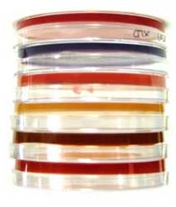
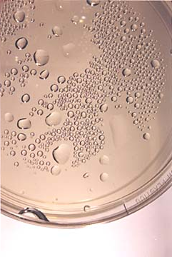
Agar plates are stored upside down to prevent condensation.

Slide 11
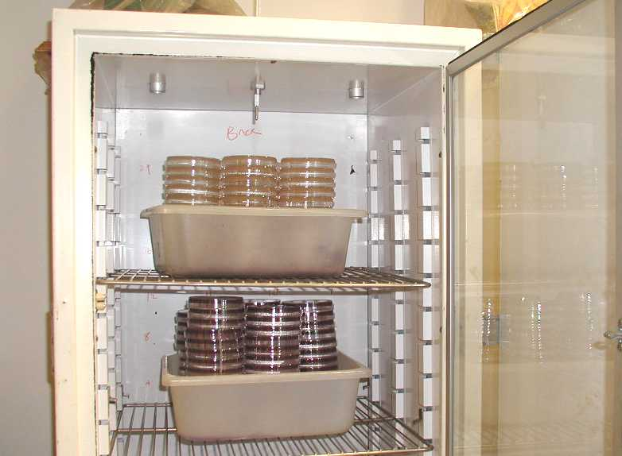
These plates of bacteria will be incubated at 37° C for 24 hours and then stored at refrigerator until next week when you will observe for results.

Slide 12
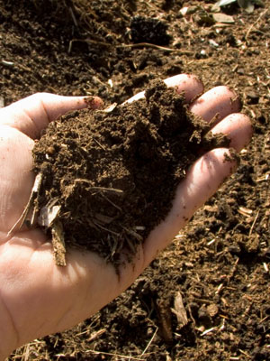
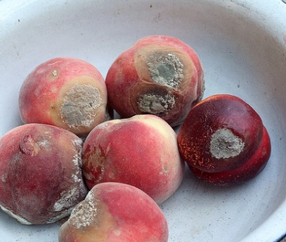
Isolation of Fungi
Expose the prepared plate of solid media in air for 5 min
Close the lid and incubate at 28 °C.
After 2-5 days fungus observe for grow
Air
Soil
Sprinkle a pinch of soil on the solid media plate
Close the lid and incubate at 28 °C
After 2-3 days fungus observe for growth.
fruit
Clean the rotten part of fruit with alcohol
Cut a piece and inoculate it on the media plate
Then incubate ,after 2-5 days fungus will grow

Slide 13
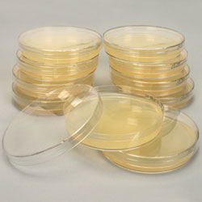
These plates of fungus will be incubated straight at 28° C for 2-5 days and then stored at refrigerator until next week when you will observe for results.

Slide 14
Result

Slide 15
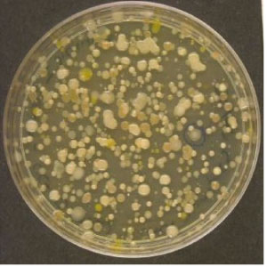
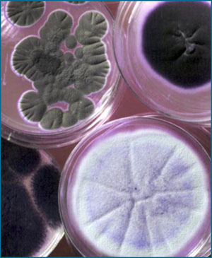
Bacteria
Fungi
Notes:
http://www.eplantscience.com/botanical_biotechnology_biology_chemistry/microbiology_methods/basic_techniques_biotechnologies/streaking_technique_obtain_pure_cultures.php

Slide 16
Thanks…
أ.شروق الشهراني

