Slide 1
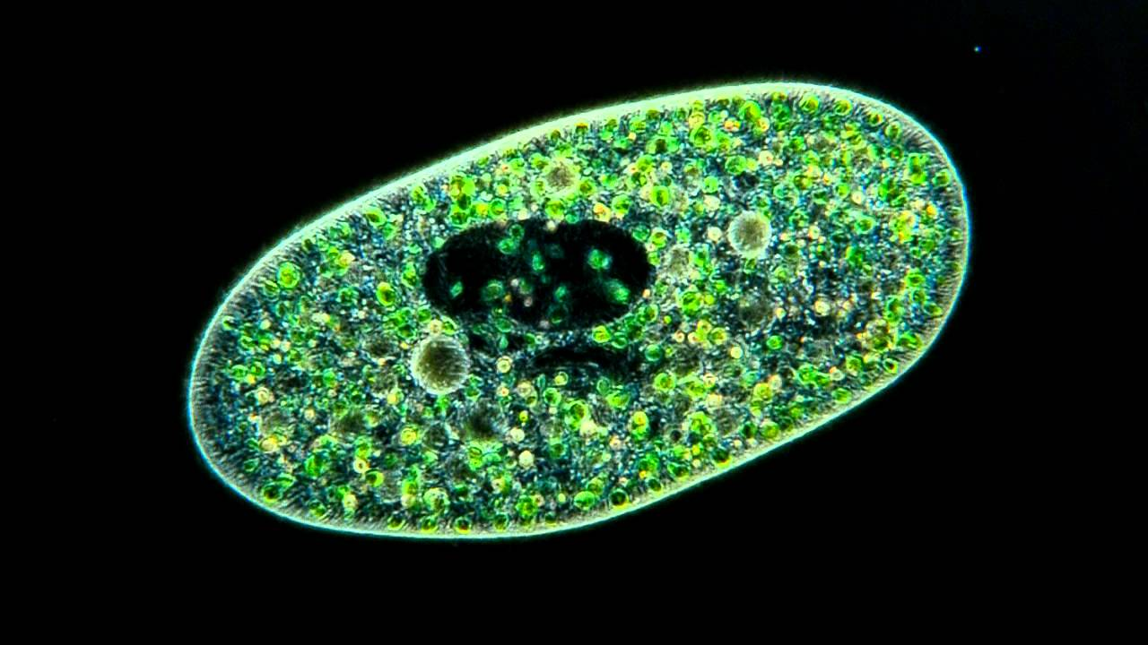
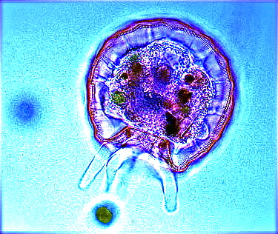
علم الأحياء الدقيقة
Microbiology
Introduction to Protozoology

Slide 2
Animal-Like Protista- Protozoa
All are unicellular heterotrophs.
Nutrition by ingesting other organisms or dead organic material.
Some organisms are parasitic, since they cannot actively capture food. They must live in an area of the host organism that has a constant food supply, such as the intestines or bloodstream of an animal.
The protozoans are grouped on the basis of their modes of locomotion to:
1. Pseudopods
move by psedupodia such as
Amoeba
2. Flagellates
move by flagella such as
Giardia
3. Ciliates
move by cilia such as Paramecium
4. Sporozoans
do not move
such as
Plasmodium

Slide 3
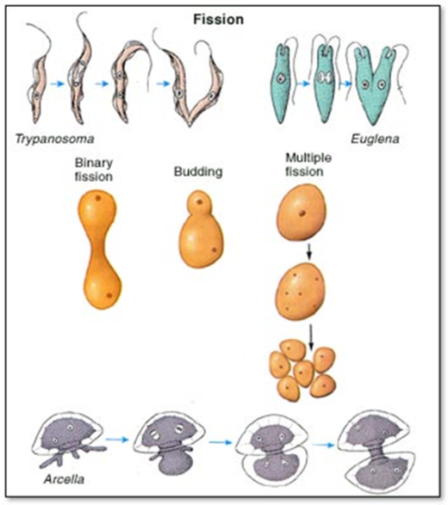
Animal-Like Protista- Protozoa
Reproduction:

Slide 4
Pseudopods e.g Amoeba
Have no wall outside of their cell membrane.
Use extensions of their cell membrane (called pseudopodia) to move, as well as, to engulf food.
Amoebas live in water, dissolved nutrients from the environment can diffuse directly through their cell membranes.
Most amoebas live in marine environments, although some freshwater species exist.
Freshwater amoebas use contractile vacuoles to pump excess water out of the cell.

Slide 5
Pseudopods e.g Amoeba
Most amoebas reproduce asexually by fission
Amoebas may form cysts when environmental conditions become unfavorable.
Two forms of amoebas have shells, the foraminiferans and the radiolarians.
Foraminiferans have a hard shell made of calcium carbonate.
Radiolarians have shells made of silica.
Both organisms have many tiny holes in their shells, through which they extend their pseudopodia.
Feeding: When the pseudopodium traps a bit of food, the cell membrane closes around the meal, this forms a food vacuole.
Digestive enzymes are secreted into the food vacuole, which break down the food. The cell then absorbs the nutrients.
Reproduce asexually by fission

Slide 6
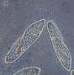
Ciliated Protozoa e.g Paramecium
Move by the cilia covering their bodies.
They can be found almost anywhere, in freshwater or marine environments.
Probably the best-known ciliate is the organism Paramecium.

Slide 7
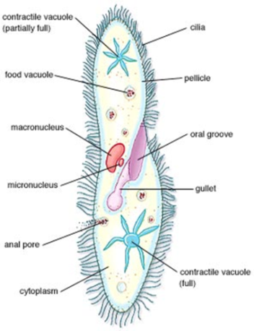
Ciliated Protozoa e.g Paramecium
Paramecia have many well-developed organelles.
Paramecia have two nuclei, a macronucleus and a micronucleus.
The larger macronucleus controls most of the metabolic functions of the cell.
The smaller micronucleus controls much of the pathways involved in sexual reproduction.
Thousands of cilia appear through the pellicle, a tough, protective covering surrounding the cell membrane.

Slide 8
Feeding:
Food enters the cell through the oral groove (lined with cilia, to "sweep" the food into the cell), where it moves to the gullet, which packages the meal into a food vacuole.
Enzymes released into the food vacuole break down the food, and the nutrients are absorbed into the cell.
Wastes are removed from the cell through an anal pore.
Contractile vacuoles pump out excess water, since paramecia live in freshwater surroundings.

Slide 9
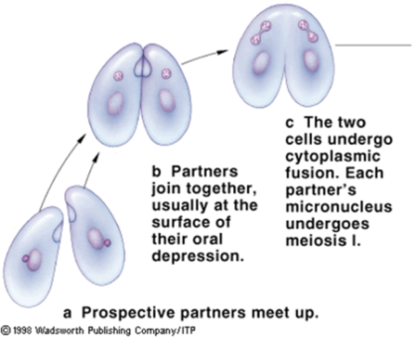
Ciliated Protozoa e.g Paramecium
Paramecia usually reproduce asexually, by transverse fission.
When conditions are unfavorable, however, the organism can reproduce sexually.
This form of sexual reproduction is called conjugation.
During conjugation, two paramecia join at the oral groove, where they exchange genetic material.
They then separate and divide asexually.

Slide 10
Sporozoans Protozoa e.g Plasmodium
Sporozoans are all Parasites e.g Plasmodium
Many of these organisms produce spores, reproductive cells that can give rise to a new organism.
Sporozoans typically have complex life cycles, as they usually live in more than one host in their lifetimes.

Slide 11
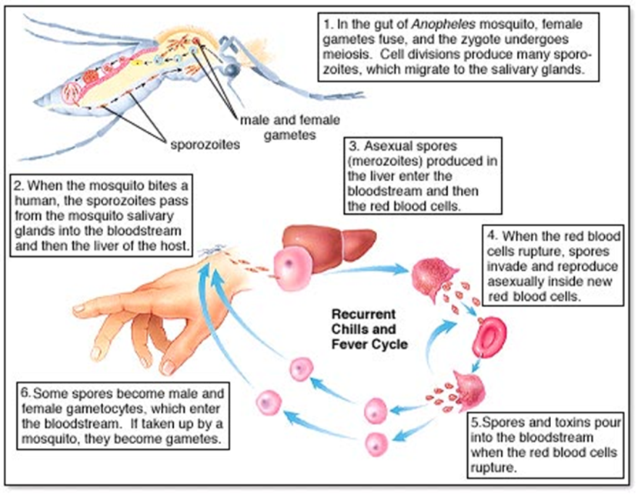
Sporozoans Protozoa e.g Plasmodium

Slide 12
Flagellates Protozoa e.g Giardia & Trypanosoma

Slide 13
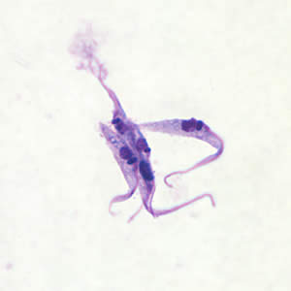
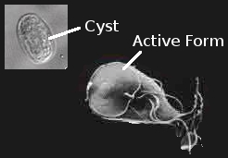
Flagellates Protozoa e.g Giardia & Trypanosoma

Slide 14
QUESTIONS??

