Slide 1
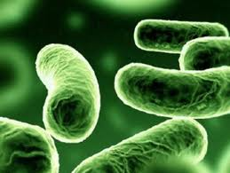
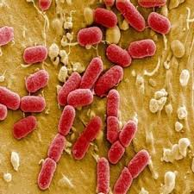
علم الأحياء الدقيقة
Microbiology
Introduction to Bacteriology

Slide 2
Bacterial Growth & Reproduction
Bacteria are multiply by a simple cell division known as binary fission (splitting into two). The single piece of DNA reproduces itself exactly.
When bacterial species produce several forms, these variants are called strains.
The calculation of bacterial growth is fairly simple, since each original cell divides to form two new cells, with the loss of the original parent.
the calculation series describing growth is: 1, 2, 4, 8, 16, …etc.

Slide 3
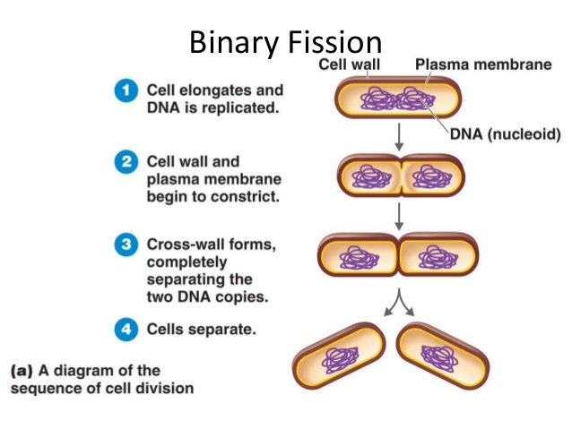
Bacterial Growth & Reproduction

Slide 4
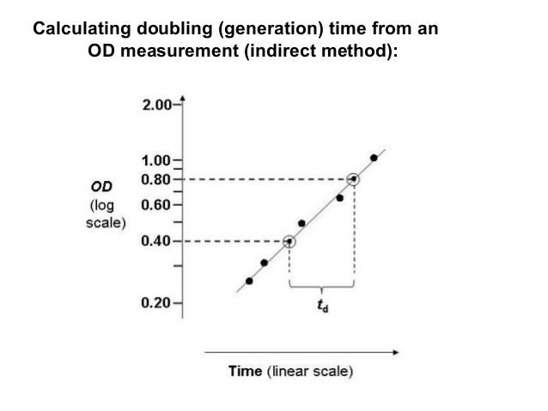
The generation time (time needed for the cell to divide into two-Doubled) differs according to species and prevailing conditions. For example, a bacterium that divides every 30 min has a generation time of 30 min.

Slide 5
The bacterial growth curve
Bacterial growth over time can be graphed as cell number versus time.
This is called a growth curve.
This curve typically has four distinct phases:
Lag Exponential Stationary Death
phase (log) phase phase phase

Slide 6
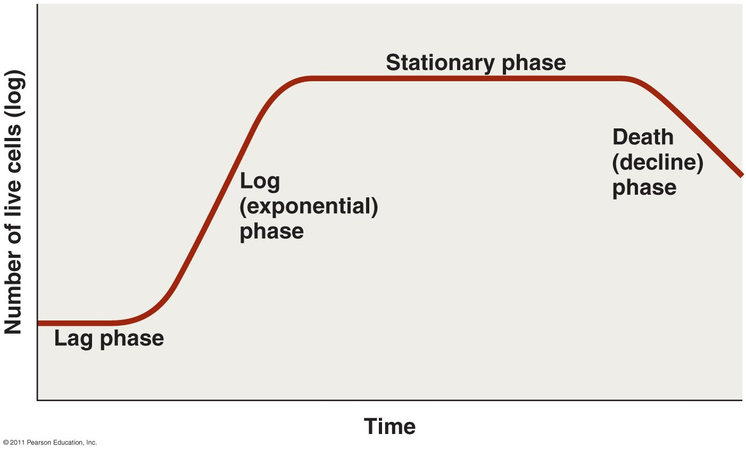
The bacterial growth curve

Slide 7
- Lag phase:
* Is the first phase. * No increase in cell number * Cells are actively metabolizing, in preparation for cell division. * It may be short or very long, according to the growth medium.

Slide 8
- Exponential or log phase: * Is the second phase. * called the exponential or log phase. * This is the period in which the cells grow most rapidly, doubling at a fairly constant rate.
- Stationary phase:
* Is third phase .
* metabolism slows.
* cells cease rapid cell division. * high cell density, depletion of nutrients, accumulation of waste products.

Slide 9
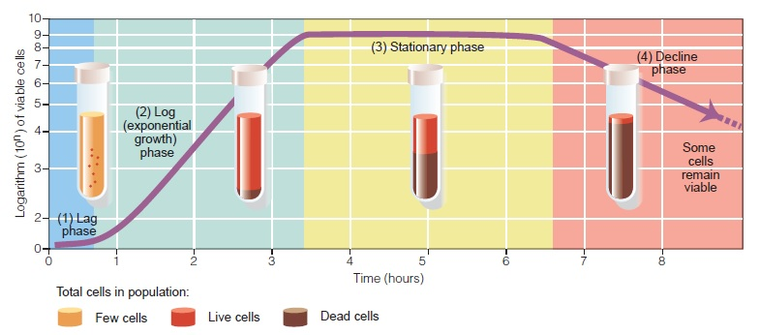
- Death phase: * Is the final phase . * Cells are quickly losing the ability to divide.

Slide 10
Factors affecting bacterial growth
- Many factors affect the generation time of the bacterium:
- Temperature.
- pH.
- Oxygen.
- Salt concentration.
- Nutrients.
- Most bacteria grow best when these parameters are optimum.

Slide 11
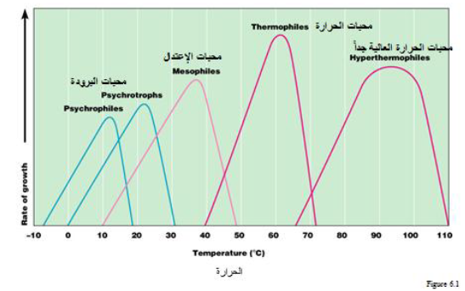
Temperature
- According to the temperature degree that bacteria can grow and/or survive, they can be classified to:

Slide 12
Temperature
Psychrophiles محبات البرودة
Mesophiles محبات الاعتدال (الوسطية)
Thermophiles محبات الحرارة
Hyperthermophiles محبات الحرارة العالية

Slide 13
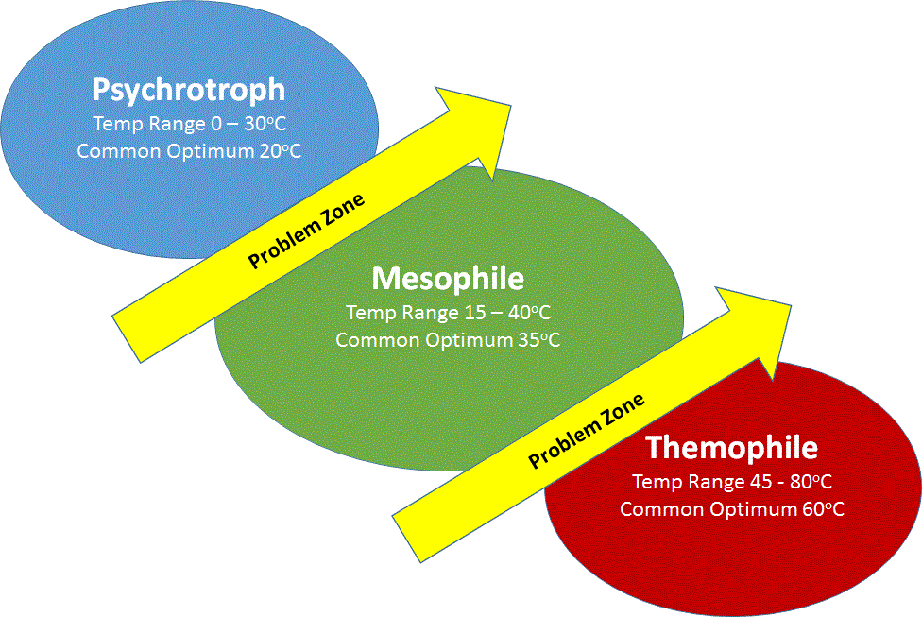
Temperature

Slide 14
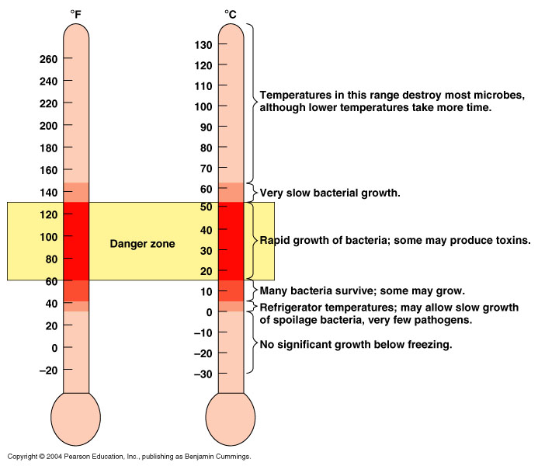
Temperature

Slide 15
QUESTIONS??

