Slide 1
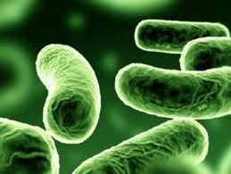
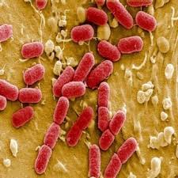
علم الأحياء الدقيقة
Microbiology
Introduction to Bacteriology

Slide 2
Factors affecting bacterial growth
- Many factors affect the generation time of the bacterium:
- Temperature.
- pH.
- Oxygen.
- Nutrient.
- Salt concentration.
- Most bacteria grow best when these parameters are
optimum.

Slide 3
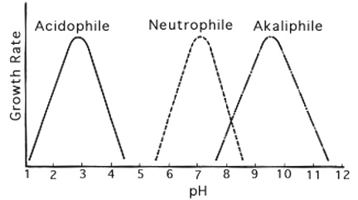
pH
- According to the pH degree that bacteria can grow and/or survive, they can be classified to:

Slide 4
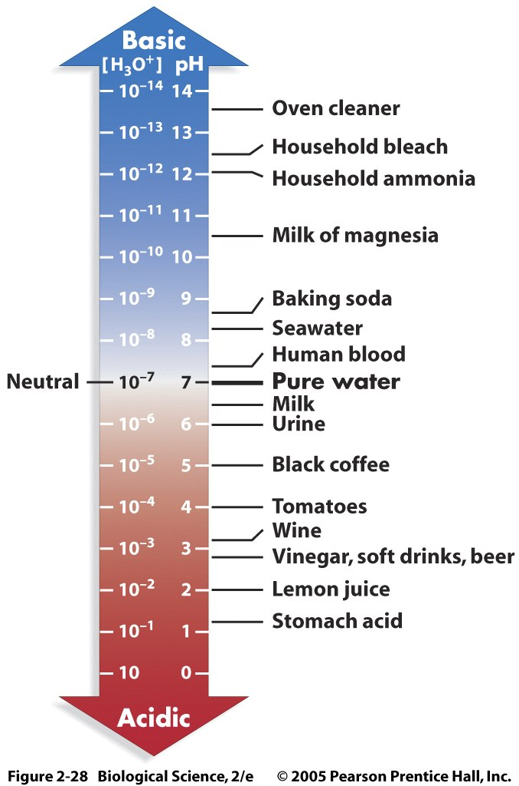
pH

Slide 5
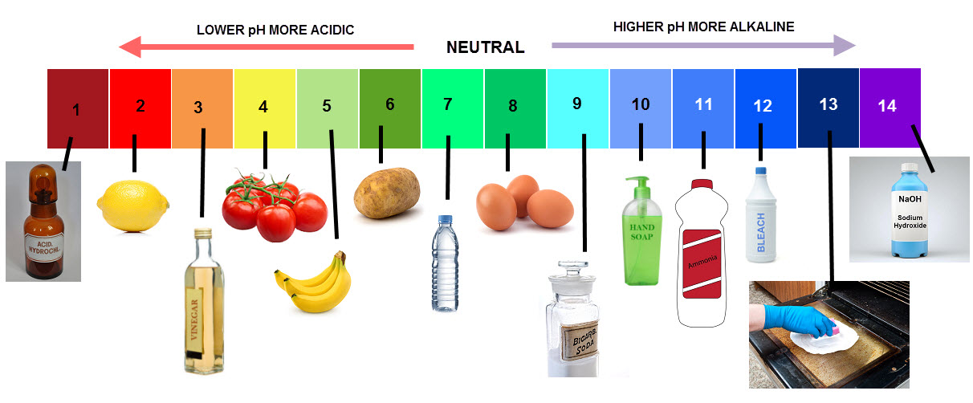
pH

Slide 6
Oxygen
Considering the oxygen demands of bacteria, it can be
classified into:
Aerobes: Grow in air, which contains 21% oxygen and small amount of (0.03%) of carbon dioxide.
Obligate aerobes: They have absolute requirement for oxygen in order to grow.
Anaerobes: Usually can not grow in the presence of oxygen.
Obligate anaerobes: These bacteria grow only under condition in which oxygen is toxic.
Facultative anaerobes: They are capable of growth under both aerobic and anaerobic conditions.
Aerotolerant anaerobes: Are anaerobic bacteria that are not killed by exposure to oxygen.

Slide 7
Oxygen
Microaerophiles: are those groups of bacteria that can grow under reduced oxygen (5% to 10%) and increased carbon dioxide (8% to 10%). Higher oxygen tensions may be inhibitory to them.
Capnophiles: Capnophilic bacteria require increased concentration of carbon dioxide (5% to 10%) and approximately 15% oxygen. This condition can be achieved by a candle jar (3% carbon dioxide) or carbon dioxide incubator, jar or bags.

Slide 8
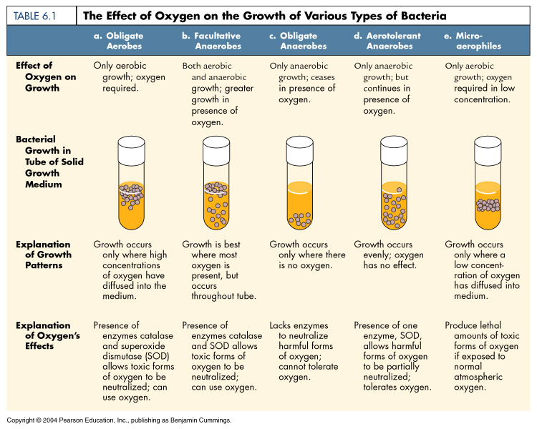

Slide 9
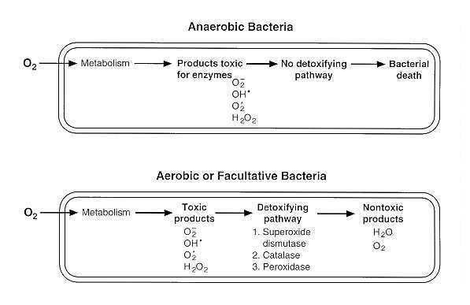

Slide 10
Mode of living in Bacteria
- If we consider the mode of nutrition, bacteria can be divided
into two categories:
- Autotrophic. They can build up complex organic
substances such as carbohydrates from simple inorganic sources
(CO₂ and water).
- Heterotrophic. They cannot build up carbohydrates from simple
inorganic sources. They depend on ready made organic materials
derived from plants , animals and humans. They can live on such
compounds , break it down , enzymatically.

Slide 11
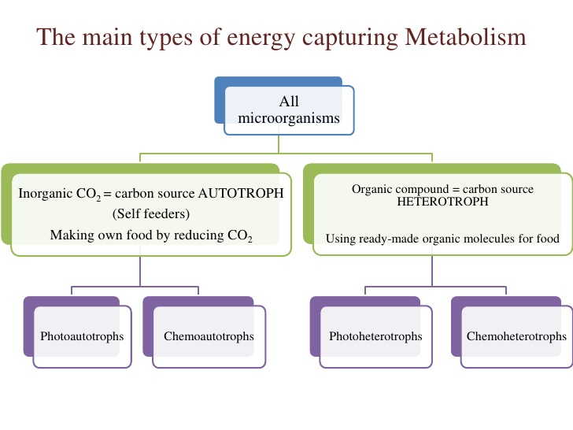
Mode of living in Bacteria

Slide 12
Mode of living in Bacteria
- Photoautotrophs: They contain in their cells a chlorophyll
known as bacterial chlorophyll by which they can perform
photosynthesis. Here, the energy used in building up processes is
derived from light. As an example of such bacteria is the green
sulphur bacteria.
Light Energy
6 CO₂ + 12 H₂S C₆H₁₂O₆ + 6 H₂O + 12 S
Green sulphur bacteria

Slide 13
Mode of living in Bacteria
Chemoautotrophs: Here the cells lack chlorophyll. Accordingly the source of energy should be something else than light. The energy used here is released from chemical reactions carried out by such bacteria.
Three examples of bacterial using oxidizing reactions to gain Energy:
- Nitrosomonas, oxidizes ammonia or ammonium salts to nitrites with
a release of energy :
2 NH_{­3} + 3O₂ 2 HNO₂ + 2 H₂o + Energy
- Nitrobacter, oxidizes nitrites to nitrates with a release of energy :
2 HNO₂ + O₂ 2 HNO₃ + Energy

Slide 14
Mode of living in Bacteria
- Thiobacillus thiooxidans, oxidizes sulphur with a release of energy:
2S +3O₂ + 2H₂O 2 H₂SO₄ + Energy
The energy released from any of these oxidation reactions is utilized by the specific organism in building up organic carbohydrates from the simple inorganic sources.

Slide 15
QUESTIONS??

