Slide 1
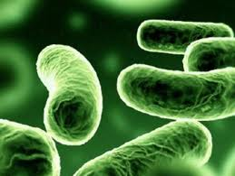
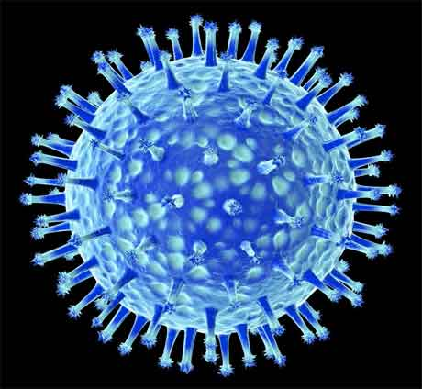
علم الأحياء الدقيقة
Microbiology
Introduction to Bacteriology

Slide 2
Factors affecting bacterial growth
- Many factors affect the generation time of the bacterium:
- Temperature.
- pH.
- Oxygen.
- Nutrient.
- Salt concentration.
- Most bacteria grow best when these parameters are optimum.

Slide 3
Mode of living in Bacteria
- If we consider the mode of nutrition, bacteria can be divided into two categories:
- Autotrophic. They can build up complex organic substances such as carbohydrates from simple inorganic sources
(CO₂ and water).
- Heterotrophic. They cannot build up carbohydrates from simple inorganic sources. They depend on ready made organic materials derived from plants , animals of humans. They can live on such
compounds , break it down , enzymatically.

Slide 4
Mode of living in Bacteria
Heterotrophic Bacteria:
Parasites on plants, animals and humans causing serious diseases.
Saprophytes on dead organic matter.
Symbionts with other living organisms sharing benefits.

Slide 5
Salinity
Halophile: organisms that grow well in high salt concentrations. Halophiles are categorized as slight, moderate, or extreme.
Slight halophiles 1.7 to 4.8%.
Moderate halophiles 4.7 to 20%.
Extreme halophiles 20 to 30%.
Halotolerant organisms can grow under saline conditions but do not require it.

Slide 6
Controlling of Microbial Growth
The control of microbial growth is necessary in many practical situations, and significant advances in agriculture, medicine, and food science .
Control of microbial growth means to inhibit or prevent growth of microorganisms.
This control is affected in two basic ways:
By killing microorganisms
Inhibiting the growth of microorganisms
Agents which kill cells are called cidal agents
Agents which inhibit the growth are called static agents

Slide 7
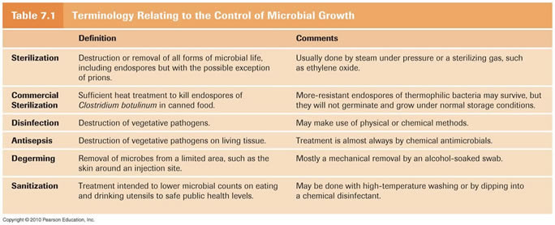
Controlling of Microbial Growth

Slide 10
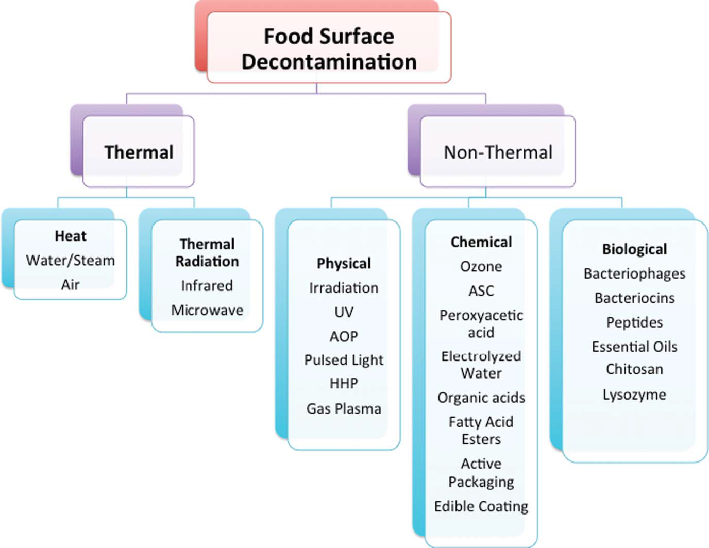

Slide 11
Controlling of Microbial Growth
Low temperature (cooling and freezing):
Most organisms grow very little or not at all at 0ºC. Perishable foods are stored at low temperatures to slow rate of growth.
Drying is often used to preserve foods (e.g. fruits, grains, etc.).
Most microorganisms cannot grow at reduced water activity.

Slide 12
Chemical Agents
1. Antiseptics
2. Disinfectants
3. Preservatives
Cidal agents.
Harmless enough to be applied to the skin and mucous membrane.
Should not be taken internally.
Examples include alcohols, silver nitrate, iodine solution, alcohols, detergents.
Cidal agents.
Not safe for application to living tissues.
Used on inanimate objects such as tables, floors, utensils, etc.
Examples: hypochlorites, chlorine compounds, copper sulfate, formaldehyde, phenolic compounds and LTGP (Low Temperature Gas Plasma).
Static agents.
Used to inhibit the growth of microorg-anisms.
Most often in foods.
If eaten they should be nontoxic.
Examples are calcium propionate, sodium benzoate, nitrate and sulfur dioxide, ethylene oxide (ETO) and ozone.
Used to prevents microbial
Reproduction
For Medical and pharmaceutical products
Used as a disinfectant for water and food

Slide 13
Biological Agents
The biological agents are antimicrobial agents that kill (cidal effect) or inhibit (static effect) the growth microorganisms.
Antimicrobial agents may be of natural or synthetic origin:
Natural
Semi-synthetic
Antimicrobial agents produced by microorganisms that kill or inhibit other microorganisms.
Examples are Penicillin and its relatives.
Molecules produced by a microbe that are subsequently modified to enhance their antimicrobial properties or to render them unique for a pharmaceutical patent.
Examples are Sulfonilamides and Chloramphenicol.

Slide 14
Efficiency of Antibiotics
Broad spectrum
Limited spectrum
Antibiotics effective against prokaryotes which kill or inhibit a wide range of Gram-positive and Gram-negative bacteria.
Antibiotics effective against prokaryotes which kill or inhibit a single organism.
Narrow spectrum
Antibiotics effective against prokaryotes which kill or inhibit specific families of bacteria.

Slide 15
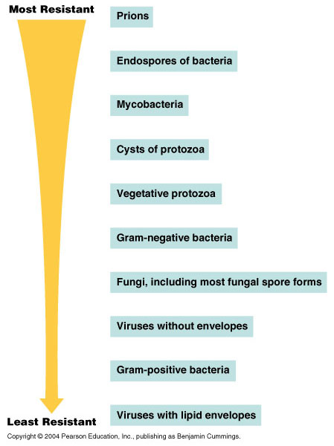

Slide 16
QUESTIONS??

