Slide 1
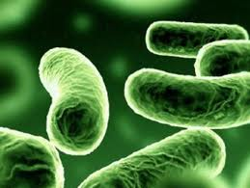
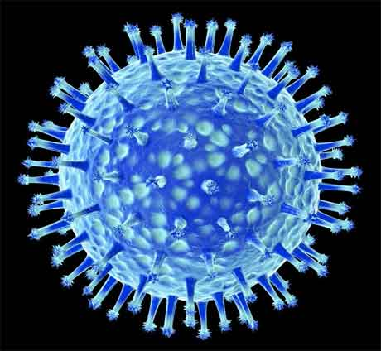
علم الأحياء الدقيقة
Microbiology
Introduction to Bacteriology

Slide 2
Cyanobacteria
Commonly known as blue-green algae, an autotrophic (Photosynthetic).
Contain chlorophyll a, phycocyanin (blue) and phycoerythrin (red).
They live in aquatic environments including oceans, ponds, lakes, tidal flats, and moist soil.
They exist mostly as colonies and filaments and sometimes as single cells.
Some filamentous forms can move. For example, filamentous forms such as Oscillatoria sp. rotate in a screw like manner.

Slide 3
Cyanobacteria
Produce gelatinous capsules which are often lighter than water and therefore help keep the algae up near the surface of the water .
Reproduction in cyanobacteria by fission, fragmentation and akinetes.
Lack chlorophyll b. The photosynthetic product is stored in their own form of starch, which is similar to animal glycogen.

Slide 4
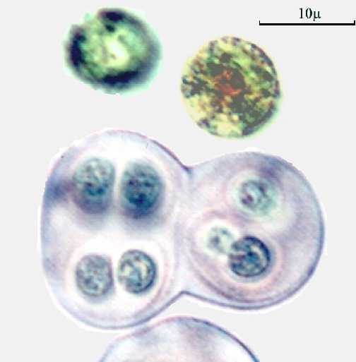
اشكال السيانوبكتيريا Forms of Cyanobacteria
1. Unicellular or aggregate.
e.g.
Gloeocapsa sp

Slide 5
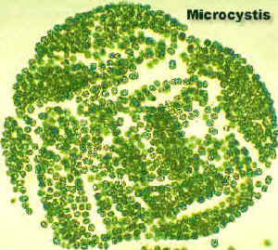
2. Colony
e.g.
Microcystis sp

Slide 6
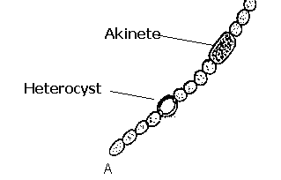
3. Filamentous forms
a). Un-branched
e.g.
Anabaena sp

Slide 7
3. Filamentous forms
b). Branched
e.g.
Stigonema sp.

Slide 8
Cell Structure
The cell structure is very primitive.
Each cell is composed of two parts:
- Cell Wall.
- Protoplast.
The cell wall is composed of 2 layers:
The inner layer of which is thin and firm composed of cellulose.
The outer layer of the wall is thicker and gelatinous known as the sheath and mainly constituted of pectic compounds.
Cell wall
Chromoplast
Central body

Slide 9
Cell Structure
The protoplast consists of 2 parts:
peripheral pigmented (coloured) region surrounding a colourless central region. It contains the blue pigment “phycocyanin” together with “chlorophyll” and known as “chromoplasm”.
The colourless inner region (central body) contains several chromatin granules (DNA) which represent a primitive type of nucleus that lacks nuclear membrane and nucleoli
Cell wall
Chromoplast
Central body

Slide 10
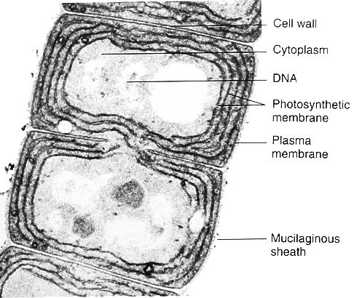
Cyanobacterial cell

Slide 11
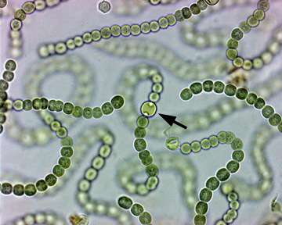
Nostoc
- Grows in water and on damp soils.
- Un-branched filaments with barrel-like cells.
- Certain enlarged cells appear at intervals, which are known as heterocysts . Its transparent and thick walls.
- The whole filament is surrounded with gelatinous material.
- Each two heterocysts delimit in between , a number of cells called hormogonia.
- In most cases clusters of filaments are grouped together in the form of gelatinous masses.

Slide 12
Reproduction
التكاثر الخضري
Vegetative reproduction.
التكاثر اللاجنسي
Asexual reproduction.
By fission.
By Akinetes.
الانشطار
الأكينيتات

Slide 13
Vegetative reproduction
By fragmentation
Filament breaks into fragments.
Each gives rise to a new filament.
Usually fragmentation occurs at the heterocysts.
This fragment is capable of creeping movements in the gelatinous sheath until it escapes and grows into a new filament.

Slide 14
Asexual Reproduction
- By fission.
A constriction is formed in the middle of the cell
extends from the surface inwards towards the center
Division into two cells
leads to the increase in number of cells per filament without production of a new one.

Slide 15
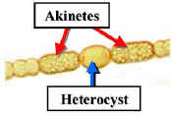
- By Akinetes
vegetative cells
enlarge in size
become rich in food materials and form a thick wall
These akinetes are yellow or brown in color and they are very resistant to un-favorable conditions
When the conditions are favorable
the akinetes germinate
into new filaments.

Slide 16
QUESTIONS??

