Slide 1
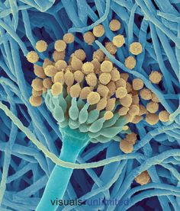
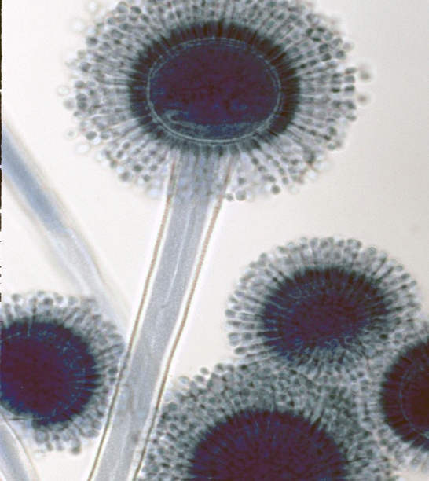
علم الأحياء الدقيقة
Microbiology
Introduction to Mycology

Slide 2
FUNGI
Fungi are eukaryotic organisms that include microorganisms such as yeasts (unicellular) and molds (multicellular) as well as the more familiar mushrooms.
الفطريات تنقسم إلى قسمين:
Two divisions in fungi.
الفطريات المخاطية (اللزجة)
Myxomycota
(slime molds)
تفتقد للجدر الخلوية خلال معظم دورة حياتها
lack cell walls during most of their life cycle
الفطريات الحقيقية
Eumycota
(true fungi)
تمتلك جدر خلوية صلبة
possess rigid cell walls

Slide 3
Division Eumycota-True Fungi
This group of organisms is characterized by the following characters :
The fungal body or thallus is known as mycelium, which is composed threads known as hyphae (seperated or non-seperated).
Cell wall in the majority of fungi is chitin.
Cellulose is usually absent from walls of most fungi.
Fungi are heterotrophic and aerobes.
The reserve food material is usually glycogen but never starch.
With regard to the mode of nutrition, fungi can be divided into the three following types :
a) Parasitic fungi.
b) Saprophytic fungi.
c) Symbiotic fungi.

Slide 4
Division Eumycota-True Fungi
A) Parasitic fungi. They are two types :
Obligate parasites, which live and grow only on their living host, e.g. Puccinia graminis on wheat (rusty infection).
Facultative parasites, which live usually as saprophytes on dead organic matter in the soil, but they can parasitize their hosts if found nearby them, e.g. Fusarium sp. which causes diseases to many plants.
The parasitic fungi can infect not only higher plants, but also insects such as house flies, which can be killed by such infection. Some skin diseases of humans are due to fungal infections.

Slide 5
Division Eumycota-True Fungi
B) Saprophytic fungi can be also divided into :
Obligate saprophytes, which live only saprophyically on dead organic matter, i.e. they do not infect living plants or animals, e.g. Rhizopus.
Facultative saprophytes, which usually live parasitically, but they can behave a saprophytes under certain conditions, e.g. Smut fungi.
C) Symbiotic fungi, which live in association with other organisms and there is a mutual benefit between them.
Lichens
(Fungus and an Algae ).
Mycorrhizas
(Fungi and roots of higher plants)

Slide 6
Division Eumycota-True Fungi
Mycorrhizas
(Fungi and roots of higher plants)
A) Ectophytic mycorrhiza,
The fungus forms an external
investment of the root in the
form of a crown of hyphae
without penetrating into the
cells other those of the
epidermis.
B) Endophytic mycorrhiza,
The fungal hyphae penetrate the inner parts of the roots and have little connection with the mycelium in the soil.

Slide 7
Classification of Eumycota
- True fungi are grouped into five classes based on their method of reproduction, these classes are:
Zygomycetes
Sexual gametangia are similar
Hyphae are coenocytic (un septated).
Ascomycetes
Spores are endogenous, i.e. produced inside special sacs called asci.
Hyphae are septated.
Oomycetes
Sexual gametangia are dissimilar, being distinguished into female gametangia or oogonia and male gametangia or antheridia.
Hyphae are coenocytic.
Basidiomycetes
Spores are exogenous, i.e. produced externally on basidia.
Hyphae are septated.
Deuteromycetes
(Imperfect fungi)
Its perfect stage or its mode of sexual reproduction is not yet known until now.
Hyphae are septated .

Slide 8
Classification of Eumycota
Zygomycetes الفطريات التزاوجية (الزيجية)
Ascomycetes الفطريات الزقية (الاسكية)
Oomycetes الفطريات البيضية
Basidiomycetesالفطريات البازيدية
Deuteromycetes الفطريات الناقصة

Slide 9
QUESTIONS??

