Slide 1
Class Diagram
Slide 1

Slide 2
Objective
z Introduces the evolutionary approach for building classes z Explain how to identify objects and attributes of classes z Describe the technique of CRC ‘Class Responsibility and
Collaborator’
z Explain how classes are related in a class diagram
z Explain generalization, association, aggregation and composition
z
Slide 2

Slide 3
OO Structural Modelling
The Static View of a system may be described using UML diagrams:
z UML Class Diagrams
Slide 3

Slide 4
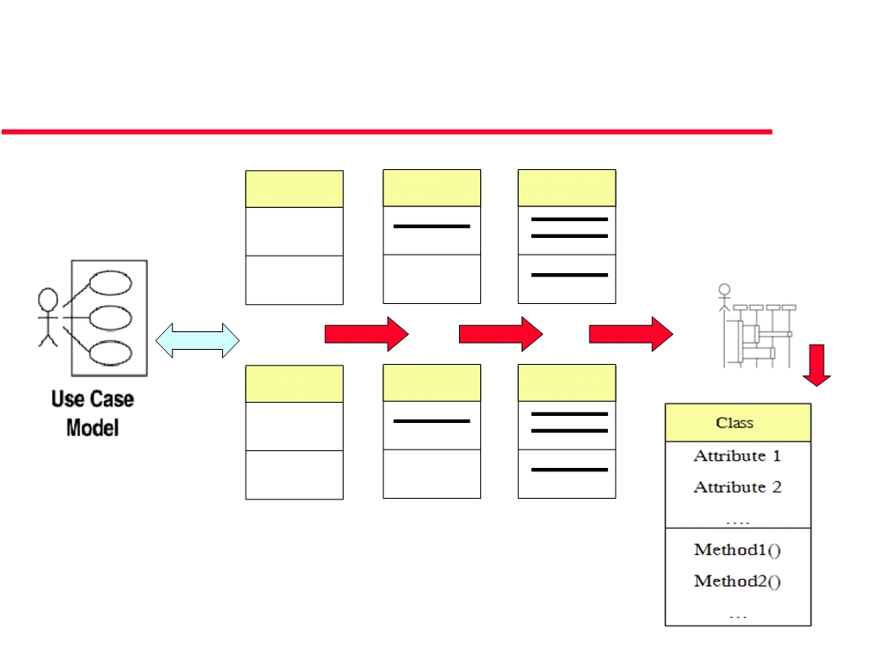
From Use Cases to: Objects, Attributes,
Operations (methods) - “evolutionary ”
Class 1
Class 1
Class 1
Class 2
Class 2
Class 2
Slide 4

Slide 5
Identifying objects
z Look for nouns in the SRS (System
Requirements Specifications) document
z Look for NOUNS in use cases descriptions
z A NOUN may be
•
Object
•
Attribute of an object
Slide 5

Slide 6
Identifying Operations ‘methods’
z Look for verbs in the SRS (System Requirements Specifications) document
z Look for VERBS in use cases descriptions
z A VERB may be
•
translated to an operation or set of operations
•
A method is the code implementation of an operation.
Slide 6

Slide 7
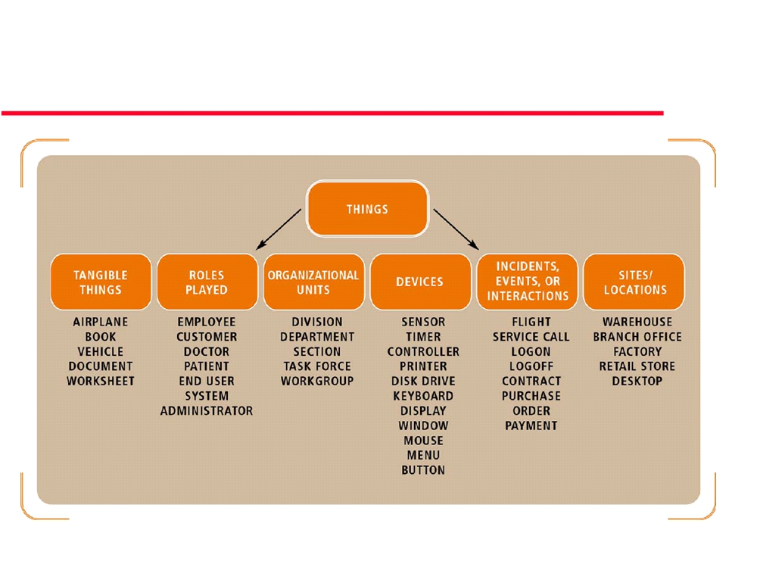
Objects
Slide 7

Slide 8
Objects
An object is a thing:
- student;
- transaction;
- car;
- customer account;
- employee;
- complex number;
- spreadsheet table;
- spreadsheet cell;
- document;
- paragraph;
- GUI Combo box
- GUI button. . . and so on.
Slide 8

Slide 9
Class and Class diagram
z Class naming: Use singular names
• because each class represents a generalized version of a singular object.
z Class diagrams are at the core of OO Eng.
Slide 9

Slide 10
Class and Class diagram
z Things naturally fall into categories (computers, automobiles, trees...).
z We refer to these categories as classes.
z An object class is an abstraction over a set of objects with common:
•
attributes (states)
•
and the services (operations) (methods)
provided by each object
z Class diagrams provide the representations used by the
developers.
Slide 10

Slide 11
CRC ‘Class Responsibility and
Collaborator’
z CRC card
z Class Responsibility:
•
What the class knows: attributes
•
What the class does: services (operations / methods)
Slide 11

Slide 12
CRC ‘Class Responsibility and
Collaborator’
z Class Collaboration:
•
Request for information from another class (what the other class knows
as attributes)
•
Request another class to do some thing (what the other class does as
operation)
Slide 12

Slide 13
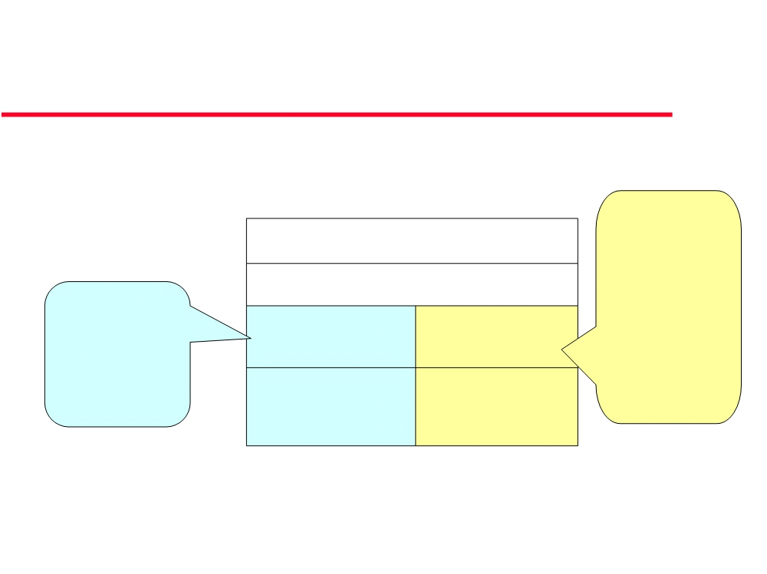
CRC Card
CRC Card
Other classes
needed to
Class name
fulfill class a responsibility
What the class
Responsibility Collaboration
knows Or
Need for
Attribute operation
• z
•
does •
z
•
Slide 13

Slide 14
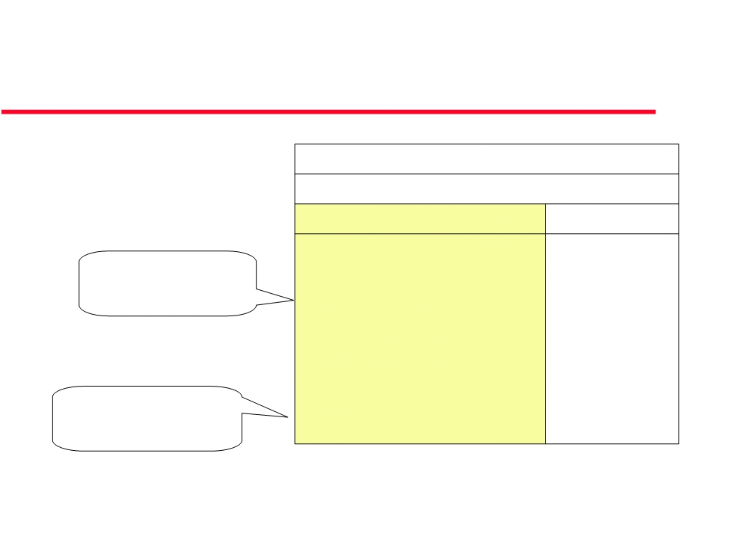
CRC - Class Responsibility
CRC Card
Student
Responsibility
Collaborator
ID
What the class
Name
knows
Department Address
Request “Register course” Drop course
What the class
does
Request Schedule
Slide 14

Slide 15
CRC - Class Collaborator
z Sometimes a class A has a responsibility to
fulfill, but not have enough information to do it.
z So class A needs help from another class z See next example
Slide 15

Slide 16
CRC - Class Collaborator
z For example, as you see in students register in courses.
• To do this, a student needs to know if a spot is available in the
course and, if so, he then needs to be added to the course. However, students only have information about themselves (their names and so forth), and not about courses.
• What the student needs to do is collaborate/interact with the
card labeled Course to sign up for a course.
•
Therefore, Course is included in the list of collaborators of
Student.
Slide 16

Slide 17
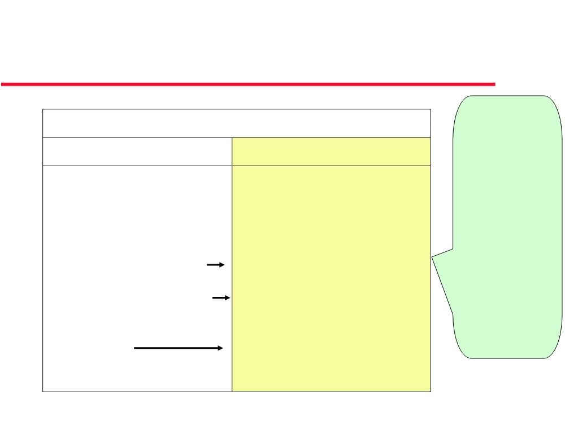
CRC - Class Collaborator
Student Responsibility
Collaborator Course :
Collaborator
ID
Class Course
Name
is needed to
Department
fulfill class
Address
Student
responsibilities
Check course availability
Course (Attribute: availability)
Need for
Request “Register course”
Course (Operation: increment
Attribute
number of registered student)
and/or
operation
Drop course
Course (Operation: decrement
number of registered student)
Request Schedule
-----
Slide 17

Slide 18
CRC - Class Collaborator
z
Collaboration takes one of two forms:
• A request for information
• or a request to do something.
z z
Example Alternative 1:
The card Student requests an indication from the card Course whether a space is available, a request for information.
z
Student then requests to be added to the Course , a request to do something.
z
Alternative 2: Another way to perform this logic, however, would have been to have Student simply request Course to enroll himself (Student ) into itself (Course). Then have Course do the work of determining if a seat is available and, if so, then enrolling the student and, if not, then informing the student that he was not enrolled.
Slide 18

Slide 19
Types of Operations
• Operations can be classified into four types, depending on the kind of service requested by clients:
1. constructor:
creates a new instance of a class
2. query:
is an operation without any side effects; it ccesses the state of an object but does not alter the state
3. update:
An operation that alters the state of an object.

Slide 20
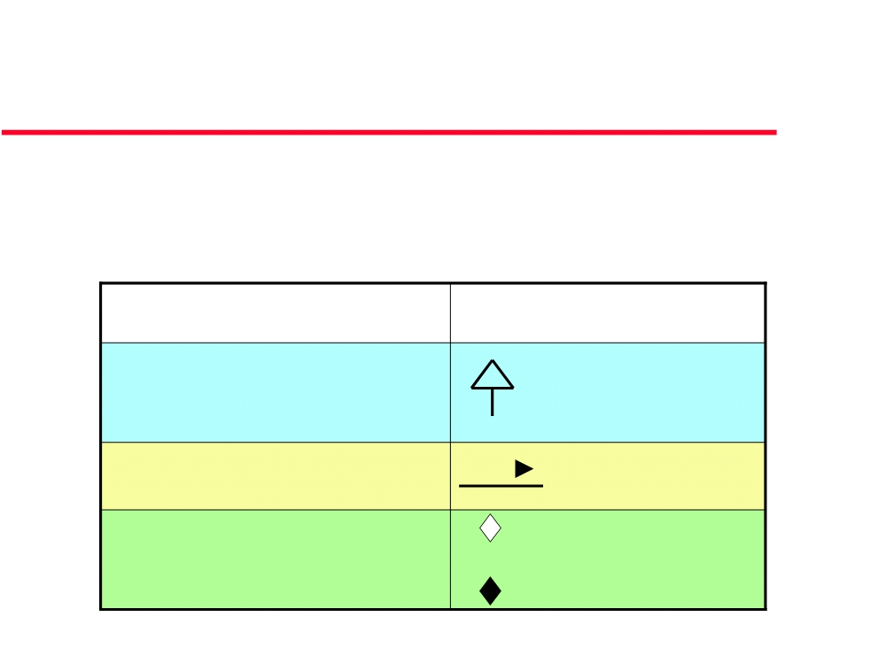
Class diagrams
z Shows relationship between classes z A class diagram may show:
Relationship
Generalization (inheritance)
”is a”
“is a kind of”
Association (dependency)
“Who does What” “uses”
does
Aggregation
“has”
“composed of”
Composition: Strong aggregation
Slide 19

Slide 21
Association, aggregation and
composition
• When considering the 3 relationships,
association, aggregation and composition,
•
the most general relationship is association,
•
followed by aggregation
•
and, finally, composition.
Slide 20

Slide 22
Association between classes
Who does What
Slide 21

Slide 23
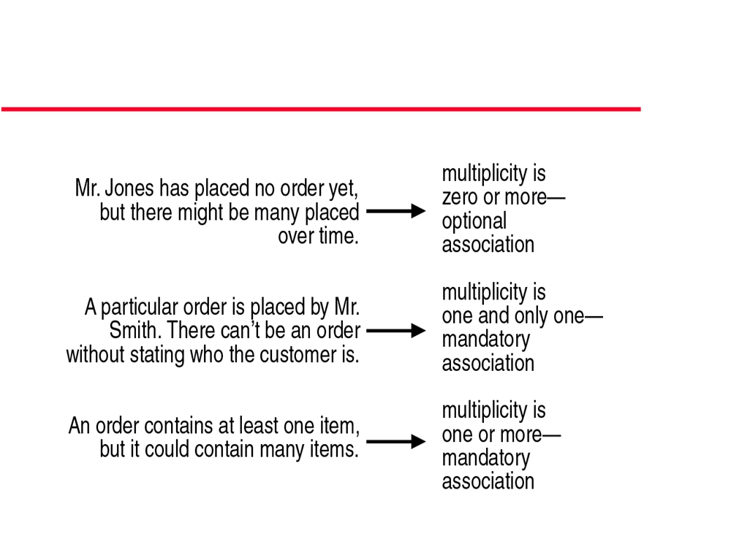
Multiplicity of Relationships
Slide 22

Slide 24
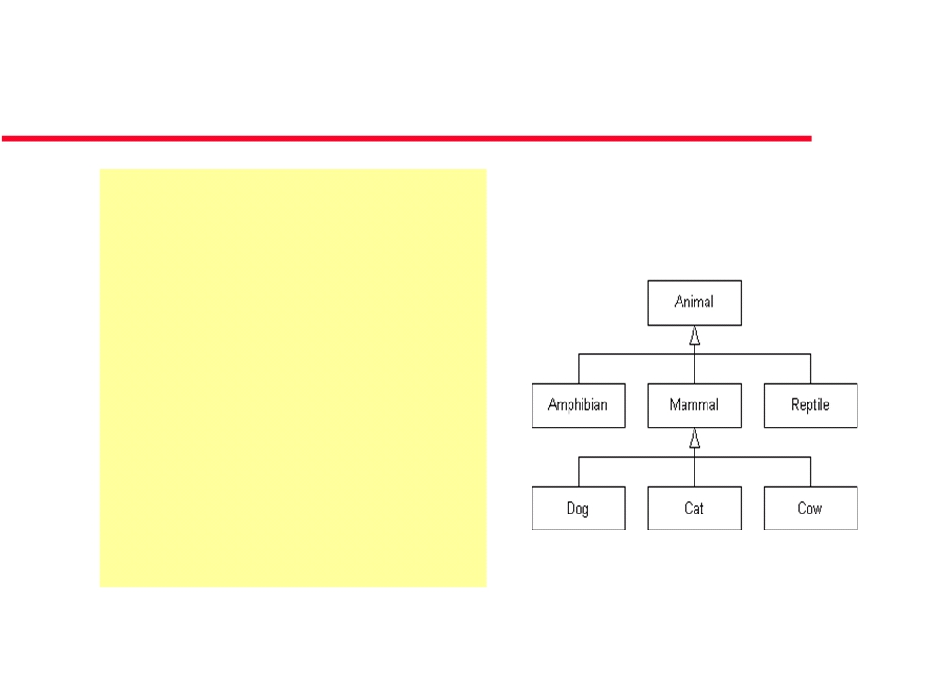
Inheritance: is a
“is a kind of”
z is a association.
z Child class ‘subclass’ can inherit attributes and
operations from parent class‘superclass’.
z Example: An inheritance
hierarchy in the animal
kingdom
Slide 25

Slide 25
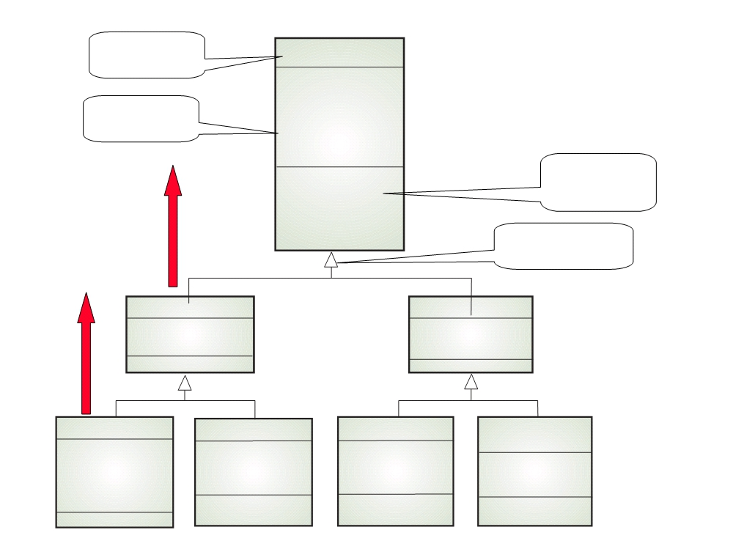
Class name
Library item
Library class hierarchy
Catalogue number Acquisition date Cost
Attributes
Type Status
Number of copies
Methods Operations
Acquire () Catalogue () Dispose () Issue ()
Is a
Return ()
Generalisation
Published item
Recorded item Title
Is a
Title
Publisher
Medium
Book
Magazine
Film Computer
program Director
Author Edition
Year Issue
Date of release Version Distributor
Publication date
Platform
ISBN

Slide 26
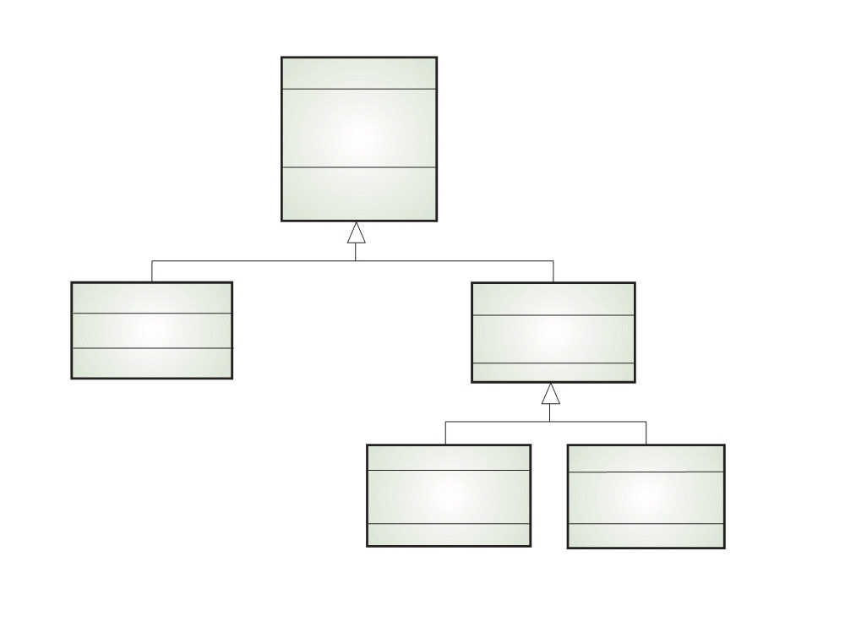
Library user
User class hierarchy
Name
Address Phone
Registration #
Register () De-register ()
Reader
Borrower
Affiliation
Items on loan
Max. loans
Staff
Student
Department
Major subject
Department phone
Home address

Slide 27
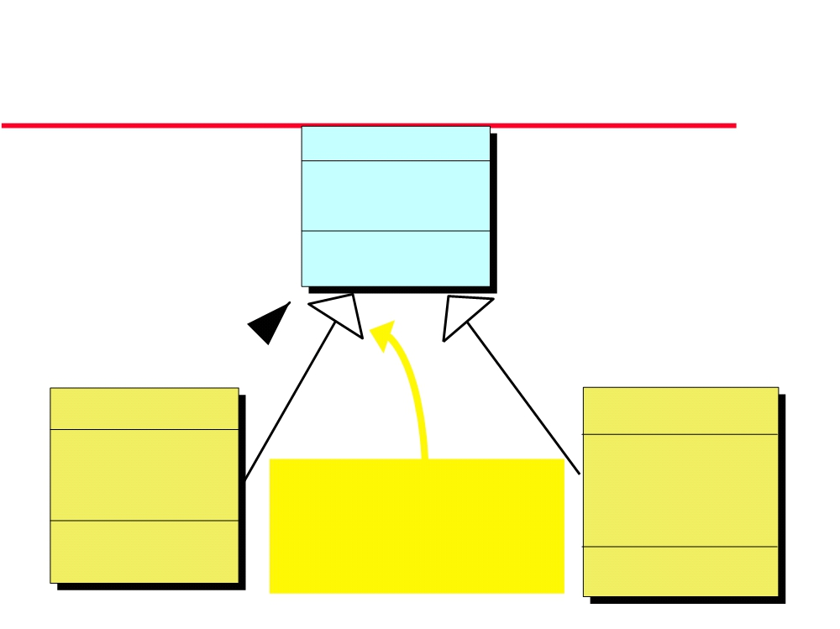
Hierarchy Diagram
(UML notation)
PERSON
Name, Address Phone, Sex
Date of Birth
ChangeAddress EnquireDOB&Sex
ISA
CUSTOMER
EMPLOYEE
Balance
SIN
O/Due 30, 60, 90 Credit Rating
Marital Status
This kind of arrowhead indicates that this
No. of Dependants Date Hired
Date Paid
CheckCrRating AgeBalances
relationship is one of subclassing
Wage Rate GiveRaise
CalcMonthPay
Slide 28

Slide 28
Multiple inheritance
z Rather than inheriting the attributes and services from a single parent class, a system which supports multiple inheritance allows object classes to inherit from several super-classes
z Can lead to semantic conflicts where attributes/services with the same name in different super-classes have different semantics
z Makes class hierarchy reorganisation more complex z Java does not support multiple inheritance
Slide 30

Slide 29
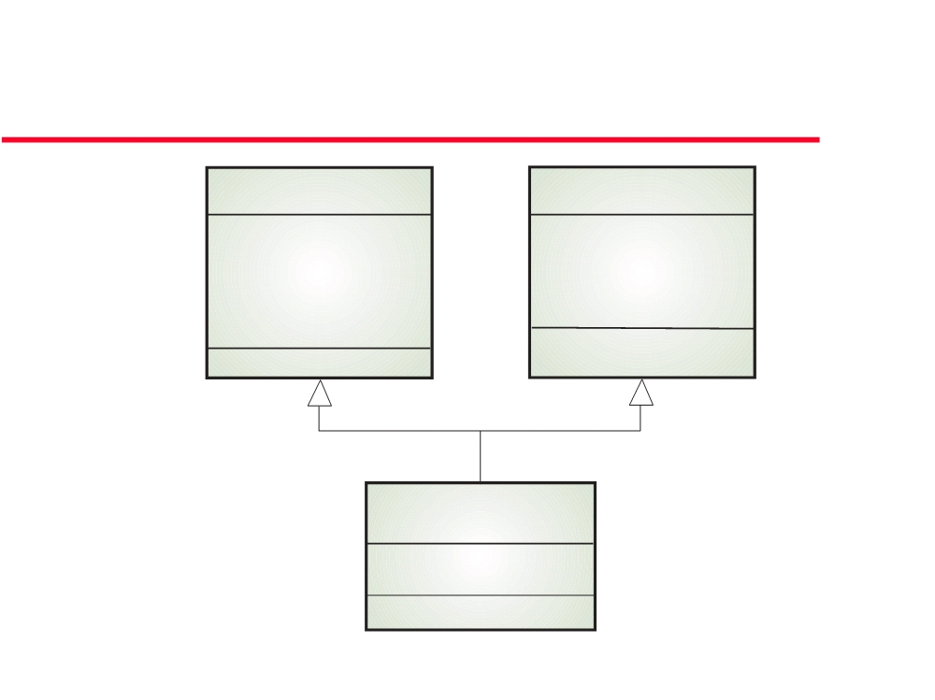
Example: Multiple inheritance
The talking book
Book
Voice recording
Author Edition
Speaker Duration
Publication date ISBN
Recording date
Talking book
# Tapes
Slide 31

Slide 30
UML: Associations of regular
classes
Association:
z Who does what relationship
Who does what Librarian works in Library
z When classes are connected together
conceptually, that connection is called an association
Slide 32

Slide 31
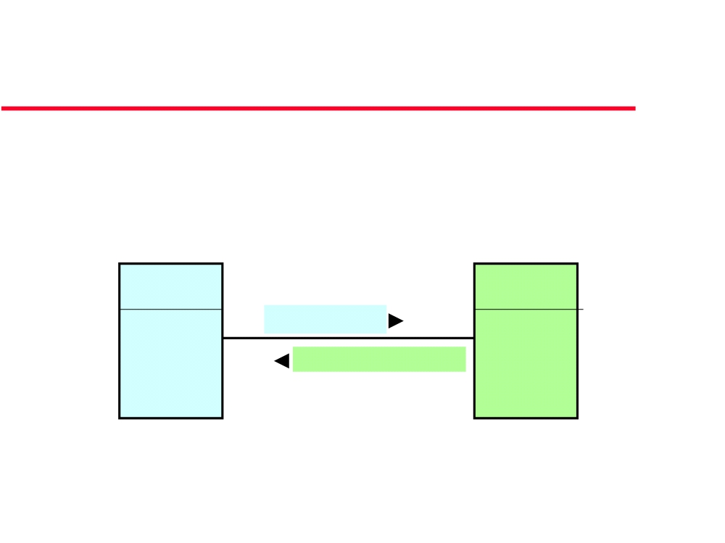
Associations of regular classes -
Who does what
• A manager supervises 1..* employees
• An employee is supervised by 1 manager
Manager 1
Employee
supervises 1..*
is supervised by
Slide 33

Slide 32
Multiplicity of an Association
z Shows the number of objects from one class that relate with a number of objects in an associated class.
Slide 35

Slide 33
UML: Multiplicity
One class can be relate to another in a: z one-to-one
z one-to-many
z one-to-one or more z one-to-zero or one
z one-to-a bounded interval (one-to-two through twenty) z one-to-exactly n
z one-to-a set of choices (one-to-five or eight)
z The UML uses an asterisk (*) to represent more and to represent many .
Slide 36

Slide 34
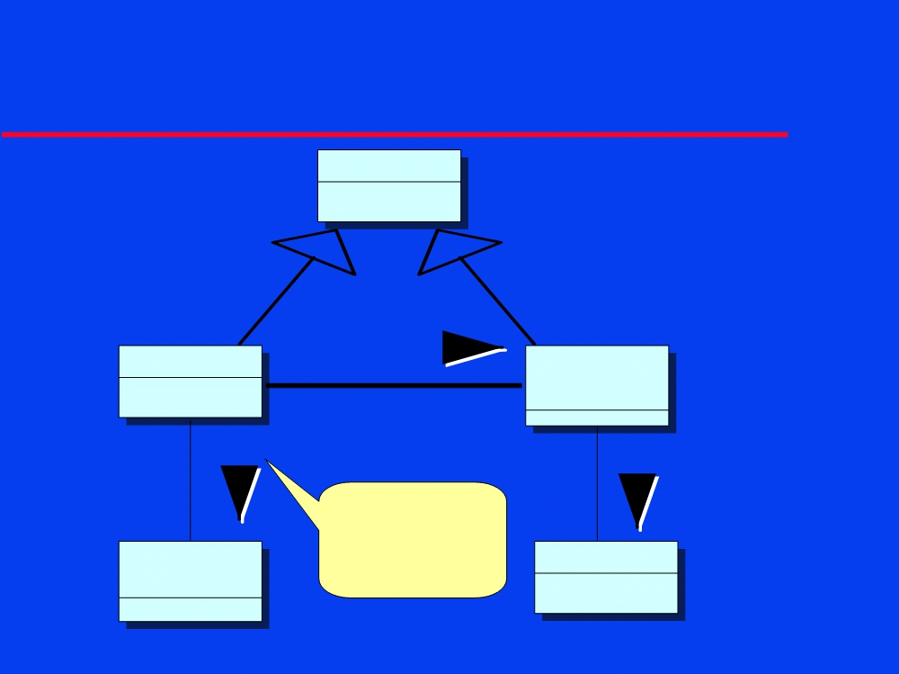
Association and Inheritance.
Employee
Manager
supervises
Regular Employee
1
*
1 drives
*
belongs to
*
Association: 1
Who does
Company Vehicle
what
Union
Slide 37

Slide 35
OO: Visibility of attributes or
operations
z Visibility: specifies the extent to which other classes can use a given class's attributes or operations.
Three levels of visibility:
: public level (usability extends to other classes) : protected level (usability is open only to classes that
z +
z #
inherit from original class)
z -
: private level (only the original class can use the attribute or operation)
Slide 38

Slide 36
OO: Visibility
Ex: Public and private operations in a Hard Disk
Slide 39

Slide 37
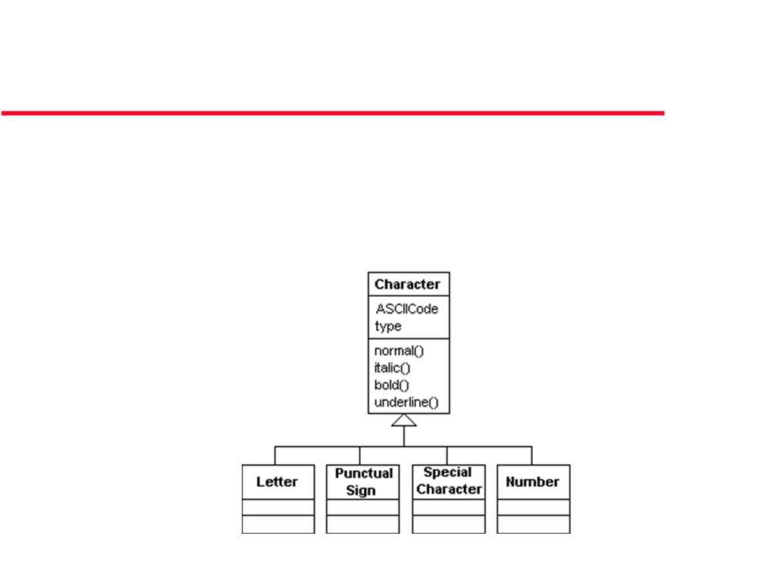
Ex: The character hierarchy
z
The Character class will have ASCIIcode and type as attributes (type tells the type of the character - normal, italic, bold or underline), and normal(), bold(), italic() and underline() as operations. The Character class children will be: Letter, PunctualSign, SpecialCharacter and Number.
Slide 40

Slide 38
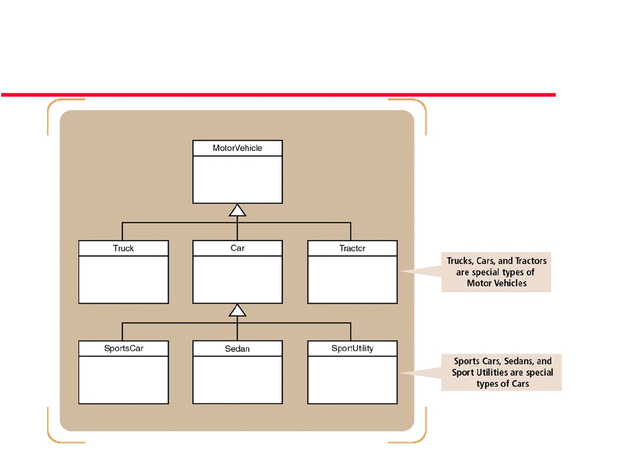
Ex: Generalization/Specialization Hierarchy Notation for Motor Vehicles
Slide 41

Slide 39
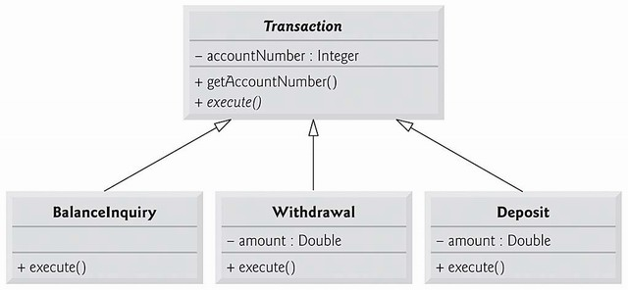
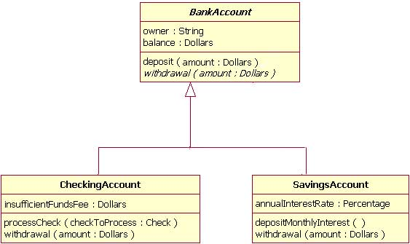
Ex: Generalization/Specialization Hierarchy
Slide 41

Slide 40
Object Aggregation
z Has-a relationship
z Structural: whole/part
z Peer relationship
•
Whole & parts objects can exist independently
z A special form of association
Slide 42

Slide 41
Object Aggregation: Peer relationship
z Whole & parts objects can exist independently z Example: a bank (whole) has customers (as parts) z Deleting a bank does not cascade deleting
customers
z Customers can move to another bank
z Programming: whole contains an array of parts
Slide 43

Slide 42
Object Aggregation
z Aggregation model shows how classes (which are collections) are composed of other classes.
z Similar to the part-of relationship in semantic data models.
z A line joins a whole to a part (component) with an open diamond on the line near the whole.
Slide 44

Slide 43
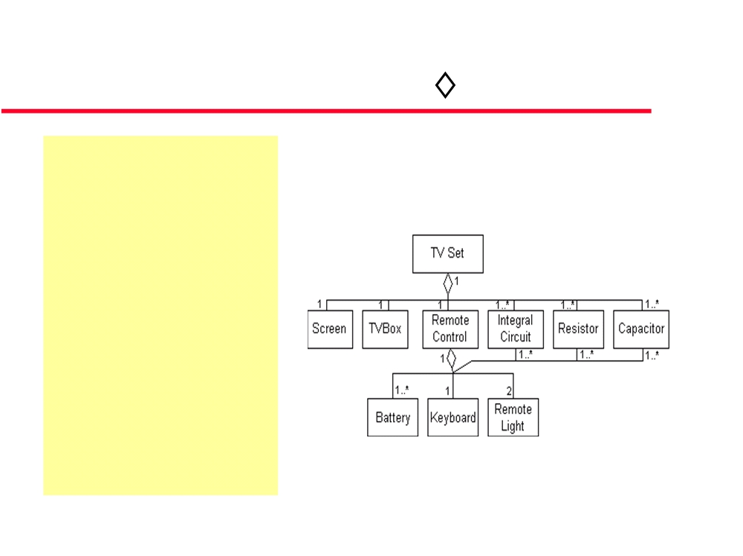
Object Aggregation
Example: An aggregation
association in the TV Set system
z Every TV has a TV box, screen, speaker(s),
resistors, capatitors,
transistors, ICs... and
possibly a remote control.
z Remote control can have these parts: resistors,
capatitors, transistors, ICs, battery, keyboard and remote lights.
Slide 45

Slide 44
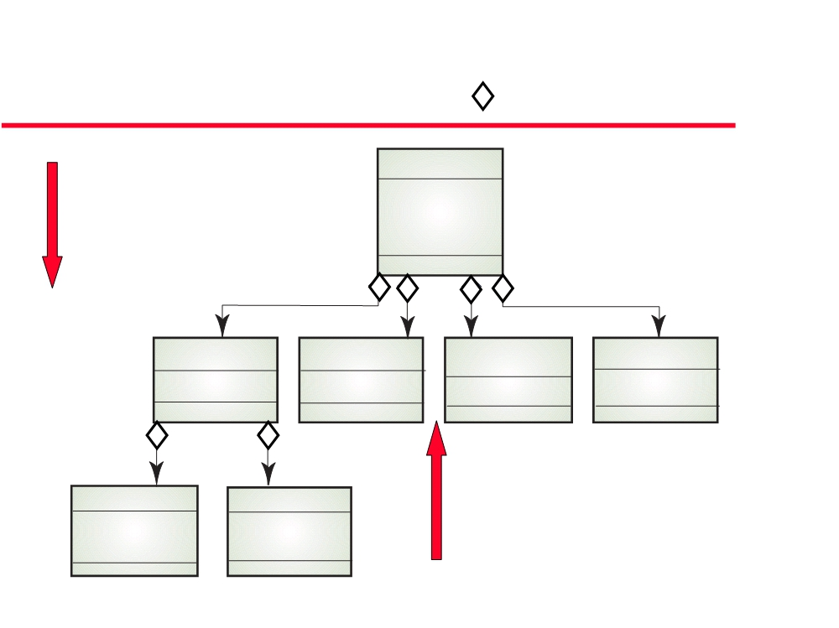
Object aggregation
Study pack
“has”
Course title Number
“composed of”
Year
Instructor
1 1 1
1
1..*
1..*
1
14
Assignment Credits
OHP slides Slides
Lecture Videotape
notes Tape ids.
Text
1
1
1..3
0..3
Exercises
Solutions
“part of”
#Problems
Text
Description
Diagrams
Slide 46

Slide 45
Composition
z A composite is a strong type of aggregation.
z Each component in a composite can belong to just one whole .
z The symbol for a composite is the same as the
symbol for an aggregation except the diamond is filled.
Slide 47

Slide 46
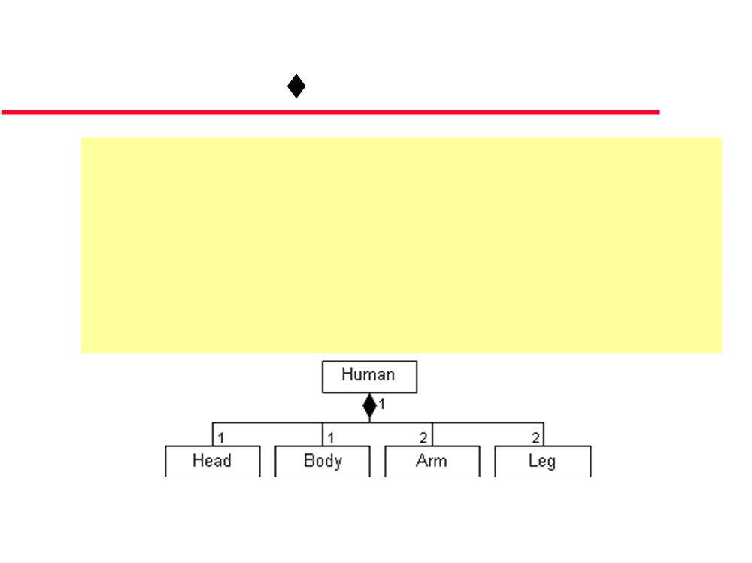
Composition
- Example 1
z Human's outside:
Every person has: head, body, arms and legs.
z A composite association. In this association each component belongs to exactly one whole .
z Whole & parts objects can NOT exist independently
Slide 48

Slide 47
Composition
- Example 2
z A bank (whole) has many branches (parts)
z Branches can not exist independently of the whole (parts objects can NOT exist independently)
z Deleting a bank (whole) cascades deleting branches (parts)
z But, if a branch (part) is deleted, the bank (whole) may remain
Slide 49

Slide 48
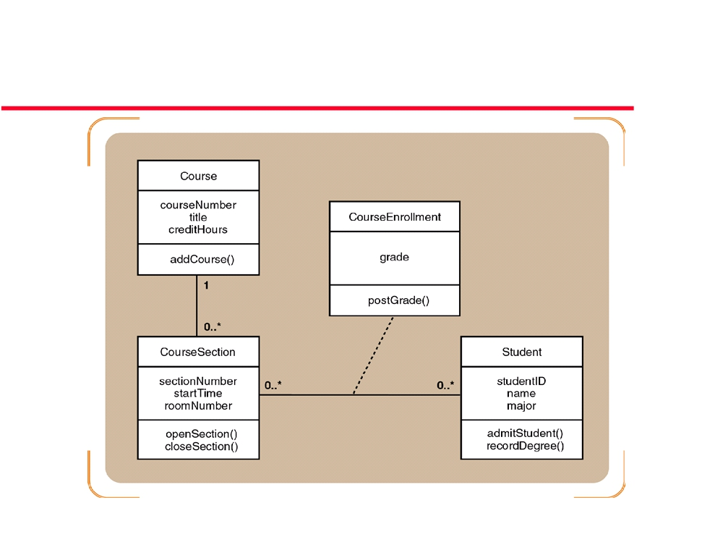
University Course Enrollment Design
Class Diagram (With Methods)
Slide 50

Slide 49
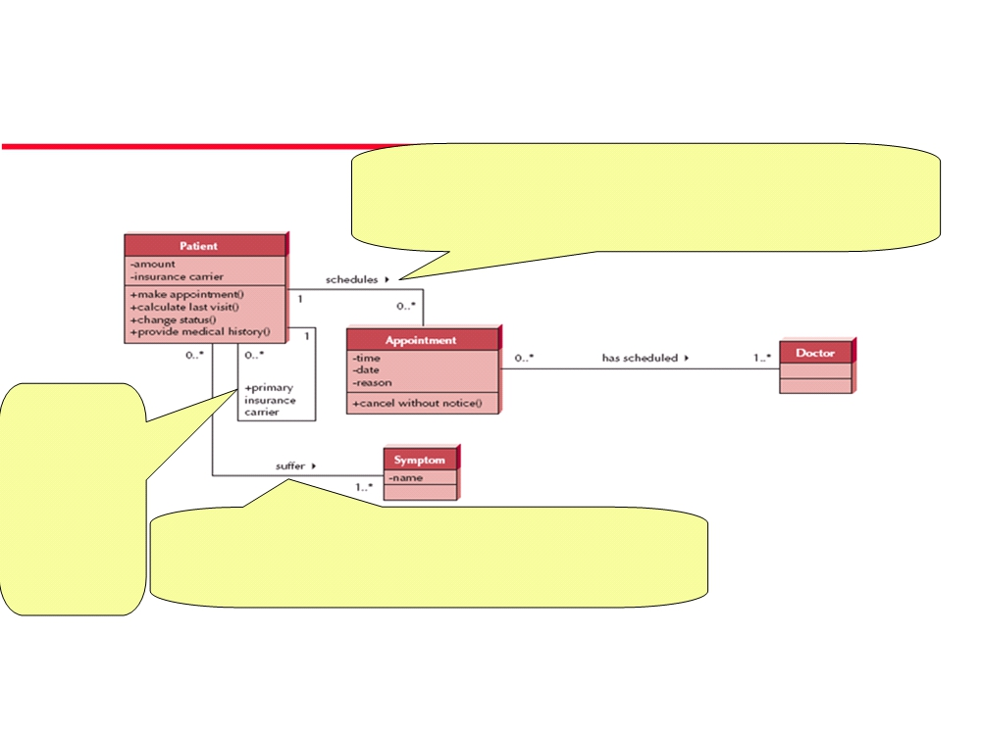
Class diagram - Example
Reflexive association
Association: Patient schedules (zero or more) Appointment
Inverse Association: Appointment is associated with only one Patient
+ Role: Class
related to itself
Patient “is
primary
insurance carrier” of another patient (child, spouse)
Association: Patient suffers (1 or more) Symptom
Inverse Association: Symptom is suffered by (zero or more) Patient
Slide 52

Slide 50
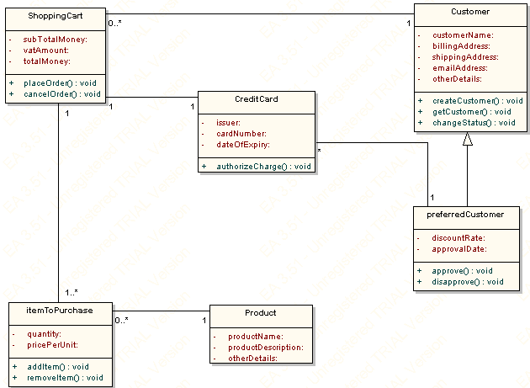
Example:
Slide 50

