Slide 1
Concepts of Object Orientation

Slide 2

What Is Object Technology?
Object technology
  A set of principles guiding software construction together with languages, databases, and other tools that support those principles.
  Object-oriented technology (OOT) is a software design model in which objects contain both data and the instructions that work on the data.

Slide 3


Best Practices Implementation
Object technology helps implement these Best Practices.
  Develop Iteratively: tolerates changing requirements, integrates elements progressively, facilitates reuse.
  Model Visually: easy understanding, easy modification.

Slide 4
Strengths of Object Technology
Provides a single paradigm
  A single language used by users, analysts, designers, and implementers
Facilitates architectural and code reuse
Models more closely reflect the real world
  More accurately describes corporate entities
  Decomposed based on natural partitioning
  Easier to understand and maintain
Provides stability
  A small change in requirements does not mean massive changes in the system under development
Is adaptive to change

Slide 5
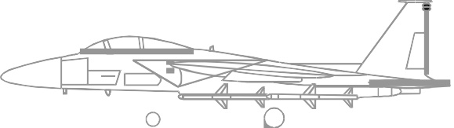

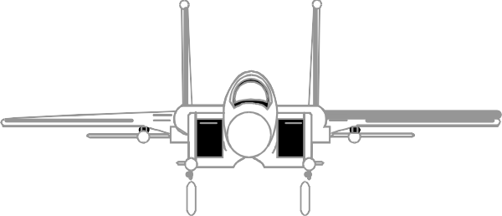
What Is a Model?
A model is a simplification of reality.

Slide 6
Why Do We Model?
We build models to better understand the system we are developing.
Modeling achieves four aims. It:
  Helps us to visualize a system as we want it to be.
  Permits us to specify the structure or behavior of a system.
  Gives us a template that guides us in constructing a system.
  Documents the decisions we have made.
We build models of complex systems because we cannot comprehend such a system in its entirety.

Slide 7
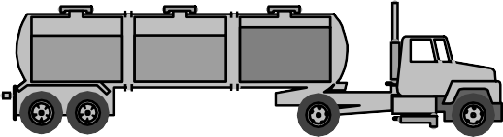
What Is an Object?
Informally, an object represents an entity, either physical, conceptual, or software.
  Physical entity
Truck
Conceptual entity
Chemical Process
Software entity
Linked List

Slide 8
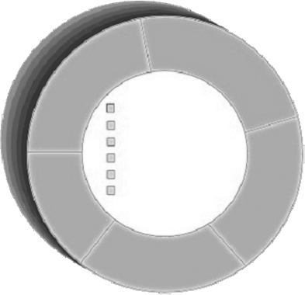
A More Formal Definition
Attributes
An object is an entity
with a well-defined boundary and identity that encapsulates state and behavior.
  State is represented by attributes and relationships.
  Behavior is represented by operations, methods, and state machines.
Object
Operations

Slide 9
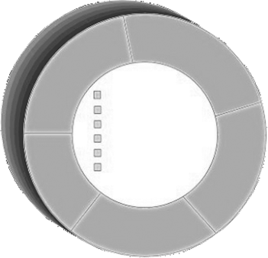
An Object Has State
The state of an object is one of the possible conditions in which the object may exist.
The state of an object normally changes over time.
Name: J Clark Employee ID: 567138 HireDate: 07/25/1991
Status: Tenured Discipline: Finance MaxLoad: 3
Name: J Clark Employee ID: 567138
Date Hired: July 25, 1991 Status: Tenured
Discipline: Finance
Maximum Course Load: 3 classes
Professor Clark

Slide 10

An Object Has Behavior
Behavior determines how an object acts and reacts.
The visible behavior of an object is modeled by the set of messages it can respond to (operations the object can perform).
AcceptCourseOffering()
SubmitFinalGrades()
Professor Clark’s behavior
Submit Final Grades Accept Course Offering Take Sabbatical
Maximum Course Load: 3 classes
SetMaxLoad()
TakeSabbatical()
Professor Clark

Slide 11


An Object Has Identity
Each object has a unique identity, even if
the state is identical to that of another object.
Professor “J Clark” teaches Biology
Professor “J Clark” teaches Biology

Slide 12
Representing Objects in the UML
An object is represented as a rectangle with an underlined name.
J Clark : Professor
Named Object
: Professor
Professor J Clark
Unnamed Object

Slide 13
Basic Principles of Object Orientation
Object Orientation
Abstraction
Encapsulation
Modularity
Hierarchy

Slide 14
What Is Abstraction?
The essential characteristics of an entity that distinguish it from all other kinds of entities
Defines a boundary relative to the perspective of the viewer
Is not a concrete manifestation, denotes the ideal essence of something

Slide 15



Example: Abstraction
Student
Professor
Course Offering (9:00 AM, Monday-Wednesday-Friday)

Slide 16
What Is Encapsulation?
Hide implementation from clients.
  Clients depend on interface.
Improves Resiliency

Slide 17

Encapsulation Illustrated
Professor Clark
needs to be able to teach four classes in the next semester.
Professor Clark
AcceptCourseOffering()
SubmitFinalGrades()
Name: J Clark Employee ID: 567138 HireDate: 07/25/1991 Status: Tenured
Discipline: Finance MaxLoad:4
SetMaxLoad(4)
SetMaxLoad()
TakeSabbatical()

Slide 18
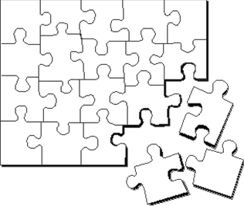
What Is Modularity?
Modularity is the breaking
up of something complex into manageable pieces.
Modularity helps people to understand complex systems.

Slide 19

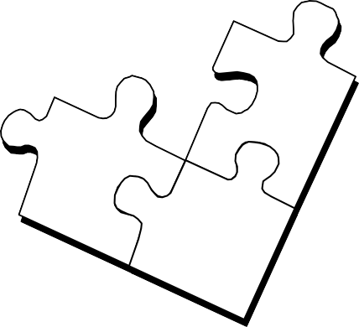


Example: Modularity
For example, break
complex systems into smaller modules.
Billing System
Course Catalog System
Course Registration System
Student Management System

Slide 20

What Is Hierarchy?
Asset
Increasing abstraction
BankAccount
Security
RealEstate
Savings
Checking
Stock
Bond
Decreasing abstraction
Elements at the same level of the hierarchy should be at the same level of abstraction.

Slide 21
What Is a Class?
A class is a description of a set of objects that share the same attributes, operations, relationships, and semantics.
  An object is an instance of a class.
A class is an abstraction in that it
  Emphasizes relevant characteristics.
  Suppresses other characteristics.
Class
+ attribute
+ operation()

Slide 22
Representing Classes in the UML
A class is represented using a rectangle with compartments.
Professor
name employeeID : UniqueID hireDate status discipline maxLoad
+ submitFinalGrade() + acceptCourseOffering() + setMaxLoad() + takeSabbatical()
Professor J Clark

Slide 23
The Relationship Between Classes and Objects
A class is an abstract definition of an object.
  It defines the structure and behavior of each object in the class.
  It serves as a template for creating objects.
Classes are not collections of objects.
Professor
Professor Torpie
Professor Meijer
Professor Allen

Slide 24
What Is an Attribute?
An attribute is a named property of a class that describes a range of values that instances of the property may hold.
  A class may have any number of attributes or no attributes at all.
Student
name address studentID dateOfBirth
Attributes

Slide 25
What Is an Operation?
An operation is the implementation of a service that can be requested from any object of the class to affect behavior.
A class may have any number of operations or none at all.
Student
+ getTuition() + addSchedule() + getSchedule() + deleteSchedule() + hasPrerequisites()
Operations

Slide 26
What Is Polymorphism?
The ability to hide many different implementations behind a single interface
Manufacturer B
Manufacturer C
Manufacturer A
OO Principle: Encapsulation

Slide 27
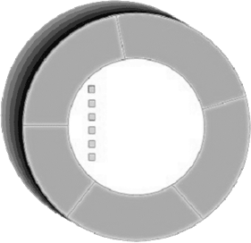
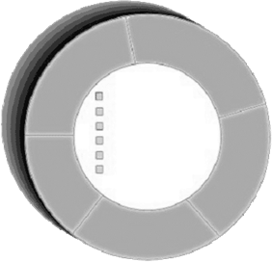

Example: Polymorphism
shapeArea.getCurrentValue()
getCurrentValue()
getCurrentValue()
getCurrentValue()
Square
Circle
Triangle

