Slide 1
Use Cases
1

Slide 2
What is a Use-Case
A use-case captures some user visible function
This may be a large or small function
A use-case achieves a discrete goal for the user
Examples
Format a document
Request an elevator

Slide 3
User Goals versus User Interactions
Consider the following when formatting a document
Define a style
Change a style
Copy a style from one document to the next
versus
Format a document
Ensure consistent formatting of two documents
The first are user interactions
Things the user does to the system to achieve the goal
The last is a user goal
Something the user wants to achieve

Slide 4
Goals and Interactions
There is a place for both goals and interactions
Understand what the system shall do
Capture the user goals
Understand how the user will achieve the goals
Capture user interactions
Sequences of user interactions
Thus, start with the user goals and then refine the user goals into several (many) user interactions

Slide 5
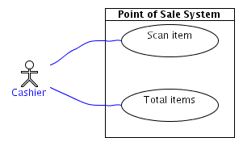
Use
Case
Diagrams
▪
A cashier uses the
to scan an item.
POS
system
▪
A cashier uses
the
POS
system
to
total
items.
20

Slide 6
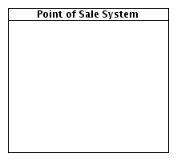
System
Boundary
▪
Marks off the system as
separate from its environment
▪
Actors are outside
▪
When no system boundary is
shown, the
system
is assumed
21

Slide 7
Actor
▪
Someone or something outside
the system that interacts with it
▪
Actors represent “roles”
individuals
not
Smith
22

Slide 8
Actors
An actor represents a set of roles that users of use case play when interacting with these use cases.
Actors can be human or automated systems.
Actors are entities which require help from the system to perform their task or are needed to execute the system’s functions.
Actors are not part of the system.
Name

Slide 9
Use Cases and Actors
From the perspective of a given actor, a use case does something that is of value to the actor, such as calculate a result or change the state of an object.
The Actors define the environments in which the system lives

Slide 10
Use
Case
▪
A use case achieves a goal of
value to an actor
Defines a task which must be
supported by the system
What system is for not how it
does it
Starts with an active verb from
▪
▪
▪
the
point of
view
of
the system
23

Slide 11
Relationships between Use Cases
1. Generalization - use cases that are specialized versions of other use cases.
2. Include - use cases that are included as parts of other use cases. Enable to factor common behavior.
3. Extend - use cases that extend the behavior of other core use cases. Enable to factor variants.

Slide 12
Use Case Modeling Example

Slide 13
Online Car Rental System
A customer can browse available cars.
A customer can create a new car reservation.
The system validates credit card information by communicating with an online credit card validator system.
A clerk can view and print car reservations.

Slide 14
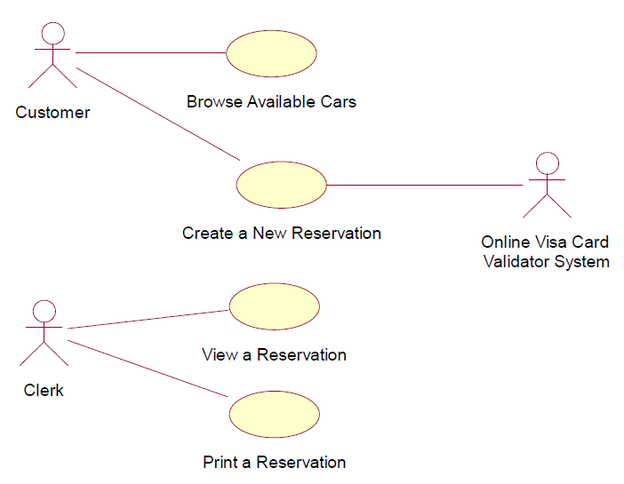
Use Case Diagram – 1 (No use of includes/extends)

Slide 15
Use Case Description 1 - Create a New Reservation
Primary Actor: Customer
Secondary Actor: Online Visa Card Validator System
Pre-conditions: Customer is on the main page.
Post-conditions: If the basic flow was successful, a new reservation is created. Otherwise, the system state is unchanged.

Slide 16
Basic flow
actor | system
1. Customer selects the “Create a New Reservation” option. | 2. System requests reservation information [pickup location, pickup date, return date, pickup time, return time, and vehicle].
3.Customer submits reservation information. | 4. System requests customer information [first name, last name, email address, driver’s license number, credit card number and date]
5. Customer submits his/her information. | 6. System sends credit card information [first name, last name, credit card number and date] to Online Visa Card Validator System.
7. Online Visa Card Validator System validates credit card information.
8.Online Visa Card Validator System sends a message acknowledging credit card validation to System.
 | 9. System displays a message confirming the new reservation and showing the reservation details.
 | 10. System sends an email message to Customer’s email address confirming the new reservation and showing the reservation details.

Slide 17
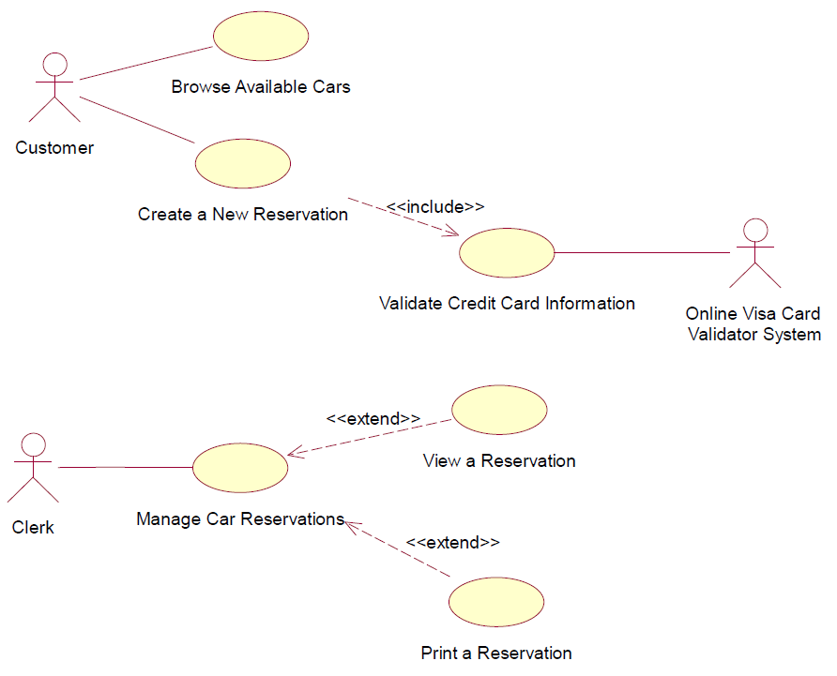
Use Case Diagram – 2 (Use of includes/extends)

Slide 18
Use Case Description 2 Create a New Reservation
Primary Actor: Customer
Secondary Actor: Online Visa Card Validator System
Pre-conditions: Customer is on the main page.
Basic Flow:
Customer selects the “Create a New Reservation” option.
System requests reservation information [pickup location, pickup date, return date, pickup time, return time, and vehicle].
Customer submits reservation information.
System requests customer information [first name, last name, email address, driver’s license number, credit card number and date]
Customer submits his/her information.
Execute the ‘Validate Credit Card Information’ use case.
System displays a message confirming the new reservation and showing the reservation details.
System sends an email message to Customer’s email address confirming the new reservation and showing the reservation details.
Post-conditions: If the basic flow was successful, a new reservation is created. Otherwise, the system state is unchanged.

Slide 19
Alternative Flows – UCD 1
In Step 7, credit card information is not valid: Online Visa Card Validator System sends an error message to System. System displays the error message to Customer. Repeat from Step 4.
In Step 3, necessary reservation information is missing: System displays an error message requesting the missing information. Repeat from Step 2.
In Steps 3 and 5, a timeout occurs: System displays a ‘timeout’ error message. Customer is returned to the main page.

Slide 20
Extra Examples
http://gyan.frcrce.ac.in/~surve/OOAD/UCD/UCD_CaseStudy.html

