Slide 1
Software Testing

Slide 2
Introduction
Software Testing is the process of executing a program or system with the intent of finding errors.
It involves any activity aimed at evaluating an attribute or capability of a program or system and determining that it meets its required results

Slide 3
Testing Objectives
Testing is a process of executing a program with the intent of finding an error.
A good test case is one that has high probability of finding an undiscovered error.
A successful test is one that uncovers an as-yet undiscovered error.
The major testing objective is to design tests that systematically uncover types of errors with minimum time and effort.

Slide 4
Test Charactaristics
A good test has a high probability of finding an error
The tester must understand the software and how it might fail
A good test is not redundant
Testing time is limited; one test should not serve the same purpose as another test
A good test should be “best of breed”
Tests that have the highest likelihood of uncovering a whole class of errors should be used
A good test should be neither too simple nor too complex
Each test should be executed separately; combining a series of tests could cause side effects and mask certain errors

Slide 5
Characteristics of Testable Software
Operable
The better it works (i.e., better quality), the easier it is to test
Observable
Incorrect output is easily identified; internal errors are automatically detected
Controllable
The states and variables of the software can be controlled directly by the tester
Decomposable
The software is built from independent modules that can be tested independently

Slide 6
Characteristics of Testable Software
Simple
The program should exhibit functional, structural, and code simplicity
Stable
Changes to the software during testing are infrequent and do not invalidate existing tests
Understandable
The architectural design is well understood; documentation is available and organized

Slide 7
Levels of Testing
Unit Testing
Integration Testing
Validation Testing
Acceptance Testing

Slide 8
Unit Testing
Algorithms and logic
Data structures (global and local)
Interfaces
Independent paths
Boundary conditions
Error handling

Slide 9
Why Integration Testing Is Necessary
One module can have an adverse effect on another
Subfunctions, when combined, may not produce the desired major function
Interfacing errors not detected in unit testing may appear
Timing problems (in real-time systems) are not detectable by unit testing

Slide 10
Validation Testing
Determine if the software meets all of the requirements defined in the SR
Having written requirements is essential
Regression testing involves selectively repeating existing validation tests, not developing new tests

Slide 11
Acceptance Testing
Similar to validation testing except that customers are present or directly involved.
Usually the tests are developed by the customer

Slide 12
Test technique
White box or glass box testing
Black box testing

Slide 13
Two Unit Testing Techniques
Black-box testing
Knowing the specified function that a product has been designed to perform, test to see if that function is fully operational and error free
Not concerned with internal logical structure of the software
White-box testing
Knowing the internal workings of a product, test that all internal operations are performed according to specifications and all internal components have been exercised
Logical paths through the software are tested
Test cases exercise specific sets of conditions and loops

Slide 14
Black-box Testing

Slide 15
Black Box Testing
Test cases are derived from formal specification of the system.
Test case selection can be done without any reference to the program design or code.
Only tests the functionality and features of the program.
Not the internal operation.
Advantages
Test case selection is done before the implementation of a program.
Help in getting the design and coding correct with respect to the specification.

Slide 16
Black box

Slide 17
Black-box Testing Categories
Incorrect or missing functions
Interface errors
Errors in data structures or external data base access
Behavior or performance errors
Initialization and termination errors

Slide 18
Questions answered by Black-box Testing
How is functional validity tested?
How are system behavior and performance tested?
What classes of input will make good test cases?
Is the system particularly sensitive to certain input values?
How are the boundary values of a data class isolated?
What data rates and data volume can the system tolerate?
What effect will specific combinations of data have on system operation?

Slide 19
White-box Testing

Slide 21
White Box Testing
Test cases are derived from the internal design specification or actual code for the program.
Advantages
Tests the internal details of the code;
Checks all paths that a program can execute.
Limitations
Wait until after designing and coding the program under test in order to define test cases.

Slide 22
White box testing

Slide 25
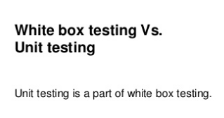

Slide 26
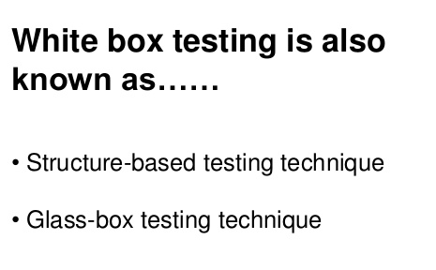
White Box Testing
White-box test design techniques include:
Control flow testing
Data flow testing
Branch testing
Path testing

Slide 27
White-box Testing
These test cases
Guarantee that all independent paths within a module have been exercised at least once
Exercise all logical decisions on their true and false sides
Execute all loops at their boundaries and within their operational bounds
Exercise internal data structures to ensure their validity

Slide 28
Basis Path Testing
White-box testing technique proposed by Tom McCabe enables the test case designer to derive a logical complexity measure of a procedural design
Uses this measure as a guide for defining a basis set of execution paths
Test cases derived to exercise the basis set are guaranteed to execute every statement in the program at least one time during testing

Slide 29
Flow Graph Notation
A circle in a graph represents a node, which stands for a sequence of one or more procedural statements
A node containing a simple conditional expression is referred to as a predicate node
Each compound condition in a conditional expression containing one or more Boolean operators (e.g., and, or) is represented by a separate predicate node
A predicate node has two edges leading out from it (True and False)
An edge, or a link, is a an arrow representing flow of control in a specific direction
An edge must start and terminate at a node
An edge does not intersect or cross over another edge

Slide 30
Flow Graph Example
FLOW CHART
FLOW GRAPH
0
0
1
1
2
2
3
3
6
4
6
4
7
8
5
7
8
5
9
9
11
10
11
10

Slide 31
Independent Program Paths
Defined as a path through the program from the start node until the end node that introduces at least one new set of processing statements or a new condition (i.e., new nodes)
Must move along at least one edge that has not been traversed before by a previous path
Basis set for flow graph on previous slide
Path 1: 0-1-11
Path 2: 0-1-2-3-4-5-10-1-11
Path 3: 0-1-2-3-6-8-9-10-1-11
Path 4: 0-1-2-3-6-7-9-10-1-11
The number of paths in the basis set is determined by the cyclomatic complexity

Slide 32
Cyclomatic Complexity
Provides a quantitative measure of the logical complexity of a program
Defines the number of independent paths in the basis set
Provides an upper bound for the number of tests that must be conducted to ensure all statements have been executed at least once
Can be computed two ways
V(G) = E – N + 2, where E is the number of edges and N is the number of nodes in graph G
Results in the following equations for the example flow graph
V(G) = 14 edges – 12 nodes + 2 = 4

Slide 33
Deriving the Basis Set and Test Cases
Using the design or code as a foundation, draw a corresponding flow graph
Determine the cyclomatic complexity of the resultant flow graph
Determine a basis set of linearly independent paths
Prepare test cases that will force execution of each path in the basis set

Slide 34
Cyclomatic Complexity
Invented by Thomas McCabe (1974) to measure the complexity of a program’s conditional logic
Cyclomatic complexity of graph G equals #edges - #nodes + 2
V(G) = e – n + 2
Also corresponds to the number of linearly independent paths in a program

Slide 35
Converting Code to Graph
CODE
FLOWCHART
GRAPH
if expression1 then
statement2
else
statement3
end if
statement4
T
expr1
?
F
n1
(a)
statm2
statm3
n2
n3
statm4
n4
switch expr1
case 1:
statement2
case 2:
statm3
case 3:
statm4
end switch
statm5
1
expr1
?
3
n1
2
(b)
statm2
statm3
statm4
n2
n3
n4
statm5
n5
statm1
n1
do
statement1
while expr2
end do
statement3
(c)
T
expr2
?
n2
F
statm3
n3

Slide 36
Example Paths
if expression1 then
statement2
end if
do
statement3
while expr4
end do
if expression5 then
statement6
end if
statement7
e1
n1
n2
e3
e2
n3
e4
e5
n4
e6
e7
n5
n6
e9
e8
n7
V(G) = e – n + 2 = 9 – 7 + 2 = 4

Slide 37
Example 1

Slide 38
V=e-n+2=11-9+2=4

Slide 40
V=e-n+2=11-9+2=4

Slide 41
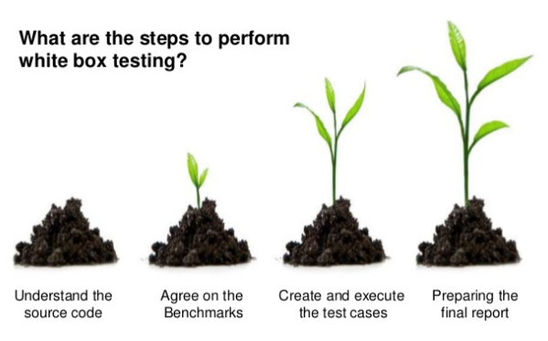

Slide 42
