Slide 1
Chapter 17
Construction Economics

Slide 2
17-1 INTRODUCTION
The financial management of a construction company is equally as important to company success as is its technical management.
The purpose of this chapter is to introduce the reader to:
  the terminology and basic principles involved in determining the owning and operating costs of construction plants and equipment,
  analyzing the feasibility of renting or leasing rather than purchasing equipment, and
  the financial management of construction projects.

Slide 3
17-2 TIME VALUE OF MONEY
The amount of money held in a savings account will increase with time if interest payments are allowed to remain on deposit (compound) in the account.
The value of a sum of money left on deposit after any period of time may be calculated using Equation 17-1.
F = P (1+i)^{n} (17-1)
where
  F =value at end of n periods (future value)
  P =present value
  i =interest rate per period
  n =number of periods
  The expression (1 + i)^{n} is often called the single-payment compound interest factor.

Slide 4
17-2 TIME VALUE OF MONEY
Equation 17-1 can be solved to find the present value (present worth) of some future amount, resulting in Equation 17-2.
p= F /(1 + i)^{n} (17-2)
The expression 1/(1 + i)n is called the single-payment present worth factor.
The methods of engineering economy are widely used to:
  analyze the economic feasibility of proposed projects,
  to compare alternative investments, and
  to determine the rate of return on an investment

Slide 5
17-3 EQUIPMENT COST
Elements of Equipment Cost
  Owning Costs
  Operating Costs

Slide 6
Elements of Equipment Cost
We have discussed the proper application of the major items of construction equipment and some methods for estimating equipment's hourly production.
We then divided the equipment's hourly cost by its hourly production to obtain the cost per unit of production.
we have simply assumed that we knew the hourly cost of operation of the equipment.
In this section we consider methods for determining the hourly cost of operation of an item of equipment.
it is necessary to estimate many factors, such as fuel consumption, tire life, and so on.

Slide 7
Elements of Equipment Cost
The best basis for estimating such factors is the use of historical data, preferably those recorded by your construction company operating similar equipment under similar conditions.
If such data are not available, consult the equipment manufacturer for recommendations.
Equipment owning and operating costs (frequently referred to as 0 & 0 costs), as the name implies, are composed of owning costs and operating costs.
  Owning costs are fixed costs that are incurred each year whether the equipment is operated or not.
  Operating costs, however, are incurred only when the equipment is used.

Slide 8
Owning Costs
Owning costs are made up of the following principal elements:
  Depreciation.
  Investment (or interest) cost.
  Insurance cost.
  Taxes.
  Storage cost.

Slide 9
Depreciation
Depreciation represents the decline in market value of an item of equipment due to age, wear, deterioration, and obsolescence.
Depreciation is used for two separate purposes:
  evaluating tax (Zakat) liability, and
  determining the depreciation component of the hourly equipment cost.

Slide 10
Depreciation
In calculating depreciation, the initial cost of an item of equipment should be the full delivered price, including:
  transportation,
  taxes, and
  initial assembly and servicing.
For rubber-tired equipment, the value of tires should be subtracted from the amount to be depreciated because tire cost will be computed separately as an element of operating cost.

Slide 11
Depreciation
Equipment salvage value should be estimated as realistically as possible based on historical data.
The most commonly used depreciation methods are:
  the straight-line method,
  the sum-of-the-years'-digits method,
  the double-declining balance method, and
  IRS-prescribed methods.

Slide 12
Straight-Line Method
The straight-line method of depreciation produces a uniform depreciation for each year of equipment life.
Annual depreciation is thus calculated as the amount to be depreciated divided by the equipment life in years (Equation 17-3).
D_{n} = (Cost - Salvage (- tires)) / N (17-3)
where
  N =equipment expected life (years)
  n =year of life (1, 2, 3, etc.)

Slide 13
EXAMPLE 17-1
Using the straight-line method of depreciation, find the annual depreciation and book value at the end of each year for a track loader having an initial cost of $50,000, a salvage value of $5000, and an expected life of 5 years.

Slide 14
EXAMPLE 17-1
Solution
  D_{l, 2, 3, 4, 5} = (50,000- 5000)/5 = $9000
Year | Depreciation | Book Value (End of Period)
0 | 0 | $50,000
1 | $9,000 | 41,000
2 | 9,000 | 32,000
3 | 9,000 | 23,000
4 | 9,000 | 14,000
5 | 9,000 | 5,000

Slide 15
Sum-of-the-Years'-Digits Method
The sum-of-the-years'-digits method of depreciation produces a nonuniform depreciation which is the highest in the first year of life and gradually decreases thereafter.
The amount to be depreciated is the same as that used in the straight-line method. (Equation 17-4)
D_{n} = [(N - (n-1))/(Sum of years ' digit)] × Amount to be depreciated (17-4)

Slide 16
EXAMPLE 17-2
For the loader of Example 17-1, find the annual depreciation and book value at the end of each year using the sum-of-the-years'-digits method.
Solution
Using Equation 17-4:
  D₁ = (5- (1-1))/15 × (50,000 - 5000) = 15,000
  D₂ = (5- (2-1))/15 × (50,000 - 5000) = 12,000
  D₃ = 3/15 × (50,000 - 5000) = 9,000
  D₄ = 2/15 × (50,000 - 5000) = 6,000
  D₅ = 1/15 × (50,000 - 5000) = 3,000

Slide 17
EXAMPLE 17-2
Year | Depreciation | Book Value (End of Period)
0 | 0 | $50,000
1 | $15,000 | 35,000
2 | 12,000 | 23,000
3 | 9,000 | 14,000
4 | 6,000 | 8,000
5 | 3,000 | 5,000

Slide 18
Double-Declining-Balance Method
The double-declining-balance method of depreciation, like the sum-of-the-years' -digits method, produces its maximum depreciation in the first year of life,
The annual depreciation factor is found by dividing 2 (or 200%) by the equipment life in years.
  Thus for a 5-year life, the annual depreciation factor is 0.40 (or 40%).
Unlike the other two depreciation methods, the double-declining-balance method does not automatically reduce the equipment's book value to its salvage value at the end of the depreciation period.

Slide 19
Double-Declining-Balance Method
Since the book value of equipment is not permitted to go below the equipment's salvage value, care must be taken when performing the depreciation calculations to stop depreciation when the salvage value is reached. (Equation 17-5)
D_{n} =2/N × Book value at beginning of year (17-5)

Slide 20
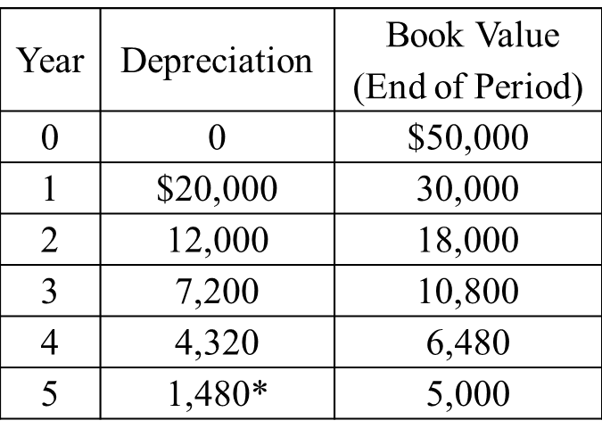
EXAMPLE 17-3
For the loader of Example 17-1, find the annual depreciation and book value at the end of each year using the double-declining-balance method.
Solution
Annual depreciation factor = 2.00/5 = 0.40
  D₁ =0.40 × 50,000= 20,000
  D₂ = 0.40 × 30,000 = 12,000
  D₃ = 0.40 × 18,000 = 7,200
  D₄ = 0.40 × 10,800 = 4,320
  D₅ = 0.40 × 6,480 = 2,592 use $1,480*
*Because a depreciation of $2592 in the fifth year would reduce the book value to less than $5000, only $1480 ($6480 - $5000) may be taken as depreciation.

Slide 21
Investment Cost
Investment cost (or interest) represents the annual cost (converted to an hourly cost) of the capital invested in a machine.
Investment cost is computed as the product of an interest rate multiplied by the value of the equipment, then converted to cost per hour.
The average hourly investment cost may be more easily calculated by Equation 17-6.
Average investment = (Initial cost + Salvage)/2 (17-6)

Slide 22
Insurance, Tax, and Storage
Insurance cost represents the cost of insurance for fire, theft, accident, and liability for the equipment.
Tax cost represents the cost of property tax and licenses for the equipment.
Storage cost represents the cost of rent and maintenance for equipment storage yards and facilities.

Slide 23
Operating Costs
Fuel Cost.
Service Cost.
Repair Cost.
Tire Cost.
Special Items
Operator

Slide 24
Operating Costs
Operating costs are incurred only when equipment is operated.
Therefore, costs vary with the amount of equipment use and job operating conditions.
The major elements of operating cost include:
  Fuel cost.
  Service cost.
  Repair cost.
  Tire cost.
  Cost of special items.
  Operators' wages.

Slide 25
Fuel Cost
The hourly cost of fuel is simply fuel consumption per hour multiplied by the cost per unit of fuel (gallon or liter). Table 17-l.
TABLE 17-1: Fuel consumption factors (gal/h/hp)
 |  | Load Conditions*
Type of Equipment | Low | Average | Severe
Clamshell and dragline | 0.024 | 0.030 | 0.036
Compactor, self-propelled | 0.038 | 0.052 | 0.060
Crane | 0.018 | 0.024 | 0.030
Excavator, hoe, or shovel | 0.035 | 0.040 | 0.048
Loader
Track | 0.030 | 0.042 | 0.051
Wheel | 0.024 | 0.036 | 0.047
Motor grader | 0.025 | 0.035 | 0.047
Scraper | 0.026 | 0.035 | 0.044
Tractor
Crawler | 0.028 | 0.037 | 0.046
Wheel | 0.028 | 0.038 | 0.052
Truck, off-highway | 0.014 | 0.020 | 0.029
Wagon | 0.029 | 0.037 | 0.046
*Low, light work or considerable idling; average, normal load and operating conditions; severe, heavy work, little idling

Slide 26
Service Cost
Service cost represents the cost of oil, hydraulic fluids, grease, and filters as well as the labor required to perform routine maintenance service. Table.17-2
TABLE 17-2: Service cost factors (% of hourly fuel cost)
Operating Conditions | Service Cost Factor
Favorable | 20
Average | 33
Severe | 50

Slide 27
Repair Cost
Repair cost represents the cost of all equipment repair and maintenance except for tire repair and replacement, routine service, and the replacement of high-wear items, such as ripper teeth.
It should be noted that repair cost usually constitutes the largest item of operating expense for construction equipment.
Lifetime repair cost is usually estimated as a percentage of the equipment's initial cost less tires (Table 17-3).

Slide 28
Repair Cost
it is suggested that Equation 17-7 be used to obtain a more accurate estimate of repair cost during a particular year of equipment life.
Hourly Repair Cost =
[Year digit / Sum of years' digits] ×
x [Lifetime repair cost/ Hours operated] (17-7)

Slide 29
TABLE 17-3: Typical lifetime repair cost (% of initial cost less tires)
 |  | Operating Conditions
Type of Equipment | Favorable | Average | Severe
Clamshell and dragline | 40 | 60 | 80
Compactor, self-propelled | 60 | 70 | 90
Crane | 40 | 50 | 60
Excavator, hoe, or shovel | 50 | 70 | 90
Loader
Track | 85 | 90 | 105
Wheel | 50 | 60 | 75
Motor grader | 45 | 50 | 55
Scraper | 85 | 90 | 105
Tractor
Crawler | 85 | 90 | 95
Wheel | 50 | 60 | 75
Truck, off-highway | 70 | 80 | 90
Wagon | 45 | 50 | 55

Slide 30
EXAMPLE 17-5
Estimate the hourly repair cost for the first year of operation of a crawler tractor costing $136,000 and having a 5-year life. Assume average operating conditions and 2000 hours of operation during the year.
Solution
Lifetime repair cost factor = 0.90 (Table 17-3)
Lifetime repair cost =0.90 × $136,000 = $122,400
Hour Repair Cost = [1/ 15] × [122,400/2000] = $4.08

Slide 31
Tire Cost
Tire cost represents the cost of tire repair and replacement.
Table 17-4 may be used as a guide to approximate tire life.
Tire repair will add about 15% to tire replacement cost.
Equation 17-8 may be used to estimate tire repair and replacement cost.
Tire Cost = 1.15 × Cost of a set of tires /Expected tire life (h) (17-8)

Slide 32
TABLE 17-4: Typical tire life (hours)
 |  | Operating Conditions
Type of Equipment | Favorable | Average | Severe
Dozers and loaders | 3,200 | 2,100 | 1,300
Motor graders | 5,000 | 3,200 | 1,900
Scrapers
Conventional | 4,600 | 3,300 | 2,500
Twin engine | 4,000 | 3,000 | 2,300
Push-pull and elevating | 3,600 | 2,700 | 2,100
Trucks and wagons | 3,500 | 2,100 | 1,100

Slide 33
Special Items
The cost of replacing high-wear items such as dozer, grader, and scraper blade cutting edges and end bits, as well as ripper tips, shanks, and shank protectors, should be calculated as a separate item of operating expense.
As usual, unit cost is divided by expected life to yield cost per hour.

Slide 34
Operator
The final item making up equipment operating cost is the operator's wage.
Care must be taken to include all costs, such as:
  worker's compensation insurance,
  Social Security taxes,
  overtime or premium pay, and
  fringe benefits in the hourly wage figure.

Slide 35
Total Owning and Operating Costs
After owning cost and operating cost have been calculated, these are totaled to yield total owning and operating cost per hour of operation.
It does not include overhead or profit.

Slide 36
EXAMPLE 17-6
Calculate the expected hourly owning and operating cost for the second year of operation of the twin-engine scraper described below.
  Cost delivered = $152,000
  Tire cost = $12,000
  Estimated life = 5 years
  Salvage value = $16,000
  Depreciation method = sum-of-the-years'-digits
  Investment (interest) rate = 10%
  Tax, insurance, and storage rate = 8%
  Operating conditions = average
  Rated power =465 hp
  Fuel price=$1.3/gal
  Operator's wages = $8.00/h

Slide 37
EXAMPLE 17-6
Solution
Owning Cost
  Depreciation cost:
  D₂ = (5-(2-1)) /15 × (152,000 - 16,000 - 12,000) = $33,067 Depreciation = 33,067/2000 =$16.53/h
  Investment, tax, insurance, and storage cost:
  Cost rate = Investment + tax, insurance, and storage
  = 10 + 8 = 18%
  Average Investment = (152000 + 16000)/2
  = $84,000 (17-6)
  Investment, tax, Insurance, and storage = (84000 × 0.18)/2000 = $7.56/h
  Total owning cost = 16.53 + 7.56 =$24.09/h

Slide 38
Operating Cost
Fuel cost:
  Estimated consumption = 0.035 x 465 = 16.3 gal/h (Table 17-1)
  Fuel cost = 16.3 × 1.3 = $21.19/h
    Fuel cost (Diesel) = SR 0.25/ l
    Rated horsepower = 350 kW
    Fuel consumption factors = 0.052 l /h/kW
    Fuel cost= 0.25 x 0.052 x 350 = SR 4.55 / h
Service cost:
  Service cost = 0.33 × 21.19 = $7.06/h (Table 17-2)
Repair cost:
  Lifetime repair cost = 0.90 × (152,000 - 12,000) = = $126,000 (Table 17-3)
  Repair cost = 2/15 × (126000/2,000) = $8.40/h (17-7)

Slide 39
Tire cost:
  Estimated tire life =3000 h (Table 17-4)
  Tire cost = 1.15× $12,000/3000 = $4.60/h
Special item cost: None
Operator wages =$32.00/h
Total operating cost
= 21.19 + 7.06 + 8.40 + 4.60 + 32.00 = $73.25/h
Total 0 & 0 Cost
  Owning and operating cost = 24.09 + 73.25 = $97.34/h

Slide 40
17-4 THE RENT-LEASE-BUY DECISION
The question of whether it is better to purchase a piece of construction equipment rather than renting or leasing the item is difficult to answer.
Leasing involves a commitment for a fixed period and may include a purchase option in which a portion of the lease payments is credited toward the purchase price if the option is exercised.
Renting is a short-term arrangement subject only to the availability of rental equipment and a minimum rental period (usually 1 day).

Slide 41
17-4 THE RENT-LEASE-BUY DECISION
In recent years there has been a trend toward increased leasing and renting of construction equipment.
Some of the reasons for this trend include:
  inflation,
  the high cost of borrowed funds, and
  the wide fluctuation in the rate of demand for construction services.
There are some construction companies that make it a policy to rent or lease all major items of equipment.
Advantages of equipment ownership include governmental tax incentives (investment credit and depreciation), full control of equipment resources, and availability of equipment when needed.

Slide 42
17-4 THE RENT-LEASE-BUY DECISION
Leasing and renting require little initial capital (usually none for renting) and equipment costs are fully tax deductible as project expenses.
In general, purchasing equipment will result in the lowest hourly equipment cost if the equipment is properly maintained and fully utilized.
equipment owning costs continue whether equipment is being utilized or sitting idle.
Therefore, renting is usually least expensive for equipment which has low utilization.

Slide 43
Leasing is intermediate between the two and may be the best solution when capital is limited and equipment utilization is high.
The lease-with-purchase option may provide an attractive opportunity to purchase the equipment at low cost after lease costs have been paid under a cost-type contract.
One approach to comparing the cost of buying, leasing, and renting an item of equipment is illustrated in Example 17-7.
Under the particular circumstances of Example 17-7, buying is significantly less expensive than either leasing or renting if the equipment is fully utilized for the planned 5 years or 10,000 hours.

Slide 44
FIGURE 17-1: Hourly cost of buying, leasing, and renting for Example 17-7.

Slide 45
17-5 FINANCIAL MANAGEMENT OF CONSTRUCTION
Construction company failure in the United States indicate that the four major factors of:
  inadequate financing,
  underestimating costs,
  inadequate cost accounting, and
  poor management
  These factors account for over 80% of all failures.
The financial management of a construction company is equally as important to company success as is its technical management is apparent.

Slide 46
Financial Planning
Financial planning for a construction project includes:
  cost estimating prior to bidding or negotiating a contract,
  forecasting project income and expenditure (or cash flow), and
  determining the amount of work that a construction firm can safely undertake at one time.

Slide 47
Cost estimating for a project, as the name implies, involves estimating the total cost to carry out a construction project in accordance with the plans and specifications.
Costs that must be considered include:
  labor,
  equipment,
  materials,
  subcontracts and services,
  indirect (or job management) costs, and
  general overhead (off-site management and administration costs).

Slide 48
Financial Planning
A finance schedule or cash flow schedule shows the planned rate of project expenditure and project income.
It is common practice in the construction industry for the owner to withhold payment for a percentage of the value of completed work (referred to as "retainage") as a guarantee until acceptance of the entire project.
Even when periodic progress payments are made for the value of completed work, such payments (less retainage) are not received until sometime after the end of each accounting period.

Slide 49
project income will almost always lag behind project expenditure.
The difference must be provided in cash from company assets or borrowed funds.
The construction industry relies heavily on the use of borrowed funds for this purpose.
the finance charges associated with the use of such funds, as well as the maximum amount of funds available, are important considerations in the financial planning for a construction project.

Slide 50
The use of CPM procedures also makes it easy to determine the effect on cash flow of different project schedules.
Figure 17-2 shows a graph of project cost versus time for three different schedules:
  an early start schedule,
  a late start schedule, and
  a proposed schedule which is between these limits.

Slide 51
FIGURE 17-2 Project cost versus time

Slide 52
Figure 17-3 illustrates a financial schedule showing project expenditures, value of completed work, and receipts for a particular project schedule.
Another important consideration in financial planning is the capacity of a firm to undertake additional projects.
It has been found that most construction contracts require a minimum working capital of about 10% of the contract value.
This working capital is needed to cover the difference between project income and project expenditures described above.
The availability of working capital also affects the type of construction contract that might be appropriate for any additional work to be undertaken.
When working capital is marginal, any additional work should be limited to low-risk projects such as cost-reimbursable contracts.

Slide 53
FIGURE 17-3 Project financial schedule

Slide 54
Project Cost Control
Project cost control involves the measurement and recording of project costs and progress and a comparison between actual and planned performance.
The principal objective of project cost control is to maximize profit while completing the project on time at a satisfactory level of quality.
Proper cost control procedures will also result in the accumulation of historical cost data, which are invaluable in estimating and controlling future project costs.

Slide 55
Project Cost Control
To carry out project cost control it is necessary to have a method for identifying cost and progress by project work element.
The use of CPM procedures greatly simplifies this process, because major work items have already been identified as activities.
To permit a comparison of project progress versus cost, it is necessary that progress reporting intervals coincide with cost reporting intervals.
The interval between reports will depend on the nature and importance of the project.

Slide 56
FIGURE 17-4 PERT/Cost progress and cost report. (PERT Coordinating Group, U.S. Government)

Slide 57
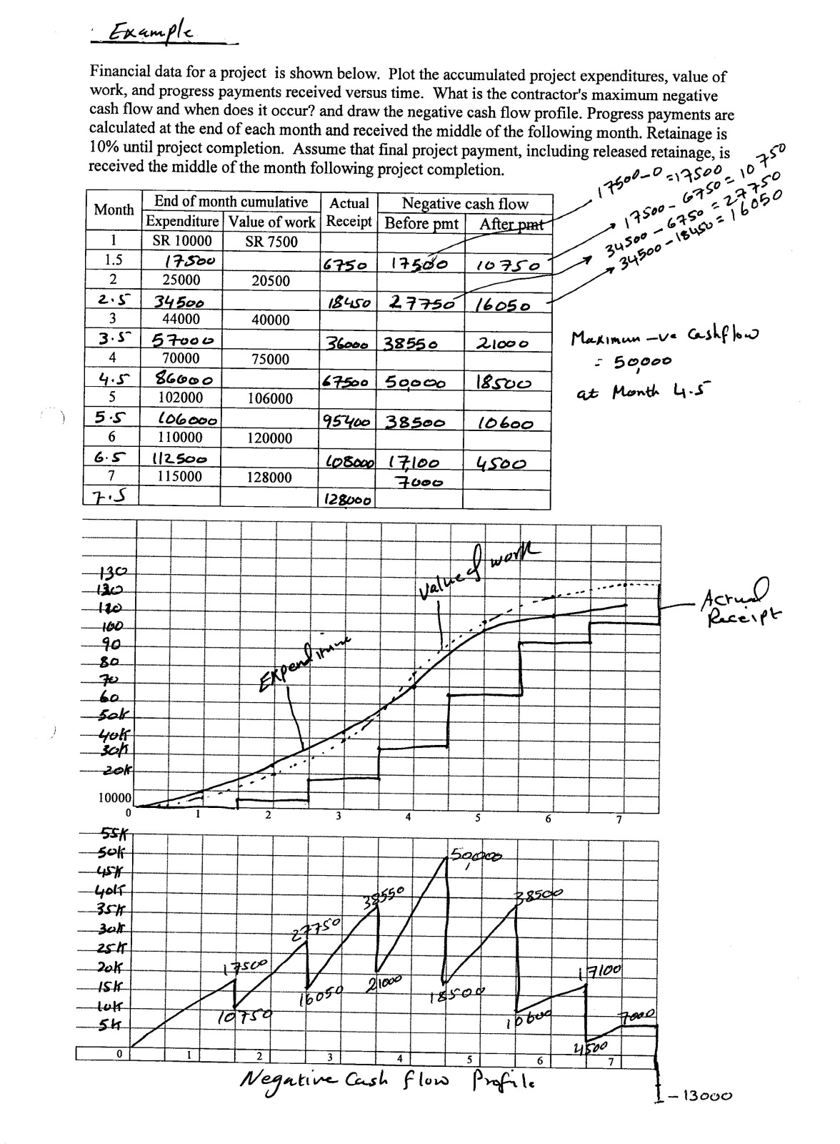

Slide 58


