Slide 1
Barium Swallow
Meaad AlMusined

Slide 2
Introduction
Definition:
A barium swallow is a test used to determine the cause of painful swallowing, difficulty with swallowing, abdominal pain, or unexplained weight loss.

Slide 3
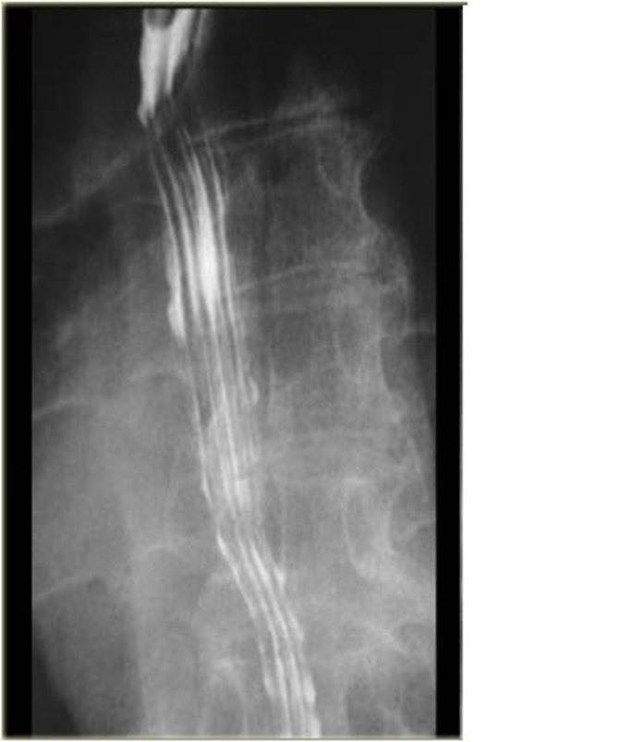
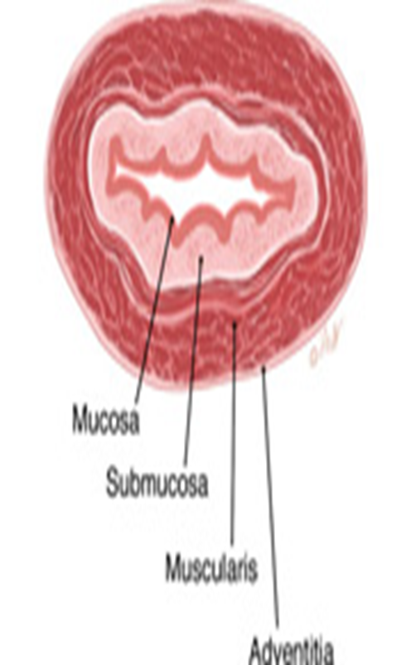
Normal esophagus apperance
When the esophagus is empty , the mucosa coat is thrown into three or four straight longitudinal folds appeared as straight parallel lines throughout the esophagus

Slide 4
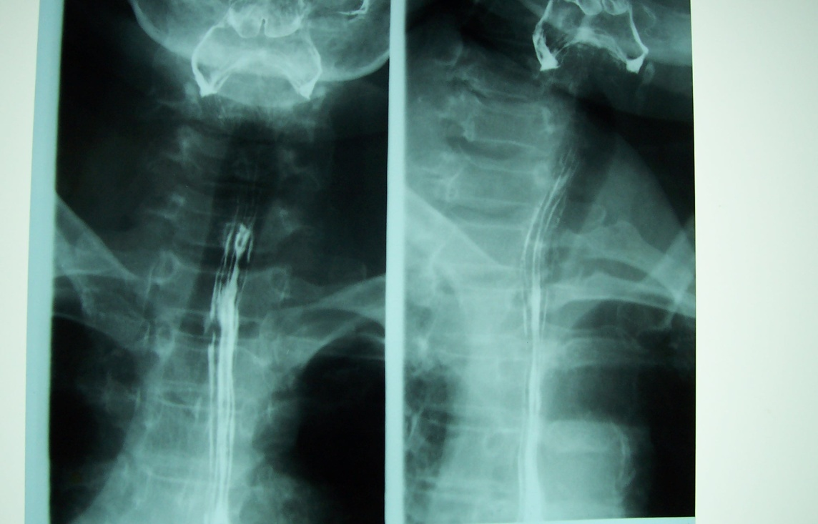
Oesophagus

Slide 5
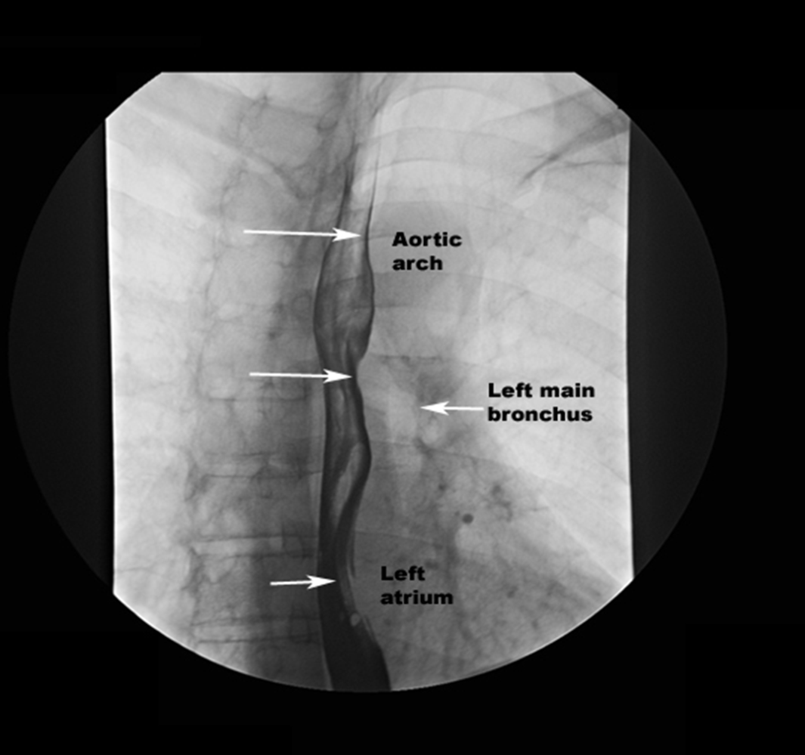
Normal indentations
There are Two normal indentations of the esophagus
1- At the aortic arch
2- At the left bronchus

Slide 6
Routine Positions
RAO (35° to 40°)
Lateral
AP
LAO

Slide 7
AP

Slide 8
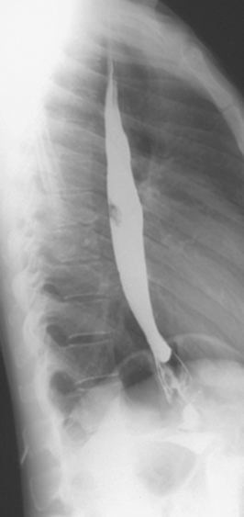
LAT
Because the esophagus is thrown away from the spine, allowing better visualization

Slide 9
RAO
The esophagus is seen
between the heart
and the spine
The patient is rotate
35- 40 degrees with
the RT side
against the table

Slide 10
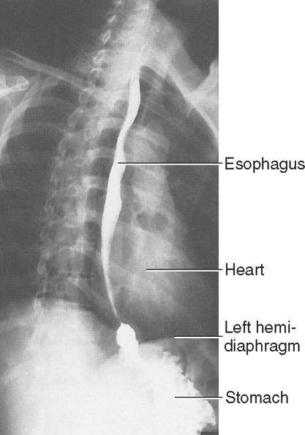
RAO

Slide 11
LAO

