Slide 1
Introduction To Pharmacy Management

Slide 2
Learning Objectives
Define the terms management and manager.
Compare and contrast management and leadership.
Compare and contrast classical views of management with modern views.
Describe the management process within the contexts of what managers do, resources they manage, and levels at which managers perform their roles.
Evaluate the need for a management perspective to better serve patients and improve outcomes to drug therapy

Slide 3
What Is Management?
Manage:
To control the movement or behavior of
To lead or direct
Or to succeed in accomplishing

Slide 4
What Is Management?
A process which brings together resources and unites them in such a way that, collectively, they achieve goals or objectives in the most efficient manner possible."

Slide 5
Resources
Tasks
Goals

Slide 6
What Is Management?
Managers are simply people who perform management activities
Anyone who has a task to accomplish or a goal to achieve is also a manager
Thus all pharmacists, regardless of their job responsibilities or position, should view themselves as managers!
Leadership?

Slide 7
The Managerial Sciences
Accounting
Finance
Economics
Human resources management
Marketing
Operations management
Keep the books
Record financial transactions
Manage cash flow
Analysis of profability
Determine the financial needs
Identify sources of capital
Develop operating budget
Invest profits
Determine optimal mix of labor and capital
Determine optimal output
Determine optimal hrs of business operation
Conduct job analysis
Hire personnel
Orient and train personnel
Appraise performance
Motivate personnel
Identify competitive advantage
Identify target markets
Evaluate promotional strategies
Price goods and service
Design workflow
Perform quality assurance initiative

Slide 8
Classical View of Management
Both Taylor and Fayol argued that all organizations, regardless of size or objective, had to perform a standard set of functions to operate efficiently.
Fayol's five management functions (planning, organizing, commanding, coordinating, and controlling) became widely accepted throughout the industrialized world.
.

Slide 9
Classical View of Management
However, most of Taylor’s and Fayol’s work was developed based on the workplace conditions of the 18th, 19th and early 20th centuries. The great industries of those times focused primarily on the mass production of tangible goods
The role of administrators was to command and control their employees, and the role of workers was to carry out the tasks without question.

Slide 10
Modern View of Management
Today, the number of people involved in the provision of services increased more than in the production of tangible goods as before.
In many cases, today’s administrators have less formal education and fewer technical skills than the people they are supervising.

Slide 11
Modern View of Management

Slide 12
The Management Process
There are three dimensions of management:
Activities that managers perform
Resources that managers need
Levels at which managers make decisions.

Slide 13
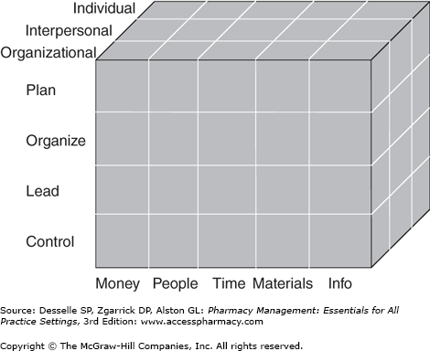
The Management Process

Slide 14
The Management Process: Management Activities
Planning
predetermining a course of action based on one's goals and objectives
internal and external environments
formal vs. informal plans

Slide 15
The Management Process: Management Activities
Organizing
the arrangement and relationship of activities and resources necessary for the effective accomplishment of a goal or objective
what resources she needs,
how she will go about obtaining these resources,
when she will need to obtain them

Slide 16
The Management Process: Management Activities
Leading
bringing about purposeful action toward some desired outcome.
It can take the form of actually doing something yourself or working with others to lead them to where you want your organization to be.

Slide 17
The Management Process: Management Activities
Controlling
reviewing the progress that has been made toward the objectives that were set out in the plan.
This step involves not only determining what actually happened but also why it happened.
Performing quality-control checks

Slide 18
The Management Process: Management Activities
Plan
Organize
Lead
Control

Slide 19
The Management Process: Resources
Organizations and individuals must use resources efficiently to achieve their goals and objectives. Why?

Slide 20
The Management Process: Resources
Money
People
Time
Material
information

Slide 21
Levels of Management
Self-management
Interpersonal management
Organizational management

Slide 22
Levels of Management
pharmacist counseling a patient about a medication?
Pharmacist ensuring that every prescription is dispensed?
Pharmacist planning to add a new service to his chain community pharmacy chains?

Slide 23
Managing Today’s Health Care Organizations
Health care organizations such as hospitals and pharmacies present a number of managerial challenges to administrators.
most health care workers are highly educated and skilled professionals.
Staff-level health care workers have more knowledge and expertise of their particular area than their administrators.

Slide 24
Integrating Modern and Classical Views of Management
Modern views of management suggest that managers must adapt their management activities to their workers.
Today's manager in addition to classical management functions, needs to:
Energize.
Empower
Support
Communicate

Slide 25
Integrating Modern and Classical Views of Management
Energize
Have a vision and ideas about what would like to see their organizations become in the future.
Empower
Provide the employees with training, resources, and advise and then let them get the job done
Support
Letting their employees know when they have done a good job, as well as helping them to learn when things are not going well.
Communicate
The corn stone of communications is trust.

Slide 26
Why Should I Study Management?

Slide 27
Management Practice and Medication Therapy Management
Good business practice and good patient care are not mutually exclusive. In fact, they are almost entirely mutually dependent.
Superior patient care and the implementation of clinical services are made possible by pharmacists who are skilled in management.

