Slide 1
Computer System
Alanoud Al Saleh

Slide 2
Computer systems
Are defined as:
A machine for solving problems. Specifically the modern computer is high-speed electronic computational machine that accepts information in the form of data and instructions through some input device and processes this information with arithmetic and logic operation from a program stored in its memory. The results of processing can be displayed stored or recovered using suitable output devices or transmitted to another location.

Slide 3
Computer system elements
Hardware
Software
Computer users

Slide 4
Computer system elements
Hardware
- the physical components of the computer, including the computer itself and matched peripherals.
Software
- the programs that run the computer.
Data
- are facts, or unorganized raw materials, which can be made up of words, numbers, images, or sounds.
Information
– data that has been processed.

Slide 5
Binary System
Bit - the smallest unit of data that a computer uses (microprocessors) . It can be used to represent two states of information, such as Yes or No(0,1).
Byte - is equal to 8 Bits. A Byte can represent
256 states of information, for example,
numbers or a combination of numbers and
letters. 1 Byte could be equal to one character.

Slide 6
Bits on Bytes
1 byte = 8 bits
1 kilobyte (K / Kb) = 1,024 bytes
1 megabyte (M / MB) = 1,048,576 bytes
1 gigabyte (G / GB) = 1,073,741,824 bytes
1 terabyte (T / TB) = 1,099,511,627,776 bytes

Slide 7
Hardware organization
Input
Processing
Output

Slide 8
Organization of a computer
It includes at least five hardware components:
-An input device
-A central processing unit (CPU)
-Internal memory
-An out put device
-An external memory or storage

Slide 9
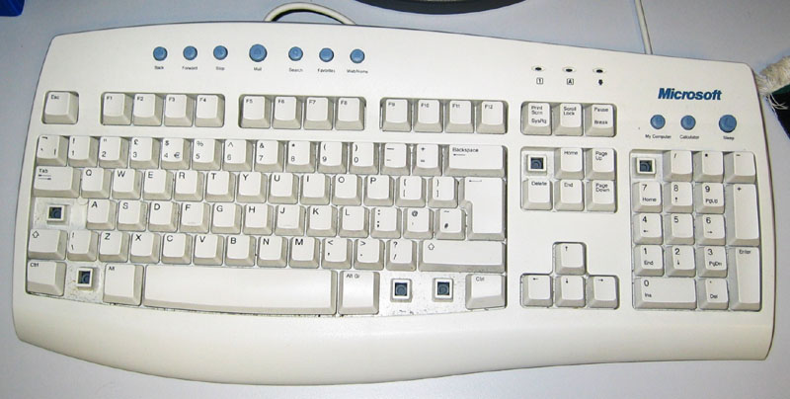
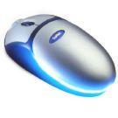
Input hardware
Refers to input devices from which information can be sent to the processor:
Example:
-Keyboards
-mouse
-tochscreen,etc.

Slide 10
Processing hardware
-CPU
-Internal memory

Slide 11
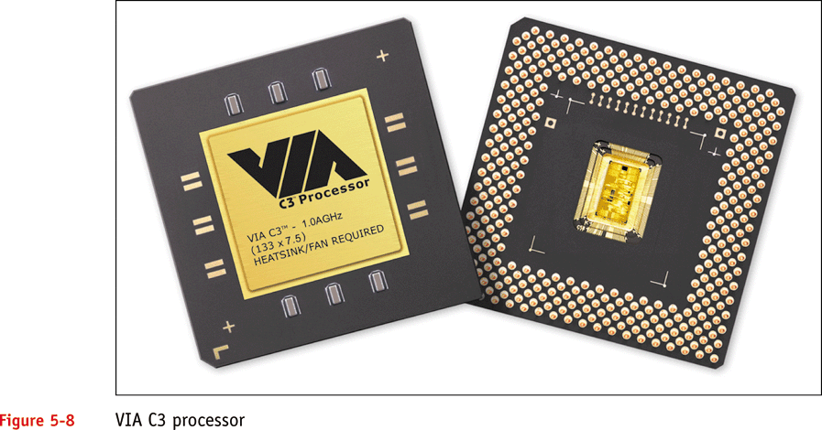
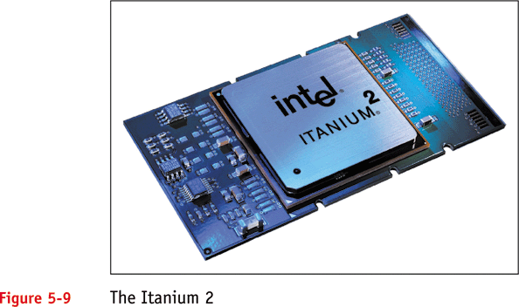
CPU
Small chip found on the motherboard.It is the brain of the computer, it consists of a control unit that direct the activities of the machine and an arithmetic-logic unit (ALU) to perform mathematical calculations and data Processing ( transforming data into information) .
The internal memory or main memory for the permanent storage of software instructions and data.
Microprocessor

Slide 12
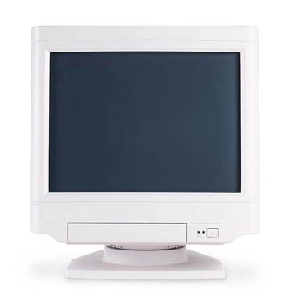
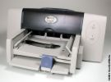
Output devices
After data is processed, results are sent to an output device in the form of hard or soft copy.
Example:
Hardcopy output devices is the printer.
Softcopy output devices is when the results are displayed on a monitor for direct viewing.

Slide 13
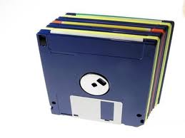
External storage devices
Finally, processing results can be stored on external storage devices
These are:
-Magnetic storage devices such as disks and tapes
-Optical storage devices

Slide 14
Secondary storage
-optical disk
-Magnetic tape
-Magnetic disk
Input devices:
-Keyboard
-Mouse
-Touch screen
-Etc
Output devices
-Video monitor
-Printers
-Plotters
Data flow
Data flow
Central processing unit
-control unit
-arithmetic-logic unit
Primary storage
Control signal
Control signal

Slide 15
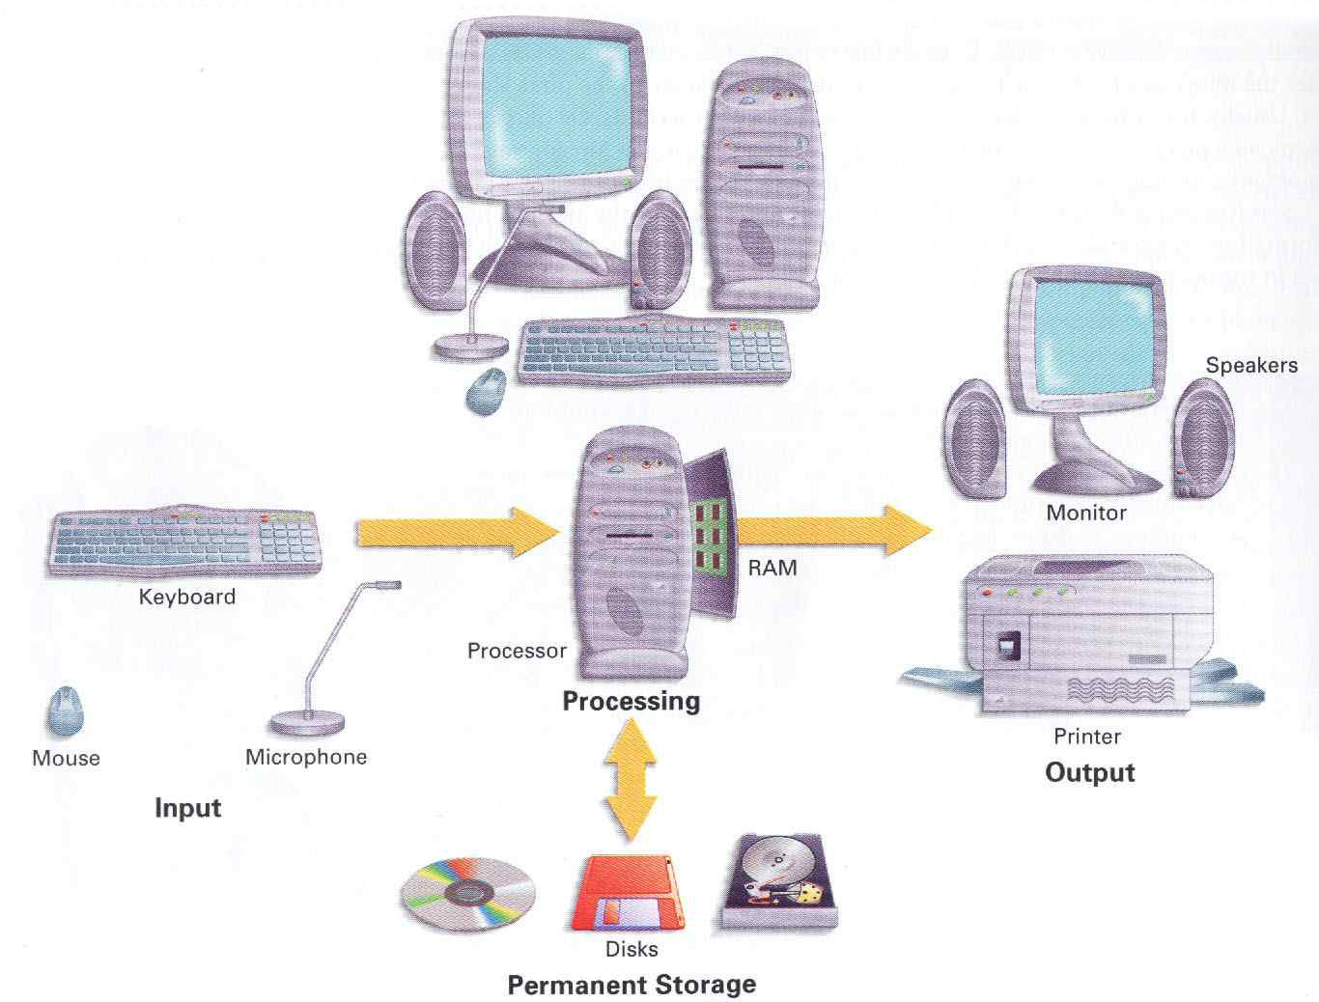

Slide 16
SOFTWARE

Slide 17
Categories of Software
System Software – programs that take control of the PC on start-up, and then play a central role in everything that happens within a computer system by managing, maintaining, and controlling computer resources.
Application Software – designed and created to perform specific personal, business, scientific processing tasks.

Slide 18
Application Software
Word Processing
– a text editing program.
Types of Word Processors
WordStar
Word perfect
Microsoft Word

Slide 19
Application Software
Electronic Spreadsheet
– is a program replacing the traditional financial modeling tools that offer modern improvements in ease of creating, editing, and using of financial models and graphical representations.
Kinds of Electronic Spreadsheet
Lotus 1-2-3
MS EXCEL
QUATTRO
FRAMEWORK

Slide 20
Historical perspective
First generation computers (1951-1958)
Second generation computers (1959-1963)
Third generation computers (1963-1970)
Fourth generation computers (1971-1987)
Fifth generation computers (1987-present)

Slide 21
Thank you

