Slide 1
Lab# 2
Competent Cells Formation and Transformation of Competent Cells with plasmid DNA.
BCH 462 [practical]

Slide 2
Objectives:
1-Insertion of foreign gene to the plasmid.
2-Anti-bacterial resistance gene.
3-Competent cell.
4-Transformation of bacterial cell.
5-Transformation efficiency.

Slide 3
DNA cloning involve: “cell based”
1.Insertion of DNA fragments in to a cloning vector ”e.g. plasmid”.
2.Introducing a vector in to bacterial cells ” the host”.
3.Amplifying the vector DNA using bacterial DNA replication machinery.
1
DNA fragment
cloning vector
Recombinant DNA
2
Recombinant DNA
the host
Transformed bacteria
3

Slide 4
What is cloning vector?
A DNA molecule that carries foreign DNA into a host cell, replicates inside a bacterial cell and produces many copies of itself and the foreign DNA.
They must be:
capable of independent replication within the host cells (e.g bacteria) .
they most contain at least one specific nucleotide sequence recognized
by a restriction endonuclease.
Tow major types of cloning vector can be found in bacterial cells they are:
-plasmid.
-bacteriophages.

Slide 5
Origin of replication
Anti-bacterial resistance gene.
e.g: ampicillin resistance gene.
Generally plasmid vectors should contain three important parts.

Slide 6
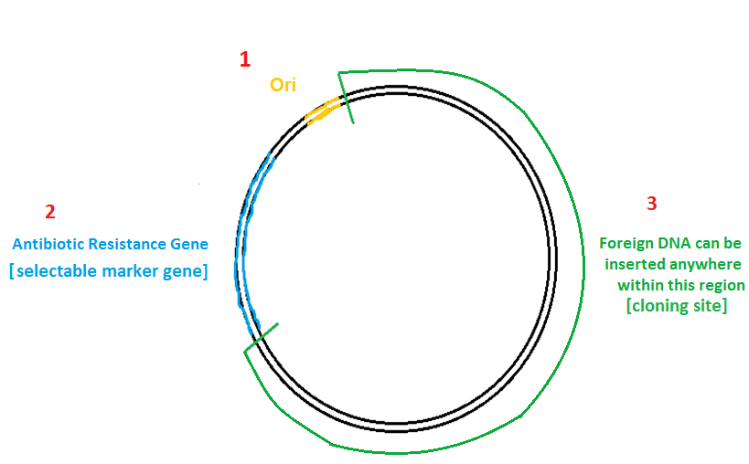
At least one
R.E recognition sites
EcoR1
Bam H1
e.g: ampicillin resistance gene
Hind III
Generally plasmid vectors should contain three important parts.

Slide 7
Restriction endonucleases Enzymes[R.E]:
-Are DNA-cutting enzymes found in bacteria (and harvested from them for use).
-Because they cut within the molecule, they are often called restriction endonucleases.
Restriction Enzyme, e.g: EcoR1

Slide 8
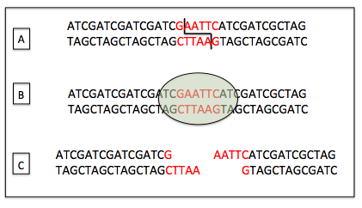
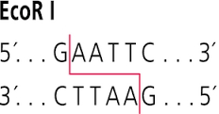
Example:
EcoR I

Slide 9
DNA ligase:
is a specific type of enzyme, that facilitates the joining of DNA strands together by catalyzing the formation of a phosphodiester bond.
https://www.youtube.com/watch?v=8rXizmLjegI

Slide 10
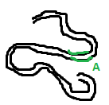
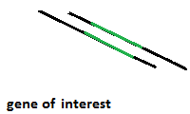
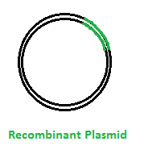
Using same R.E used
For cutting gene A
Using R.E
Animal DNA
“gene A”
“gene A”
1
Ligation
[using ligase enzymes]
DNA cloning using plasmid
2
Bacterial cell
Introducing
(combatant cell)
3
Amplified Recombinant plasmid
cloning
Chromosomal
DNA
Culture plate
[media containing appropriate antibiotic ]
Transformed bacteria

Slide 11
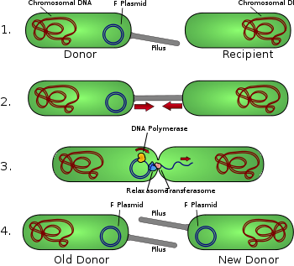
Bacteria in general can acquire new genetic information by:
1.During conjugation → direct contact.
Conjugation: DNA is transferred directly from one organism to another and it requires direct cell-cell contact.

Slide 12
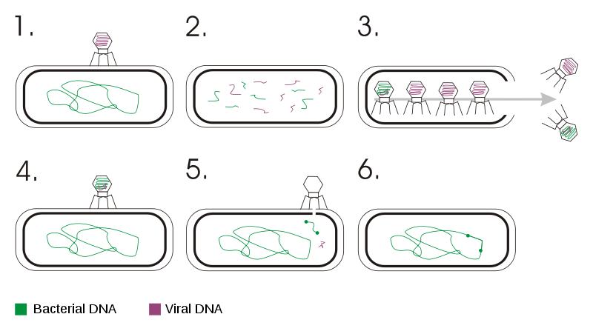
2.Transduction → bacteriophages
Transduction: is the process by which DNA is transferred from one bacterium to another by a virus[bacteriophges].

Slide 13
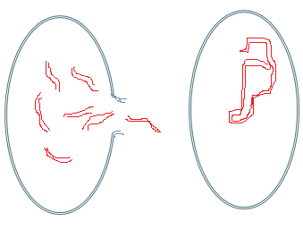
Bacterial cell
Introducing
Chromosomal
DNA
Transformed bacteria
3.Transformation→ DNA, plasmid DNA
Transformation: acquisition of extracellular DNA from the environment.

Slide 14
-Competence is the ability of a cell to take up extracellular ("naked") DNA from its environment.
-It is the ability to undergo transformation, which means the ability of a cell to take the DNA from the environment.
-There are two classes of competent cells :
Natural competence: a genetically specified ability of bacteria that is occur under natural condition.
Artificial competence: when cells in laboratory cultures are treated to be permeable to DNA.

Slide 15
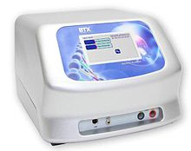
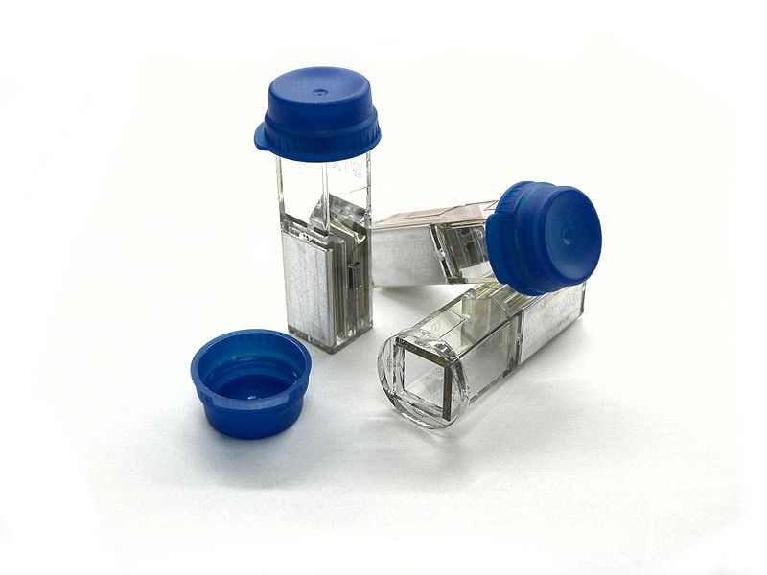
Methods of transformation:
1. Electroporation, or Electropermeabilization

Slide 16
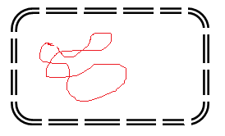
2.Chemical transformation.
Less efficient than electroporation.
Insertion
1.CaCl2 treatment
To permeabilize the bacterial cell membrane
2.Brief heat shock
to facilitate
The DNA up take.
Transformed bacteria

Slide 17
Practical part

Slide 18
Competent Cells formation and transformation of competent Cells with plasmid DNA
Principle of the experiment: “ chemical transformation method “
Cells are incubated in CaCl2 solution that help the cells to take up the DNA plasmid by increasing the bacterial cell s membranes permeability [renders them competent to take up DNA], then applying brief heat shock will facilitate the DNA up take.
Note: the transformed cells are then grown in LB agar plate containing appropriate antibiotic to be able to count the transformed colonies only , “which they are colonies containing transformed cells -containing the DNA plasmid-” , each colony on an antibiotic plate presents a single transformation event.
-Then calculations of the transformation efficiency will be done.

Slide 19
Principle of the experiment:
[Chemical transformation]
Insertion
Competent
Bacterial cell
1.CaCl2 treatment
To permeabilize the bacterial cell membrane
2.Brief heat shock
to facilitate
The DNA up take.
Transformed bacteria

Slide 20
Transformation efficiency
-Transformation efficiency, is a quantitative value that describes how effective you were at getting plasmid DNA into your E. coli bacteria. The number represents how many cells were transformed per microgram (μg) of plasmid DNA used.
-This calculation requires two values: the number of cells that were successfully transformed and the amount of plasmid DNA used for the transformation.
Transformation efficiency= total number of colonies on LB/Amp plate CFU/µg
amount of DNA plated [µg/ml]
CFU: colony –forming units.

Slide 21
Animation:
http://www.dnai.org/b/index.html
Principle of chemical transformation :
http://www.dnalc.org/resources/animations/transformation2.html
Mechanism of Recombination:
http://www.dnalc.org/resources/3d/20-mechanism-of-recombination.html

