Slide 1
2.2 Set Operations

Slide 2
The Union
DEFINITION 1
Let A and B be sets. The union of the sets A and B , denoted by A U B , is the set that contains
those elements that are either in A or in B , or in both.
An element x belongs to the union of the sets A and B if and only if x belongs to A or x belongs
to B .
This tells us that
A U B = {x | x ϵ A V x ϵ B } .

Slide 3
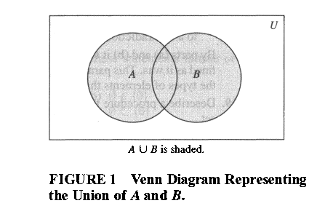
EXAMPLE 1
The union of the sets {1,3,5} and {1,2,3} is the set {1,2,3,5} ; that is,
{1,3,5} U {1,2,3} = {1,2,3,5} .

Slide 4
The Intersection
DEFINITION 2
Let A and B be sets. The intersection of the sets A and B , denoted by A ∩ B , is the set
containing those elements in both A and B .
An element x belongs to the intersection of the sets A and B if and only if x belongs to A and x belongs to B .
This tells us that
A ∩ B = {x | x ϵ A Λ x ϵ B } .

Slide 5
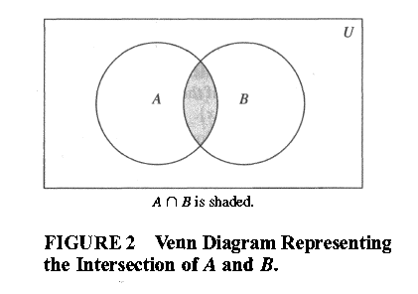
EXAMPLE 3
The intersection of the sets {1,3,5} and {1,2,3} is the set {1,3} ; that is, {1,3,5} ∩ {1,2,3} = {1,3} .

Slide 6
Disjoint Sets
DEFINITION 3
Two sets are called disjoint if their intersection is the empty set.
EXAMPLE 5
Let A = {1,3,5,7,9} and B = {2, 4, 6, 8 , 10} . Because A ∩ B = Ф, A and B are disjoint.

Slide 7
The Cardinality Of a Union Of Two Finite Sets
Note that I A I + I B I counts each element that is in A but not in B or in B but not in A exactly once, and each element that is in both A and B exactly twice. Thus, if the number of elements that are in both A and B is subtracted from IAI+ IBI , elements in A∩B will be counted only once.
Hence, I A U B I = I A I + I B I - I A ∩ B I .
The generalization of this result to unions of an arbitrary number of sets is called the principle of inclusion-exclusion.

Slide 8
The Difference Of Two Sets
DEFINITION 4
Let A and B be sets. The difference of A and B , denoted by A - B , is the set containing those
elements that are in A but not in B .
The difference of A and B is also called the complement of B with respect to A.
An element x belongs to the difference of A and B if and only if x ϵ A and x ɇ B . This tells us
that
A - B = {x | x ϵ A Λ x ɇ B } .

Slide 9
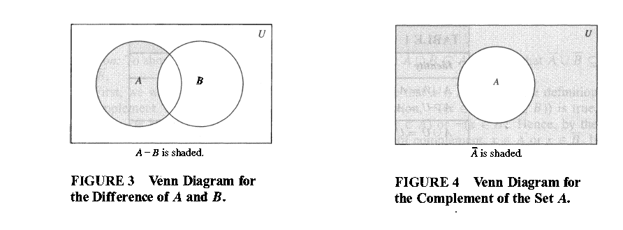

Slide 10
EXAMPLE 6
The difference of {1,3,5} and {1,2,3} is the set {5}; that is, {1,3,5} - {1,2,3} = {5} .
Caution!
This is different from the difference of {1,2,3} and {1,3,5} , which is the set {2}.
{1,2,3}- {1,3,5} = {2}.

Slide 11
The Complement Of a Set
DEFINITION 5
Let U be the universal set. The complement of the set A , denoted by Ā , is the complement of A with respect to U.
In other words, the complement of the set A is Ā=U-A.
An element belongs to Ā if and only i f x ɇ A . This tells u s that
Ā = {x | x ɇ A } .

Slide 12
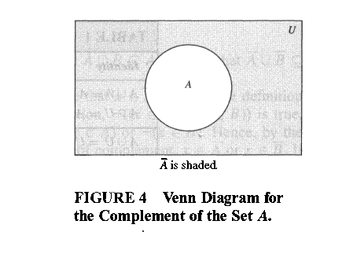

Slide 13
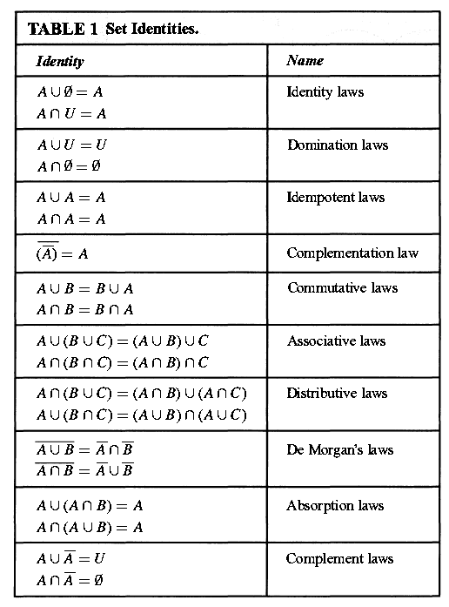
Set Identities

Slide 14
Homeworks
Page 130
3 (a,b,c,d)
14
19
25 (a,c)
59

