Slide 1


Slide 2
Geotechnical Engineering II
CE 481
2. Compressibility of Soil
Chapter 11
All sections except 11.17, 11.18, 11.19

Slide 3
Course Contents
Compressibility of soils
Shear strength of soils
Slope stability
Lateral earth pressures
Retaining walls

Slide 4
Topics
INTRODUCTION
ELASTIC SETTLEMENT
Stress distribution in soil masses
CONSOLIDATION SETTLEMENT
Fundamentals of consolidation
Calculation of One-Dimensional Consolidation Settlement
One-dimensional Laboratory Consolidation Test
Calculation of Settlement from One-Dimensional Primary Consolidation
TIME RATE OF CONSOLIDATION SETTLEMENT
1-D theory of consolidation
SECONDARY CONSOLIDATION SETTLEMENT

Slide 5
Topics
INTRODUCTION
ELASTIC SETTLEMENT
Stress distribution in soil masses
CONSOLIDATION SETTLEMENT
Fundamentals of consolidation
One-Dimensional Consolidation Settlement
One-dimensional Laboratory Consolidation Test
Calculation of Settlement from One-Dimensional Primary Consolidation
TIME RATE OF CONSOLIDATION SETTLEMENT
1-D theory of consolidation
SECONDARY CONSOLIDATION SETTLEMENT

Slide 6
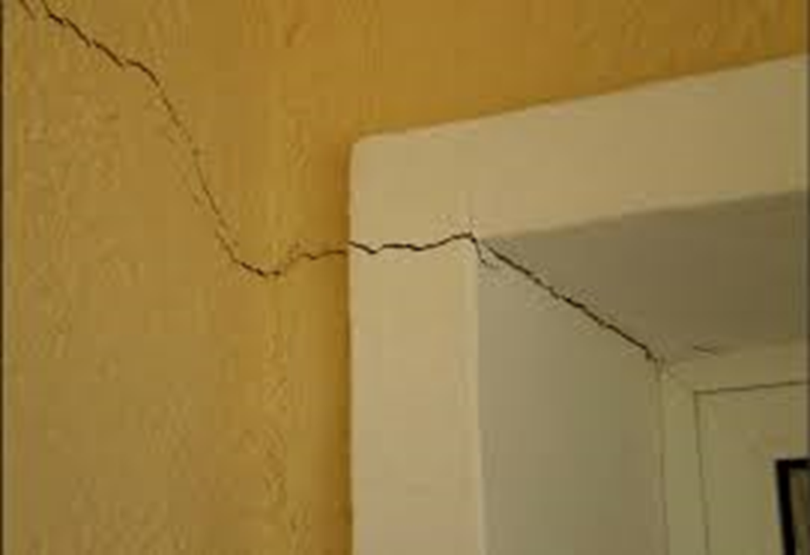
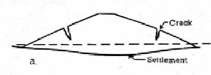
Introduction
Why should soil compressibility be studied?
Ignoring soil compressibility may lead to unfavorable settlement and other engineering problems.
Embankment and building constructed on
soft ground (highly compressible soil)
Crack
Soft ground
Settlement is one of the aspects that control the design of structures.

Slide 7
Why soils compressed?
Every material undergoes a certain amount of strain when a stress is applied.
A steel rod lengthens when it is subjected to tensile stress, and a concrete column shortens when a compressive load is applied.
The same thing holds true for soils which undergo compressive strains upon loading. Compressive strains are responsible for settlement of the structure.
What distinguish soils from other civil engineering materials is the fact that the deformation of soils is largely unrecoverable (i.e. permanent). Therefore simple elasticity theory like elasticity cannot be applied to soils.
Notes:
No stress increase → no settlement, no porosity → no settlement

Slide 8
What makes soil compressed?
In soils voids exist between particles and the voids may be filled with a liquid, usually water, or gas , usually air. As a result, soils are often referred to as a three-phase material or system (solid, liquid and gas).
Solid (mineral particles)
Gas (air),
Liquid (usually water)
Stress increase

Slide 9
Causes of settlement
Settlement of a structure resting on soil may be caused by two distinct kinds of action within the foundation soils:-
I. Settlement Due to Shear Stress (Distortion Settlement)
In the case the applied load caused shearing stresses to develop within the soil mass which are greater than the shear strength of the material, then the soil fails by sliding downward and laterally, and the structure settle and may tip of vertical alignment. This will be discussed in CE483 Foundation Engineering. This is what we referred to as BEARING CAPACITY.
II. Settlement Due to Compressive Stress (Volumetric Settlement)
As a result of the applied load a compressive stress is transmitted to the soil leading to compressive strain. Due to the compressive strain the structure settles. This is important only if the settlement is excessive otherwise it is not dangerous.

Slide 10
However, in certain structures, like for example foundation for RADAR or telescope, even small settlement is not allowed since this will affect the function of the equipment.
This type of settlement is what we will consider in this chapter and this course. In the following sections we will discuss its components and ways for their evaluation. We will consider only the simplest case where settlement is one-dimensional and a condition of zero lateral strain is assumed.

Slide 11
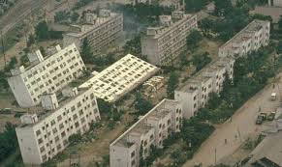

Slide 12
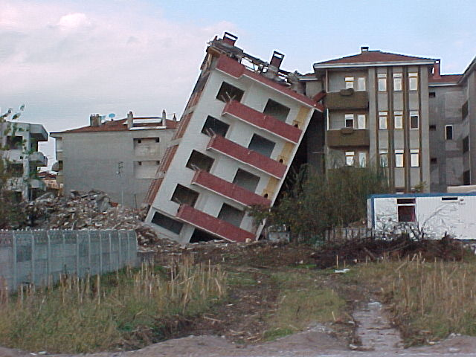

Slide 13
Causes of Settlement
Alien
Causes
Shear
Stresses
Compressive
Stresses
Immediate
Subsidence
Cavities
Excavation
etc..
Bearing
Capacity
Failure
Primary
Secondary

Slide 14
Mechanisms of compression
Compression of soil is due to a number of mechanisms:
Deformation of soil particles or grains
Relocations of soil particles
Expulsion of water or air from the void spaces
Components of settlement
Settlement of a soil layer under applied load is the sum of two broad components or categories:
1. Elastic settlement (or immediate) settlements
Elastic or immediate settlement takes place instantly at the moment of the application of load due to the distortion (but no bearing failure) and bending of soil particles (mainly clay). It is not generally elastic although theory of elasticity is applied for its evaluation. It is predominant in coarse-grained soils.

Slide 15
2. Consolidation settlement
Consolidation settlement is the sum of two parts or types:
A. Primary consolidation settlement
In this the compression of clay is due to expulsion of water from pores. The process is referred to as PRIMARY CONSOLIDATION and the associated settlement is termed PRIMARY CONSOLIDATION SETTLEMENT. Commonly they are referred to simply as CONSOLIDATION AND CONSOLIDATION SETTLEMENT.
B. Secondary consolidation settlement
The compression of clay soil due to plastic readjustment of soil grains and progressive breaking of clayey particles and their interparticles bonds is known as SECONDARY CONSOLIDATION OR SECONDARY COMPRESSION, and the associated settlement is called SECONDARY CONSOLIDATION SETTLEMENT or SECONDARY COMPRESSION.

Slide 16
Components of settlement
The total settlement of a foundation can be expressed as:
S_{T} = S_{e} + S_{c} + S_{s}
Where
S_{T} = Total settlement
S_{e} = Elastic or immediate settlement
S_{c} = Primary consolidation settlement
S_{s}= Secondary consolidation settlement
Total settlement S _{T}
Immediate settlement
Primary consolidation settlement
Secondary consolidation or creep
It should be mentioned that S_{c} and S_{s} overlap each other and impossible to detect which certainly when one type ends and the other begins. However, for simplicity they are treated separately and secondary consolidation is usually assumed to begin at the end of primary consolidation.

Slide 17
Components of settlement
The total soil settlement S _{T} may contain one or more of these types:
Immediate settlement
Due to distortion or elastic deformation with no change in water content
Primary consolidation settlement
Decrease in voids volume due to squeeze of pore-water out of the soil
Secondary consolidation or creep
Occurs rapidly during the application of load
Quite small quantity in dense sands, gravels and stiff clays
Occurs in saturated fine grained soils (low coefficient of permeability)
Time dependent
Only significant in clays and silts
Due to gradual changes in the particulate structure of the soil
Occurs very slowly, long after the primary consolidation is completed
Time dependent
Most significant in saturated soft clayey and organic soils and peats
Notes:
When foundations are constructed on very compressible clays, the consolidation settlement
can be several times greater than the elastic settlement.

Slide 18
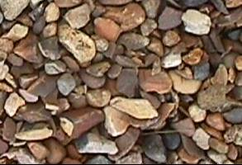

Rates of Drainage
Coarse soils
soil type | coeff. of permeability (k) | seepage rate
Gravel | > 10^{-2 m/sec} | very quick
Sand | 10⁻² ~ 10⁻⁵ | quick
Silt | 10⁻⁵ ~ 10⁻⁸ | slow
Clay | < 10⁻⁸ | very slow
For design purposes it is common to assume:
Quick drainage in coarse soils (Sand and Gravel)
Slow drainage in fine soils (Clay and Silt).
Fine soils
Notes:
Let’s have a closed look at the drained and undrained conditions

Slide 19
For coarse grained soils…
Rates of Drainage
Granular soils are freely drained, and thus the settlement is instantaneous.
settlement
time
0
0
S_{T} = S_{e} + S_{c} + S_{s}

Slide 20

For Fine grained soils…
Rates of drainage
GL
saturated clay
settlement
When a saturated clay is loaded externally, the water is squeezed out of the clay over a long time (due to low permeability of the clay).
time
This leads to settlements occurring over a long time…..which could be several years
S_{t} = S_{e} + S_{c} + S_{s}
negligible

Slide 21
Topics
INTRODUCTION
ELASTIC SETTLEMENT
Stress distribution in soil masses
CONSOLIDATION SETTLEMENT
Fundamentals of consolidation
One-Dimensional Consolidation Settlement
One-dimensional Laboratory Consolidation Test
Calculation of Settlement from One-Dimensional Primary Consolidation
TIME RATE OF CONSOLIDATION SETTLEMENT
1-D theory of consolidation
SECONDARY CONSOLIDATION SETTLEMENT

Slide 22
ELASTIC SETTLEMENT
S_{T} = S_{e} + S_{c} + S_{s}
This type of settlement occur immediately after the application of load. It is predominant in coarse-grained soil (i.e. gravel, sand). Analytical evaluation of this settlement is a problem which requires satisfaction of the same set of conditions as the determination of stresses in continuous media.
In fact we could view the process as one of :
Determining the stresses at each point in the medium
Evaluating the vertical strains
Integrating these vertical strains over the depth of the material.
Theory of elasticity is used to determine the immediate settlement. This is to a certain degree reasonable in cohesive soils but not reasonable for cohesionless soils.

Slide 23
Contact pressure and settlement profile
The contact pressure distribution and settlement profile under the foundation will depend on:
Flexibility of the foundation (flexible or rigid).
Type of soil (clay, silt, sand, or gravel).
Contact pressure distribution
Contact pressure distribution
flexible
flexible
CLAY
Settlement profile
SAND
Settlement profile
rigid
rigid
CLAY
Settlement profile
SAND

Slide 24
There are solutions available for different cases depending on the following conditions:
Load: - point
- distributed
These conditions are the same as these discussed at the time when we presented stresses in soil mass from theory of elasticity in CE 382.
One of the well-known and used formula is that for the vertical settlement of the surface of an elastic half space uniformly loaded.
Loaded area: - Rectangular
- Square
- Circular
Stiffness: - Flexible
-Rigid
Soil: - Cohesive
- Cohesionless
Medium: - Finite
- Infinite
- Layered
In CE 382, the relationships for determining the increase in stress (which causes elastic settlement) were based on the following assumptions:
The load is applied at the ground surface.
The loaded area is flexible.
The soil medium is homogeneous, elastic, isotropic, and extends to a great depth.

Slide 25
Settlement calculation
More details about the calculation are given in Section 11.3 in the textbook.
For shallow foundation subjected to a net force per unit area equal to Δσ and if the foundation is perfectly flexible, the settlement may be expressed as:
Δσ
(flexible)
E_{s} = Average modulus of elasticity of soil
N_{s} = Poisson’s ratio of soil
B’ = B/2 center = B corner of foundation
I_{s} = shape Factor
I_{f} = depth factor
α = factor depends on location where settlement of foundation is calculated (α = 4 center of foundation, α = 1 corner of the foundation).
rigid

Slide 26
I_{f} = f (L,B, H, μ_{s})
I_{s} = f (L,B, H, μ_{s})
(See textbook for values)

Slide 27
Settlement calculation
(flexible)
q

Slide 28
Settlement Calculation
B
Due to the nonhomogeneous nature of soil deposits, the magnitude of E_{s} may vary with depth. For that reason, Bowles (1987) recommended using a weighted average value of E_{s}.
Es(1)
H
Es(2)
where:
E_{s(i)} soil modulus of elasticity within a depth Δz.
whichever is smaller.
Es(3)
Notes:
This is not mathematical average

Slide 29
Topics
INTRODUCTION
ELASTIC SETTLEMENT
Stress distribution in soil masses
CONSOLIDATION SETTLEMENT
Fundamentals of consolidation
Calculation of One-Dimensional Consolidation Settlement
One-dimensional Laboratory Consolidation Test
Calculation of Settlement from One-Dimensional Primary Consolidation
TIME RATE OF CONSOLIDATION SETTLEMENT
1-D theory of consolidation
SECONDARY CONSOLIDATION SETTLEMENT

Slide 30
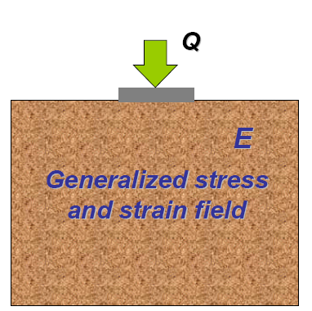
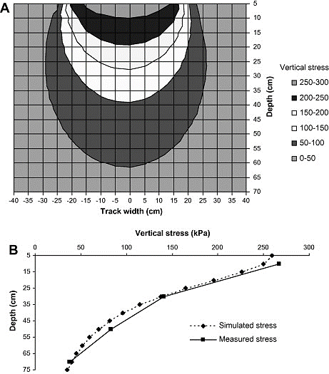
Stress distribution in soil masses
Settlement is caused by stress increase, therefore for settlement calculations, we first need vertical stress increase, Δσ , in soil mass imposed by a net load, q, applied at the foundation level.
CE 382 and Chapter 10 in the textbook present many methods based on Theory of Elasticity to estimate the stress in soil imposed by foundation loadings.
B
q [kPa]
Since we consider only vertical settlement we limit ourselves to vertical stress distribution.
Since mostly we have distributed load we will not consider point or line load.
Pressure bulb

Slide 31
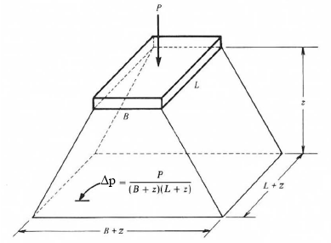
I. Stresses from approximate methods
2:1 Method
In this method it is assumed that the STRESSED AREA is larger than the corresponding dimension of the loaded area by an amount equal to the depth of the subsurface area.
P
L
z
B
L+z
B+z

Slide 32
Wide uniformly distributed load
For wide uniformly distributed load, such as for vey wide embankment fill, the stress increase at any depth, z, can be given as:
Δσ_{z} = q
q kPa
GL
z
Δσ
z
does not decreases with depth z
soil

Slide 33
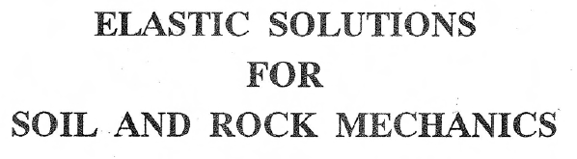

II. Stresses from theory of elasticity
There are a number of solutions which are based on the theory of elasticity. Most of them assume the following assumptions:
The soil is homogeneous
The soil is isotropic
The soil is perfectly elastic infinite or semi-finite medium
Tens of solutions for different problems are now available in the literature. It is enough to say that a whole book (Poulos and Davis) is now available for the elastic solutions of various problems.
The book contains a comprehensive collection of graphs, tables and explicit solutions of problems in elasticity relevant to soil and rock mechanics.

Slide 34
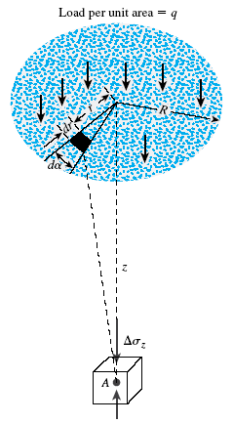

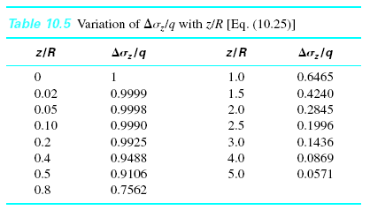
Vertical Stress Below the Center of a Uniformly Loaded Circular Area

Slide 35
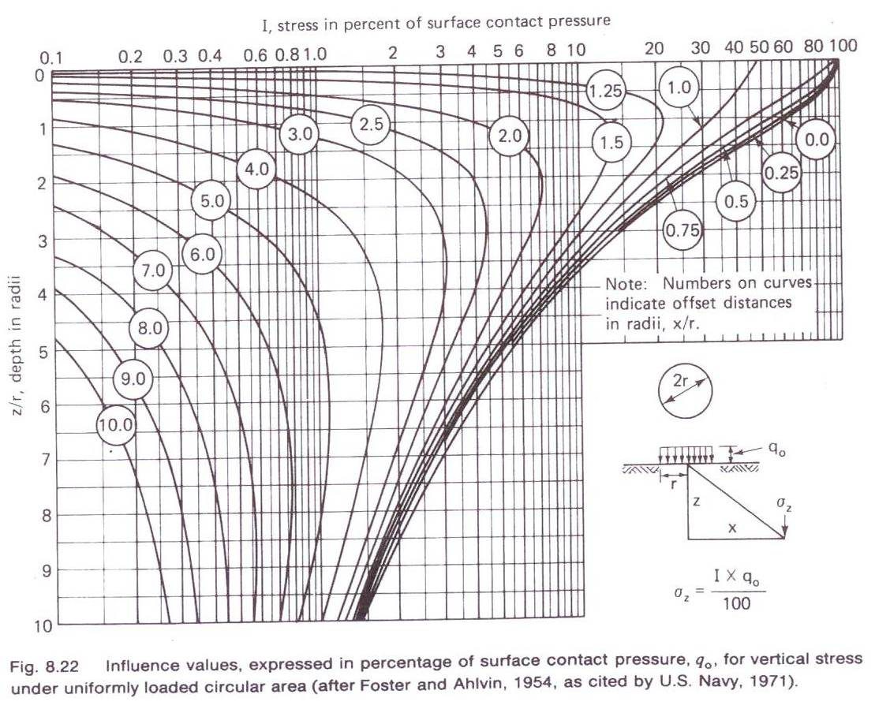
Vertical Stress at any Point Below a Uniformly Loaded Circular Area

Slide 36
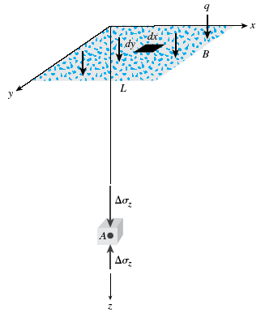





Vertical Stress Below the Corner of a Uniformly Loaded Rectangular Area
I₃ is a dimensionless factor and represents the influence of a surcharge covering a rectangular area on the vertical stress at a point located at a depth z below one of its corner.

Slide 37
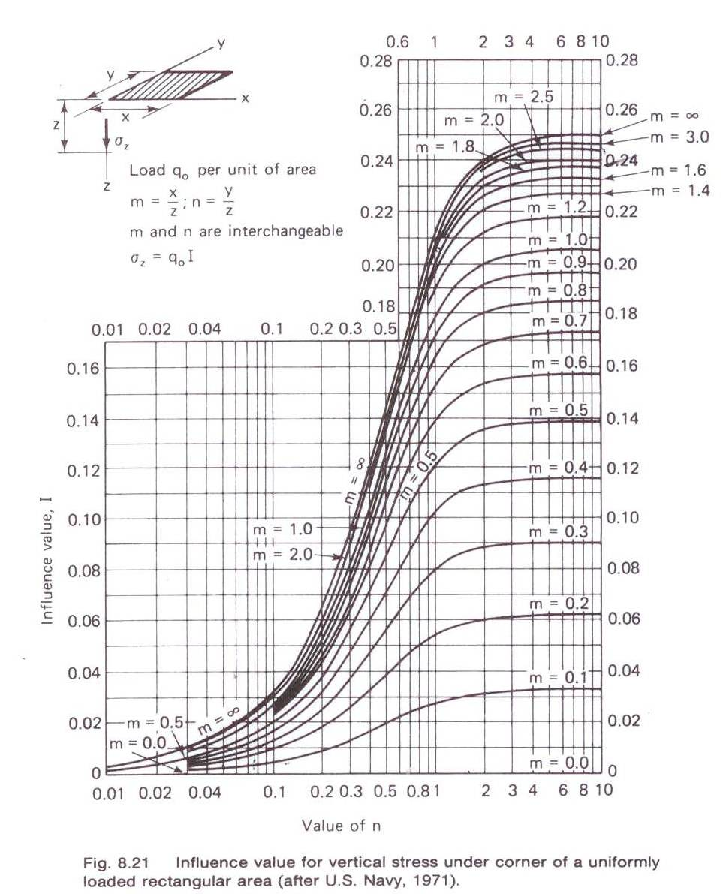

Slide 38
Newmark’s Influence Chart

Slide 39
Topics
INTRODUCTION
ELASTIC SETTLEMENT
Stress distribution in soil masses
CONSOLIDATION SETTLEMENT
Fundamentals of consolidation
Calculation of One-Dimensional Consolidation Settlement
One-dimensional Laboratory Consolidation Test
Calculation of Settlement from One-Dimensional Primary Consolidation
TIME RATE OF CONSOLIDATION SETTLEMENT
1-D theory of consolidation
SECONDARY CONSOLIDATION SETTLEMENT

Slide 40
Topics
INTRODUCTION
ELASTIC SETTLEMENT
Stress distribution in soil masses
CONSOLIDATION SETTLEMENT
Fundamentals of consolidation
Calculation of One-Dimensional Consolidation Settlement One-dimensional Laboratory Consolidation Test
Calculation of Settlement from One-Dimensional Primary Consolidation
TIME RATE OF CONSOLIDATION SETTLEMENT
1-D theory of consolidation
SECONDARY CONSOLIDATION SETTLEMENT

Slide 41
CONSOLIDATION SETTLEMENT
S_{T} = S_{e} + S_{c} + S_{s}
Consolidation is the process of gradual reduction in volume change of fully saturated low permeability soils (clays & silts) due to the slow drainage (expulsion) of pore water from the voids.
Fundamentals of consolidation
When a soil layer is subjected to a compressive stress, such as during the construction of a structure, it will exhibit a certain amount of compression. This compression is achieved through a number of ways, including:
Rearrangement of the soil solids
Bending of particles
Extrusion of the pore air and/or water
If the soil is dry, its voids are filled with air and since air is compressible, rearrangement of soil particles can occur rapidly.
If soil is saturated, its voids are filled with incompressible water which must be extruded from the soil mass before soil grains can rearrange themselves.

Slide 42
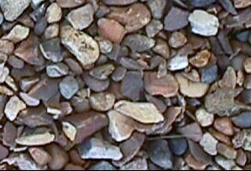
In coarse soils (sands & gravels) any volume change resulting from a change in loading occurs immediately; increases in pore pressures are dissipated rapidly due to high permeability. This is called drained loading.
In fine soils (silts & clays) - with low permeability - the soil is undrained as the load is applied. Slow seepage occurs and the excess pore pressures dissipate slowly, and consolidation settlement occurs.
In coarse soils (sand & gravel) the settlement takes place instantaneously.
In fine soils (clay & silt): settlement takes far much more time to complete. Why?
coarse soils
So, consolidation settlement: is decrease in voids volume as pore-water is squeezed out of the soil. It is only significant in fine soil (clays & silts).
Settlement
Fine soils
Time (months or years)

Slide 43
The gradual reduction in volume of a fully saturated soil of low permeability due to drainage of the pore water is called consolidation.
In soils of high permeability this process occurs rapidly, so the settlement is immediate and the theory of elasticity is applied for its evaluation as has been discussed previously.
However, in fine-grained soil the process requires along time interval for its completion and the nature of settlement is more difficult to analyze.
Gradual reduction in volume == gradual reduction in void ratio, e. Therefore we have to know the change in e in order to know settlement.
e is our internal variable that through it we can follow the change in soil volume.

Slide 44
Description of primary consolidation process:
When a saturated soil layer is subjected to a stress increase, the external load is initially transferred to water causing sudden increase in the pore water pressure (excess pore water pressure).
Elastic settlement occurs immediately. However, due to the low coefficient of permeability of clay, the excess pore water pressure generated by loading gradually squeezes over a long period of time.
Eventually, excess pore pressure becomes zero and the pore water pressure is the same as hydrostatic pressure prior to loading.
The associated volume change (that is, the consolidation) in the clay may continue long after the elastic settlement.
The settlement caused by consolidation in clay may be several times greater than the elastic settlement.

Slide 45
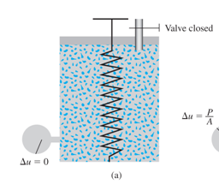
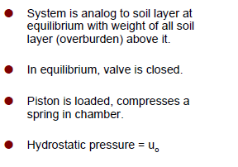

Consolidation process – Spring analogy
i. At equilibrium under overburden stress

Slide 46
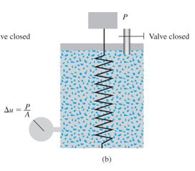
Consolidation process- Spring analogy (cont.)
ii. Under Load (t = 0)
Soil is loaded by stress increment Δσ
Valve is initially closed
As water is incompressible and valve is closed, no water is out, no movement of piston.
Stress is (Δσ) is transferred to water.
Pressure gauge reads an excess pore pressure (Δu) such that:
Δu = Δσ
u = u_{o} + Δu
No Settlement
From the principle of effective stresses:
Δσ’ = Δσ – Δu Then Δσ’ = 0

Slide 47
Consolidation process- Spring analogy (cont.)
ii. Under Load (t = 0)
Soil is loaded by stress increment Δσ
Valve is initially closed
As water is incompressible and valve is closed, no water is out, no movement of piston.
Stress is (Δσ) is transferred to water.
Pressure gauge reads an excess pore pressure (Δu) such that:
Δu = Δσ
u = u_{o} + Δu
No Settlement
From the principle of effective stresses:
Δσ’ = Δσ – Δu Then Δσ’ = 0

Slide 48
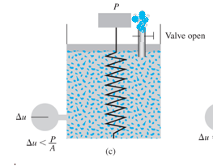
Consolidation process- Spring analogy (cont.)
iii. Under Load (0 < t < ∞)
To simulate fine grained cohesive soil, where permeability is slow, valve is slightly opened.
Water slowly leave the chamber.
As water flows out excess pore pressure (Δu) decreases, and load is transferred to the spring.
Settlement is observed.
From the principle of effective stresses:
Δσ’ = Δσ – Δu Δu < Δσ Then Δσ’ > 0
Δu < Δσ
u = u_{o} + Δu

Slide 49
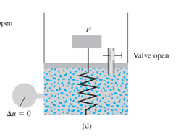
Consolidation process- Spring analogy (cont.)
iv. End of consolidation (t = ∞)
At the end of consolidation, no further water is squeezed out, excess pore pressure is zero.
Pore water pressure is back to hydrostatic.
Δu = 0
u = u_{o}
The spring (soil) is in equilibrium with applied stress.
Final (ultimate) settlement is reached.
All stresses are transferred to soil
From the principle of effective stresses:
Δσ’ = Δσ – Δu Δu = 0 Then Δσ’ = Δσ

Slide 50
Short-term and long-term stresses
With the spring analogy in mind, consider the case where a layer of saturated clay of thickness H that is confined between two layers of sand is being subjected to an instantaneous increase of total stress of Δσ.
Due to a surcharge q applied at the GL, the stresses and pore pressures are increased at point A and, they vary with time.
q
The load q applied on the saturated soil mass, is carried by pore water in the beginning.
Δσ
Δu
Δσ’
A
As the water starts escaping from the voids, the excess water pressure gets gradually dissipated and the load is shifted to the soil solids which increases the effective stress.
saturated clay

Slide 51
Short-term and long-term stresses
Δσ, the increase in total stress remains the same during consolidation, while effective stress Δσ ’ increases.
Δu the excess pore-water pressure decreases (due to drainage) transferring the load from water to the soil.
Excess pore pressure (Δu)
is the difference between the current pore pressure (u) and the steady state pore pressure (u_{o}).
Δu = u - u_{o}
uniformly distributed pressure
Δσ
Δu
Δσ’
q
Δσ
Δu
Δσ’
Δσ
A
Δσ’
q
Δu
saturated clay
Time

Slide 52
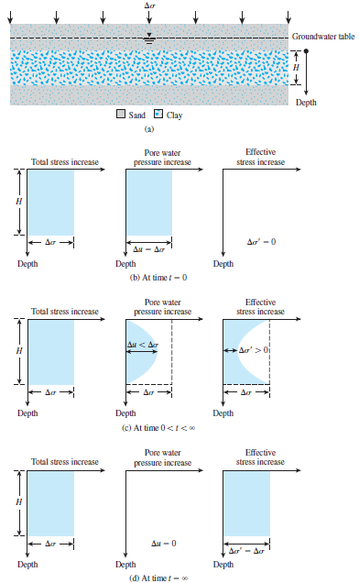
Short-term and long-term stresses (cont.)
Variation of total stress [σ], pore water pressure [u], and effective stress [σ′] in a clay layer drained at top and bottom as a result of an added stress, Δσ.
Remark:
If an additional load is applied, the cycle just described will be repeated and further settlement will develop.
This is noticed in the consolidation test where for each load increment we get a t vs. e curve.

Slide 53
Example
The figure below shows how an extensive layer of fill will be placed on a certain site.
The unit weights are:
  Clay and sand = 20 kN/m³
  Rolled fill =18 kN/m³
  Water = 10 kN/m³
Calculate the total and effective stress at the mid-depth of the sand and the mid-depth of the clay for the following conditions:
(i) Initially, before construction
(ii) Immediately after construction
(iii) Many years after construction
Fill
Note: You know how to handle these
cases from your background in CE382.
(we consider here the extreme cases with respect to loading time and the p.w.p is taken equal to the extended load).
Sand

Slide 54
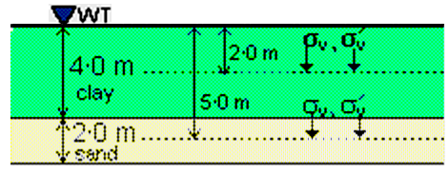
Solution
(i) Initially, before construction
  Initial stresses at mid-depth of clay (z = 2.0m)
  Vertical total stress σ_{v} = 20.0 x 2.0 = 40.0kPa
  Pore pressure u = 10 x 2.0 = 20.0 kPa
  Vertical effective stress σ´_{v} = σ_{v} - u = 20.0kPa
  Initial stresses at mid-depth of sand (z = 5.0 m)
  Vertical total stress σ_{v} = 20.0 x 5.0 = 100.0 kPa
  Pore pressure u = 10 x 5.0 = 50.0 kPa
  Vertical effective stress σ´_{v} = σ_{v} - u = 50.0 kPa

Slide 55
(ii) Immediately after construction
The construction of the embankment applies a surface surcharge:
q = 18 x 4 = 72.0 kPa.
The sand is drained (either horizontally or into the rock below) and so there is no increase in pore pressure. The clay is undrained and the pore pressure increases by 72 kPa.
  Initial stresses at mid-depth of clay (z = 2.0m)
  Vertical total stress σ_{v} = 20.0 x 2.0 + 72.0 = 112.0kPa
  Pore pressure u = 10 x 2.0 + 72.0 = 92.0 kPa
  Vertical effective stress σ´_{v} = σ_{v} - u = 20.0kPa (i.e. no change immediately)
  Initial stresses at mid-depth of sand (z = 5.0m)
  Vertical total stress σ_{v} = 20.0 x 5.0 + 72.0 = 172.0kPa
  Pore pressure u = 10 x 5.0 = 50.0 kPa
  Vertical effective stress σ´_{v} = σ_{v} - u = 122.0kPa (i.e. an immediate increase)

Slide 56
(iii) Many years after construction
After many years, the excess pore pressures in the clay will have dissipated.
The pore pressures will now be the same as they were initially.
  Initial stresses at mid-depth of clay (z = 2.0 m)
  Vertical total stress σ_{v} = 20.0 x 2.0 + 72.0 = 112.0 kPa
  Pore pressure u = 10 x 2.0 = 20.0 kPa
  Vertical effective stress σ´_{v} = σ_{v} - u = 92.0 kPa (i.e. a long-term increase)
  Initial stresses at mid-depth of sand (z = 5.0 m)
  Vertical total stress σ_{v} = 20.0 x 5.0 + 72.0 = 172.0 kPa
  Pore pressure u = 10 x 5.0 = 50.0 kPa
  Vertical effective stress σ´_{v} = σ_{v} - u = 122.0 kPa (i.e. no further change)
This gradual process of drainage under an additional load application and the associated transfer of excess pore water pressure to effective stress cause the time-dependent settlement in the clay soil layer. This is called consolidation.

Slide 57
Topics
INTRODUCTION
ELASTIC SETTLEMENT
Stress distribution in soil masses
CONSOLIDATION SETTLEMENT
Fundamentals of consolidation
Calculation of One-Dimensional Consolidation Settlement
One-dimensional Laboratory Consolidation Test
Calculation of Settlement from One-Dimensional Primary Consolidation
TIME RATE OF CONSOLIDATION SETTLEMENT
1-D theory of consolidation
SECONDARY CONSOLIDATION SETTLEMENT

Slide 58


Calculation of 1-D Consolidation Settlement
A general theory for consolidation, incorporating three-dimensional flow is complicated and only applicable to a very limited range of problems in geotechnical engineering.
y
x
z
A simplification for solving consolidation problems, drainage and deformations are assumed to be only in the vertical direction.
z
q kPa
GL
Sand
water squeezed out
reasonable simplification if the surcharge is of large lateral extent
saturated clay
Sand

Slide 59
……….($)
The consolidation settlement can be determined knowing:
- Initial void ratio e₀.
- Thickness of layer H
- Change of void ratio Δe
It only requires the evaluation of Δe

Slide 60
Topics
INTRODUCTION
ELASTIC SETTLEMENT
Stress distribution in soil masses
CONSOLIDATION SETTLEMENT
Fundamentals of consolidation
Calculation of One-Dimensional Consolidation Settlement
One-dimensional Laboratory Consolidation Test
Calculation of Settlement from One-Dimensional Primary Consolidation
TIME RATE OF CONSOLIDATION SETTLEMENT
1-D theory of consolidation
SECONDARY CONSOLIDATION SETTLEMENT

Slide 61
One-dimensional Laboratory Consolidation Test
1-D field consolidation can be simulated in laboratory.
Data obtained from laboratory testing can be used to predict magnitude of consolidation settlement reasonably, but rate is often poorly estimated.
Wide foundation
simulation of 1-D field consolidation in Lab
GL
Sand or Drainage layer
porous stone
Undisturbed soil specimen
metal ring
(oedometer)
Saturated clay
field
lab

Slide 62
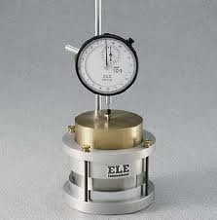
The one-dimensional consolidation test was first suggested by Terzaghi. It is performed in a consolidometer (sometimes referred to as oedometer). The schematic diagram of a consolidometer is shown below.
The complete procedures and discussion of the test was presented in CE 380.
Consolidometer or Oedometer
Dial gauge
Load
Water
Porous stone
Soil specimen
Specimen ring

Slide 63
Incremental loading
loading in increments
q₁
q₂
ΔH₁
ΔH₂
H_{o}
e_{o}
e_{o}- Δe₁
e₁- Δe₂
Load increment ratio (LIR) = Δq/q = 1 (i.e., double the load)
Allow full consolidation before next increment (24 hours)
Record compression during and at the end of each increment using dial gauge.
Example of time sequence: (10 sec, 30 sec, 1 min, 2, 4, 8, 15, 30, 1 hr, 2, 4, 8, 16, 24)
The procedure is repeated for additional doublings of applied pressure until the applied pressure is in excess of the total stress to which the clay layer is believed to be subjected to when the proposed structure is built.
The total pressure includes effective overburden pressure and net additional pressure due to the structure.
Example of load sequence (25, 50, 100, 200, 400, 800, 1600, … kPa)

Slide 64
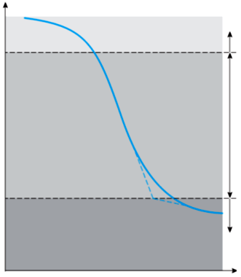
Presentation of results
The results of the consolidation tests can be summarized in the following plots:
Rate of consolidation curves (dial reading vs. log time or dial reading vs. square root time)
Void ratio-pressure plots (Consolidation curve)
e – σ_{v’} plot or e - log σ_{v’} plot
The plot of deformation of the specimen against time for a given load increment can observe three distinct stages:
Stage I: Initial compression, which is caused mostly by preloading.
Stage II: Primary consolidation, during which excess pore water pressure gradually is transferred into effective stress because of the expulsion of pore water.
Stage III: Secondary consolidation, which occurs after complete dissipation of the excess pore water pressure, caused by plastic readjustment of soil fabric.
Stage I
Deformation
Stage II
Stage III
Time (log scale)

Slide 65
Presentation of results (cont.)
After plotting the time-deformation for various loadings are obtained, it is necessary to study the change in the void ratio of the specimen with pressure. See section 11.6 for step-by-step procedure for doing so.
=
Proceeding in a similar manner, one can obtain the void ratios at the end of the consolidation for all load increments. See Example 11.2.

Slide 66
Data reduction
Load (kPa) | Dial Reading (mm) | ΔH (mm) | Δe | e
0 | 0
25 | 0.71882
50 | 0.90424
100 | 1.62052
200 | 2.68986
400 | 3.84556
800 | ………..
1600 | ………..

Slide 67
e – σ’ plot
Presentation of Results (cont.)
loading
σ’ increases & e decreases
void ratio
unloading
σ’ decreases &
e increases (swelling)
σ’
The figure above is usually termed the compressibility curve , where compressibility is the term applied to 1-D volume change that occurs in cohesive soils that are subjected to compressive loading.
Note: It is more convenient to express the stress-stain relationship for soil in consolidation studies in terms of void ratio and unit pressure instead of unit strain and stress used in the case of most other engineering materials.

Slide 68
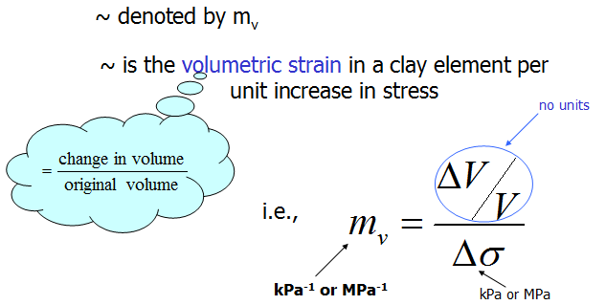

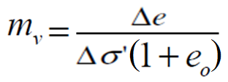
Coefficient of Volume Compressibility [m_{v}]
m_{v} is defined as the volume change per unit volume per unit increase in effective stress
m_{v} is also known as Coefficient of Volume Change.
The value of m_{v} for a particular soil is not constant but depends on the stress range over which it is calculated.

Slide 69

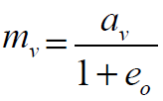
Coefficient of Compressibility a_{v}
a_{v} is the slope of e-σ’plot, or a_{v} = -de/dσ’ (m²/kN)
Within a narrow range of pressures, there is a linear relationship between the decrease of the voids ratio e and the increase in the pressure (stress). Mathematically,
a_{v} decreases with increases in effective stress
Because the slope of the curve e-σ’ is constantly changing, it is somewhat difficult to use a_{v} in a mathematical analysis, as is desired in order to make settlement calculations.

Slide 70
e – log σ’ plot
Presentation of results
void ratio
loading
σ’ increases &
e decreases
Unloading
σ’ decreases &
e increases
log σ’

Slide 71
Compression and Swell Indices
As we said earlier, the main limitation of using a_{v} and m_{v} in describing soil compressibility is that they are not constant. To overcome this shortcoming the relationship between e and σ_{v}’ is usually plotted in a semi logarithmic plot as shown below.
C_{c} ~ compression index
void ratio
Δe₁
C_{c}
1
C_{s} ~ Swell index
Δe₂
C_{s}
σ’₄
σ’₃
σ’₁
σ’₂
log σ’

Slide 72
Correlations for compression index, c_{c}
This index is best determined by the laboratory test results for void ratio, e, and pressure σ’ (as shown above).
Because conducting compression (consolidation) test is relatively time consuming (usually 2 weeks), C_{c} is usually related to other index properties like:

Slide 73
Several empirical expressions have also been suggested:
G_{S}: Specific Gravity
e₀ : in situ void ratio
PI: Plasticity Index
LL: Liquid Limit
Compression and Swell Indices of some Natural Soils

Slide 74
Normally consolidated and overconsolidated clays
The upper part of the e – log σ’ plot is as shown below somewhat curved with a flat slope, followed by a linear relationship having a steeper slope.
This can be explained as follows:
A soil in the field at some depth has been subjected to a certain maximum effective past pressure in its geologic history.
This maximum effective past pressure may be equal to or less than the existing effective overburden pressure at the time of sampling.
The reduction of effective pressure may be due to natural geological processes or human processes.
During the soil sampling, the existing effective overburden pressure is also released, which results in some expansion.

Slide 75
The soil will show relatively small decrease of e with load up until the point of the maximum effective stress to which the soil was subjected to in the past.
(Note: this could be the overburden pressure if the soil has not been subjected to any external load other than the weight of soil above that point concerned).
This can be verified in the laboratory by loading, unloading and reloading a soil sample as shown across.
Normal Compression
Void ratio, e
Swelling re-compression
Effective pressure, σ’ (log scale)

Slide 76
Normally Consolidated Clay (N.C. Clay)
A soil is NC if the present effective pressure to which it is subjected is the maximum pressure the soil has ever been subjected to.
The branches bc and fg are NC state of a soil.
Over Consolidated Clays (O.C. Clay)
A soil is OC if the present effective pressure to which it is subjected to is less than the maximum pressure to which the soil was subjected to in the past
Normal Compression
Void ratio, e
Swelling re-compression
The branches ab, cd, df, are the OC state of a soil.
The maximum effective past pressure is called the preconsolidation pressure.
Effective pressure, σ’ (log scale)

Slide 77
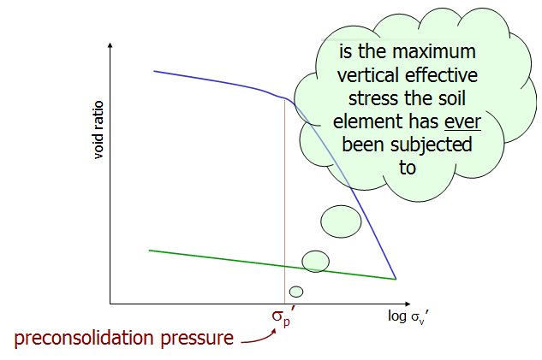
Preconsolidation pressure
The stress at which the transition or “break” occurs in the curve of e vs. log σ’ is an indication of the maximum vertical overburden stress that a particular soil sample has sustained in the past.
This stress is very important in geotechnical engineering and is known as Preconsolidation Pressure.
σ_{c}’

Slide 78
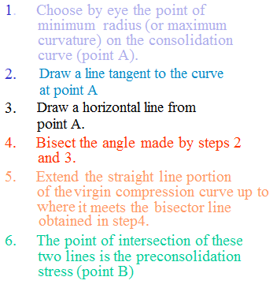
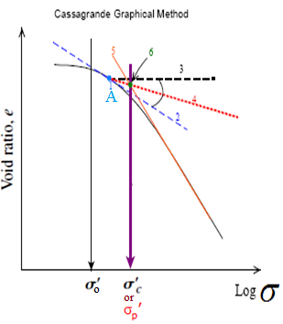
Casagrande procedure of determination preconsolidation stress
σ_{c}’
Casagrande (1936) suggested a simple graphic construction to determine the preconsolidation pressure σ’_{c} from the laboratory e –log σ‘ plot.
Point B

Slide 79
Overconsolidation ratio (OCR)
In general the overconsolidation ratio (OCR) for a soil can be defined as:
Void ratio, e
where σ ’ is the present effective vertical pressure.
From the definition of NC soils, they always have OCR=1.
Effective pressure, σ’ (log scale)
σ_{c}’
To calculate OCR the preconsolidation pressure should be known from the consolidation test and σ’ is the effective stress in the field.

Slide 80
σ_{c}’
Factors affecting the determination of
Duration of load increment
t_{p} is to be known from either plotting of deformation vs. time or excess p.w.p. if it is being monitored during the test.
When the duration of load maintained on a sample is increased the e vs. log gradually moves to the left.
σ ’
The reason for this is that as time increased the amount of secondary consolidation of the sample is also increased. This will tend to reduce the void ratio e.
σ_{c} ’
The value of will increase with the decrease of t.

Slide 81
Load Increment Ratio (LIR)
LIR is defined as the change in pressure of the pressure increment divided by the initial pressure before the load is applied.
LIR =1, means the load is doubled each time, this results in evenly spaced data points on e vs. log curve
σ ’
When LIR is gradually increased, the e vs. log curve gradually moves to the left.
σ’

Slide 82
Field consolidation curve
Due to soil disturbance, even with high-quality sampling and testing the actual compression curve has a SLOPE which is somewhat LESS than the slope of the field VIRGIN COMPRESSION CURVE. The “break” in the curve becomes less sharp with increasing disturbance.
Sources of disturbance:
Sampling
Transportation
Storage
Preparation of the specimen (like trimming)

Slide 83
Graphical procedures to evaluate the slope of the field compression curve
σ₀’
We know the present effective overburden and void ratio e₀.
We should know from the beginning whether the soil is NC or OC by comparing σ’₀ and σ’_{C} . σ’₀ = γ z, σ’_{C} we find it through the procedures presented in a previous slide.
Recall

Slide 84
Topics
INTRODUCTION
ELASTIC SETTLEMENT
Stress distribution in soil masses
CONSOLIDATION SETTLEMENT
Fundamentals of consolidation
Calculation of One-Dimensional Consolidation Settlement
One-dimensional Laboratory Consolidation Test
Calculation of Settlement from One-Dimensional Primary Consolidation
TIME RATE OF CONSOLIDATION SETTLEMENT
1-D theory of consolidation
SECONDARY CONSOLIDATION SETTLEMENT

Slide 85
Calculation of Settlement from 1-D Dimensional Primary Consolidation
With the knowledge gained from the analysis of consolidation test results, we can now proceed to calculate the probable settlement caused by primary consolidation in the field assuming one-dimensional consolidation.
I) Using e - log σ_{v prime}
If the e-log σ/ curve is given, Δe can simply be picked off the plot for the appropriate range and pressures. This number may be substituted into Eq. ($) for the calculation of settlement, S_{c}.
void ratio
Δe
σ_{ο}
σ_{f}
log σ_{v}’

Slide 86
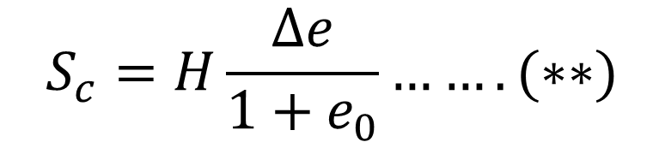

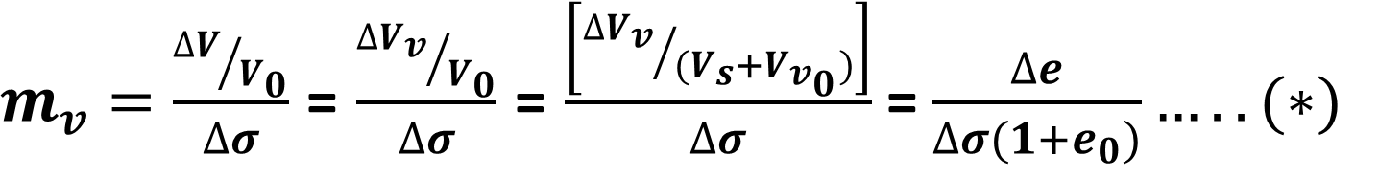
II) Using m_{v}
$m_{v}=\frac{{∆V}/{V_{0}}}{∆σ}$ = $\frac{{∆V_{v}}/{V_{0}}}{∆σ}$ = $\frac{\left[{∆V_{v}}/{{(V}_{s}+V_{v_{0}})}\right]}{∆σ}$ = $\frac{∆e}{∆σ(1+e_{0})}…..(∗)$
But
$$S_{c}=H\frac{∆e}{1+e_{0}}…….(∗∗)$$
From (*) and (**)
$$S_{C}=m_{v}.H.∆σ (∗∗∗)$$
Disadvantage of (***) is related to m_{v} since it is obtained from e vs. Δσ which is nonlinear and m_{v} is stress level dependent. This is on contrast to C_{c} which is constant for a wide range of stress level.

Slide 87
III) Using Compression and Swelling Indices
a) Normally Consolidated Clay (σ ’ ₀ = σ _{c}’ )

Slide 88
b) Overconsolidated Clays
Case I:
σ ’ ₀ +Δσ ’ ≤ σ _{c}’
σ _{c}’
Case II:
σ ’ ₀ +Δσ ’ > σ _{c}’

Slide 89
Summary of calculation procedure
Calculate σ’_{o} at the middle of the clay layer
Determine σ’_{c} from the e-log σ/ plot (if not given)
Determine whether the clay is N.C. or O.C.
Calculate Δσ
Use the appropriate equation
If N.C.
If O.C.

Slide 90
Nonlinear pressure increase
q
Approach 1: Middle of layer (midpoint rule)
For settlement calculation, the pressure increase Δσ_{z} can be approximated as :
Compressible Layer
Δσ_{m}
Δσ_{z} = Δσ_{m}
where Δσ_{m} represent the increase in the effective pressure in the middle of the layer.
z
Δσ_{z} under the center of foundation

Slide 91
q
Approach 2: Average pressure increase
For settlement calculation we will use the average pressure increase Δσ_{av} , using weighted average method (Simpson’s rule):
Compressible Layer
z
Δσ_{z} under the center of foundation
where Δσ_{t} , Δσ_{m} and Δσ_{b} represent the increase in the pressure at the top, middle, and bottom of the clay, respectively, under the center of the footing.

Slide 92
Example problem
The figure shows 2.5m-square footing constructed in sand layer underlain by clay. Calculate the average increase of effective pressure in the clay layer.
Solution:
Using weighted average method:
Q=1000 kN
1.5m
3m
2.5x2.5m
Dry sand
Δσ’_{t} , Δσ’_{m} and Δσ’_{b} below the center of the footing can be obtained using Boussinesq’s method.
3m
Sand
l = ½ L = b = ½ B = 1.25 m
Δσ’ = 4 q. I_{R} = 4 (1000/2.5²) I_{R} =640 I_{R}
3m
Clay
Z | m = l/z | n = b/z | I_{R} | Δσ’ [kPa]
4.5 | 0.28 | 0.28 | 0.03 | 19.2
6 | 0.21 | 0.21 | 0.02 | 12.8
7.5 | 0.17 | 0.17 | 0.013 | 8.3
Bed rock
z

Slide 94
Topics
INTRODUCTION
ELASTIC SETTLEMENT
Stress distribution in soil masses
CONSOLIDATION SETTLEMENT
Fundamentals of consolidation
Calculation of One-Dimensional Consolidation Settlement
One-dimensional Laboratory Consolidation Test
Calculation of Settlement from One-Dimensional Primary Consolidation
TIME RATE OF CONSOLIDATION SETTLEMENT
1-D theory of consolidation
SECONDARY CONSOLIDATION SETTLEMENT

Slide 95
Time Rate of Consolidation Settlement
We now know how to evaluate total settlement of primary consolidation S_{c} which will take place in a certain clay layer.
However this settlement usually takes place over time, much longer than the time of construction.
One question one might ask is in how much time that magnitude of settlement will take place. Also might be interested in knowing the value of S_{c} for a given time, or the time required for a certain magnitude of settlement.
In certain situations, engineers may need to know the followings information:
  The amount of settlement S_{c}(t) ~ at a specific time, t, before the end of consolidation, or
  The time, t, required for a specific settlement amount, before the end of consolidation.

Slide 96
How to get to know the rate of consolidation?
From the spring analogy we can see that S_{c} is directly related to how much water has squeezed out of the soil voids.
How much water has squeezed out and thus the change in void ratio e is in turn directly proportional to the amount of excess p.w.p that has dissipated.
Therefore, the rate of settlement is directly related to the rate of excess p.w.p. dissipation.
What we need is a governing equation that predict the change in p.w.p. with time and hence e, at any point in TIME and SPACE in the consolidation clay layer. In other words, we need something to tell us how we get from the moment the load is entirely carried by the water to the point the load is completely supported by the soil.
S_{c} vs. water
Water vs. Δe
Δ e vs. σ’
σ’ vs. u
It is the THEORY OF CONSOLIDATION which tells us that.

Slide 97
Topics
INTRODUCTION
ELASTIC SETTLEMENT
Stress distribution in soil masses
CONSOLIDATION SETTLEMENT
Fundamentals of consolidation
Calculation of One-Dimensional Consolidation Settlement
One-dimensional Laboratory Consolidation Test
Calculation of Settlement from One-Dimensional Primary Consolidation
TIME RATE OF CONSOLIDATION SETTLEMENT
1-D theory of consolidation
SECONDARY CONSOLIDATION SETTLEMENT

Slide 98
1-D Theory of Consolidation
Terzaghi developed a theory based on the assumption that an increment of load immediately is transferred to the pore water to create excess pore water pressure (p.w.p).
Then as the pore water squeezed out, the excess p.w.p. relaxes gradually transferring the load to effective stress.
He assumed that all drainage of excess pore water is vertical toward one or two horizontal drainage faces. This is described as ONE-DIMENSIONAL CONSOLIDATION.
3-D consolidation theory is now available but more cumbersome.
However 1-D theory is useful and still the one used in practice, and it tends to overpredict settlement.

Slide 99
ASSUMPTIONS
The soil is homogeneous.
The soil is fully saturated.
The solid particles and water are incompressible.
Compression and flow are 1-D (vertical).
Darcy’s law is valid at all hydraulic gradients.
The coefficient of permeability and the coefficient of volume change remain constant throughout the process.
Strains are small.

Slide 100
Mathematical Derivation
Rate of outflow of water - Rate of inflow of water = Rate of Volume Change

Slide 101
……(I)
……(II)
From Darcy’s law
Substituting (**) into (*)
……(III)
0
0
……(IV)
……(V)
The one-dimensional consolidation equation derived by Terzaghi
From (III) to (V)

Slide 102
Solution of Terzaghi’s 1-D consolidation equation
Terzaghi’s equation is a linear partial differential equation in one dependent variable. It can be solved by one of various methods with the following boundary conditions:
The solution yields
(*)
Where
u = excess pore water pressure
u_{o} = initial pore water pressure
M = π/2 (2m+1) m = an integer
z = depth
H_{dr} = maximum drainage path

Slide 103
Remarks
The theory relates three variables:
Excess pore water pressure u
The depth z below the top of the clay layer
The time t from the moment of application of load
Or it gives u at any depth z at any time t
The solution was for doubly drained stratum.
Finding degree of consolidation for single drainage is exactly the same procedure as for double drainage case except here H_{d}= the entire depth of the drainage layer when substituting in equations or when using the figure of isochrones.
Eq. (*) represents the relationship between time, depth, p.w.p for constant initial pore water pressure u₀ .
If we know the coefficient of consolidation C_{v} and the initial p.w.p. distribution along with the layer thickness and boundary conditions, we can find the value of u at any depth z at any time t.

Slide 104
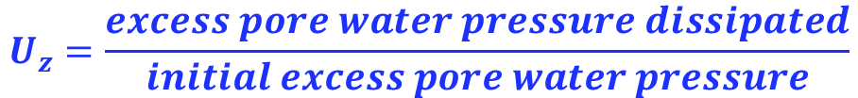
Degree of consolidation
The progress of consolidation after sometime t and at any depth z in the consolidating layer can be related to the void ratio at that time and the final change in void ratio.
This relationship is called the DEGREE or PERCENT of CONSOLIDATION or CONSOLIDATION RATIO.
Because consolidation progress by the dissipation of excess pore water pressure, the degree of consolidation at a distance z at any time t is given by:
$$U_{z}=\frac{excess pore water pressure dissipated}{initial excess pore water pressure}$$
……($)

Slide 105
Substituting the expression for excess pore water pressure, i.e.
into Eq. ($) yields
2
U_{z} = 1-
…… ($$)
The above equation can be used to find the degree of consolidation at depth z at a given time t.
At any given time excess pore water pressure u_{z} varies with depth, and hence the degree of consolidation U_{z} also varies.
If we have a situation of one-way drainage Eq. ($$) is still be valid, however the length of the drainage path is equal to the total thickness of the clay layer.

Slide 106

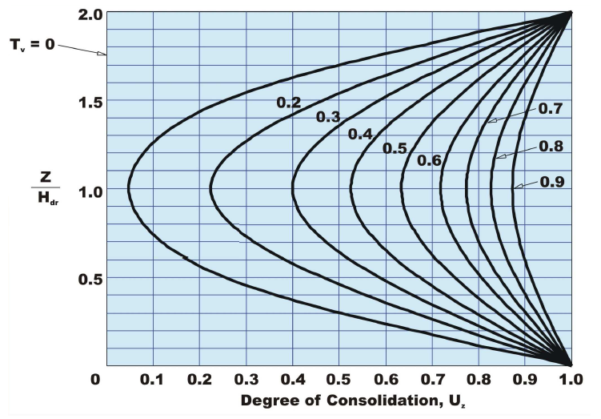
2
H_{dr}
U_{z} = 1-
H
Permeable layer
H_{dr}
T_{v}
0.1
Variation of U_{z} with T_{v} and z/H_{dr}

Slide 107
Variation of U_{z} with T_{v} and z/H_{dr}
Remarks
From this figure it is possible to find the amount or degree of consolidation (and therefore u and σ’) for any real time after the start of loading and at any point in the consolidating layer.
All you need to know is the C_{v} for the particular soil deposit, the total thickness of the layer, and boundary drainage conditions.
These curves are called isochrones because they are lines of equal times.
With the advent of digital computer the value of U_{z} can be readily evaluated directly from the equation without resorting to chart.

Slide 108
Length of the drainage path, H_{dr}
During consolidation water escapes from the soil to the surface or to a permeable sub-surface layer above or below (where Δu = 0).
The rate of consolidation depends on the longest path taken by a drop of water. The length of this longest path is the drainage path length, H_{dr}
H_{dr}
H_{dr}
H_{dr}
Permeable layer
H
Clay
H_{dr}
H_{dr}
L
Typical cases are:
  An open layer, a permeable layer both above and below (H_{dr} = H/2)
  A half-closed layer, a permeable layer either above or below (H_{dr} = H)
  Vertical sand drains, horizontal drainage (H_{dr} = L/2)

Slide 109

Degree of consolidation
$$U_{z}=\frac{excess pore water pressure dissipated}{initial excess pore water pressure}$$
U_{z} = 1-
2

Slide 110
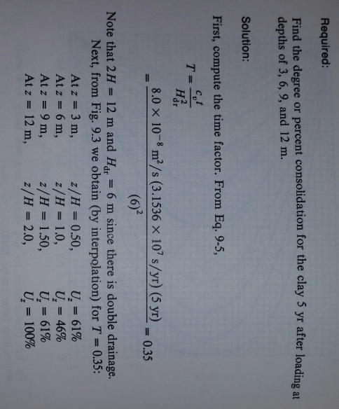
Example 1
A 12 m thick clay layer is doubly drained (This means that a very pervious layer compared to the clay exists on top of and under the 12 m clay layer. The coefficient of consolidation C_{v} = 8.0 X 10⁻⁸ m²/s.

Slide 111
61%
100%
46%
61%

Slide 112
Average degree of consolidation
In most cases, we are not interested in how much a given point in a layer has consolidated.
Of more practical interest is the average degree or percent consolidation of the entire layer.
This value, denoted by U or U_{av} , is a measure of how much the entire layer has consolidated and thus it can be directly related to the total settlement of the layer at a given time after loading.
Note that U can be expressed as either a decimal or a percentage.
To obtain the average degree of consolidation over the entire layer corresponding to a given time factor we have to find the area under the T_{v} curve.

Slide 113
Average degree of consolidation
The average degree of consolidation for the entire depth of clay layer is,
u_{o}
…… (&)
Area under the pore pressure curve
Substituting the expression of u_{z} given by
2 H_{dr}
Into Eq. (&) and integrating, yields
Degree of consolidation

Slide 114
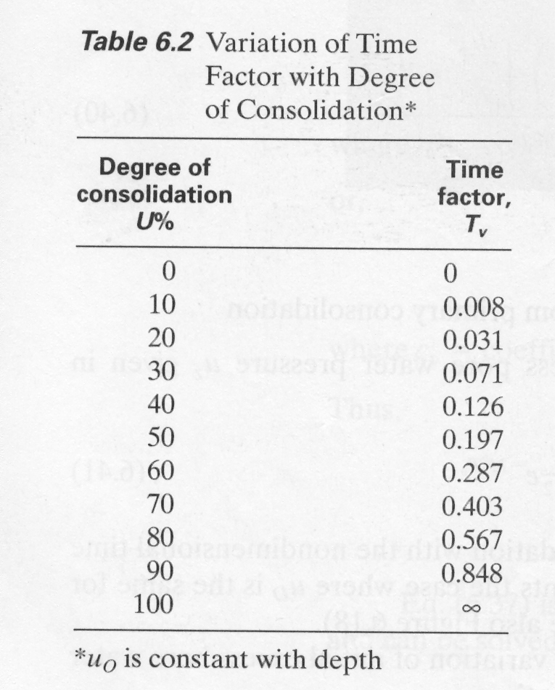
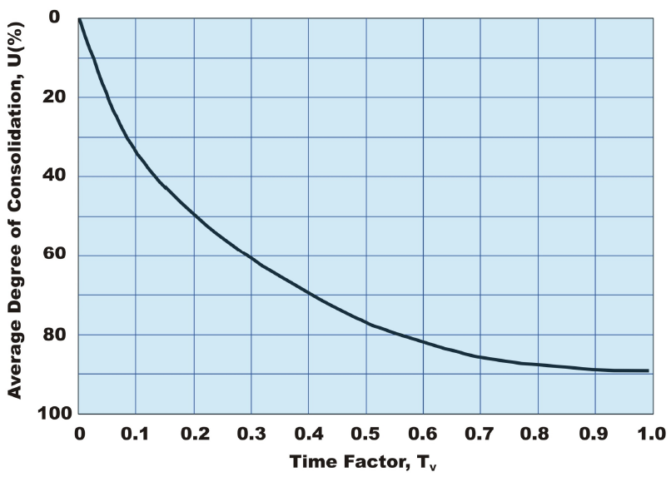

Variation of U with T_{v}
$$S_{c(t)}=U_{(t)}S_{c}$$
S_{c(t)} = Settlement at any time, t
S_{c} = Ultimate primary consolidation settlement of the layer.

Slide 115
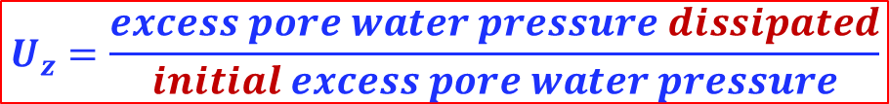
Summary
Because consolidation progress by the dissipation of excess pore water pressure, the degree of consolidation at a distance z at any time t is given by:
$$U_{z}=\frac{excess pore water pressure dissipated}{initial excess pore water pressure}$$
U_{z} = 1-
2
Average Degree of consolidation
Degree of consolidation

Slide 116

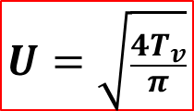
Approximate relationships for U vs. T_{V}
Many correlations of variation of U with T_{v} have been proposed.
Terzaghi proposed the followings:
$$U=\sqrt{\frac{4T_{v}}{π}}$$
or
Average degree of consolidation, U (%)
or
$$U=100−{10}^{− \frac{T_{v}−1.781}{0.933}}$$
Time factor, T_{v}
Do not forget, this is the theoretical relationship

Slide 117

or:
$$S_{c(t)}=U_{(t)}S_{c}$$
Note
These equations can be applied for all ranges of U value with small errors .
Error in T_{v} of less than 1% for 0% < U < 90% and less than 3% for 90% < U < 100%.

Slide 118
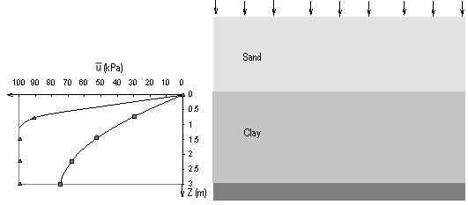
Example 2
A soil profile consists of a sand layer 2 m thick, whose top is the ground surface, and a clay layer 3 m thick with an impermeable boundary located at its base. The water table is at the ground surface. A widespread load of 100 kPa is applied at the ground surface.
(i) What is the excess water pressure, Δu corresponding to:
  t = 0 (i.e. immediately after applying the load)
  t = ∞ (very long time after applying the load)
100 kPa
Sand
2m
(ii) Determine the time required to reach 50% consolidation if you know that C_{v}= 6.5 m²/year.
Clay
3m
Solution
Impermeable layer
(i) Immediately after applying the load, the degree of consolidation U_{z} = 0% and the pore water would carry the entire load:
at t = 0 → Δu₀ = Δσ = 100 kPa

Slide 119
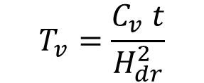
Solution (cont.)
On contrary, after very long time, the degree of consolidation U = 100% and the clay particles would carry the load completely:
at t = ∞ → Δu∞ = 0
Δσ = 100 kPa
Sand
2m
(ii) The time required to achieve 50% consolidation can be calculated from the equation:
One-way drain
3m
Clay
$$T_{v}=\frac{C_{v} t}{H_{dr}^{2}}$$
t = H_{dr}².T_{v} / c_{v}
Impermeable layer
c_{v} = coefficient of consolidation (given) = 6.5 m²/year
H_{dr} = the drainage path length = height of clay = 3m (because the water drain away from the sand layer only)
T_{v} = is the time factor for U=50%, and can approximately be calculated from:
≈ 0.197
Can also be obtained from the theoretical relationship or graph
Substitution of these values in the above equation of t:
t ≈ 0.27 year

Slide 120
Example 3
The time required for 50% consolidation of a 25-mm-thick clay layer (drained at both top and bottom) in the laboratory is 2 min. 20 sec.
(i) How long (in days) will it take for a 3-m-thick clay layer of the same clay in the field under the same pressure increment to reach 50% consolidation? In the field, there is a rock layer at the bottom of the clay.
Laboratory
Field
Porous stone
(permeable)
GW
Clay
25mm
Sand
(ii) How long (in days) will it take in the field for 30% primary consolidation to occur? Assuming:
Clay
3m
Rock (impermeable)

Slide 121
Example 3 - solution
(i) As the clay in lab and field reached the same consolidation degree (U=50%), Thus, The time factor in the lab test = The time factor for the field
Approach I:
Approach II:
From Lab.
At U=50% …..> T_{v} = 0.197
From T_{v} = C_{v} t/H_{d}² ....> C_{v} = 2.2 X 10⁻⁷ m²/S
In the field
0.197 = 2.2 X 10⁻⁷ X t
(3)²
t = 93.3 days
or
12.5mm/1000 m
3
(ii)
T_{v} = C_{v} X t
H_{d}²
T_{v} = 3.14 X (0.3)² = 0.071
4
0.071 = 2.2X10⁻⁷ X t
(3)²
t = 33.5 days

Slide 122
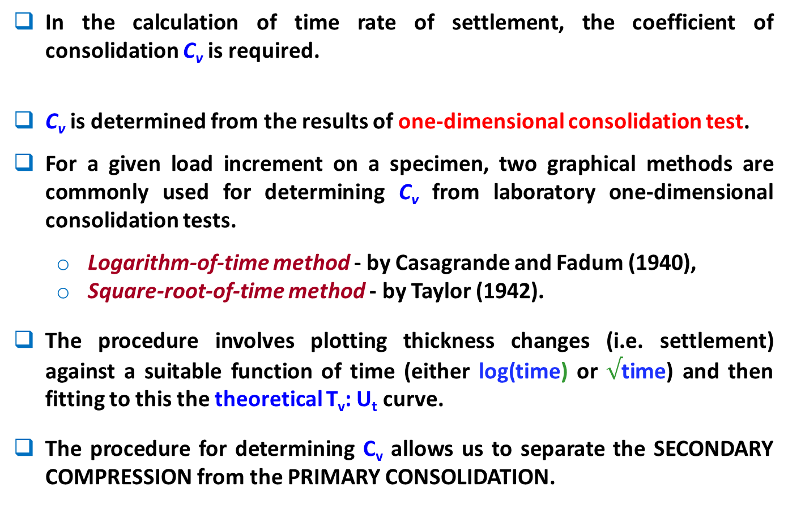
Determination of coefficient of consolidation (C_{v})
122
In the calculation of time rate of settlement, the coefficient of consolidation C_{v} is required.
C_{v} is determined from the results of one-dimensional consolidation test.
For a given load increment on a specimen, two graphical methods are commonly used for determining C_{v} from laboratory one-dimensional consolidation tests.
  Logarithm-of-time method - by Casagrande and Fadum (1940),
  Square-root-of-time method - by Taylor (1942).
The procedure involves plotting thickness changes (i.e. settlement) against a suitable function of time (either log(time) or $√$time) and then fitting to this the theoretical T_{v}: U_{t} curve.
The procedure for determining C_{v} allows us to separate the SECONDARY COMPRESSION from the PRIMARY CONSOLIDATION.
The procedures are based on the similarity between the shapes of the theoretical and experimental curves when plotted versus the square root of T_{v} and t.
Notes:
122

Slide 123
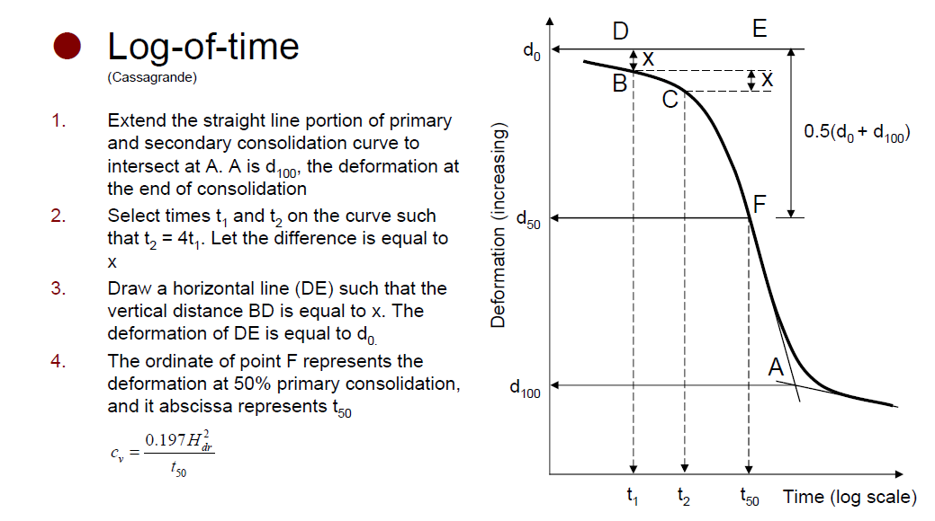
logarithm-of-time method (Casagrande’s method)
Parabola portion
3
2
2
4
5
1
Note: This is only for the case of constant or linear u₀.

Slide 124
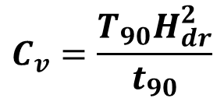
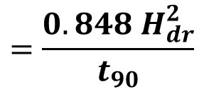
Square-root-of-time method (Taylor’s method)
Draw the line AB through the early portion of the curve
Draw the line AC such that OC = 1.15 AB. Find the point of intersection of line AC with the curve (point D).
The abscissa of D gives the square root of time for 90% consolidation.
The coefficient of consolidation is therefore:
$$C_{v}=\frac{T_{90}H_{dr}^{2}}{t_{90}}$$
$$=\frac{0.848 H_{dr}^{2}}{t_{90}}$$
124

Slide 125
Notes
For samples drained at top and bottom, H_{d} equals one-half of the AVERGAE height of sample during consolidation. For samples drained only on one side, H_{d} equals the average height of sample during consolidation.
The curves of actual deformation dial readings versus real time for a given load increment often have very similar shapes to the theoretical U-T_{v} curves.
We take advantage of this observation to determine the C_{v} by so-called “curve fitting methods” developed by Casagrande and Taylor.
These empirical procedures were developed to fit approximately the observed laboratory test data to the Terzaghi’s theory of consolidation.
Often C_{v} as obtained by the square time method is slightly greater than C_{v} by the log t fitting method.
C_{v} is determined for a specific load increment. It is different from load increment to another.
Taylor’s method is more useful primarily when the 100 percent consolidation point cannot be estimated from a semi-logarithmic plot of the laboratory time-settlement data.

Slide 126
Topics
INTRODUCTION
ELASTIC SETTLEMENT
Stress distribution in soil masses
CONSOLIDATION SETTLEMENT
Fundamentals of consolidation
Calculation of One-Dimensional Consolidation Settlement
One-dimensional Laboratory Consolidation Test
Calculation of Settlement from One-Dimensional Primary Consolidation
TIME RATE OF CONSOLIDATION SETTLEMENT
1-D theory of consolidation
SECONDARY CONSOLIDATION SETTLEMENT

Slide 127
Components of settlement
The total soil settlement S _{T} may contain one or more of these types:
Immediate settlement
Due to distortion or elastic deformation with no change in water content
Primary consolidation settlement
Decrease in voids volume due to squeeze of pore-water out of the soil
Secondary consolidation or creep
Occurs rapidly during the application of load
Quite small quantity in dense sands, gravels and stiff clays
Occurs in saturated fine grained soils (low coefficient of permeability)
Time dependent
Only significant in clays and silts
Due to gradual changes in the particulate structure of the soil
Occurs very slowly, long after the primary consolidation is completed
Time dependent
Most significant in saturated soft clayey and organic soils and peats
S_{T} = S_{e} + S_{c} + S_{s}
Notes:
When foundations are constructed on very compressible clays, the consolidation settlement
can be several times greater than the elastic settlement.

Slide 128
Secondary Consolidation Settlement
In some soils (especially recent organic soils) the compression continues under constant loading after all of the excess pore pressure has dissipated, i.e. after primary consolidation has ceased.
This is called secondary compression or creep, and it is due to plastic adjustment of soil fabrics.
Secondary compression is different from primary consolidation in that it takes place at a constant effective stress.
This settlement can be calculated using the secondary compression index, C_{α}.
The Log-Time plot (of the consolidation test) can be used to estimate the coefficient of secondary compression C_{α} as the slope of the straight line portion of e vs. log time curve which occurs after primary consolidation is complete.

Slide 129
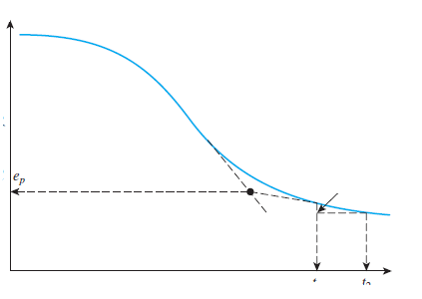


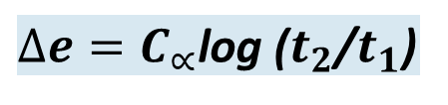
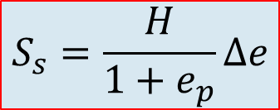
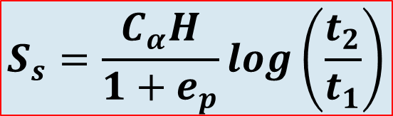
The magnitude of the secondary consolidation can be calculated as:
$$S_{s}=\frac{H}{1+e_{p}}∆e$$
void ratio, e
e_{p} void ratio at the end of primary consolidation, H thickness of clay layer.
$∆e=C_{∝}$log ($t_{2}$/$t_{1}$)
e_{p}
Δe
C_{α} = coefficient of secondary compression
t₁
t₂
$$S_{s}=\frac{C_{α}H}{1+e_{p}}log\left(\frac{t_{2}}{t_{1}}\right)$$
e₀ = can still be used with only a minor error.

Slide 130
Remarks
Causes of secondary settlement are not fully understood but is attributed to:
Plastic adjustment of soil fabrics
Compression of the bonds between individual clay particles and domains
Factors that might affect the magnitude of S_{s} are not fully understood. In general secondary consolidation is large for:
Soft soils
Organic soils
Smaller ratio of induced stress to effective overburden pressure.

Slide 131
Example 4
An open layer of clay 4 m thick is subjected to loading that increases the average effective vertical stress from 185 kPa to 310 kPa. Assuming m_{v}= 0.00025 m²/kN, C_{v}= 0.75 m²/year, determine:
The ultimate consolidation settlement
The settlement at the end of 1 year,
The time in days for 50% consolidation,
The time in days for 25 mm of settlement to occur.
Solution
(i) The consolidation settlement for a layer of thickness H can be represented by the coefficient of volume compressibility m_{v} defined by:
S_{c} = m_{v} H Δσ´_{z}
= 0.00025 X 4 X 125 = 0.125m = 125mm.

Slide 132


Example 4 – Solution (cont.)
(ii) The procedure for calculation of the settlement at a specific time includes:
Calculate time factor: = ……. = 0.1875
Calculate average degree of consolidation
U_{t} = ……………………….. = 0.49
Calculate the consolidation settlement at the specific time (t) from:
S_{t} = U_{t} . S_{c} = …… ……. = 61 mm
(iii) For 50% consolidation T_{v}= 0.197 , therefore from
……. ……………….. → t = 1.05 year = 384 days
(vi) For S_{t} = 25 mm U_{t} = 0.20 , therefore
……. ……………….. → t = 0.1675 year = 61 days
$$T_{v}=\frac{C_{v} t}{H_{dr}^{2}}$$
$$T_{v}=\frac{C_{v} t}{H_{dr}^{2}}$$

Slide 133


Average Degree of Consolidation, can be obtained using the table, graph, approximate formulae or analytical formula
or
$$U=\sqrt{\frac{4T_{v}}{π}}$$
Average degree of consolidation, U (%)
or
$$U=100−{10}^{− \frac{T_{v}−1.781}{0.933}}$$
Time factor, T_{v}
Do not forget, this is the theoretical relationship

Slide 134
Example 5
For a normally consolidated laboratory clay specimen drained on both sides, the following are given:
σ‘₀ = 150 kN/m², e₀ = 1.1
σ‘₀ + Δσ‘ = 300 kN/m², e = 0.9
Thickness of clay specimen = 25 mm
Time for 50% consolidation = 2 min
For the clay specimen and the given loading range, determine the hydraulic conductivity (also called coefficient of permeability, k) estimated in: m/min.
How long (in days) will it take for a 3 m clay layer in the field (drained on one side) to reach 60% consolidation?

Slide 135
Example 5 – solution
The hydraulic conductivity (coefficient of permeability, k) can be calculated from:
= …….. x ……. x 9.81 = ………
m/min
m_{v}
m_{v} = Δe / (1+e_{o}) / Δσ' = ...0.00063
m²/kN
for U=50%, T_{v} can be calculated from:
T₅₀ ≈ … 0.197
c_{v}
c_{v} = H_{dr}².T_{v} /t = (0.0125)² x 0.197/2 = 0.000015
m²/min

Slide 136
Example 5 - solution (cont.)
Time factor relation with time:
Because the clay layer has one-way drainage, H_{dr} = 3 m
for U=60%, T₆₀ can be calculated from:
T₆₀ ≈ 0.285
H_{dr}².T_{v} /c_{v} = (3)² x 0.286 / (0.000015)… =………… min
=………… days

Slide 137

Midterm Exam
QUESTION# 1
It is anticipated that a wide backfill well be placed on the surface of the soil profile shown in Figure 1. The initial vertical effective stress, σ′_{o} = 296.9 kPa, and the final vertical effective stress, σ′_{f} = 419.2 kPa, before and after the backfill; respectively.
An undisturbed sample was obtained from the midpoint (depth of 29.5 m) of the clay layer. A double drained consolidation test was performed on a sample 2.5 in. (63.5 mm) in diameter. The initial height was 25.4 mm. The time-compression results of consolidation test on the undisturbed sample, for stress increment 384 to 768 kPa, are shown in Figure 2.
Determine, for this load increment, the coefficient of consolidation C_{v} (m²/day).
Figure 1: Soil Profile

Slide 138
0.94 mm
1.47 =
23.93 mm
1.47 mm
C_{v} = 2.59 mm²/min
= 0.00373 m²/day
1.99 mm
10.9 min
Figure 2. Log time-compression curve for load increment 384 to 768 kPa.

Slide 139

QUESTION# 2
For the same profile shown in Question# 1, the coefficient of consolidation (C_{v}) versus normal stress curve is shown on Figure 3. For simplicity, assume instantaneous loading and predict the time (t) and settlement (S) of the clay layer in the field due to backfill loading for 50% degree of consolidation (U = 50%). Complete the given time settlement data in Table 1.
Hints: t = T H²_{DP} /C_{v} & S = ∆H (U) = 0.217 U meter
H_{DP} is the length of the longest drainage path.
Figure 3. Variation of coefficient of consolidation versus normal stress curve.

Slide 140
Table 1. Rate of settlement data.
1081
0.108

Slide 141
FINAL EXAM
A foundation is to be constructed at a site where the soil profile is shown in Fig. 1. The total load is 4000 kN , which includes the weight of the structure and foundation.
A sample was obtained by a Shelby tube sampler from the midheight of the clay layer and a consolidation test was conducted on a portion of this sample. The sample thickness was 19 mm and drainage was allowed from both the top and bottom of the sample. For the first load increment, the sample reached 40% compression in 60 min.
The relationship between the void ratio and the logarithm of consolidation pressure is shown in Fig. 2. The results of the consolidation test indicated that the natural (or initial) void ratio of the clay (e₀) is 1.06 .
Fig. 1

Slide 142
Required
The ultimate consolidation settlement of the clay layer.
How many years will it take for 50% of the expected total settlement to take place?
Compute the amount of consolidation settlement that will occur in 17 years.
How many years will it take for a consolidation settlement of 4 mm to take place?
The excess pore water pressure at the middle of the clay layer 34 years after the application of footing load. (Assume the initial excess pore water pressure is equal to the applied total pressure and is constant throughout the clay layer).
Fig. 2

Slide 143


Slide 144
Summary
Introduction
Elastic Settlement
Stress distribution
Consolidation Settlement
Fundamental of consolidation Spring analogy
Calculation of Settlement from One-Dimensional Primary Consolidation
From Phase diagram
Handling of nonlinear stress
One-Dimensional Consolidation
Consolidation test m_{v} , a_{v} , C_{c} , C_{s} , σ’_{c} , NC, OC, OCR, Field Curve
Time Rate of Consolidation Settlement
1-D theory of consolidation
Degree of consolidation, u_{z} , U_{z} , U, C_{v}
Secondary Consolidation Settlement

Slide 145
The end

