Slide 1
Chapter 2
Earthmoving Materials and Operations

Slide 2
2-1 INTRODUCTION TO EARTHMOVING
The Earthmoving Process
Equipment Selection
Production of Earthmoving Equipment

Slide 3
The Earthmoving Process
Earthmoving is the process of moving soil or rock from one location to another and processing it so that it meets construction requirements of location, elevation, density, moisture content, and so on.

Slide 4
The Earthmoving Process
Activities involved in this process include :
  excavating,
  loading,
  hauling,
  placing (dumping and spreading),
  compacting,
  grading, and
  finishing.

Slide 5
The Earthmoving Process
The construction procedures and equipment involved in earthmoving are described in Chapters 3 to 6.
Efficient management of the earthmoving process requires :
  accurate estimating of work quantities and job conditions,
  proper selection of equipment, and
  competent job management.
  Production = Volume per cycle × Cycles per hour (2-1)

Slide 6
Production of Earthmoving Equipment
The cost per unit of production may be calculated as follows:
Cost per unit of production = Equipment cost per hour ÷ Equipment production per hour. (2-2)
Methods for determining the hourly cost of equipment operations are explained in Chapter 17.

Slide 7
Production of Earthmoving Equipment
There are two principal approaches to estimating job efficiency in determining the number of cycles per hour to be used in Equation 2-1.
  One method is to use the number of effective working minutes per hour to calculate the number of cycles achieved per hour.
    This is equivalent to using an efficiency factor equal to the number of working minutes per hour divided by 60.

Slide 9
2-2 EARTHMOVING MATERIALS
General Soil Characteristics
Soil and Rock

Slide 10
General Soil Characteristics
Several terms relating to a soil's behavior in the construction environment should be understood.
  Trafficability.
  Loadability.

Slide 11
General Soil Characteristics
Trafficability :
  is the ability of a soil to support the weight of vehicles under repeated traffic (equipment within the construction area) .
  Trafficability is primarily a function of:
    soil type and
    moisture conditions.

Slide 12
General Soil Characteristics
Loadability:
  It is a measure of the difficulty in excavating and loading a soil. Loose granular soils are highly loadable.
  whereas compacted cohesive soils and rock have low loadability.

Slide 13
General Soil Characteristics
Moisture content (%) = (Moist weight - Dry weight) /
Dry weight ×100 (2-3)
  If, for example, a soil sample weighed 120 lb (54.4 kg) in the natural state and 100 lb (45.3 kg) after drying, the weight of water in the sample would be 20 lb (9.1 kg) and the soil moisture content would be 20%. Using Equation 2-3, this is calculated as follows:
Moisture content = (120 – 100)/100 × 100 = 20%
[= (54.4 - 45.3) / 45.3 × 100 = 20%]

Slide 14
2-4 SOIL VOLUME-CHANGE CHARACTERISTICS
Soil Conditions
Swell
Shrinkage
Load and Shrinkage Factors

Slide 15
Soil Conditions
There are three principal conditions or states in which earthmoving material may exist:
  bank,
  loose, and
  compacted.
Bank:
  Material in its natural state before disturbance. Often referred to as "in-place" or "in situ."
  A unit volume is identified as a bank cubic yard (BCY) or a bank cubic meter (BCM).

Slide 16
Soil Conditions
Loose:
  Material that has been excavated or loaded.
  A unit volume is identified as a loose cubic yard (LCY) or loose cubic meter (LCM).
Compacted:
  Material after compaction.
  A unit volume is identified as a compacted cubic yard (CCY) or compacted cubic meter (CCM).

Slide 17
Swell
A soil increases in volume when it is excavated because the soil grains are loosened during excavation and air fills the void spaces created.
As a result, a unit volume of soil in the bank condition will occupy more than one unit volume after excavation.
This phenomenon is called swell.
Swell may be calculated as follows:
Swell (%) = (Weight/bank volume ÷ Weight/loose volume −1) × 100 (2-4)

Slide 18
EXAMPLE 2-1
Find the swell of a soil that weighs 2800 lb/cu yd (1661 kg/m3) in its natural state and 2000 lb/cu yd (1186 kg/m3) after excavation.
Solution
Swell = (2800/2000 −1) × 100 =40%
[= (1661/1186 − 1) × 100=40%]
That is, 1 bank cubic yard (meter) of material will expand to 1.4 loose cubic yards (meters) after excavation.

Slide 19
Shrinkage
When a soil is compacted, some of the air is forced out of the soil's void spaces.
As a result, the soil will occupy less volume than it did under either the bank or loose conditions.
This phenomenon, which is the reverse of the swell phenomenon, is called shrinkage.

Slide 20
Shrinkage
The value of shrinkage may be determined as follows:
Shrinkage (%) = (1−Weight/bank volume ÷ Weight/compacted volume) × 100 (2-5)
Soil volume change due to excavation and compaction is illustrated in Figure 2-2.
Note that both swell and shrinkage are calculated from the bank (or natural) condition.

Slide 21
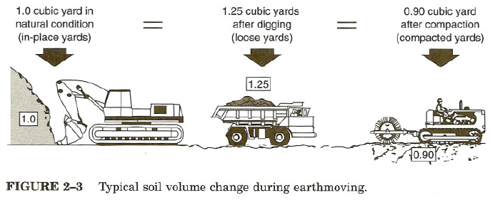
2-2

Slide 22
EXAMPLE 2-2
Find the shrinkage of a soil that weighs 2800 lb/cu yd (1661 kg/m3) in its natural state and 3500 lb/cu yd (2077 kg/m3) after compaction.
Solution
Shrinkage = (1− 2800/ 3500) × 100 = 20% (Eq 2-5)
[= (1− 1661/ 2077) × 100 = 20%]
Hence 1 bank cubic yard (meter) of material will shrink to 0.8 compacted cubic yard (meter) as a result of compaction.

Slide 23
Load and Shrinkage Factors
A pay yard (or meter) is the volume unit specified as the basis for payment in an earthmoving contract. It may be any of the three volume units.

Slide 24
Load and Shrinkage Factors
A soil's load factor may be calculated by use of Equation 2-6 or 2-7.
Load factor = Weight/loose unit volume ÷ Weight/bank unit volume (2-6)
or
Load factor = 1/ (1+swell) (2-7)
Loose volume is multiplied by the load factor to obtain bank volume.

Slide 25
Load and Shrinkage Factors
A factor used for the conversion of bank volume to compacted volume is sometimes referred to as a shrinkage factor.
The shrinkage factor may be calculated by use of Equation 2-8 or 2-9.
Shrinkage factor = Weight/bank unit volume ÷ Weight/compacted unit volume (2-8)
or
Shrinkage factor = 1 − shrinkage (2-9)

Slide 26
Load and Shrinkage Factors
Bank volume may be multiplied by the shrinkage factor to obtain compacted volume or compacted volume may be divided by the shrinkage factor to obtain bank volume.

Slide 27
EXAMPLE 2-3
A soil weighs 1960lb/LCY (1163kg/LCM), 2800lb/BCY(1661kg/BCM), and 3500 lb/CCY (2077 kg/CCM).
  Find the load factor and shrinkage factor for the soil.
  How many bank cubic yards (BCY) or meters (BCM) and compacted cubic yards (CCY) or meters (CCM) are contained in 1 million loose cubic yards (593,300 LCM) of this soil?

Slide 28
EXAMPLE 2-3
Solution
(a) Load factor = 1960/2800 =0.70 (Eq 2-6)
[=1163/1661 =0.70]
Shrinkage factor = 2800/3500 = 0.80 (Eq 2-8)
[= 1661/2077 = 0.80]
(b) Bank volume = 1,000,000 × 0.70 = 700,000 BCY
[= 593300 x 0.70 = 415310 BCM]
Compacted volume = 700,000 × 0.80= 560,000 CCY
[= 415310 × 0.80 = 332248 CCM]

Slide 29
Load and Shrinkage Factors
Typical values of unit weight, swell, shrinkage, load factor, and shrinkage factor for some common earthmoving materials are given in Table 2-5.

Slide 30
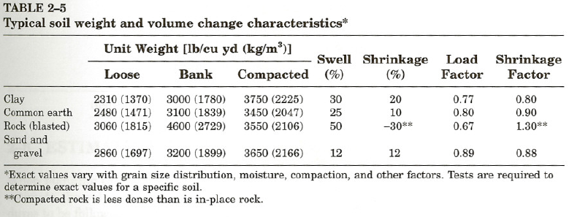

Slide 31
2-5 SPOIL BANKS
When planning and estimating earthwork, it is frequently necessary to determine the size of the pile of material that will be created by the material removed from the excavation.
If the pile of material is long in relation to its width, it is referred to as a spoil bank. Spoil banks are characterized by a triangular cross section.

Slide 32
2-5 SPOIL BANKS
If the material is dumped from a fixed position, a spoil pile is created which has a conical shape.
To determine the dimensions of spoil banks or piles, it is first necessary to convert the volume of excavation from in-place conditions (BCY or BCM) to loose conditions (LCY or LCM).

Slide 33
2-5 SPOIL BANKS
Bank or pile dimensions may then be calculated using Equations 2-10 to 2-13 if the soil's angle of repose is known.

Slide 34
Triangular Spoil Bank
Volume = Section area x Length (2-10)
B = ( 4V/( L× tan R)) ^{½}
H = B × tan R /2 (2-11)
where
  B =base width (ft or m)
  H =pile height (ft or m)
  L =pile length (ft or m)
  R =angle of repose (deg)
  V =pile volume (cu ft or m3)

Slide 35
Triangular Spoil Bank
Typical values of angle of repose for common soils are given in Table 2-6.

Slide 36
Conical Spoil Pile
Volume = ⅓ × Base area × Height
D = (7.64V / tan R)^{⅓} (2-12)
H= D/2 ×tan R (2-13)
where
  D is the diameter of the pile base (ft or m).

Slide 37
2-5 SPOIL BANKS
A soil's angle of repose is the angle that the sides of a spoil bank or pile naturally form with the horizontal when the excavated soil is dumped onto the pile.
The angle of repose (which represents the equilibrium position of the soil) varies with the soil's physical characteristics and its moisture content.

Slide 38
EXAMPLE 2-4
Find the base width and height of a triangular spoil bank containing 100 BCY(76.5BCM)if the pile length is 30 ft (9.14 m), the soil's angle of repose is 37°, and its swell is 25%.
Solution
Loose volume =27 × 100 × 1.25 =3375 cu ft
[= 76.5 × 1.25 = 95.6 m3]
Base Width = (4 × 3375 /(30 × tan 37o))^{½} =24.4 ft (Eq 2-10)
[=( 4 x 95.6 /(9.14 × tan 37°))^{½} =7.45 m]
Height = 24.4/2 × tan 37° =9.2 ft (Eq 2-11)
[= 7.45/2 × tan 37° = 2.80 m]

Slide 39
EXAMPLE 2-5
Find the base diameter and height of a conical spoil pile that will contain 100BCY (76.5 BCM) of excavation if the soil's angle of repose is 32° and its swell is 12%.
Solution
Loose volume = 27 × 100 × 1.12 = 3024 cu ft
[= 76.5 × 1.12 × 85.7 m³]
Base diameter = (7.64 × 3024 / tan 32o)^{⅓} =33.3 ft (Eq 2-12)
[=(7.64 × 85.7 / tan 32°)^{⅓} =10.16 m]
Height = 33.3 /2 × tan 32° = 10.4 ft (Eq 2-13)
[= 10.16 /2 × tan 32°= 3.17 m]

Slide 40
2-6 ESTIMATING EARTHWORK VOLUME
When planning or estimating an earthmoving project it is often necessary to estimate the volume of material to be excavated or placed as fill.
The procedures to be followed can be divided into three principal categories:
  1) pit excavations (small, relatively deep excavations such as those required for basements and foundations),
  2) trench excavation for utility lines, and
  3) excavating or grading relatively large areas.

Slide 41
2-6 ESTIMATING EARTHWORK VOLUME
Procedures suggested for each of these three cases will now be described.
  The estimation of the earthwork volume involved in the construction of roads and airfields is customarily performed by the design engineer.
  The usual method is to calculate the cross-sectional area of cut or fill at regular intervals (such as stations [l00 ft or 33 m]) along the centerline.
  The volume of cut or fill between stations is then calculated, accumulated, and plotted as a mass diagram.

Slide 42
2-6 ESTIMATING EARTHWORK VOLUME
  While the construction of a mass diagram is beyond the scope of this book, some construction uses of the mass diagram are described in Section 2-7.
  When making earthwork volume calculations, keep in mind that cut volume is normally calculated in bank measure while the volume of compacted fill is calculated in compacted measure.
  Both cut and fill must be expressed in the same volume units before being added.

Slide 43
Pit Excavations
For these cases simply multiply the horizontal area of excavation by the average depth of excavation (Equation 2-14).
Volume = Horizontal area × Average depth (2-14)

Slide 44
Pit Excavations
To perform these calculations,
  first divide the horizontal area into a convenient set of rectangles, triangles, or circular segments.
  After the area of each segment has been calculated, the total area is found as the sum of the segment areas.
  The average depth is then calculated.
  For simple rectangular excavations, the average depth can be taken as simply the average of the four corner depths.
  For more complex areas, measure the depth at additional points along the perimeter of the excavation and average all depths.

Slide 45
EXAMPLE 2-6
Estimate the volume of excavation required (bank measure) for the basement shown in Figure 2-4. Values shown at each corner are depths of excavation. All values are in feet (m).

Slide 46
EXAMPLE 2-6
Solution
Area = 25 x 30 =750 sq ft
[= 7.63 x 9.15 = 69.8 m2]
Average depth = (6.0 + 8.2 + 7.6 + 5.8)/ 4
= 6.9 ft
[= (1.8 + 2.5 + 2.3 + 1.8)/4
= 2.1 m]
Volume = 750 × 6.9/27 = 191.7 BCY
[= 69.8 × 2.1 = 146.6 BCM]

Slide 47
Trench Excavations
The volume of excavation required for a trench can be calculated as the product of the trench cross-sectional area and the linear distance along the trench line (Equation 2-15).
Volume = Cross-sectional area × Length (2-15)

Slide 48
Trench Excavations
For rectangular trench sections where the trench depth and width are relatively constant, trench volume can be found as simply the product of trench width, depth, and length.
When trench sides are sloped and vary in width and/or depth,
  cross sections should be taken at frequent linear intervals and the volumes between locations computed.
  These volumes are then added to find total trench volume.

Slide 49
EXAMPLE 2-7
Find the volume (bank measure) of excavation required for a trench 3 ft (0.92 m) wide, 6 it (1.83 m) deep, and 500 it (152 m) long. Assume that the trench sides will be approximately vertical.
Solution
Cross-sectional area = 3 × 6 = 18 sq ft
[= 0.92 x 1.83 = 1.68 m²]
Volume = 18 ×500/ 27 = 333 BCY
[= 1.68 × 152 = 255 BCM]

Slide 50
Large Areas
To estimate the earthwork volume involved in large or complex areas, one method is
  to divide the area into a grid indicating the depth of excavation or fill at each grid intersection.

Slide 51
Large Areas
  Assign the depth at each corner or segment intersection a weight according to its location (number of segment lines intersecting at the point). Thus,
    interior points (intersection of four segments) are assigned a weight of four,
    exterior points at the intersection of two segments are assigned a weight of two, and
    corner points are assigned a weight of one.

Slide 52
Large Areas
  Average depth is then computed using Equation 2-16 and multiplied by the horizontal area to obtain the volume of excavation.
  Note, however, that this calculation yields the net volume of excavation for the area. Any balancing of cut and fill within the area is not identified in the result.
Average depth =(Sum of products of depth×weight) / Sum of weights (2-16)

Slide 53
EXAMPLE 2-8
Find the volume of excavation required for the area shown below. The figure at each grid intersection represents the depth of cut at that location. Depths in parentheses represent meters.

Slide 54
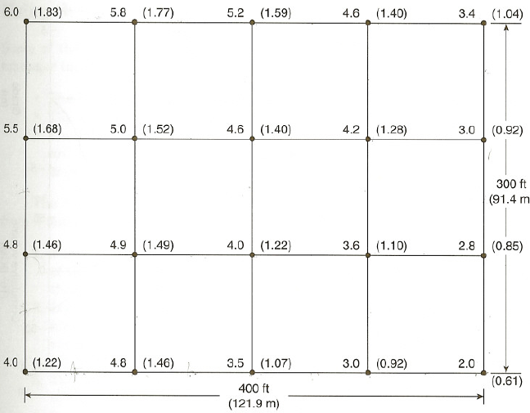

Slide 55
EXAMPLE 2-8
Solution
Corner points = 6.0 + 3.4 + 2.0 + 4.0 = 15.4 ft
[= 1.83 + 1.04 + 0.61 + 1.22 = 4.70 m]
Border points = 5.8 + 5.2 + 4.6 + 3.0 + 2.8 + 3.0 + 3.5 + 4.8 + 4.8 + 5.5 =43.0 ft
[= 1.77 + 1.59 + 1.40 + 0.92 + 0.85 + 0.92 + 1.07 + 1.46 + 1.46 + 1.68 =13.12 m ]
Interior points = 5.0 +4.6 +4.2 +4.9 +4.0 +3.6 = 26.3 ft
[= 1.52+ 1.40+ 1.28+ 1.49+ 1.22+ 1.10=8.01 m]

Slide 56
EXAMPLE 2-8
Average depth = {15.4 + 2(43.0) + 4(26.3)}/48 = 3.97 ft
[= {4.70 + 2(13.12) +4(8.01)}/48 = 1.21 m]
Area =300 × 400 = 120,000 sq ft
[= 91.4 × 121.9 = 11,142 m²]
Volume= 120,000 × 3.97/27 = 17,689 BCY
[= 11,142 x 1.21 = 13,482 BCM]

Slide 57
2-7 CONSTRUCTION USE OF THE MASS DIAGRAM
A mass diagram is a continuous curve representing the accumulated volume of earthwork plotted against the linear profile of a roadway or airfield.
Mass diagrams are prepared by highway and airfield designers to assist in selecting an alignment which minimizes the earthwork required to construct the facility while meeting established limits of roadway grade and curvature.

Slide 58
Characteristics of a Mass Diagram
Some of the principal characteristics of a mass diagram include the following.
  The vertical coordinate of the mass diagram corresponding to any location on the roadway profile represents the cumulative earthwork
  volume from the origin to that point.
  Within a cut, the curve rises from left to right.

Slide 59
Characteristics of a Mass Diagram
  Within a fill, the curve falls from left to right. A peak on the curve represents a point where the earthwork changes from cut to fill.
  A valley (low point) on the curve represents a point where the earthwork changes from fill to cut.
  When a horizontal line intersects the curve at two or more points, the accumulated volumes at these points are equal. Thus, such a line represents a balance line on the diagram.

Slide 60
Using the Mass Diagram
Some of the information which a mass diagram can provide a construction manager includes the following.
  The length and direction of haul within a balanced section.
  The average length of haul for a balanced section.
  The location and amount of borrow (material hauled in from a borrow pit) and waste (material hauled away to a waste area) for the project.

Slide 61
Using the Mass Diagram
The following explanation of methods for obtaining this information from a mass diagram will be illustrated using Figure 2-5.
  For a balanced section (section 1 on the figure), project the end points of the section up to the profile (points A and B). These points identify the limits of the balanced section.
  Locate point C on the profile corresponding to the lowest point of the mass diagram within section 1. This is the point at which the excavation changes from fill to cut. The areas of cut and fill can now be identified on the profile.
  The direction of haul within a balanced section is always from cut to fill.

Slide 62
Using the Mass Diagram
  Repeat this process for sections 2, 3, and 4 as shown.
  Since the mass diagram has a negative value from point D to the end, the ordinate at point E (-50,000 BCY or -38,230 BCM) represents the volume of material which must be brought in from a borrow pit to complete the roadway embankment.
  The approximate average haul distance within a balanced section can be taken as the length of a horizontal line located midway between the balance line for the section and the peak or valley of the curve for the section. Thus, the length of the line F-G represents the average haul distance for section 1, which is 1800 ft or 549 m.

