Slide 1
Organic Chemistry (1)
Course Number and Symbol:
240 Chem
Credit hours: (2+0)

Slide 2
What is Organic Chemistry?
Organic chemistry is the chemistry of compounds that contain the element carbon.
Carbon compounds are central to life on this planet.
Importance of Organic Compounds
The chemical substances that make up our bodies; are organic.
    DNA: the giant molecules that contain all the genetic information for a given species.
    proteins: blood, muscle, and skin.
    Enzymes: catalyze the reactions that occur in our bodies.
Petroleum: furnish the energy that sustains life.
Polymers: Cloths, cars, plastic, kitchen appliances.
Medicine.

Slide 3
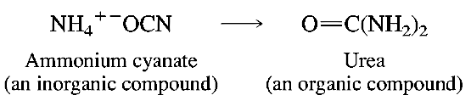
Development of the Science of Organic Chemistry
Theory Vitalism
According to Vitalism, organic compounds were only those that came from living organisms through intervention of a vital force.
Inorganic compounds are the compounds that came from nonliving sources.
In 1823, Friedrich Wohler discovered the synthesis of organic compound called urea ( a constituent of urine ) from inorganic compound.

Slide 4
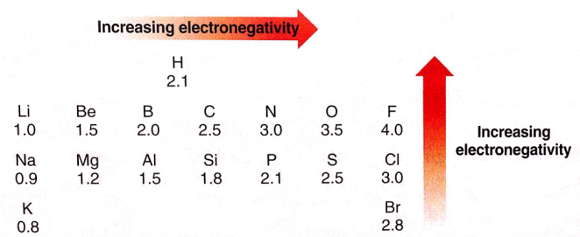
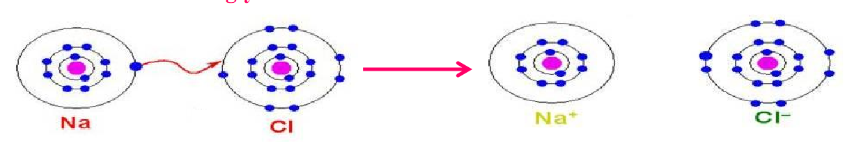
Chemical Bonds: The Octet Rule
A chemical bond is an attraction between atoms.
When two atoms with large different electronegativity values:
          Ionic Bonding
Ionic bonds form from the electrostatic attraction between oppositely charged ions.
Atoms become ionic by losing or gaining electrons from the atom it is bonding with.
Example: NaCl

Slide 5
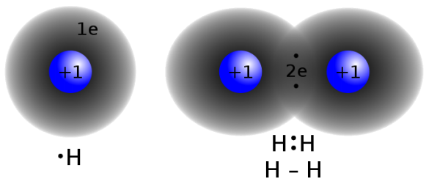
  When two atoms with similar electronegativity values:
1) Covalent Bonding
A covalent bond is a form of chemical bonding that is characterized by the sharing of pairs of electrons between atoms
Example: H₂

Slide 6
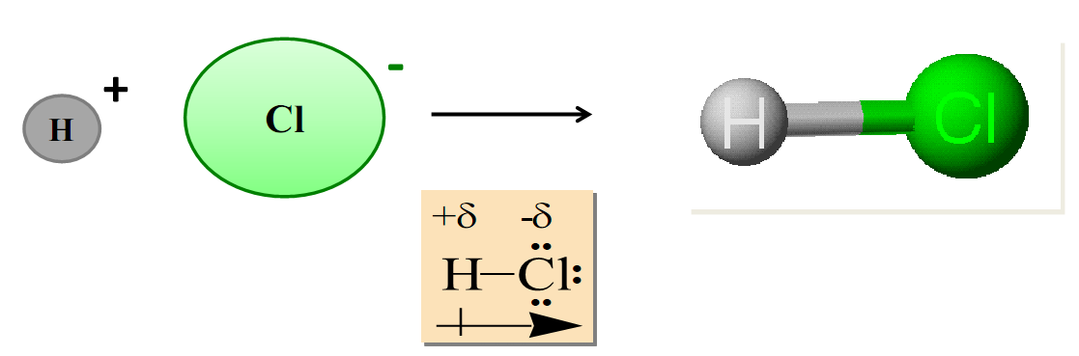
When two atoms with different electronegativity values:
  Polar Covalent Bonding
A polar covalent bond is one in which one atom has a greater attraction for the electrons than the other atom.
The electron cloud in a σ-bond between two unlike atoms is not uniform and is slightly displaced towards the more electronegative of the two atoms.
Example: HCl

Slide 7
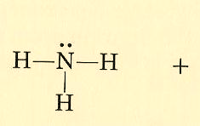
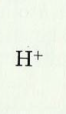
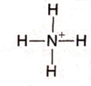
  Coordinate Covalent Bonding
There are molecules in which one atom supplies both electrons to another atom in the formation of covalent bond.
Example: Ammonium ion NH₄⁺

Slide 8
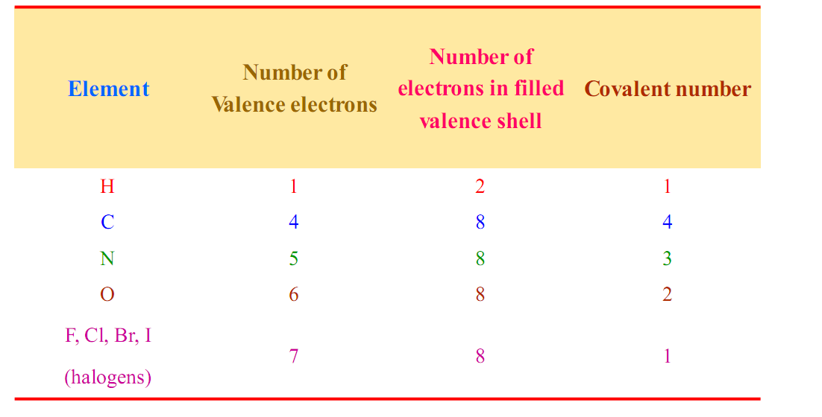
How Many Bonds to an Atoms?
Covalent Number: is the number of covalent bonds that an atom can form with other atoms.
Covalence Numbers of Typical Elements in Organic Compounds

Slide 9
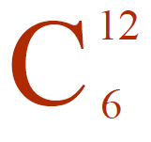
The Uniqueness of Carbon:
It has 6 electrons in its outer shell arranges 1s²2s²sp²
Carbon is unique among the elements for its ability
to bond with itself to form compounds of various sizes
and shapes as well as to bond with many other elements
Carbon atom can form multiple bonds, long chains, side chains and cyclic chains.

Slide 10
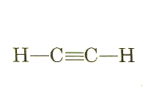
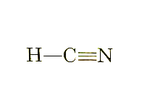
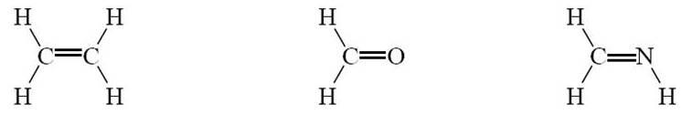
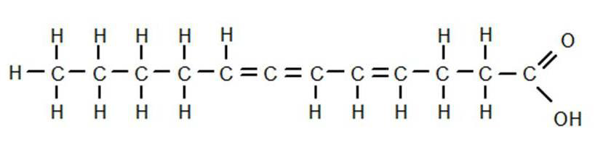
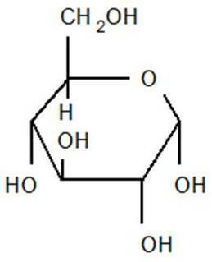
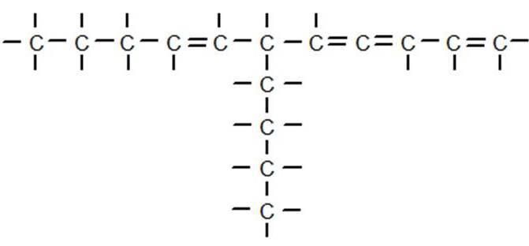
Examples:
1- Multiple bonds: double or triple
2-Long chains
3-Side chains
4-Cyclic chains

Slide 11
Formula and Diagrams:
1- Molecular Formula
Examples:
The molecular formula of alkyne
C_{n}H_{2n-2}
The molecular formula of carboxylic acids
C_{n}H_{2n}O₂

Slide 12
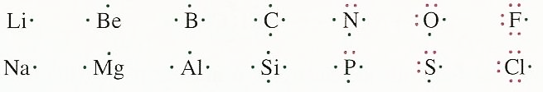
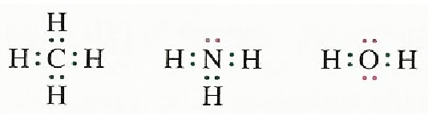
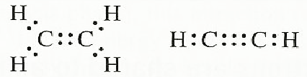
2- Electron Dot Diagrams (Lewis structure)
Electron valance as electron dots
Examples:

Slide 13
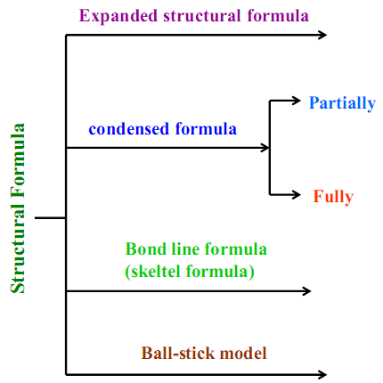
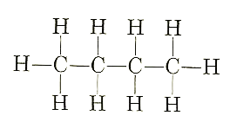

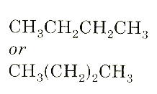
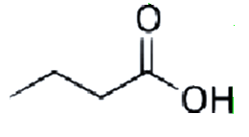
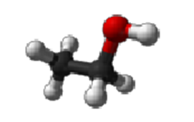
3- Structural Formula
The structure formula can be expressed by several ways

Slide 14
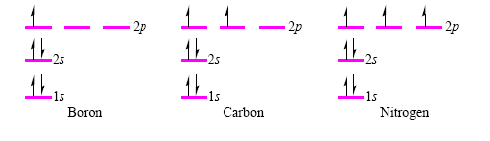
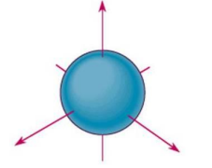
Atomic Orbitals and their Shapes
S-Orbital

Slide 15
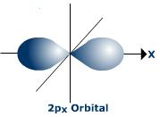
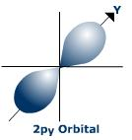
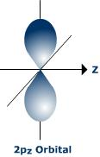
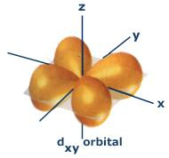
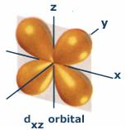
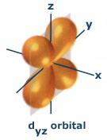
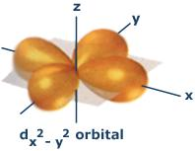
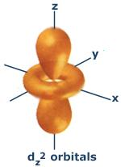
P-Orbital
d-Orbital

Slide 16
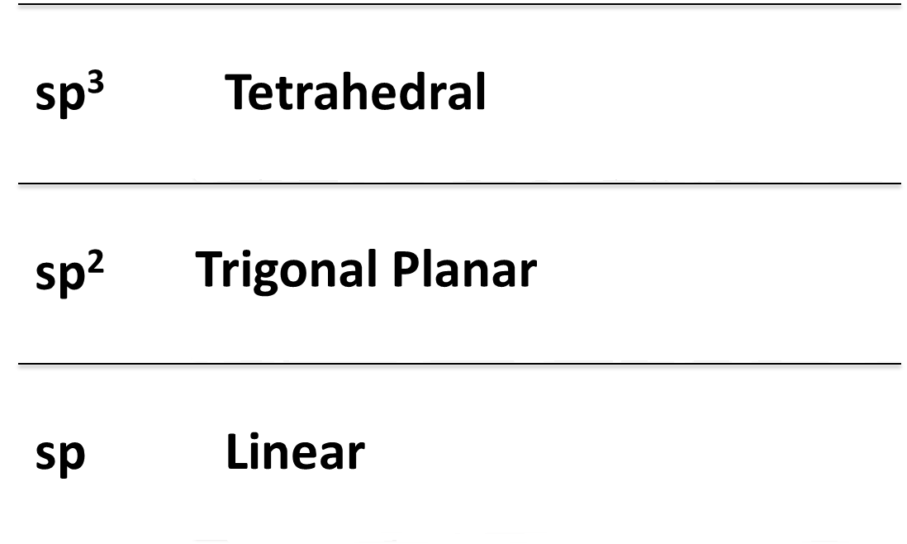
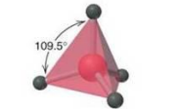
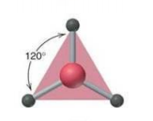

Molecular Orbital
A molecular orbital is formed when two atomic orbitals overlap
to generate a bond.
Types of Hybridization

Slide 17
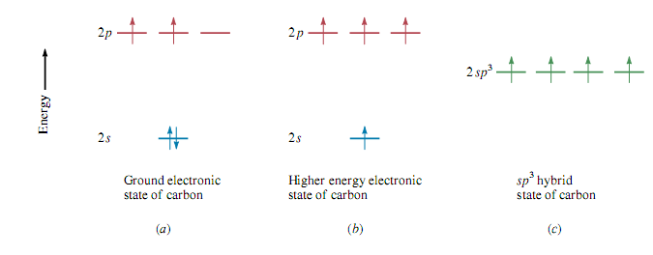
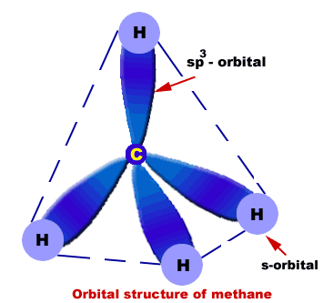
sp³ hybridization in Methane

Slide 18
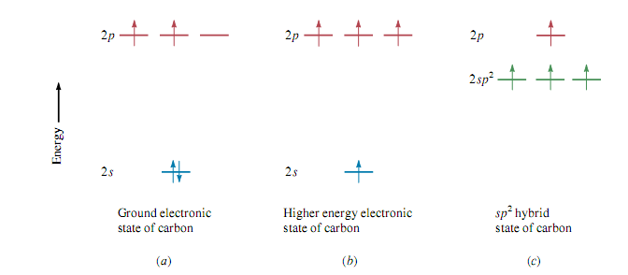
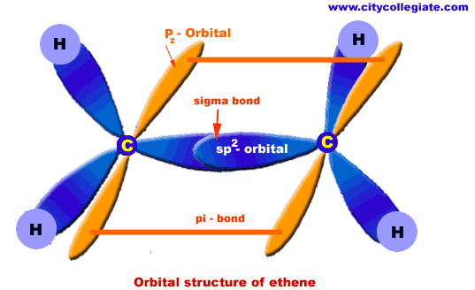
sp² hybridization in Ethene

Slide 19
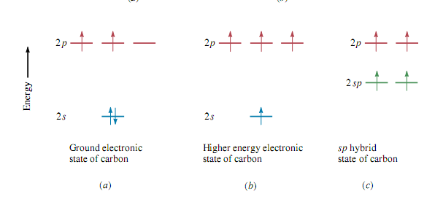
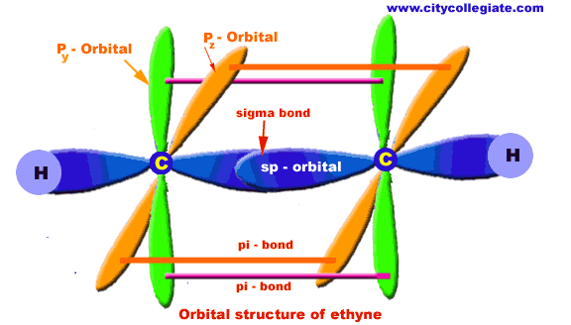
sp hybridization in Ethyne

Slide 20
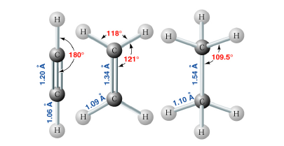
Bond lengths of Ethyne, Ethene, and Ethane

Slide 21
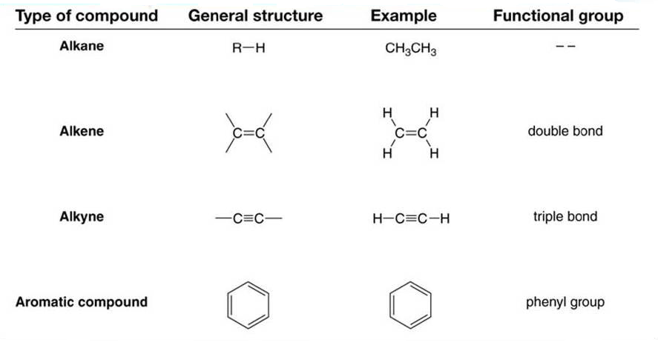
Functional Groups
Functional groups: special groups of reactive atoms that carry out chemical reactions in many organic compounds.
Hydrocarbons

Slide 22
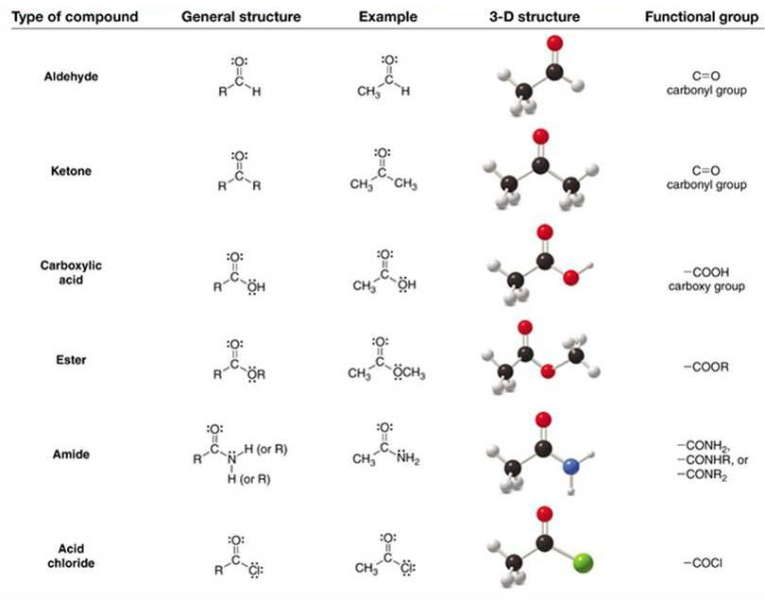
Compounds containing C=O

Slide 23
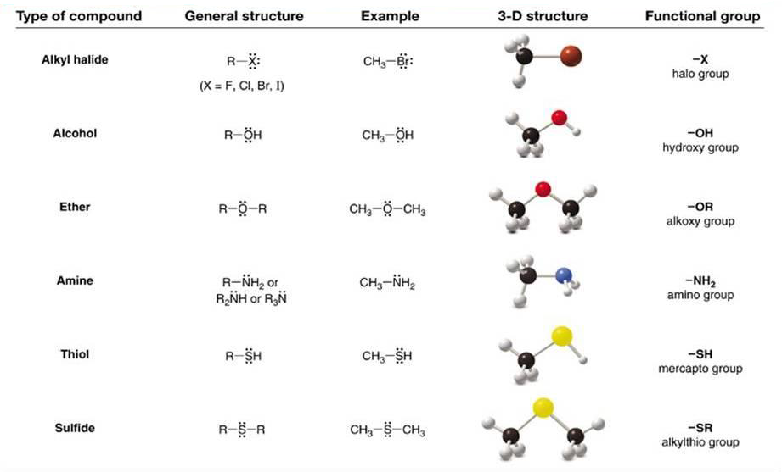
Compounds containing C-Z σ bonds

