Slide 1
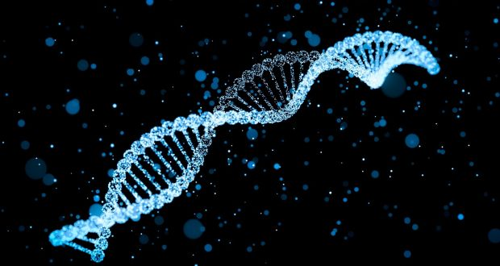
LECTURE (3)
DNA: Genetic Material

Slide 2
Lecture contents
Watson and Crick model
DNA: the genetic material
A comparison between DNA and RNA
Nucleic acids and polynucleotides
Chromatin and Chromatin structure
Final hints
1
2
3
4
5
6

Slide 3
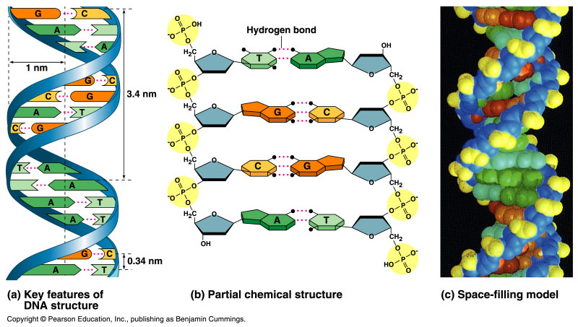
Watson and Crick discovered the double helix by building models to conform to X-ray data
In April 1953, James Watson and Francis Crick shook the scientific world with an elegant double-helical model for the structure of deoxyribonucleic acid or DNA.
Watson and Crick began to work on a model of DNA with two strands, the double helix.

Slide 4
DNA: the Genetic Material
The amino acid sequence of a polypeptide is programmed by a gene.
A gene is a small region in the DNA.
Nucleic acids store and transmit hereditary information.
There are two types of nucleic acids: ribonucleic acid (RNA) and deoxyribonucleic acid (DNA).
DNA also directs mRNA synthesis, thus, controls protein synthesis.
Organisms inherit DNA from their parents.
Each DNA molecule is very long and usually consists of hundreds to thousands of genes.
When a cell divides, its DNA is copied and passed to the next generation of cells.
The mRNA interacts with ribosomes to direct the synthesis of amino acids in a polypeptide (protein)

Slide 5
Structure of DNA
3
5
o
o
P
o
o
DNA nucleotide
Base
5
o
Phosphate group
CH₂
4
H
H
1
H
H
3
2
H
o
Deoxyribose
o
P
o
o
Base
The sugar-phosphate backbones of the two polynucleotides are on the outside of the helix.
The PO₄³⁻ group of one nucleotide is attached to the sugar of the next nucleotide in line.
The result is a “backbone” of alternating phosphates and sugars, from which the bases starts.
o
CH₂
H
H
H
H
5
3
3
H
Sugar-phosphate backbone

Slide 6
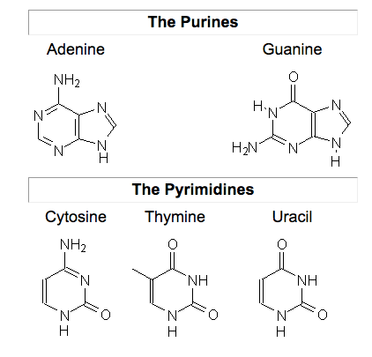
Nitrogenous bases
Pairs of nitrogenous bases (one from each strand) connect the polynucleotide chains with hydrogen bonds.
Most DNA molecules have thousands to millions of base pairs (bP).
In case of RNA

Slide 7
Because of their shapes, only some bases are compatible with each other.
Adenine (A) always pairs with thymine (T) and guanine (G) with cytosine (C).
With these base-pairing rules, if we know the sequence of bases on one strand, we know the sequence on the opposite strand.
The two strands are complementary.
During preparations for cell division each of the strands serves as a template to order nucleotides into a new complementary strand.
This results in two identical copies of the original double-stranded DNA molecule.
The copies are then distributed to the daughter cells.
This mechanism ensures that the genetic information is transmitted to the new cells.

Slide 8
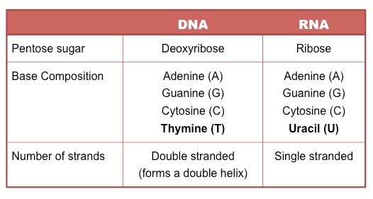
A comparison between DNA and RNA
Deoxiribo-Nucleic-Acid
Ribo-Nucleic-Acid

Slide 9
Nucleic acids and polynucleotides
Nucleic acids are polymers of monomers called nucleotides.
Each nucleotide consists of three parts: a nitrogen base, a pentose sugar, and a phosphate group.
The nitrogen bases (rings of carbon and nitrogen) come in two types: Purines and Pyrimidines.
The pentose sugar joined to the nitrogen base is ribose in nucleotides of RNA and deoxyribose in DNA.
The only difference between the sugars is the lack of an oxygen atom on carbon 2 in deoxyribose.
Polynucleotides are synthesized by connecting the sugars of one nucleotide to the phosphate of the next with a phosphodiester link.

Slide 10
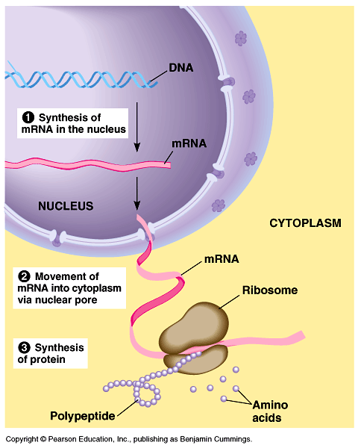
The sequence of nitrogen bases along a DNA or mRNA polymer is unique for each gene.
Genes are normally hundreds to thousands of nucleotides long.
The linear order of bases in a gene specifies the order of amino acids (the monomers of a protein).
The flow of genetic information
The flow of genetic information is from DNA mRNA protein.
Protein synthesis occurs in ribosomes.
In eukaryotes, DNA is located in the nucleus, but most ribosomes are in the cytoplasm with mRNA as an intermediary.

Slide 11
Final hints
Repeated Sugar - Phosphate
DNA backbone
Sugar–Phosphate-Base
One nucleotide
DNA Molecule
Polynucleotide
DNA Double stranded
RNA single stranded
DNA
A
G
C
T
A
T
C
mRNA
T
C
G
A
T
A
G
U
U

Slide 12
Nucleosomes are repeated functional and structural units of chromatin
Nucleosomes are composed of Histones (a family of small, positively charged proteins: H1, H2A, H2B, H3, and H4). DNA is negatively charged, due to the phosphate groups in its backbone, so histones bind with DNA very tightly.
Nucleosomes are structured as follows:
Two of the histones H2A, H2B, H3, and H4 come together to form a histone octamer.
This histone octamer binds and wraps 146 bp of DNA (approximately 1.7 turns).
H1 histone binds to a region known as the “Linker DNA” ~another 20 base pairs.
This results in two full turns around the octamer and forming a structure called a chromatosome.
The resulting structure when viewed under the electron microscope appears as “beads on a string”

Slide 13
Nucleosomes are repeated functional and structural units of chromatin
Nucleosomes are composed of Histones (a family of small, positively charged proteins: H1, H2A, H2B, H3, and H4). DNA is negatively charged, due to the phosphate groups in its backbone, so histones bind with DNA very tightly.
Nucleosomes are structured as follows:
Two of the histones H2A, H2B, H3, and H4 come together to form a histone octamer.
This histone octamer binds and wraps 146 bp of DNA (approximately 1.7 turns).
H1 histone binds to a region known as the “Linker DNA” ~another 20 base pairs.
This results in two full turns around the octamer and forming a structure called a chromatosome.
The resulting structure when viewed under the electron microscope appears as “beads on a string”

Slide 14
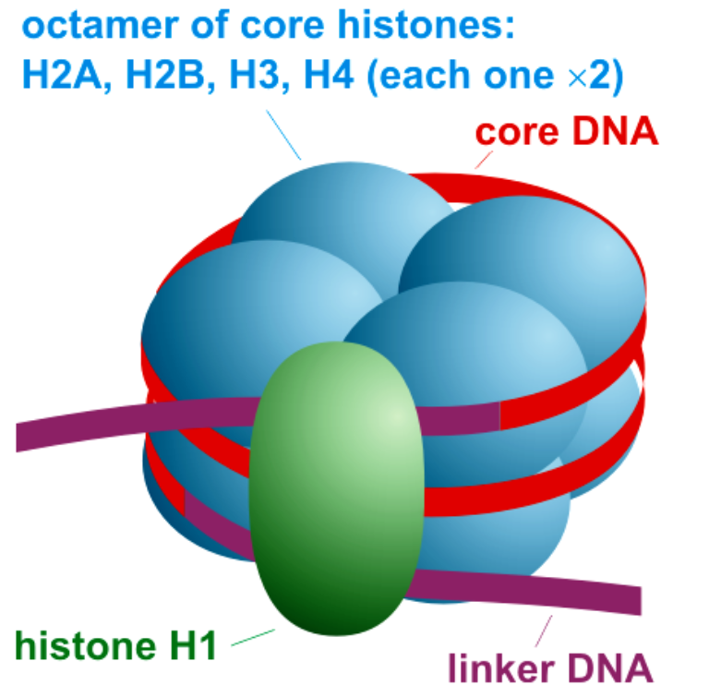
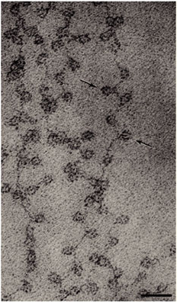
Nucleosomes are composed of an octamer of histones
Olins, D. E. & Olins, A. L. (2003) Nature reviews

Slide 15
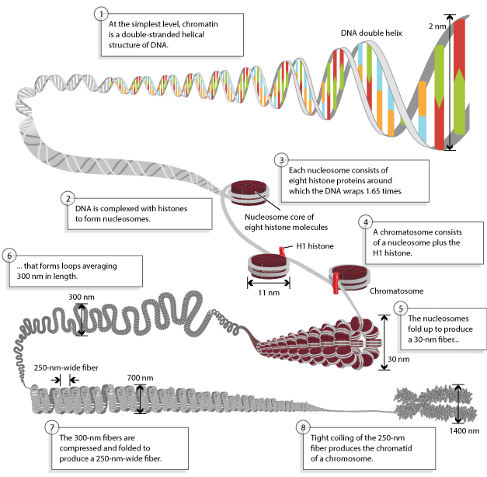
Chromatin organization is critical for packaging, protection, and regulation of gene expression
Annunziato, A. (2008) Nature Education

Slide 16
The nucleosomal core is composed of histones
Histones cores are required for DNA interaction and wrapping.
The histones also have “tails” that extend out of the nucleosomes.
The amino acids in histone tails serve as binding docks and as recruiters for DNA and histone-modifying enzyme complexes.
Luger, K. et al. (1997) Nature

Slide 17
Gene Expression
Using a gene to make a protein is called gene expression.
It includes the synthesis of the protein by the processes of transcription of DNA and translation of mRNA.
It may also include further processing of the protein after synthesis.
Gene expression is regulated to ensure that the correct proteins are made when and where they are needed.
Regulation may occur at any point in the expression of a gene, from the start of the transcription phase of protein synthesis to the processing of a protein after synthesis occurs.
The regulation of transcription is one of the most complicated parts of gene regulation in eukaryotic cells and is the focus of this concept

Slide 18
Regulation of Transcription
Transcription is controlled by regulatory proteins or transcription factors.
These proteins bind to regions of DNA, called regulatory elements which are located near promoters.
The promoter is the region of a gene where RNA polymerase binds to initiate transcription of the DNA to mRNA.
After regulatory proteins bind to regulatory elements, the proteins can interact with RNA polymerase.

Slide 19
Regulation of Transcription
Regulatory proteins are typically either activators or repressors:
Activators are regulatory proteins that promote transcription by enhancing the interaction of RNA polymerase with the promoter.
Repressors are regulatory proteins that prevent transcription by impeding the progress of RNA polymerase along the DNA strand so the DNA cannot be transcribed to mRNA.
Enhancers are distant regions of DNA that can loop back to interact with a gene's promoter and enhance transcription.

Slide 20
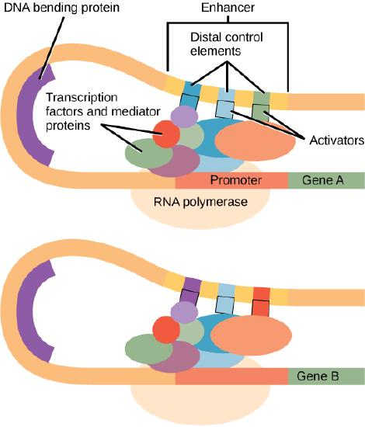
An enhancer is a DNA sequence that promotes transcription.
Each enhancer is made up of short DNA sequences called distal control elements. Activators bound to the distal control elements interact with mediator proteins and transcription factors.
Two different genes may have the same promoter but different distal control elements, enabling differential gene expression.

Slide 21
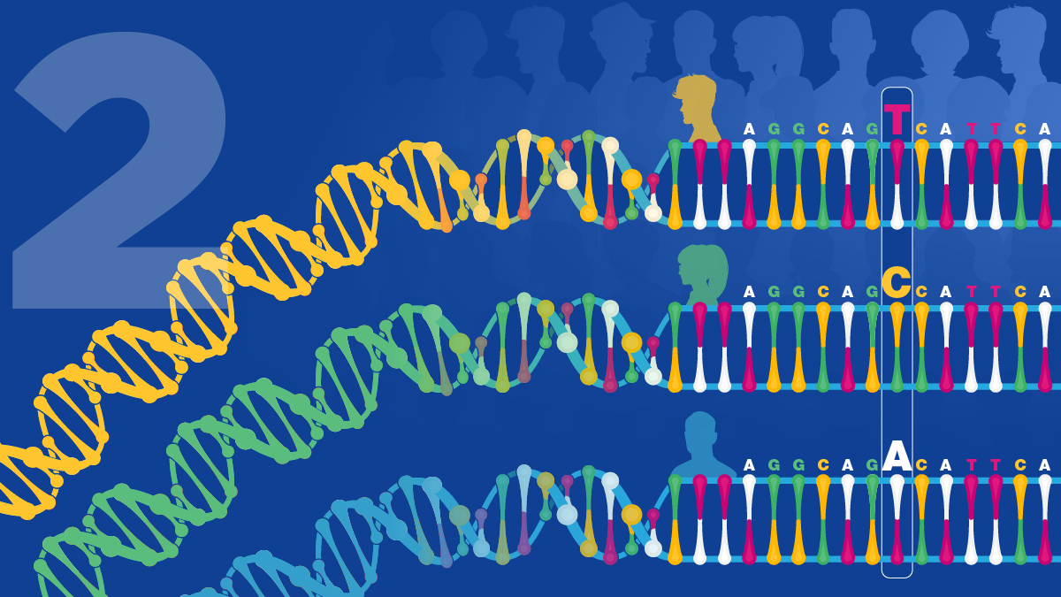
THANK YOU ……

