Slide 1
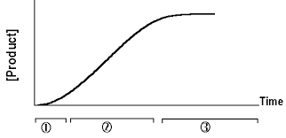
The effect of incubation time on the rate of an enzyme catalyzed reaction

Slide 2
Objectives
To monitor the progress of an enzyme catalyzed reaction.
To determine the initial rate of the reaction (V_{i}).

Slide 3
Enzyme kinetics
Enzyme kinetics is the study of the chemical reactions that are catalyzed by enzymes.
Kinetics analysis of enzymes are used for characterization of enzyme catalyzed reaction
It determines the rate of the enzymatic reaction (velocity) and its changes in response with the changes in parameters such as substrate concentration, enzyme concentration, pH, temperature.

Slide 4
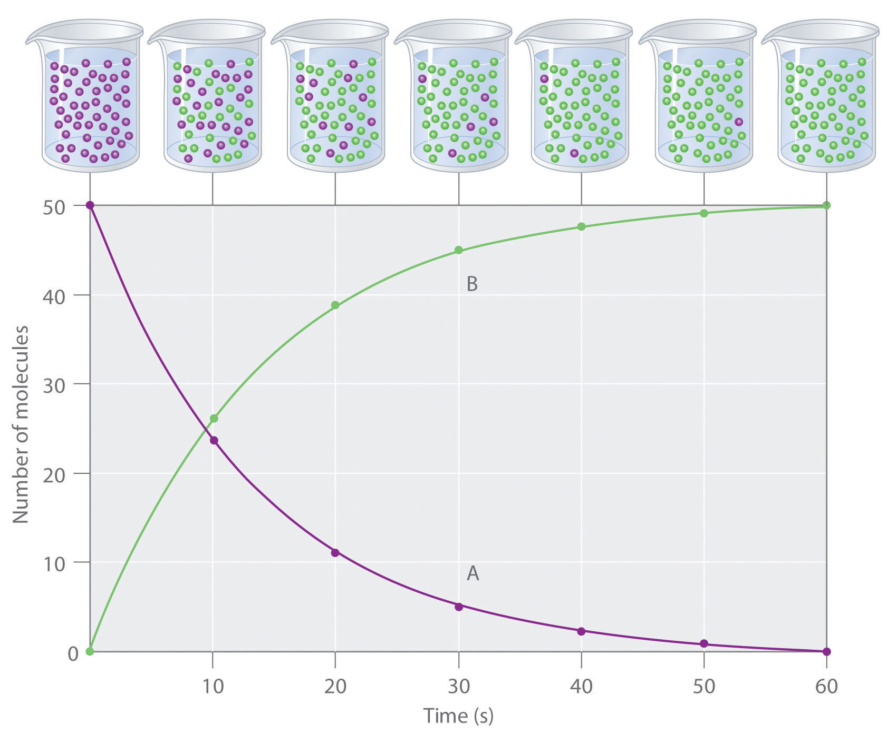
Measuring the rate of reaction (velocity)
The progress of an enzyme catalyzed reaction may be followed by measuring either the
amount of substrate consumed, or
Amount of product formed
Velocity (V) = rate of reaction= change in [P] or [S] per unit time
Unit : µmoles/minute
per unit time.

Slide 5
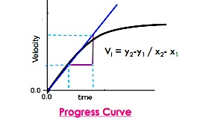
initial velocity
The initial rate of reaction (V_{i}) is measured as the slope at the origin (time= 0).
The effect of time on the enzyme catalyzed reaction:
The rate of the reaction is highest at time zero and decreases with increasing time, eventually falling to zero itself, reaching a plateau.
This usually occurs either when all the substrate is used up or when equilibrium is reached.
Plateau
Product formed (µmole)

Slide 6
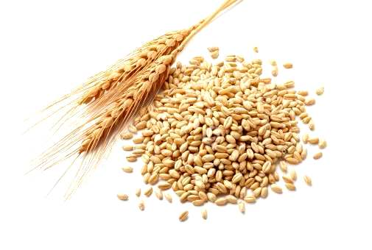
Acid phosphatase
In this experiment, you will measure the velocity of the reaction catalyzed by purified acid phosphatase (ACP) from wheat germ.
Acid phosphatase is a phosphatase that acts on monoesters of orthophosphoric acid. It does not act on phosphoric diesters or triesters.
The hydrolysis of phosphate esters is an important process in energy metabolism, metabolic regulation and a wide variety of cellular signal transduction pathways

Slide 7
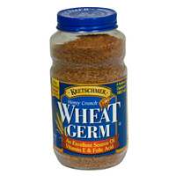
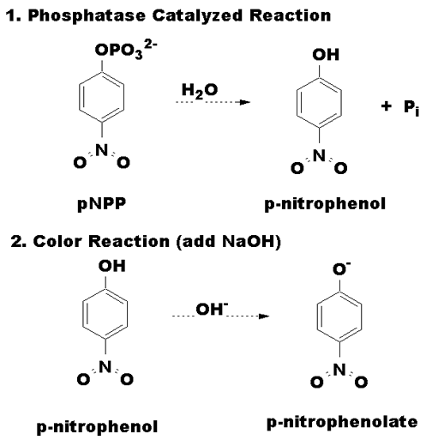
Acid phosphatase from wheat germ
The enzyme catalyzes the hydrolysis of p-nitrophenyl phosphate to inorganic phosphate and p-nitrophenol, under acidic conditions (pH=5.7), with optimum temperature 37◦C
Mg⁺⁺ ion act as an activator for the enzyme
ACP
Mg⁺⁺
pH=5.7
37◦C

Slide 8
Principal of the enzyme assay in vitro
1.
2.
Both p-nitrophenyl phosphate and p-nitrophenol are colorless at acidic pH values.
Under alkaline conditions, p-nitrophenol is converted to a p-nitrophenolate (yellow color) and concentration can be measured at 405 nm.
Note: Since ACP works under acidic condition, adding alkaline will cause the enzymatic reaction to stop.

Slide 9
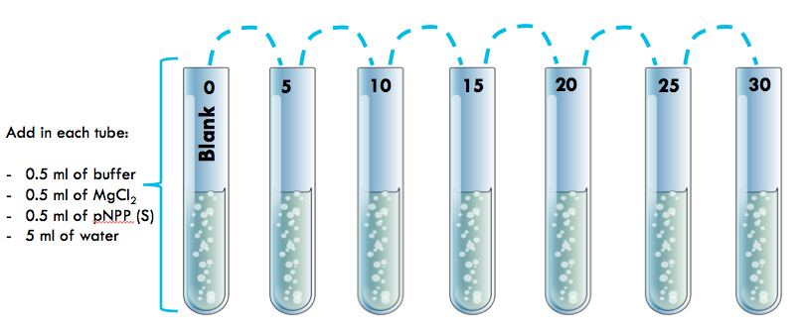
Method
The reaction is stopped after 5 minutes intervals (by Addition of KOH ), hence called Fixed-time assay
Place in a water bath maintained at 37 ºC for 5 minutes.

Slide 10
To start the reaction → add 0.5ml of E
To stop the reaction → add 0.5ml of KOH
Start at (min) | 0 | 0 | 2 | 4 | 6 | 8 | 10
Stop at (min) | 0 | 5 | 12 | 19 | 26 | 33 | 40
Add KOH to blank ((FIRST)), to prevent the reaction from happening.
After all the reactions have been terminated, determine the absorbance at 405 nm for each sample against blank.

Slide 11
Tube | 5 | 10 | 15 | 20 | 25 | 30
Start at (min) | 0 | 2 | 4 | 6 | 8 | 10
Stop at (min) | 5 | 12 | 19 | 26 | 33 | 40
To convert the time table to an easier way try the following

Slide 12
Results
[P] (µmoles) | Absorbance at 405nm | Time (min)
 |  | 0
 |  | 5
 |  | 10
 |  | 15
 |  | 20
 |  | 25
 |  | 30
Product formed (µmole)
[P] = ( A x 10⁶ ) / E X L= µmole
E= extension coefficient=18.8x10³
A= absorbance
L= path length (1 cm)

Slide 13
Discussion
Draw the graph [ do not forget the title and the units ]
X axis = Time (min)
Y axis = [P] (µmoles)
Calculate from the graph the value initial velocity
Principle
Comment on the graph that you get in details

Slide 14
Questions
How is the initial velocity of an enzymatic reaction determined?
What are the factors that influence the rate of enzyme catalyzed reactions?
What is the pH which the acid phosphatase activity is measured?

