Slide 1
Chapter 3
Excavating and Lifting
Part 1

Slide 2
3-1 INTRODUCTION
Excavating and Lifting Equipment
Excavators and Crane-Shovels
Excavator Production

Slide 3
Excavating and Lifting Equipment
An excavator is defined as a power-driven digging machine.
The major types of excavators used in earthmoving operations include
hydraulic excavators and
the members of the cable-operated crane-shovel family (shovels, draglines, hoes, and clamshells).
Dozers, loaders, and scrapers can also serve as excavators.

Slide 4
Excavating and Lifting Equipment
In this chapter we focus on
hydraulic excavators and
the members of the crane-shovel family used for excavating and lifting operations.
Operations involving the dozer, loader, and scraper are described in Chapter 4.
Special considerations involved in rock excavation are discussed in Chapter 8.

Slide 5
Excavators and Crane-Shovels
From this machine evolved a family of cable-operated construction machines known as the crane shovel.

Slide 6
Excavators and Crane-Shovels
Members of this family include:
the shovel,
backhoe,
dragline,
clamshell,
mobile crane, and
pile driver.

Slide 7
Excavators and Crane-Shovels
hydraulic excavators (Figure 3-1) have largely replaced the cable-operated crane-shovel family.
functionally similar hydraulic machines are available including the front shovel and backhoe.
Attachments available for the hydraulic excavator include clamshells, augers, compactors, and hammers.

Slide 8
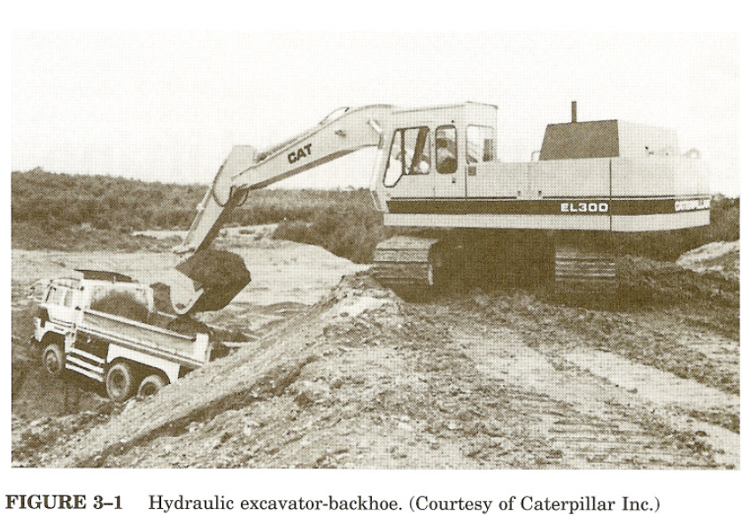

Slide 9
Excavators and Crane-Shovels
The advantages of hydraulic excavators over cable-operated machines are:
faster cycle time,
higher bucket penetrating force,
more precise digging, and
easier operator control.

Slide 10
Excavators and Crane-Shovels
Hydraulic telescoping-boom mobile cranes are also available.
The major remaining cable-operated machines based on the original crane-shovel are:
the dragline and
the mobile lattice-boom crane
See Page 24 for some of many attachments for the hydraulic excavator and their uses include.

Slide 11
Excavators and Crane-Shovels
Excavators and crane-shovels consist of three major assemblies:
a carrier or mounting,
a revolving superstructure containing the power and control units
also called the revolving deck or turntable
a front-end assembly.

Slide 12
Excavators and Crane-Shovels
Carriers available include:
crawler,
truck, and
wheel mountings, as shown in Figure 3-2.

Slide 13
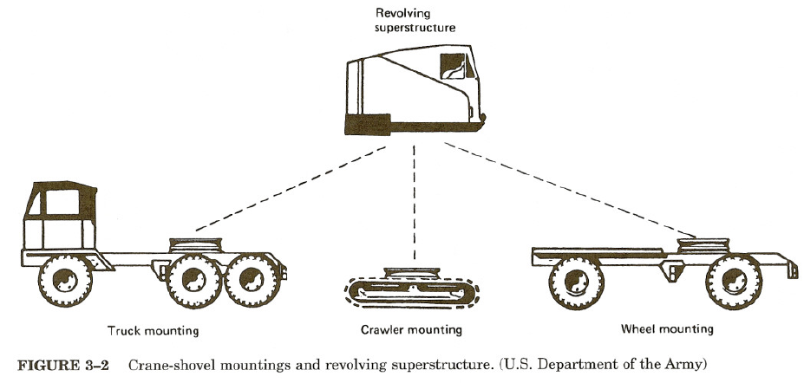

Slide 14
Excavators and Crane-Shovels
The crawler mounting
provides excellent on-site mobility and its low ground pressure enables it to operate in areas of low trafficability.
widely used for drainage and trenching work as well as for rock excavation.

Slide 15
Excavators and Crane-Shovels
Truck and wheel mountings
They provide greater mobility between job sites
but are less stable than crawler mountings and require better surfaces over which to operate.
Truck mountings use a modified truck chassis as a carrier and thus have separate stations for operating the carrier and the revolving superstructure.

Slide 16
Excavators and Crane-Shovels
Wheel mountings, on the other hand, use a single operator's station to control both the carrier and the excavating mechanism.
Truck mountings are capable of highway travel of 50 mile/hr (80 km/hr) or more, whereas wheel mountings are usually limited to 30 mile/hr (48 km/hr) or less.

Slide 17
Comparison summary between the 3 mounting type
Speed limit | Number of Station | Mobility between job site | On-site Mobility | Mounting
Low speed | 1 | Less Stabile | Excellent | Crawler
50 mile/hr [80 km/hr] | 2 | Great | Good | Truck
30 mile/hr [48 km/hr] | 1 | Great | Good | Wheel

Slide 18
Excavators and Crane-Shovels
In this chapter we discuss:
the principles of operation,
methods of employment, and
techniques for estimating the production of
shovels, backhoes, clamshells, and draglines.
Cranes and their employment are also discussed.
Pile drivers and their employment are covered in Chapter 10.

Slide 19
Excavator Production
To utilize Equation 2-1 for estimating the production of an excavator, it is necessary to know the volume of material actually contained in one bucket load.
The methods by which excavator bucket and dozer blade capacity are rated are given in Table 3-1.

Slide 20
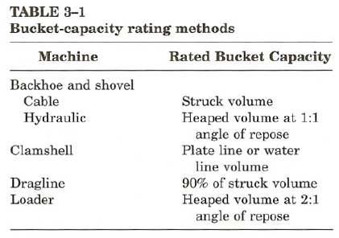

Slide 21
Excavator Production
Plate line capacity is the bucket volume contained within the bucket when following the outline of the bucket sides.
Struck capacity is the bucket capacity when the load is struck off flush with the bucket sides.

Slide 22
Excavator Production
Water line capacity assumes a level of material flush with the lowest edge of the bucket (i.e., the material level corresponds to the water level that would result if the bucket were filled with water).
Heaped volume is the maximum volume that can be placed in the bucket without spillage based on a specified angle of repose for the material in the bucket.

Slide 23
Excavator Production
Note: Since bucket ratings for the cable shovel, dragline, and cable backhoe are based on struck volume, it is often assumed that the heaping of the buckets will compensate for the swell of the soil.

Slide 24
Excavator Production
A better estimate of the volume of material in one bucket load will be obtained if the nominal bucket volume is multiplied by a bucket fill factor or bucket efficiency factor.

Slide 25
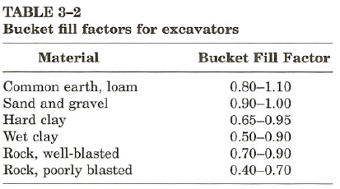

Slide 26
EXAMPLE 3-1
Estimate the actual bucket load in bank cubic yards for a loader bucket Whose heaped capacity is 5 cu yd (3.82 m3).The soil's bucket fill factor is 0.90 and its load factor is 0.80.
Solution
Bucket load = 5 × 0.90 = 4.5 LCY × 0.80
= 3.6 BCY
[= 3.82 × 0.90 = 3.44 LCM × 0.80
= 2.75 BCM]

Slide 27
3-2 HYDRAULIC EXCAVATORS
Operation and Employment
Production Estimating
Job Management

Slide 28
Operation and Employment
A backhoe (or simply hoe) is an excavator designed primarily for excavation below grade.
The backhoe is:
widely utilized for trenching work.
In addition to excavating the trench.

Slide 29
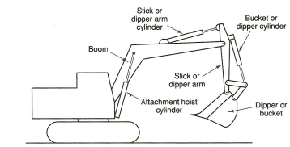
FIGURE 3-3: Components of a hydraulic excavator-backhoe

Slide 30
Operation and Employment
In trench excavation the best measure of production is the length of trench excavated per unit of time.
Therefore, a dipper width should be chosen which matches the required trench width as closely as possible.

Slide 31
Operation and Employment
When equipped with dozer blade, they may also be employed in:
leveling,
grading,
backfilling, and
general job cleanup.

Slide 32
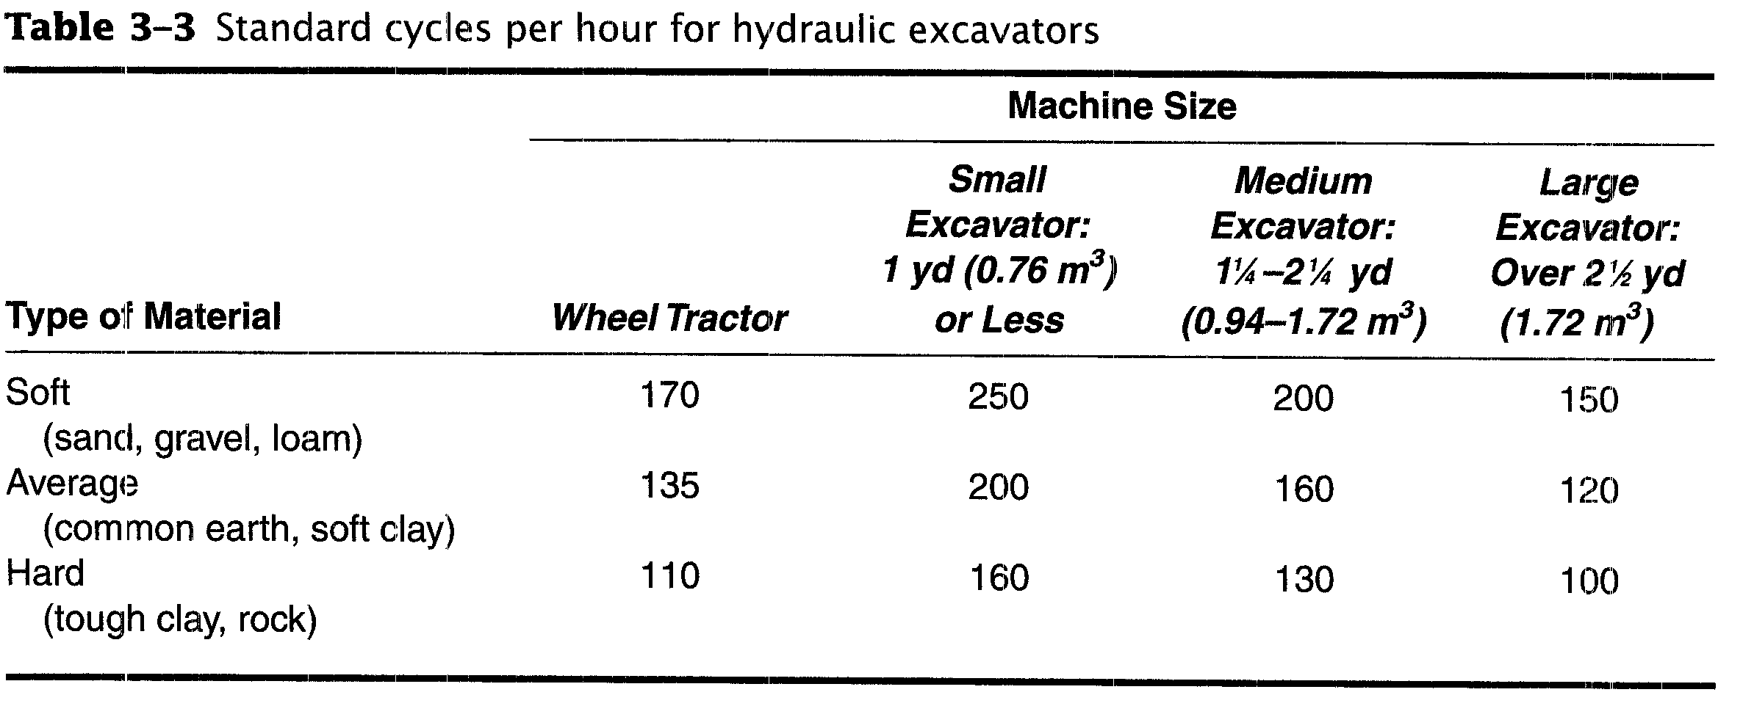

Slide 33
Production Estimating
Production (LCY/h) = C × S × V x B x E (3-1)
Where C = cycles/h (Table 3-3)
S = swing-depth factor (Table 3-4)
V = heaped bucket volume (LCY or LCM)
B = bucket fill factor (Table 3-2)
E = job efficiency

Slide 34
3-2 HYDRAULIC EXCAVATORS
In trenching work, a fall-in factor should be applied to excavator production
to account for the work required to clean out material that falls back into the trench from the trench walls.
Normal excavator production should be multiplied by the appropriate value from Table 3-5 to obtain the effective trench production.

Slide 35
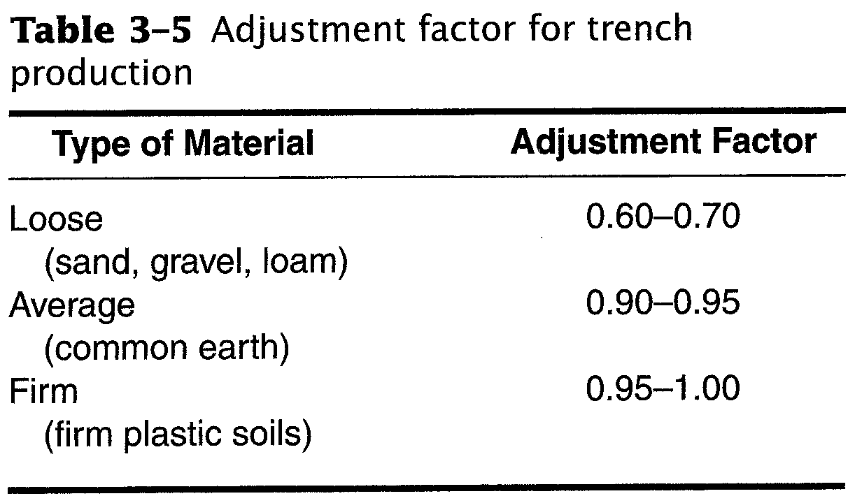

Slide 36
EXAMPLE 3-2
Find the expected production in loose cubic yards (LCM) per hour of a small hydraulic excavator.
Heaped bucket capacity is 3/4 cu yd (0.57 m³).
The material is sand and gravel with a bucket fill factor of 0.95.
Job efficiency is 50 min/h.
Average depth of cut is 14 ft (4.3 m).
Maximum depth of cut is 20 ft (6.1m) and
average swing is 90°.

Slide 37
EXAMPLE 3-2
Solution
Cycle output = 250 cycles/60 min (Table 3-3)
Swing-depth factor = 1.00 (Table 3-4)
Bucket volume = 0.75 LCY (0.57 LCM)
Bucket fill factor = 0.95
Job efficiency = 50/60 = 0.833
Production = 250 × 1.00 × 0.75 × 0.95 × 0.833
= 148 LCY/h
[= 250 × 1.00 × 0.57 × 0.95 × 0.833
= 113 LCM/h]

Slide 38
Job Management
In selecting the proper backhoe for a project, consideration must be given to the :
maximum depth,
working radius, and
dumping height required.
Check also for adequate clearance for the carrier, superstructure, and boom during operation.

Slide 39
Job Management
Although the backhoe will excavate fairly hard material, do not use the bucket as a sledge in attempting to fracture rock.
Light blasting, ripping, or use of a power hammer may be necessary to loosen rock sufficiently for excavation.
When lifting pipe into place do not exceed load given in the manufacturer's safe capacity chart for the situation.

Slide 40
3-3 SHOVELS
Operation and Employment
Production Estimating
Job Management

Slide 41
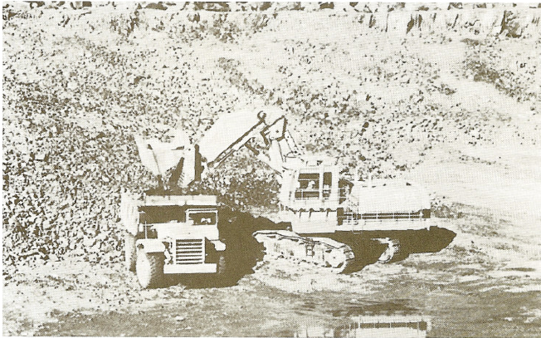
FIGURE 3-6: Hydraulic shovel. (Courtesy of Kobelco American, Inc.)

Slide 42
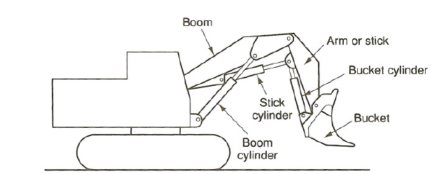
FIGURE 3-7: Components of a hydraulic shovel

Slide 43
Operation and Employment
The hydraulic shovel illustrated in Figure 3-6
It is also called a :
front shovel or
hydraulic excavator-front shovel.

Slide 44
Operation and Employment
The hydraulic shovel digs with a combination of:
crowding force and
breakout (or prying) force.
illustrated in Figure 3-8.

Slide 45
FIGURE 3-8: Digging action of a hydraulic shovel

Slide 46
Operation and Employment
Crowding force: is generated by the stick cylinder and acts at the bucket edge on a tangent to the arc of the radius from point A.

Slide 47
Operation and Employment
Breakout force: is generated by the bucket cylinder and acts at the bucket edge on a tangent to the arc of the radius through point B.

Slide 48
Operation and Employment
For hydraulic shovels, there are 2 types of Bucket available:
front-dump buckets and
bottom-dump buckets.

Slide 49
Operation and Employment
Bottom-dump buckets are:
more versatile,
provide greater reach and dump clearance, and
produce less spillage.
Bottom-dump buckets are heavier than front-dump buckets of equal capacity,
resulting in a lower bucket capacity for equal bucket weight.
Front-dump buckets:
cost less and
require less maintenance.

Slide 50
Operation and Employment
Shovel has a limited ability to dig below track level.
It is most efficient when digging above track level.
For most effective digging, the shovel should have a vertical face to dig against.
This surface, known as digging face,
It is easily formed when excavating a bank of hillside.

Slide 51
Production Estimating
Production for hydraulic shovels may be estimated using Equation 3-2 together with Table 3-6, which has been prepared from manufacturers' data.
Production (LCY/h or LCM/h) = C × S × V × B × E (3-2)
where C =cycles/h (Table 3-6)
S =swing factor (Table 3-6)
V = heaped bucket volume (LCY or LCM)
B =bucket fill factor (Table 3-2)
E =job efficiency

Slide 52
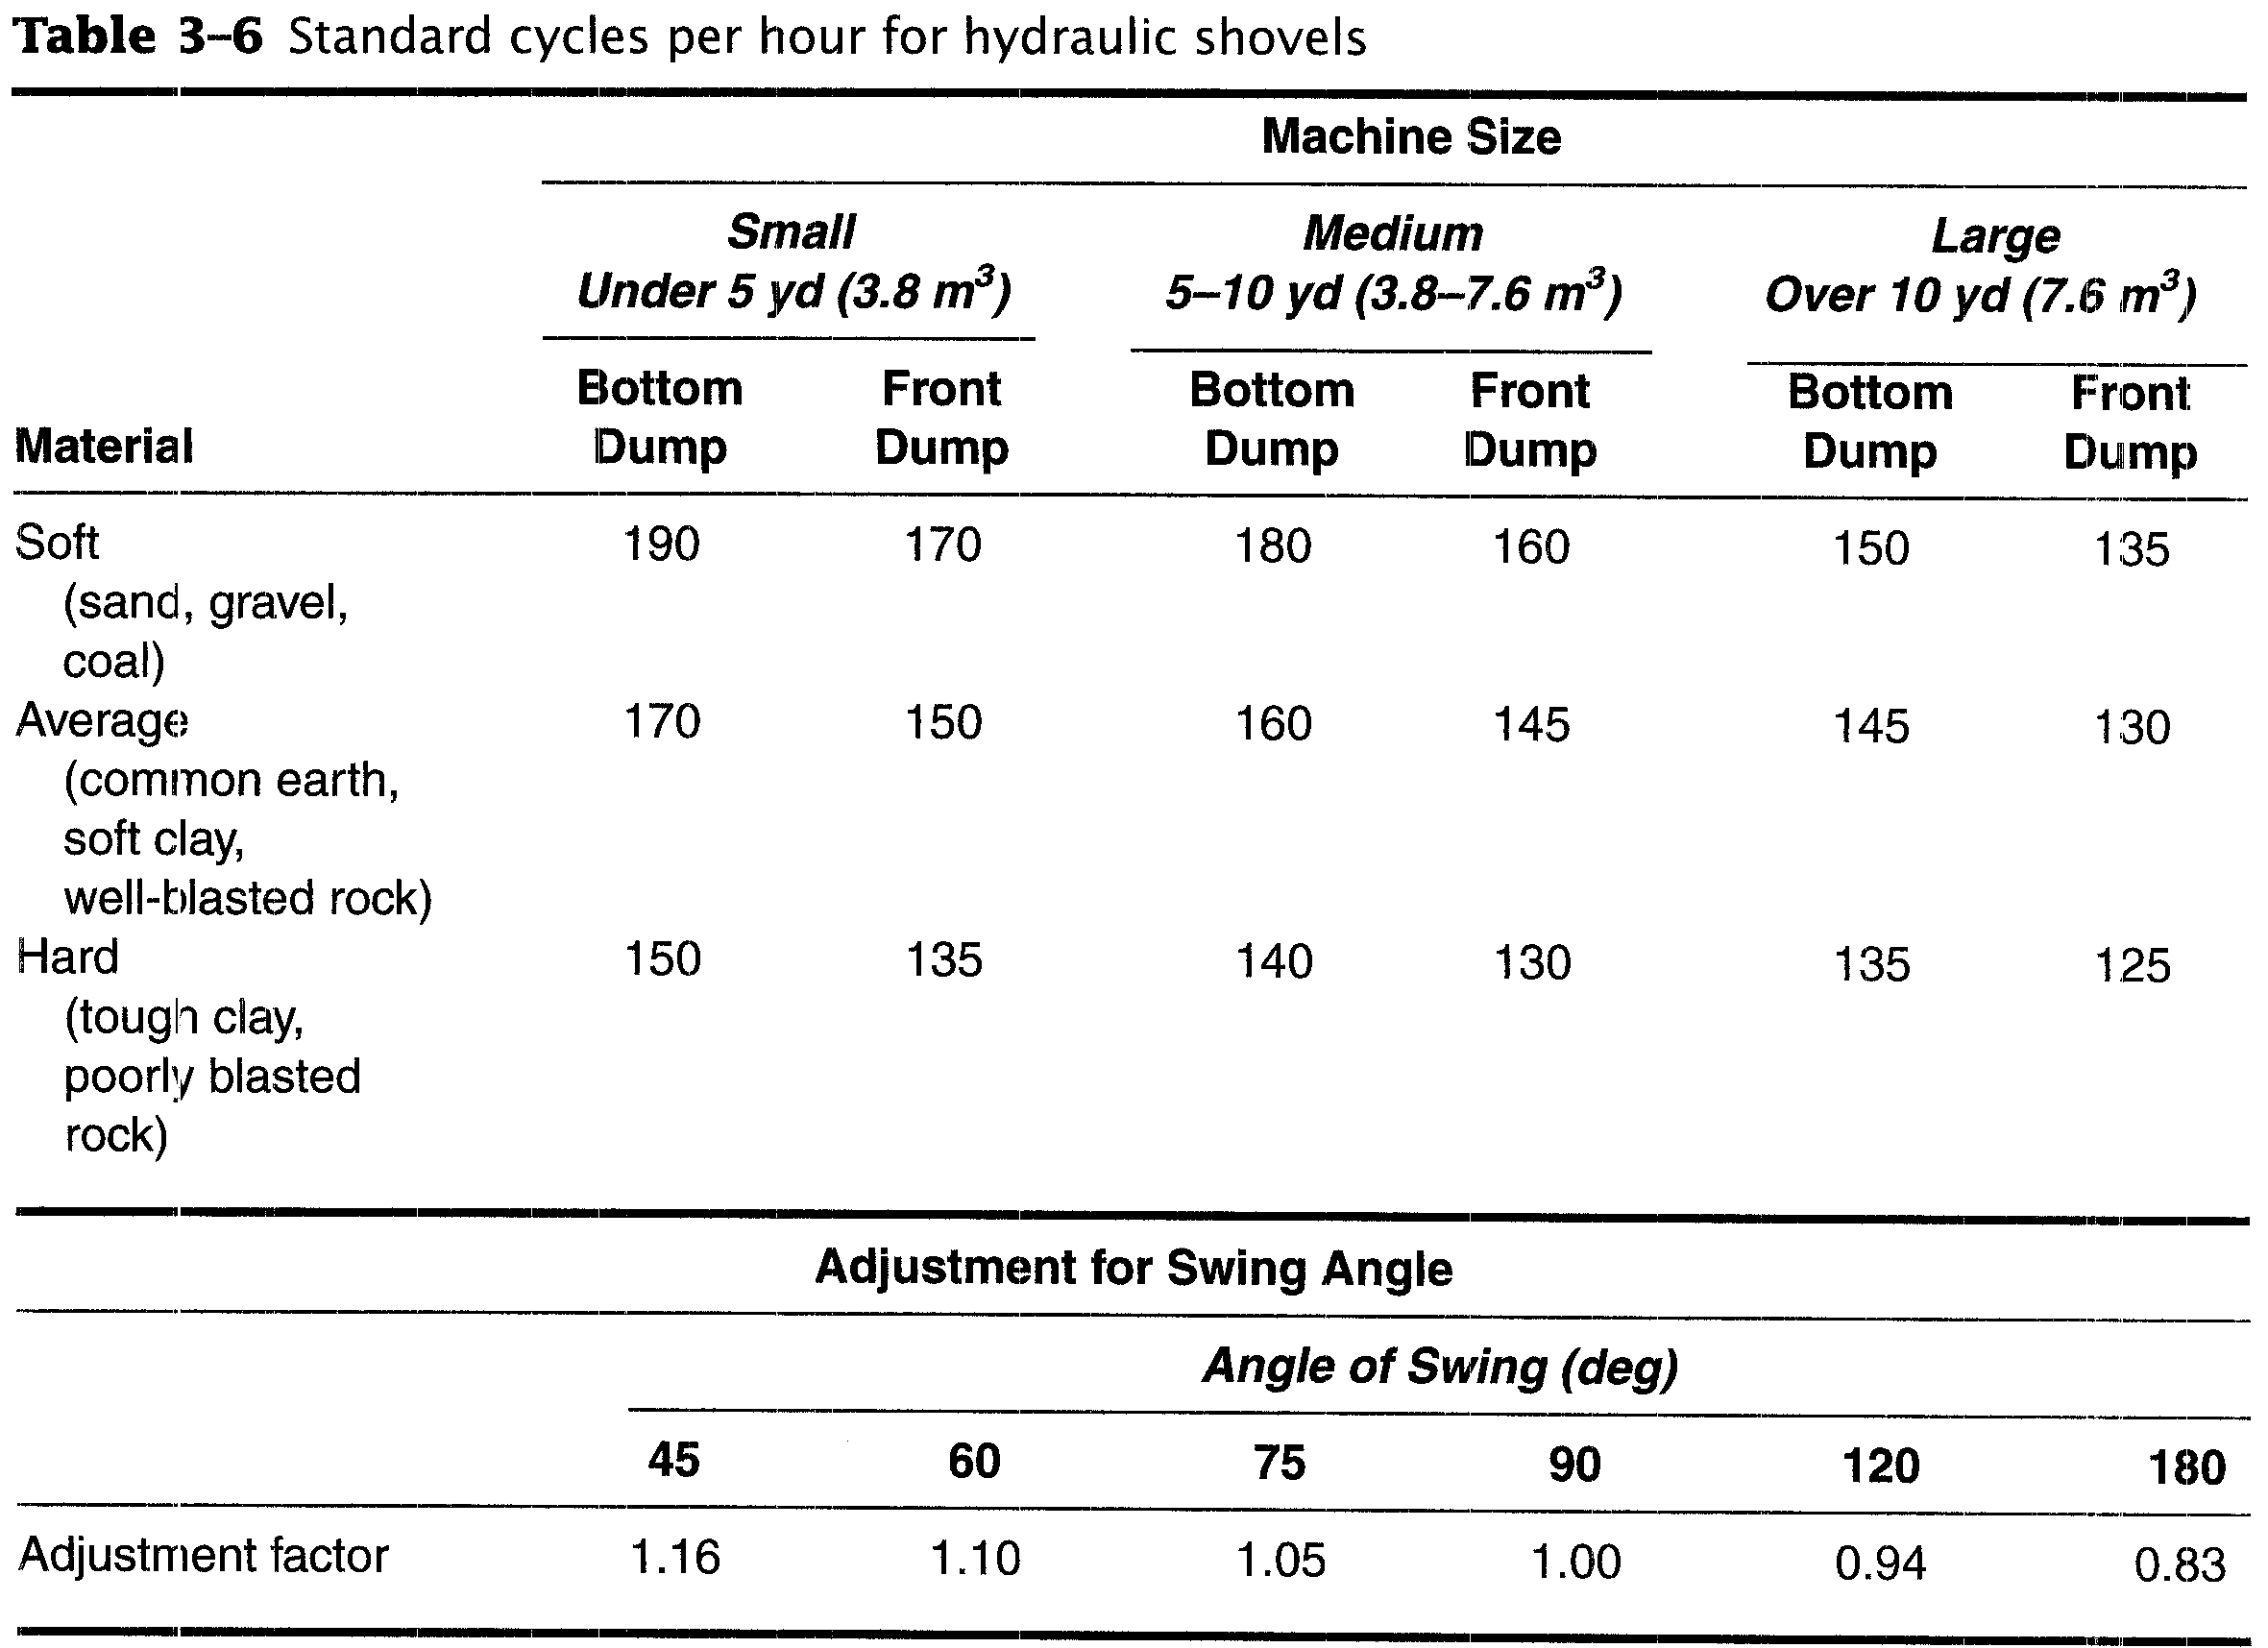

Slide 53
EXAMPLE 3-3
Find the expected production in loose cubic yards (LCM) per hour of:
a 3-yd (2.3-m3) hydraulic shovel equipped with a front-dump bucket.
The material is common earth with a bucket fill factor of 1.0.
The average angle of swing is 75°and
job efficiency is 0.80.

Slide 54
EXAMPLE 3-3
Solution
Standard cycles = 150/60 min (Table 3-3)
Swing factor =1.05 (Table 3-3)
Bucket volume = 3.0 LCY (2.3 LCM3)
Bucket fill factor = 1.0
Job efficiency = 0.80
Production = 150 × 1.05 × 3.0 × 1.0 × 0.80
= 378 LCY/h
[= 150 × 1.05 × 2.3 × 1.0 × 0.80
= 290 LCM/h]

Slide 55
Job Management
The two major factors controlling shovel production are:
the swing angle and
lost time during the production cycle.

