Slide 1
Chapter 3
Excavating and Lifting
Part 3

Slide 2
3-7 CRANES
Heavy Lift Cranes
Tower Cranes
Job Management

Slide 3
3-7 CRANES
Cranes are primarily used for:
lifting,
lowering, and
transporting loads.
They move loads horizontally by swinging or traveling.
Most mobile cranes consist of a carrier and superstructure equipped with a boom and hook.
as illustrated in Figure 3-22.

Slide 4
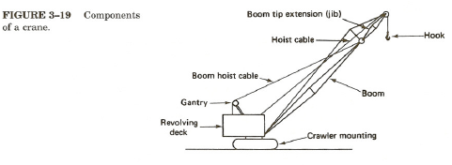
FIGURE 3-22: Components of a crane

Slide 5
3-7 CRANES
The current trend toward the use of hydraulically operated equipment includes hydraulically powered telescoping boom cranes.
The mobile telescoping boom crane is capable of lifting loads to the top of a 24-story building.
As shown in Figure 3-23

Slide 6
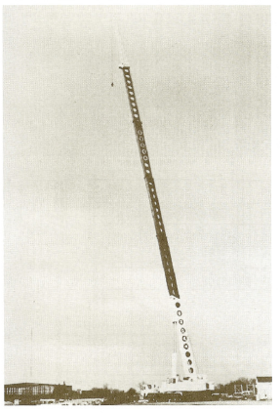
FIGURE 3-23: Large mobile hydraulic crane with telescoping boom. (Courtesy of Grove Worldwide)

Slide 7
Figure 3-27. Crane with ring attachment. (Courtesy of Maintowoc)

Slide 8
3-7 CRANES
Tower Cranes
Another special type of crane is the tower crane, illustrated in Figure 3-27.
The tower crane is widely used on building construction projects because of:
its wide operating radius and
almost unlimited height capability.

Slide 9
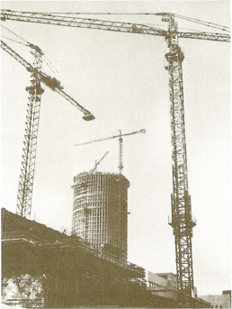
FIGURE 3-27: Tower crane on a building site. (Courtesy of Potain Tower Cranes, Inc.)

Slide 10
3-7 CRANES
Tower Cranes
Major types of tower cranes include (Figure 3-28):
horizontal jib (or saddle jib) cranes,
luffing boom cranes, and
articulated jib cranes
Thus, such Tower cranes can be operated in either the horizontal or luffed position.

Slide 11
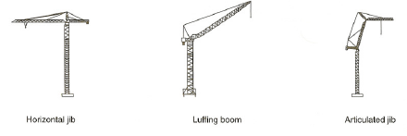
FIGURE 3-28: Major types of tower cranes

Slide 12
3-7 CRANES
Comparison between the 3 types:
luffing boom (inclined boom) models (see Figure 14-8) have the ability to operate in areas of restricted horizontal clearance not suitable for horizontal jib cranes with their fixed jibs and counterweights.
Articulated jib cranes are able to reposition their hinged jibs to convert excess hook reach into added hook height.

Slide 13
3-7 CRANES
Types of tower crane by method of mounting include:
static (fixed mount) tower cranes,
rail-mounted tower cranes,
mobile tower cranes and
climbing cranes.

Slide 14
3-7 CRANES
Climbing cranes:
are supported by completed building floors and are capable of raising themselves from floor to floor as the building is erected.
Most tower cranes incorporate self-raising masts.
Some specialized types of lifting equipment used in steel construction are described in Chapter 14.

Slide 15
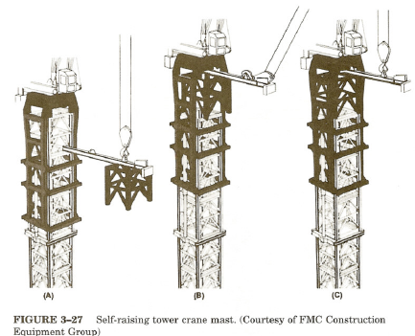
FIGURE 3-30: Self-raising tower crane mast. (Courtesy of FMC Construction Equipment Group)

Slide 16
3-7 CRANES
The major factor controlling the load that may be safely lifted by a crane is:
its operating radius
(horizontal distance from the center of rotation to the hook).
Some other factors:
the position of the boom in relation to the carrier,
whether or not outriggers (beams that widen the effective base of a crane) are used,
the amount of counterweight, and
the condition of the supporting surface.

Slide 17
3-7 CRANES
Safety regulations:
limit maximum crane load to a percentage of the tipping load (load that will cause the crane to actually begin to tip).
Notice that hook blocks, slings, spreader bars, and other load-handling devices are considered part of the load and their weight must be included in the maximum safe load.

Slide 18
3-7 CRANES
A standard method of rating the capacity of mobile cranes:
has been adopted by the PCSA Bureau of the Construction Industry Manufacturers Association (CIMA).
Under this system, a nominal capacity rating is assigned which indicates the safe load capacity (with outriggers set) for a specified operating radius
usually 12 ft (3.6 m) in the direction of least stability.

Slide 19
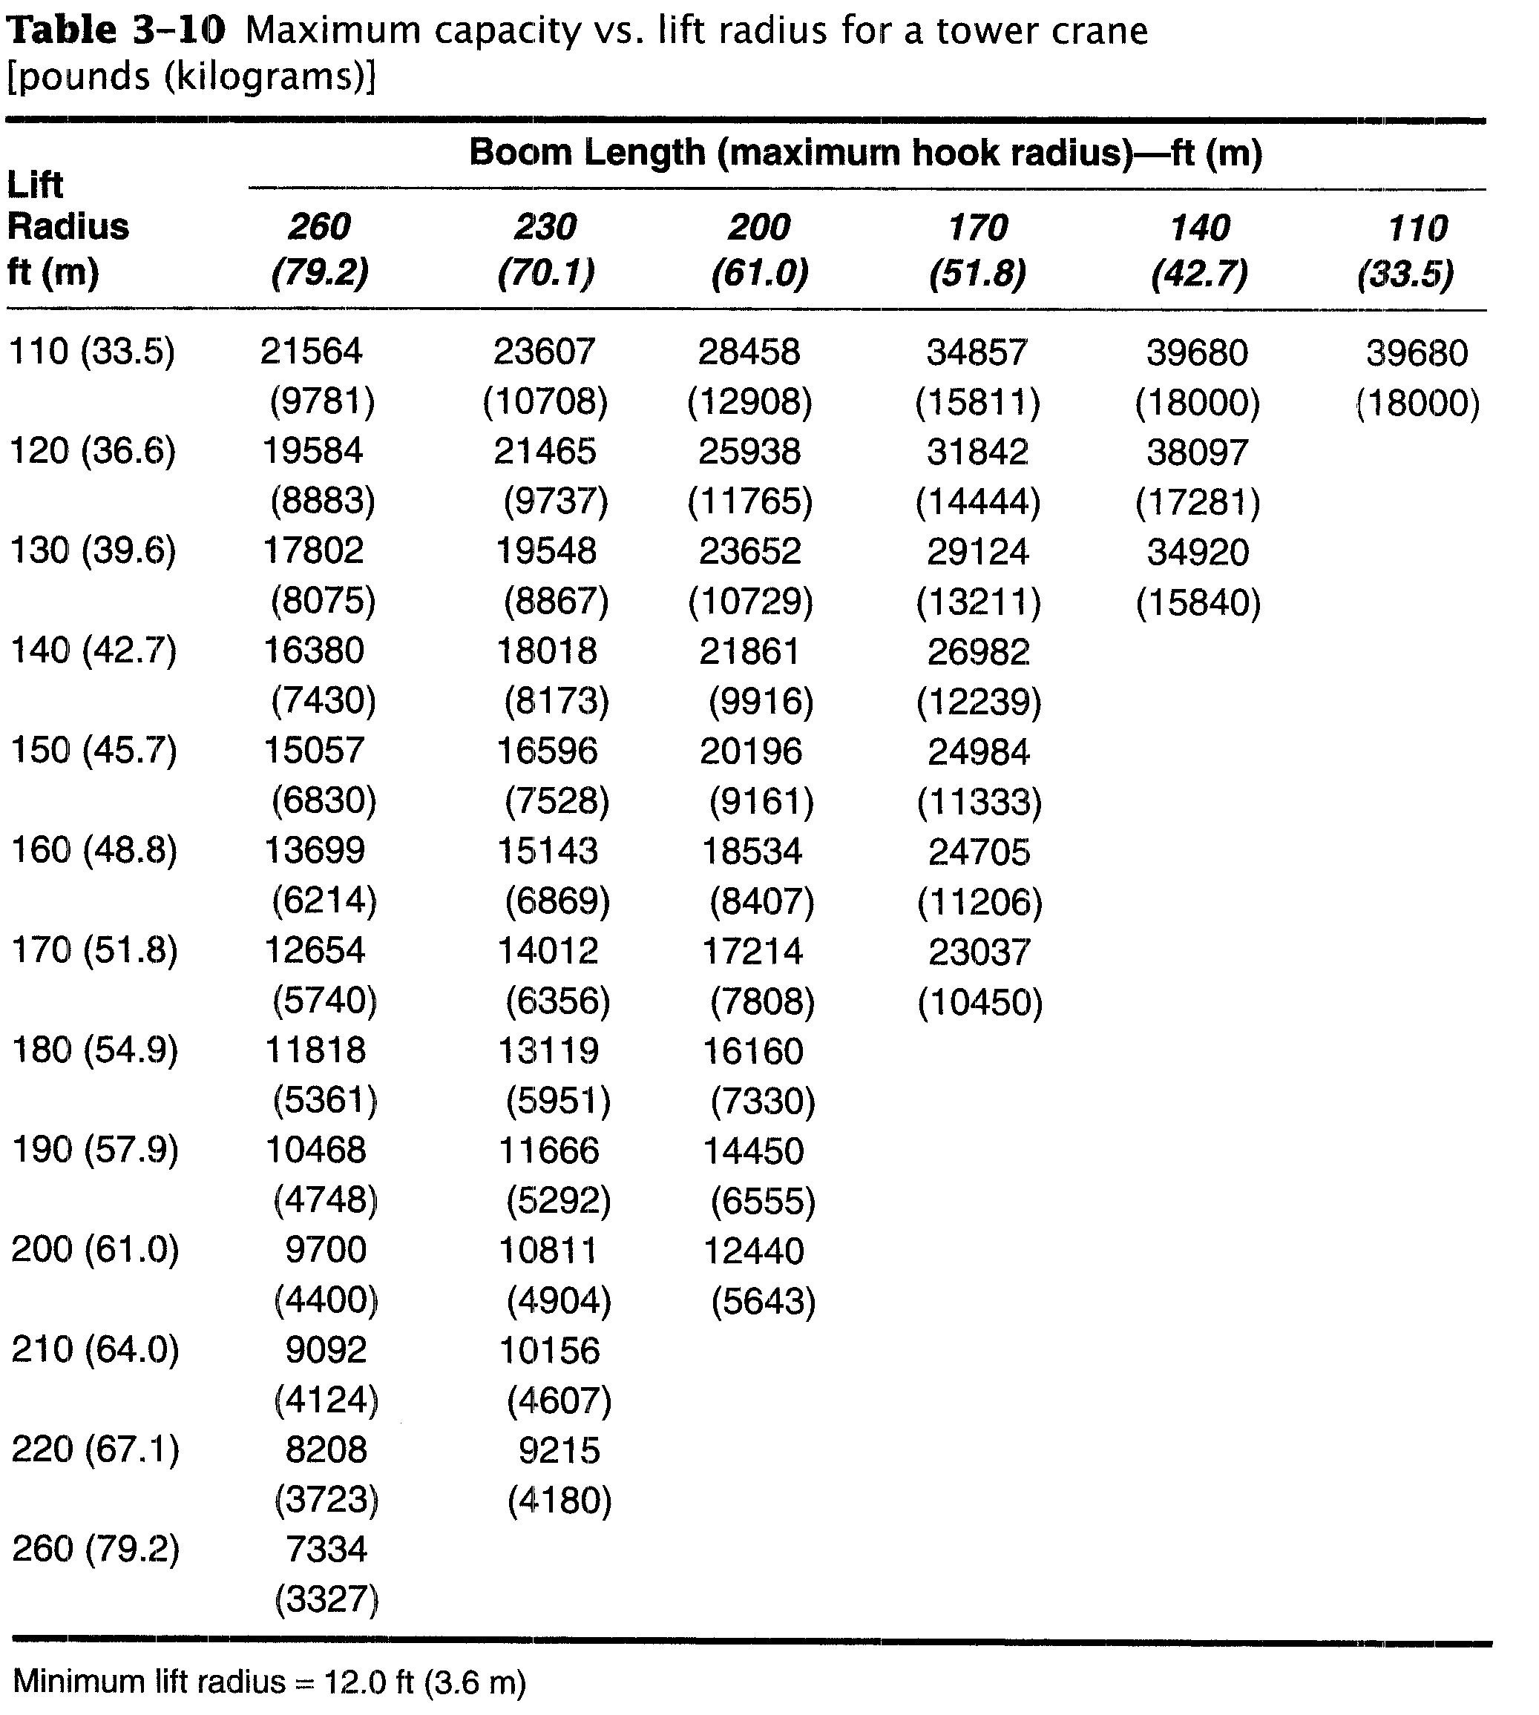

Slide 20
3-7 CRANES
Job Management
A number of attachments besides the basic hook available to assist the crane in performing construction tasks.
Several of these attachments are illustrated in Figure 3-31.

Slide 21
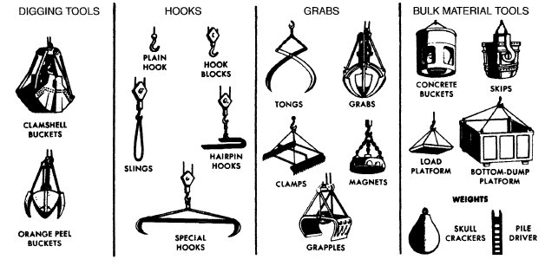
FIGURE 3-31: FIGURE 3-28 Lifting attachments for the crane. [Permission to reproduce this material has been granted by the Power Crane & Shovel Assn. (PCSA), a bureau of the Construction Industry Manufacturers Assn. (CIMA).Neither PCSA nor ClMA can assume responsibility for the accuracy of the reproduction.]

Slide 22
3-7 CRANES
Among these attachments, concrete buckets, slings, and special hooks are most often used in construction applications.
High-voltage lines present a major safety hazard to crane operations.

Slide 23
3-7 CRANES
U.S. Occupational Safety and Health Act (OSHA) regulations:
prohibit a crane or its load from approaching closer than 10 ft (3 m) to a high-voltage line carrying 50 kV or less.
An additional 0.4 in. (1 cm) must be added for each kilovolt over 50 kY.

Slide 24
3-7 CRANES
These safety clearances must be maintained:
unless the line is deenergized and visibly grounded at the work site, or
unless insulating barriers not attached to the crane are erected which physically prevent contact with the power line.
Crane accidents occur all too frequently in construction work,
particularly when lifting near-capacity loads and when operating with long booms.

Slide 25
3-7 CRANES
Some suggestions for safe crane operations include the following:
Carefully set of outriggers on firm supports.
The crane base must be level. Safe crane capacity is reduced as much as 50% when the crane is out of level by only 3º and operating with a long boom at minimum radius.

Slide 26
3-7 CRANES
Use a communications system or hand signals when the crane operator cannot see the load at all times. Make sure that all workers involved in the operation know the hand signals to be used.
Provide tag lines (restraining lines) when there is any danger due to swinging loads.
Ensure that crane operators are well trained and know the capability of their machines.
Check safe-lifting-capacity charts for the entire range of planned swing before starting a lift. Use a load indicator if possible.

