Slide 2
KINGDOOM OF SAUDI ARABIA
King Saud University
College of Sciences - Department Botany & Microbiology
Eco- Physiology
BOT 349
Dr. Abdulrahman AL-Hashimi

Slide 3
Lecture 4
The Influence of salinity stress
Part 2

Slide 4
The Adaptive Response of the Plant Cell to salt stress:
An osmotic stressor such as salt caused strain in the plant cell , which can be interpreted as adaptation to the new osmotic condition.
Adaptation means new synthesis of proteins to alleviate the stress.
In the case of osmotic stress, this alleviation comprises:
Reaction to the regain ion homeostasis.
Reactions to adapt to the osmotic potential
Synthesis of specifically acting, protective proteins.

Slide 5
Intracellular signals:
The adaptation commences with the perception of the osmotic stress.
Since little is known osmosensors, Particularly as they apply to salt stress.
The next step the genesis of the signal-will now be considered.
Genes and the proteins have recently been identified which point to a biochemical connection between the osmotic adaptation of the plant and an increase in the cytosolic Ca++ level.

Slide 6
At the yeast which has been used as model to understand the intercellular reaction under the salinity stress, The subunit B of the Ca- binding protein calcineurin and salt tolerance.
Then the protein phosphatase calcineurin activates on the one hand transcription factors, which lead to increased expression of the plasma membrane Na+ -ATPase and a tono-plastic Na+/H+ symporter in such a way that it becomes both more effective and strongly selective for K+

Slide 7
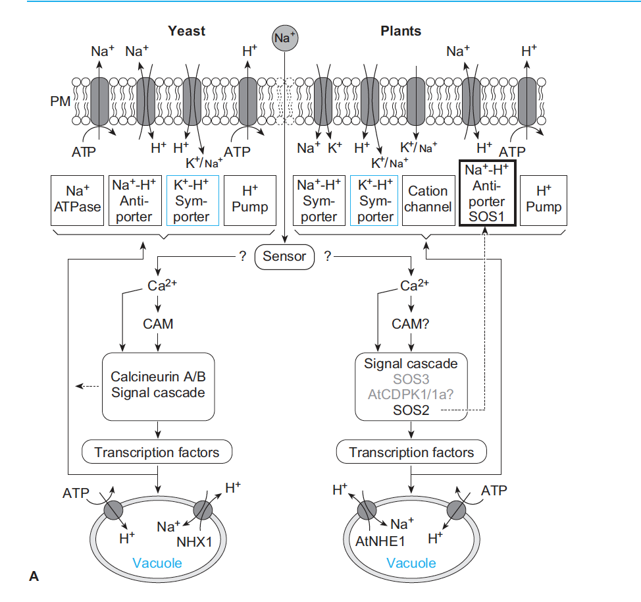

Slide 8
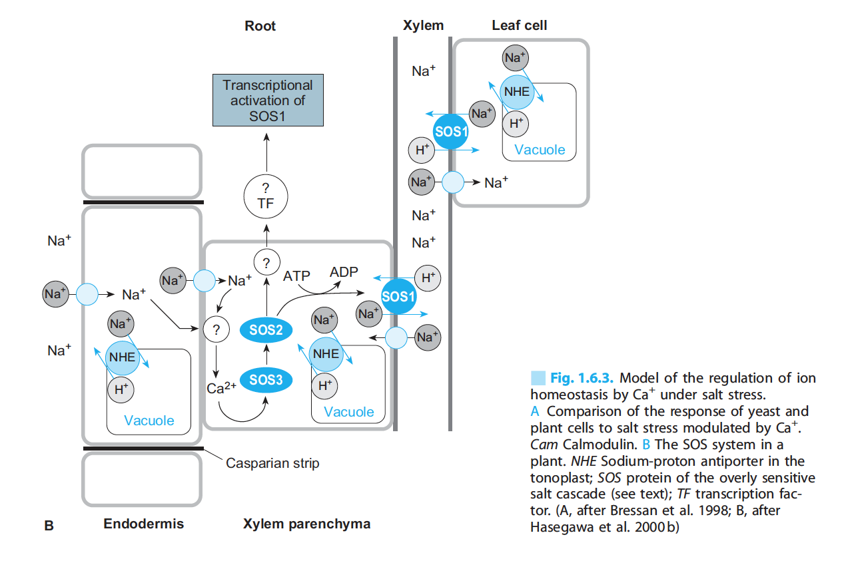
At the Arabidopsis, a mutation in which makes plants sensitive to Na+ and also to Li+. (‘Salt Overly Sensitive’ : SOS)
The functions of three SOS proteins have now been elucidate: SOS1 is a Na+ - H+ antiporter in the plasma membrane, SOS2 is serine-threonine protein kinase which activates SOS2.

Slide 9
Adaptation Reactions to Restore Ion Homeostasis:
Glycophytes and Halophytes basically make use of the same mechanism to deal with salinity stress.
Halophytes are able to adapt faster and to tolerate extreme salinity, whereas glycophytes adapt stepwise to develop tolerance to a moderate degree of salinity.
In both constitutive types salt tolerance require the expression of certain similar gene. However, the transition from extremely salt –sensitive plants to extremely salt tolerance plants is not clear yet.

Slide 10
Nowadays, many example of the salt stress glycophtes and halophytes having been investigated, it becomes clear that adaptation serves to regain ion homeostasis and the original membrane potentials and PH value.
The better plants is able to achieve this, the better it becomes tolerant of osmotic stress. However, regaining ion homeostasis does not signify a “ return’ to the original ion concentration.

Slide 11
The plant attemts to achieve homeostasis with the entire ionic load, including the NaCl that has been taken up. Depletion of the aggressive NaCl ions in the cytoplasm during adaptation require considerable energy, which can not be supplied with the normal provision of the cellullar transport system.
Therefore, more of those protein are synthesised which contriute either directly or indirectly to the removal of NaCl from the cytoplasm.
Relief of the cystosol by removal of the Na+ ions from the cytoplasm and their transport into the vacuols and the apoplast is effected mainly by mean of Na+/H+ antiportters, both in the plasmalemma area at cell wall.

Slide 12
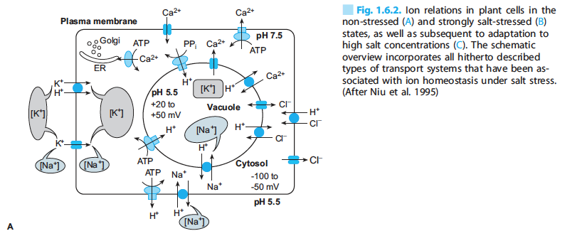
These pumps are synthesised to a greater extent upon start stress.
If ion homeostasis is established, the increased expression of e.g., the plasma membrane H+-ATPase decreases once more.
Adapted cells no longer exhibit enhanced pump activity.

Slide 13
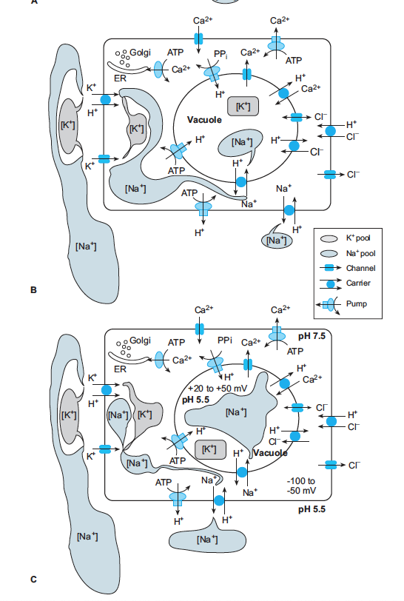

Slide 14
The Na+ Concentation in the cytosol has returned to the original value , while that in the vacuole has increased many-fold.
The original membrance potential and PH value have never- theless been reestablished.
Over-expression of a vacuolar Na+/H+ antiporter gene in Arabidopsis increased salt tolerance considerably.
The K+ status is the weak point in the cellular ion budget subsequent to an adaption process, irrespective of ion homeostasis.
The reduced growth of the halpophytes and glycophytes under salt stress is possibly related to problematical provision of the cell with K+.

Slide 15
Adaptation of Osmotic Potential
Plants must possess a higher osmotic potential than their medium if they are to take up water and nutrients from a saline milieu i.e.
They must increase their own osmotic potential. It is thus inevitable that changes in their internal concentration relations must take place, something with necessitates further adaptive action.
In addition to maintaining ion homeostasis, in seedling of pea (salt- sensitive) and spinach (salt-resistant) were transferred to nutrient solution and exposed to 100 mM NaCl.
The ion concentrations of the root and leaves, as well as the in tercellular distribution of ions, were monitored.

Slide 16
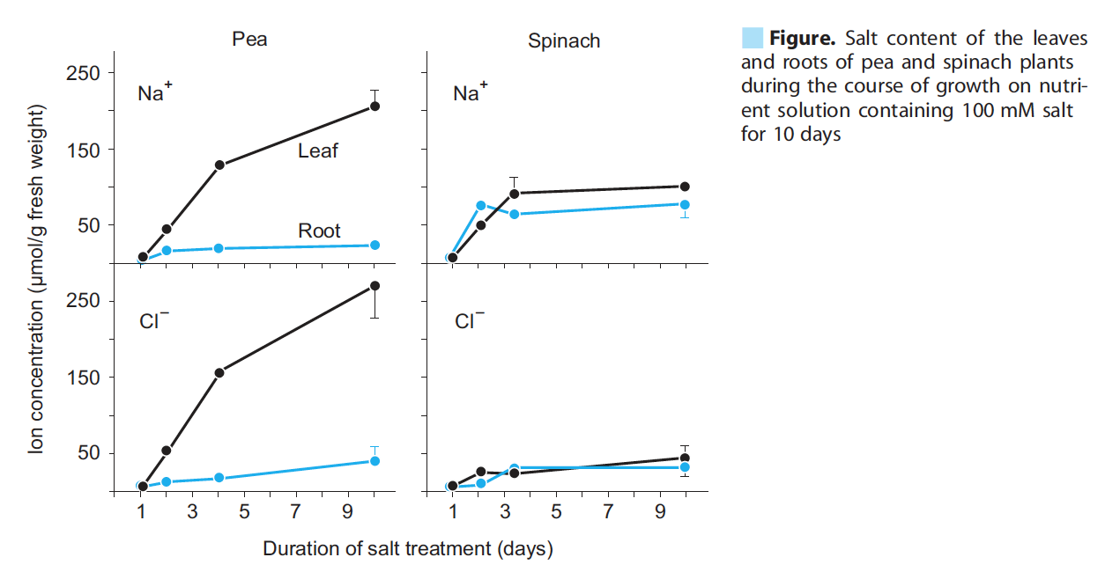

Slide 17
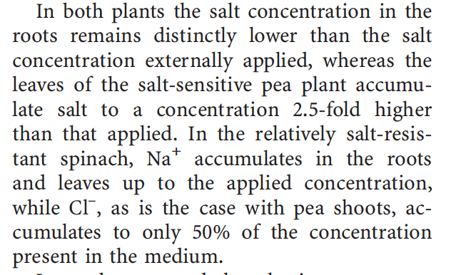

Slide 18
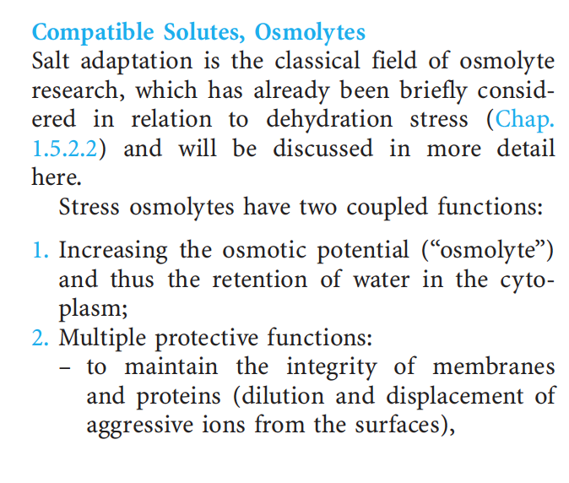

Slide 19
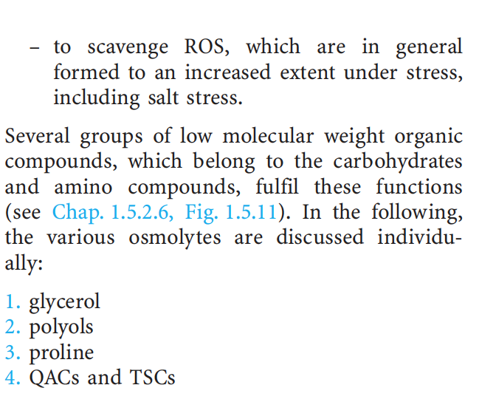

Slide 20
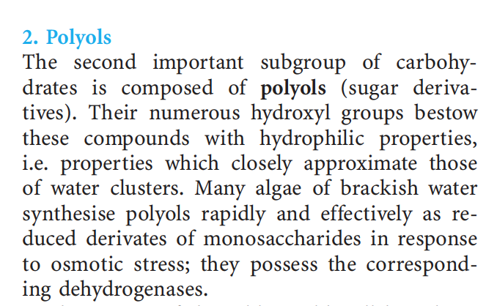

Slide 21
Question:
Can you summarize the effect of the salt stress on Proline ?

Slide 22
Any
QUESTIONS ?

