Slide 1
King Saud University College of Engineering IE – 462: “Industrial Information Systems” Fall – 2018 (1st Sem. 1439-40H)
Chapter 4
Structured Analysis and Functional
Architecture Design – p2 – DFD – ii - Diagrams
Prepared by: Ahmed M. El-Sherbeeny, PhD

Slide 2
Lesson Overview
Modeling IIS – (p1)
Integrated Computer-Aided Manufacturing Definition 0 (IDEF0) – (p1)
Data Flow Diagram (DFD) – (p2)

Slide 3
Context Diagram

Slide 4
Functional Decomposition
Functional decomposition: an iterative process of breaking a system description down into finer and finer details:
Creates a set of hierarchically related charts in which one process on a given chart is explained in greater detail on another chart
Continues until no sub-process can logically be broken down any further
Lowest level of a DFD is called a primitive DFD
Notes:
Note how similar this is to the IDEF0 model

Slide 5
Developing DFDs: Context Diagram
Context Diagram
DFDs follow the same principles of hierarchic decomposition as IDEF0; highest level diagram is called the context diagram
Context diagram includes overall process (i.e. scope of the system) and sources and sinks that interact with the overall process, showing:
system boundaries
external entities that interact with the system (sources/sinks)
major information flows between the entities and the system

Slide 6
Developing DFDs: Context Diagram (cont.)
Context Diagram (cont.)
Context diagram consists of only one process symbol (labeled 0), and no data stores are shown
It is decomposed into a first-level diagram (level-0 diagram) that shows more details of the process and data flow

Slide 7
Developing DFDs: Context Diagram (cont.)
Context Diagram (cont.)
The boundary relationships of the context level are maintained at each successive level of decomposition
Therefore, data flows from sources and to sinks that appear at the context level also appear at the first level of decomposition (this is called Level-0 DFD)
Decomposition explores greater levels of detail, so data stores not represented at the context level may be introduced (e.g. filing cabinet, local to sub-system)
In general, decomposition should be carried out to the degree necessary for the analyst to understand the details of the functions and data flows

Slide 8
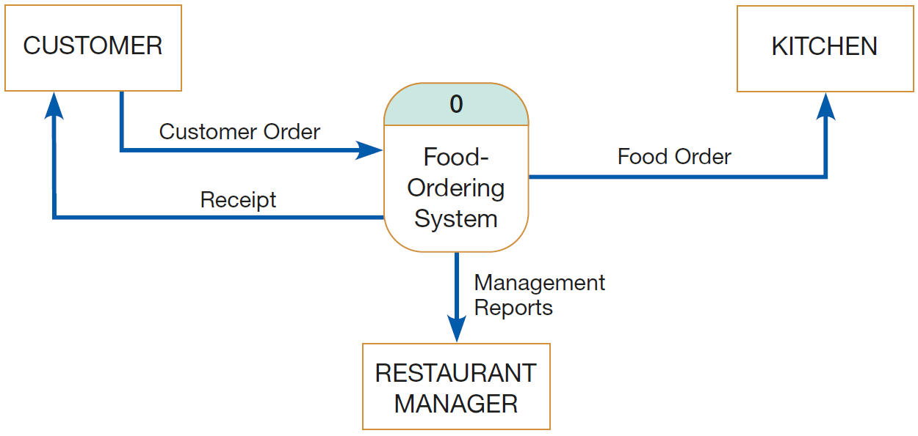
Developing DFDs: Context Diagram (cont.)
Context Diagram (cont.)
e.g. see below context diagram for food ordering system
Notes:
Hoosier Burger, a fictional restaurant in Bloomington, Indiana, owned by Bob and Thelma Mellankamp.

Slide 9
Developing DFDs: Context Diagram (cont.)
Context Diagram (cont.)
Restaurant uses an IS to enable it to:
takes customer orders
send orders to the kitchen
monitors goods sold and inventory, and
generate reports for management
Note how context diagram contains:
only one process (labeled 0, representing entire system)
no data stores (don’t appear on context diagram)
four data flows, and
three sources/sinks (environmental boundaries)
Notes:
Note, because the data stores of the system are conceptually inside one process, data stores do not appear on a context diagram

Slide 10
Level-0 DFD

Slide 11
Developing DFDs: Level 0
Level-0 diagram: data flow diagram that represents a system’s,
major processes
data flows, and
data stores at a high level of detail
Processes are labeled 1.0, 2.0, etc.; these will be decomposed into more primitive (lower-level) DFDs
see (following page) of Level-0 diagram for food ordering system example

Slide 12
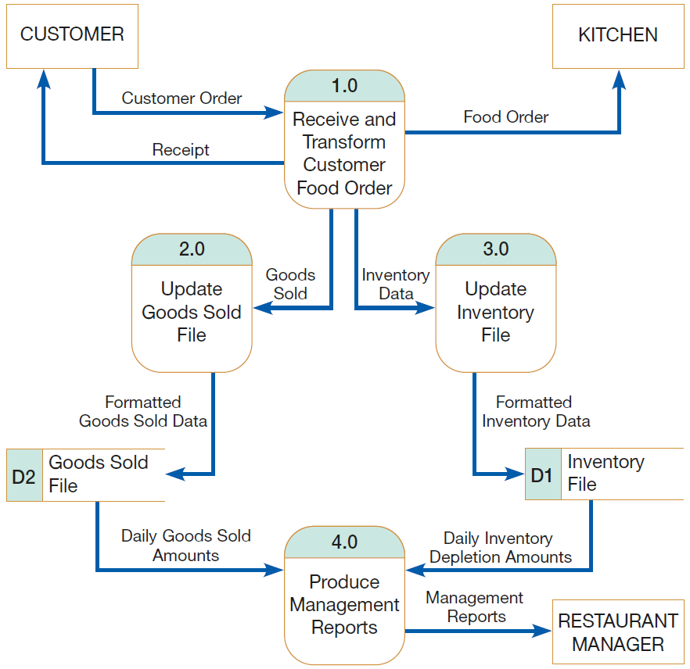

Slide 13
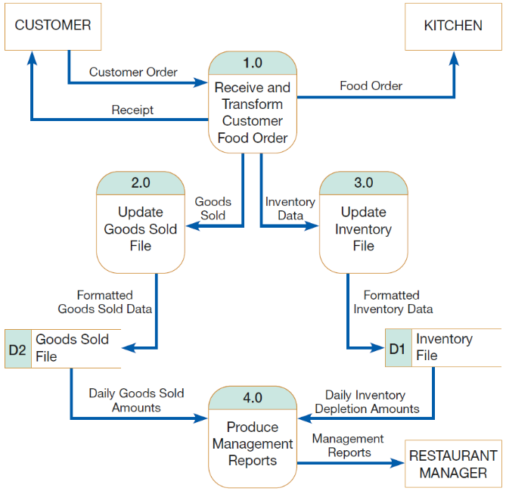
Developing DFDs: Context Diagram (cont.)
Level-0 diagram (cont.)
Result of process 1.0 (process customer order):
food order is transmitted to the kitchen
order is transformed into a list of goods sold
order is transformed into inventory data
process generates a receipt for the customer
Notice:
sources/sinks are the same in context diagram & level-0 diagram
each process in level-0 diagram has a number that ends in .0 (corresponding to the level number of the DFD)
no need to worry about data flows to sinks (go to ‘black box’)
Notes:
Remember, we are not concerned about what happens outside the system

Slide 14
Developing DFDs: Context Diagram (cont.)
Level-0 diagram (cont.)
Data flow from Process 1.0 to Process 3.0:
DFD hides many physical characteristics of the system it describes (e.g. timing of when data flow is produced, how frequently it is produced, or what volume of data is sent)
however, we know that Process 1.0 does provide this data to Process 3.0
also, Process 1.0 is coupled to Process 3.0 (i.e. Process 3.0 must always accept Inventory Data flow from Process 1.0)
Data flow between Process 2.0 and Process 4.0:
output from Process 2.0 is placed in a data store and, later, when Process 4.0 needs such data, it reads Daily Goods Sold Amounts from this data store
Thus, Processes 2.0 and 4.0 are decoupled by placing a buffer, a data store, between them (i.e. each works at its own pace)
Notes:
Note, similar to what is described above, Process and 1.0 and Process 2.0 are coupled; also, Process 3.0 and 4.0 are decoupled

Slide 15
Data Flow Diagramming Rules

Slide 16
Data Flow Diagramming Rules

Slide 17
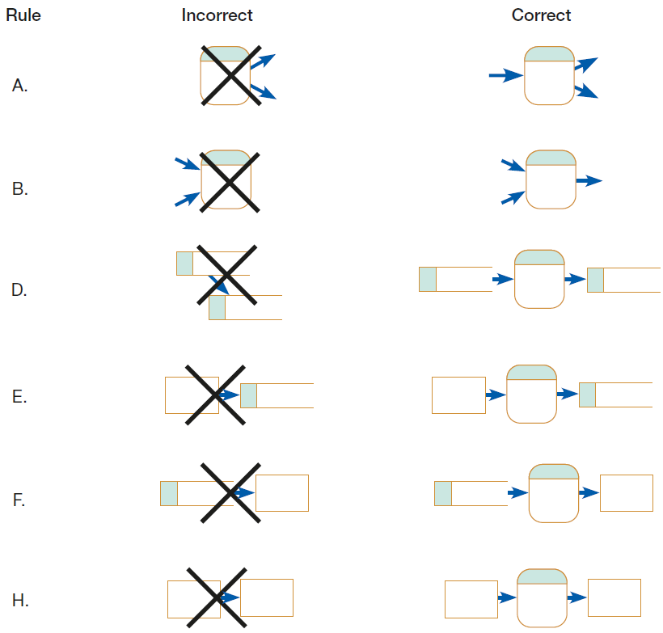

Slide 18
Data Flow Diagramming Rules - cont.

Slide 19
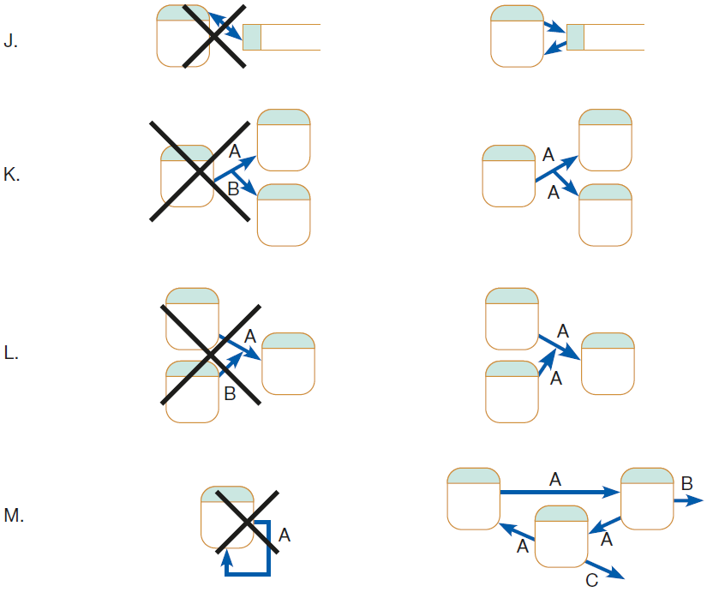

Slide 20
Data Flow Diagramming Rules - cont.
Additional Rules
The inputs to a process are different from the outputs of that process
exception: same input goes in and out of a process, but the process also produces other new data flows
Objects on a DFD have unique names
however, you may repeat data stores and sources/sinks
also, when two arrows have the same data flow name, you must be careful that these flows are exactly the same
Notes:
Note, because the data stores of the system are conceptually inside one process, data stores do not appear on a context diagram

Slide 21
Decomposition of DFDs

Slide 22
Notes:
Hoosier Burger, a fictional restaurant in Bloomington, Indiana, owned by Bob and Thelma Mellankamp.

Slide 24
Developing DFDs: Level 1
Level-1 diagram:
Level-1 diagram results from decomposition of Level-0 diagram
Level-n diagram is a DFD diagram that is the result of n nested decompositions from a process on a level-0 diagram
Each level-1, -2, or -n DFD represents one process on a level-‘n-1’ DFD
Each DFD should be on a separate page
No DFD should have more than ~7 processes (too many processes makes the diagram too crowded/ difficult to understand)
Notes:
For second point above, as e.g.: Level-4 DFD would be result of 4 nested decompositions from a process on a level-0 diagram (e.g. 2.0 → 2.2 → 2.2.3 → 2.2.3.1 → 2.2.3.1.3); just count the dots to know # of decompositions

Slide 25
Developing DFDs: Level 1
Level-1 diagram (cont.):
Process 1.0 decomposition:
Each of the five processes is labeled as a subprocess of Process 1.0: Process 1.1, Process 1.2, etc.
Notice how no sources or sinks are represented (only for context and level-0 DFDs)
Note regarding Processes 2.0 and 3.0:
Both perform similar functions since both use data input to update data stores
However, updating a data store is a singular logical function ⇒ no need to decompose them further
Notes:
For second point above, as e.g.: Level-4 DFD would be result of 4 nested decompositions from a process on a level-0 diagram (e.g. 2.0 → 2.2 → 2.2.3 → 2.2.3.1 → 2.2.3.1.3); just count the dots to know # of decompositions

Slide 26
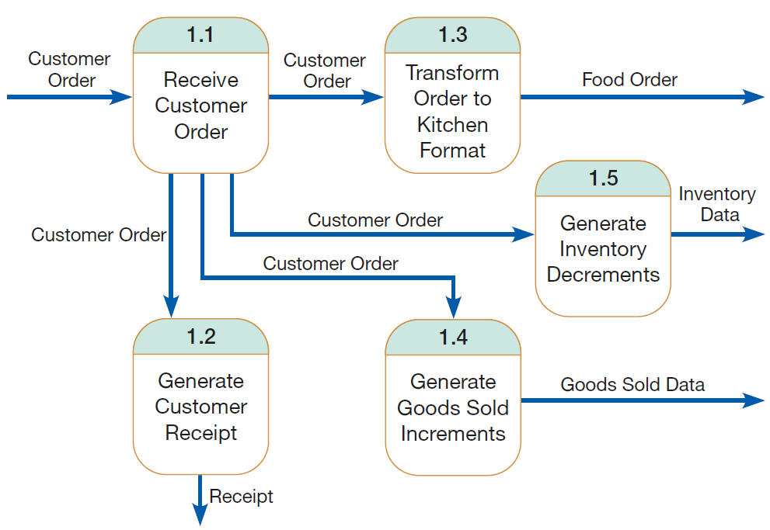
Notes:
Q: can you tell the sources and sinks in this DFD just by looking at the data flow arrows? (i.e. customer, kitchen); also can you tell what level-0 processes are connected to this DFD? (i.e. Update Inventory Data File, Update Goods Sold File)

Slide 27
Developing DFDs: Level 1
Level-1 diagram (cont.):
Process 4.0 decomposition:
We can decompose Process 4.0 into at least three subprocesses:
Process 4.1: Access Goods Sold and Inventory Data
Process 4.2: Aggregate Goods Sold and Inventory Data
Process 4.3: Prepare Management Reports
Notes:
Aggregate: i.e. combine

Slide 28
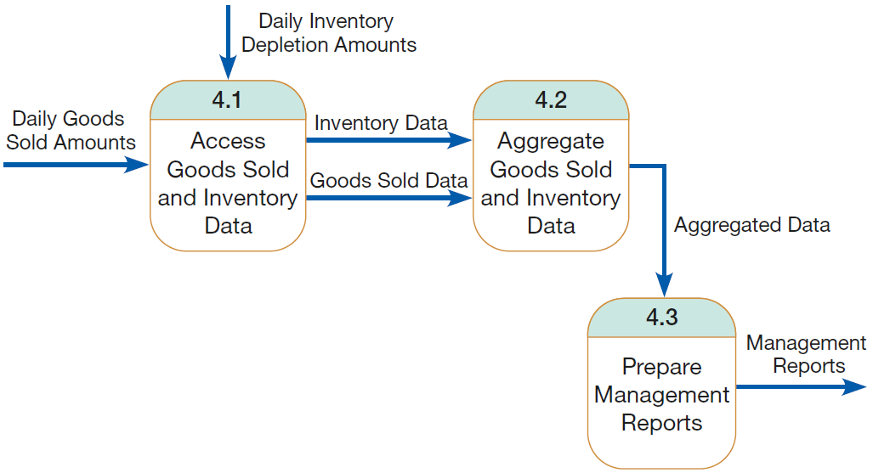
Notes:
Q: can you tell the sink in this DFD just by looking at the data flow arrow? (i.e. store manager); also can you tell what level-0 data stores are connected to this DFD? (i.e. Data File, Goods Sold File)

Slide 29
Developing DFDs: Level 2
Level-2 diagram:
Process 4.3 decomposition:
We can decompose Process 4.3 into 2 subprocesses:
Process 4.3.1: Format Management Reports
Process 4.3.2: Print Management Reports
Note about action verbs used in DFD processes
e.g.: Receive, Calculate, Transform, Generate, Produce
these process names often are the same as the verbs used in many computer programming languages, e.g. Merge, Sort, Read, Write, Print
⇒ process names should be short and descriptive of process
Notes:
Note that 4.3 decomposition DFD could be considered as a primitive DFD

Slide 30
Notes:
Note how this DFD has the same external data flows (i.e. external I/O flows) as in the 4.3 DFD

Slide 31
Food Ordering System Summary

Slide 33
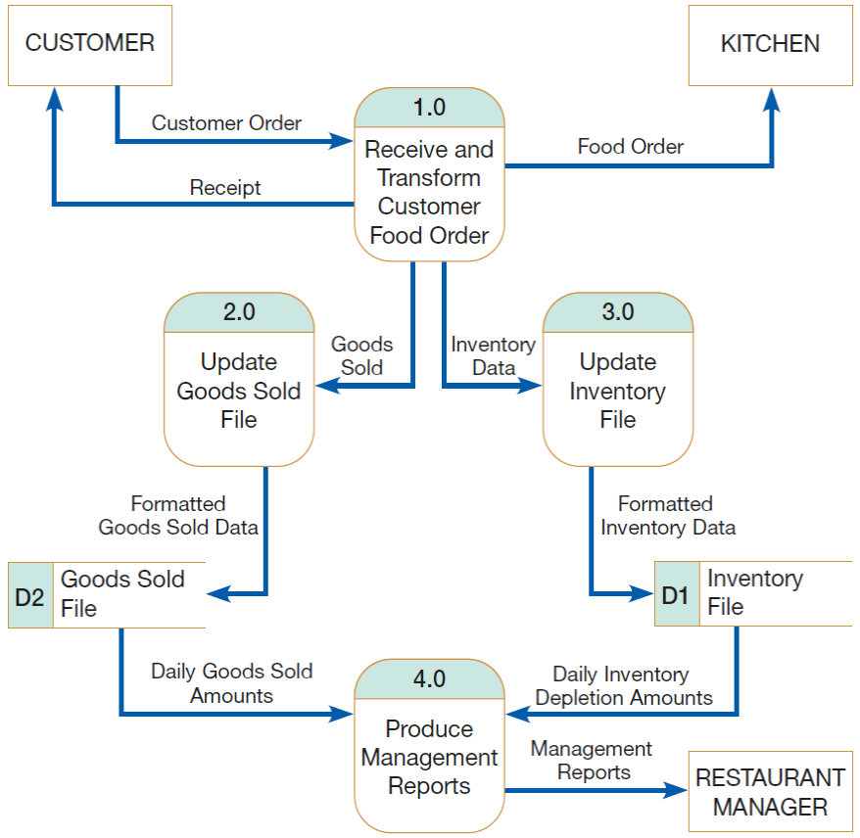
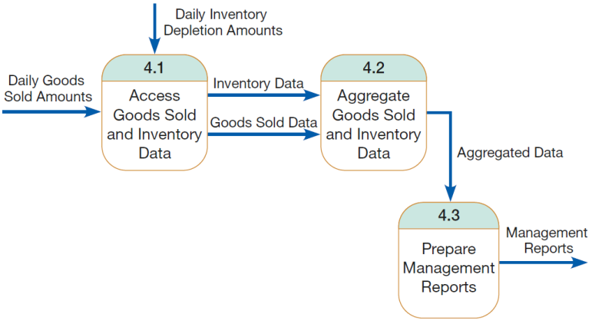

Slide 34
Balancing DFDs

Slide 35
Balancing DFDs
Balancing DFDs
Balancing: conservation of I’s / O’s to a DFD process when that process is decomposed to a lower level
Process in context diagram must have same I’s / O’s when decomposed into a level-0 diagram, e.g.:
Context Diagram:
1 I: customer order (from customer)
3 Os: customer receipt, food order (for kitchen), management reports
Level-0 Diagram:
note the same 1 I + 3 O’s
also, no new I’s to or O’s from the system have been added
⇒ context diagram and level-0 DFDs are balanced
Notes:
Remember, all data stores and flows to or from them are internal to the system

Slide 36
Balancing DFDs (cont.)
Balancing DFDs (cont.)
Process in level-0 diagram must have same I’s / O’s when decomposed into a level-1 diagram, e.g.:
Process 1.0 in Level-0 Diagram:
1 I + 3 O’s (same as before)
Process 1.0 decomposition in Level-1 Diagram:
note the same single I and multiple O’s
also no new I’s or O’s have been introduced
again we see conservation/balance of I’s and O’s
Can you also compare Process 4.0 with its decomposition? Are they balanced?
Notes:
For process 4.0: 2 I’s and O I

Slide 37
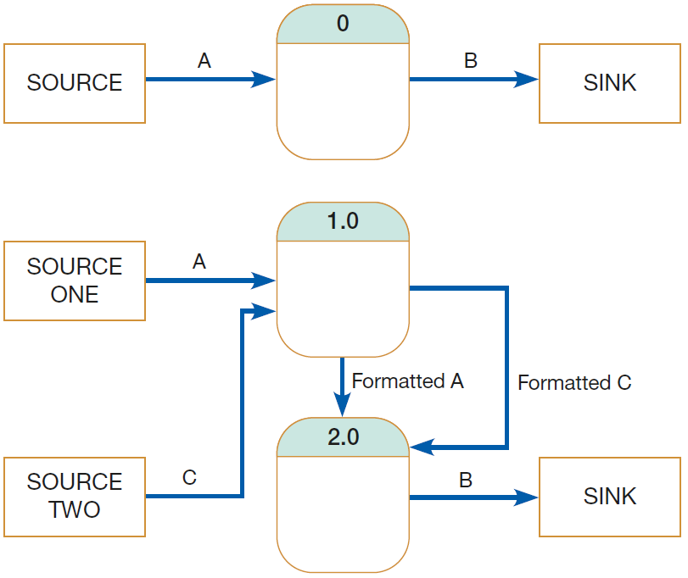
Balancing DFDs (cont.)
Balancing DFDs (cont.)
An unbalanced set of DFDs (why? can we fix this?)
Notes:
Context diagram: 1 I + 1 O; Level-0 DFD: 2 external I’s + 1 external O; most likely analyst drew Source 2 in Level-0 DFD but forgot to update it in Context diagram

Slide 38
Balancing DFDs (cont.)
Data flow splitting
Composite (aka package) data flow for a process can be split apart into several subflows
This occurs when:
process is decomposed (aka exploded/nested) into 2/more subprocesses (see e.g.)
each subprocess (e.g. Level-1) receives one of the components of the composite data flow from the higher-level DFD (e.g. Level-0)
Note, these diagrams are still balanced because exactly the same data are included in each diagram

Slide 39
Balancing DFDs (cont.)
Data flow splitting (cont.)
Notes:
This reminds us of the concept of bundling in the IDEF0 methodology; note how in a) this is I to Level-0 DFD (aka package data flow), and how it was split (exploded/nested) into 2 sub-data flows in Level-1 DFD (subprocesses)

Slide 40
Balancing DFDs (cont.)
Data flow splitting (cont.)
Notes:
Note, Rule Q addresses data flow splitting concept; Rule R conservation principle about process inputs and outputs; Rule S: exception to balancing; Rule T: how to minimize clutter on a DFD

Slide 41
Guidelines for Drawing DFDs

Slide 42
Guidelines for Drawing DFDs
Guidelines for Drawing DFDs:
Completeness
Consistency
Timing considerations
Iterative nature of drawing DFDs
Primitive DFDs
Note, these are considered besides DFD diagramming rules (A – T)

Slide 43
Guidelines for Drawing DFDs (cont.)
1. Completeness:
It is extent to which all necessary components of a DFD have been included and fully described
Examples of incomplete DFDs
data flows that do not lead anywhere
data stores, processes, or external entities that are not connected to anything else
CASE tools have built-in facilities that you can run to help you determine if your DFD is incomplete and/or contains errors/problems
Notes:
* Note, gap analysis is a process of discovering discrepancies between two or more sets of DFDs or discrepancies within a single DFD

Slide 44
Guidelines for Drawing DFDs (cont.)
2. Consistency:
It is extent to which information contained on one level of a set of nested DFDs is also included on other levels
Examples of inconsistency:
level-1 diagram with no level-0 diagram
data flow that appears on a higher-level DFD but not on lower levels (this’s also violation of balancing)
data flow attached to one object on a lower-level diagram but also attached to another object at a higher level e.g. data flow named Payment, which serves as input to Process 1 on a level-0 DFD, appears as input to Process 2.1 on a level-1 diagram for Process 2
Note CASE tools can also be used to removed such inconsistencies*
Notes:
e.g. it is possible on lower-level DFD to accidentally delete or change a data flow that would cause the diagrams to be out of balance
* Note, gap analysis is a process of discovering discrepancies between two or more sets of DFDs or discrepancies within a single DFD

Slide 45
Guidelines for Drawing DFDs (cont.)
3. Timing considerations:
DFDs do not do a very good job of representing time
There is no indication of whether a data flow occurs constantly in real time, once per week, etc.
Also, there is no indication of when a system would run
⇒ you should draw DFDs as if the system you are modeling has never started and will never stop (i.e. timeless)

Slide 46
Guidelines for Drawing DFDs (cont.)
4. Iterative nature of drawing DFDs:
First DFD you draw will rarely capture perfectly the system you are modeling
⇒ you should be willing to revise/repeat DFDs several times (i.e. in an iterative fashion)
With each attempt, you will come closer to a good approximation of the system you are modeling
It should take you ~3 revisions for each DFD you draw
Note, CASE tools make revising drawings much easier (than manual drawing)

Slide 47
Guidelines for Drawing DFDs (cont.)
5. Primitive DFDs:
A difficult decision when drawing DFDs is: when to stop decomposing processes? i.e. how to determine if you have reached the lowest logical level?
Complete sets of DFDs should extend to the primitive level (i.e. lowest level of decomposition for a DFD)
where every component reflects certain irreducible properties
e.g. process represents a single database operation (e.g. retrieve, update, create, delete, or read) and
every data store (e.g. customer, employee, product, order) represents data about a single entity
Notes:
Remember Process 2.0 or Process 3.0 (why did we not decompose those?)

Slide 48
Videos to Watch
What is DFD? Data Flow Diagram Symbols and More https://youtu.be/6VGTvgaJllM
How to Draw Data Flow Diagram? https://youtu.be/ztZsEI6C-mI
DFD Diagram 0 https://youtu.be/Ik85hZkyYPA
Notes:
Note, some videos regard Context Diagram as Level-0 Diagram, Level-0 DFD as Level-1, etc.

Slide 49
Sources
Modern Systems Analysis and Design. Joseph S. Valacich and Joey F. George. Pearson. Eighth Ed. 2017. Chapter 7.
Design of Industrial Information Systems. Thomas Boucher, and Ali Yalcin. Academic Press. First Ed. 2006. Chapter 4.

