Slide 1
Sodium Dodecyl Sulfate -Polyacryl Amide Gel Electrophoresis [SDS-PAGE]
Lab# 4
BCH 462 [practical]

Slide 2
Objectives:
-Separation of bacterial proteins using SDS-PAGE.

Slide 3
SDS-Polyacrylamide Gel Electrophoresis
-Sodium Dodecyl Sulfate-Polyacrylamide gel Electrophoresis (SDS-PAGE), is a technique widely used in biochemistry ,forensics, genetics and molecular biology to separate and identify proteins according to their molecular weight.
-This method separates proteins based primarily on their molecular weights.

Slide 4
Principle:
-Sodium Dodecyl Sulfate [SDS]: is a detergent which denature proteins by binding to the hydrophobic regions, all non-covalent bonds will disrupted and the proteins acquire a negative net charge.
-So, the proteins samples are having uniformed structure and charge(-ve) → the separation will depend on their molecular weight only.
-Small proteins migrate faster through the gel under the influence of the applied electric field, whereas large proteins are successively retarded, due to the sieving effect of the gels.

Slide 5
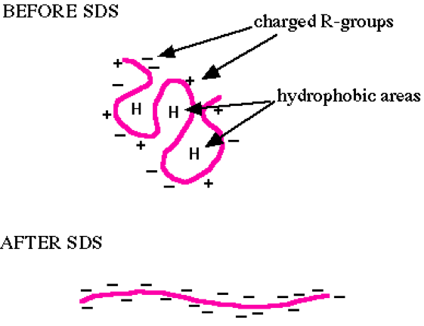

Slide 6
http://www.youtube.com/watch?v=3CrzY7jb9fQ

Slide 7
-SDS-treated proteins have very similar charge-to-mass ratios, and similar shapes. During PAGE, the rate of migration of SDS-treated proteins is effectively determined by molecular weight.

Slide 8
Polyacrylamide gel (Acrylamide stock):
- The polyacrylamide gel is formed by co-polymerization of acrylamide and a cross-linking
By N,N’-methylene-bis-acrylamide “bis-acrylamide “.
To polymerize the gel a system:
1- Ammonium PerSilfate (APS)[initiator].
2-TetraMethylene Ethylene Diamin (TEMED) [catalyst].

Slide 10
SDS-Polyacrylamide Gel Electrophoresis

Slide 11
SDS-Polyacrylamide Gel Electrophoresis preparations:
1-Sample Preparation:
-40µl of protein sample + 10 µl of disruption buffer→ boil the mixture 3minets at 99C.̊
-Disruption buffer [loading buffer] contain:
-10% (w/v) SDS [?]
-1M Tris/HCl, pH 6.8
-Glycerol [?]
-β-Mercaptoethanol [?]
-Bromophenol blue [?]

Slide 12
2- Polyacrylamide Gel Preparation :
Acrylamide stock should be prepared first :
A-Separation gel preparation:
Volume of stock solution required to make 12% polyacrylamide gel | Stock solutions
2.0 ml | 1.5 M Tris/HCl, pH 8.8
3.2 ml | Acrylamide stock
2.8 ml | Water
80 µl | 10% SDS
100 µl | 10% Ammonium persulphate (fresh)
10 µl | TEMED

Slide 13
B-Stacking gel preparation:
Volume of stock solution required to make 7% polyacrylamide gel | Stock solutions
1.0 ml | 0.5M Tris/HCl, pH6.8
1.0 ml | Acrylamide stock
3.0 ml | Water
80 µl | 10% SDS
50 µl | 10% Ammonium persulphate (fresh)
5 µl | TEMED

Slide 14
3-Loading the samples:

Slide 15
4-Running the gel using , Running buffer 1x pH 8.4:
It is contain:
-Tris-HCl.
-Glycine.
-SDS.
5- Stain the gel using staining buffer :
It is contain:
-Glacial acetic acid
-Methanol
-Coomassie brilliant blue 250-R
6- De-stain the gel using De-staining buffer:
It is contain:
-Glacial acetic acid
-Methanol

Slide 16
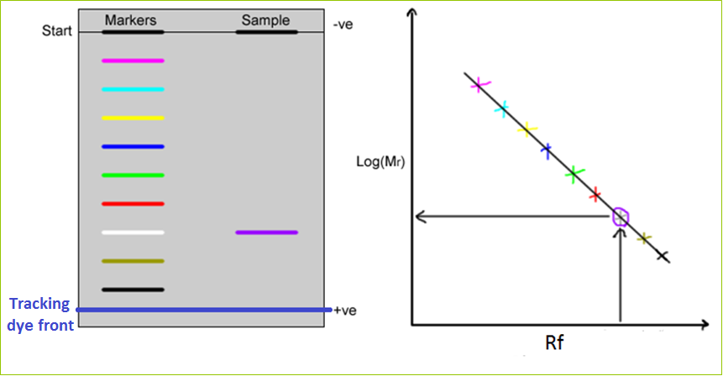
7-Analysis:
For Molecular weight Determination.
- Rf = Distance of migration of sample
Distance moved by tracking dye

Slide 18
Applications:
1. To detect the purity of the protein.
2. Determine of protein molecular weight.
3. Determine the presence of certain protein.
http://www.youtube.com/watch?v=EDi_n_0NiF4

Slide 19
