Slide 1
Group 2 Organometallics

Slide 2
Group 2 Organometallics
In many ways the chemistry of group 2 elements (the alkaline earth metals) mimics that of group 12 elements because both groups have filled s shells for valence electrons. Thus, both groups have nominal valency 2 and oxidation state +2.
All group 2 elements are electropositive towards carbon and electronegativity decreases down the group.
At the same time the atomic radius increases resulting in increasingly ionic character, higher coordination numbers, and increased ligand reactivity.
The group 2 elements are known to form organometallic compounds. Of these, organomagnesium compounds, usually in the form of Grignard reagents, are widely used in organic chemistry, while the other organometallic compounds of this group are largely academic.

Slide 3
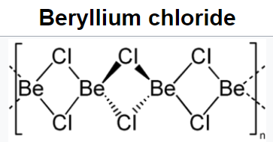
Organometallics compounds of Beryllium (Organoberyllium)
Synthesis and structure
Transmetallation reaction
Organoberyllium compounds are best prepared via transmetallation reactions
either with a Grignard reagent or with other organometallic compounds
2 RMgX + BeCl₂ → R₂Be + 2 MgXCl
HgMe₂ + Be → Me₂Be + Hg
In the gas phase Me₂Be is monomeric with a linear C—Be—C (Be-C = 170 pm), but in the solid state it is polymeric and resembles that of BeCl₂ with a bonding that is considered electron deficient with 3-center-2-electron bonds.
With higher alkyls, the amount of polymerisation decreases and the tert-butyl derivative is monomeric and linear in both solid and vapour phases.

Slide 4
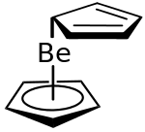
Beryllocene
Metathesis reaction
The reaction of NaCp with beryllium chloride leads to beryllocene (Cp₂Be)
BeCl₂ + 2 NaCp ⟶ Cp₂Be + 2 NaCl
The solid state structure suggests that the compound has a mixed η⁵ - C₅H₅ and η¹ -C₅H₅ coordination.

Slide 5
Organometallics Compounds of Magnesium
(Organomagnesium)
Alkyl and aryl magnesium halides (Grignard reagents, RMgX) are extremely well-known on account of their uses in synthetic chemistry.
The general procedure for their preparation was discovered by Victor Grignard in 1900 and involved the direct reaction of magnesium with organohalides.
R−X + Mg → R−Mg−X (X= Cl, Br, I)
When the reaction is performed in diethyl ether or THF and in the absence of air and moisture, the compounds are reasonably stable although they need to be used immediately. Grignard reactions often start slowly.

Slide 6
Synthesis and structure
Transmetallation is useful means of preparing pure Grignard reagents
Mg + RHgBr ⟶ Hg + RMgBr
Mg + R₂Hg ⟶ Hg + R₂Mg
Two-coordination at Mg in R₂Mg is observed only when the R groups are sufficiently bulky, e.g. Mg{C(SiMe₃)₃}₂.
RMgXRMgX are generally solvated and MgMg center is typically tetrahedral (e.g. EtMgBr.2Et₂O; PhMgBr.2Et₂O)
Cp₂Mg has a staggered sandwich structure.

Slide 7
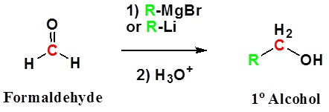
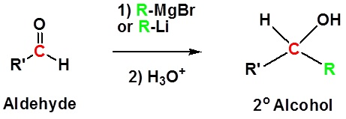
Reactions of Grignard Reagents
Because organometallic reagents react as their corresponding carbanion, they are excellent nucleophiles. The basic reaction involves the nucleophilic attack of the carbanionic carbon in the organometallic reagent with the electrophilic carbon in the carbonyl to form alcohols.
Both Grignard and Organolithium Reagents will perform these reactions.
Addition to formaldehyde gives 1° alcohols
Addition to aldehydes gives 2° alcohols

Slide 8
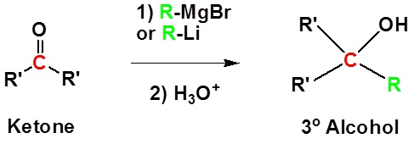
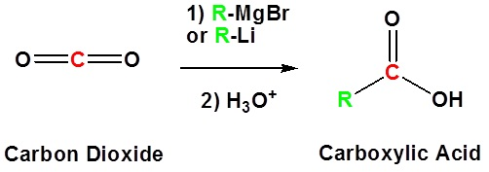
Addition to ketones gives 3° alcohols
Addition to carbon dioxide (CO₂) forms a carboxylic acid

Slide 9
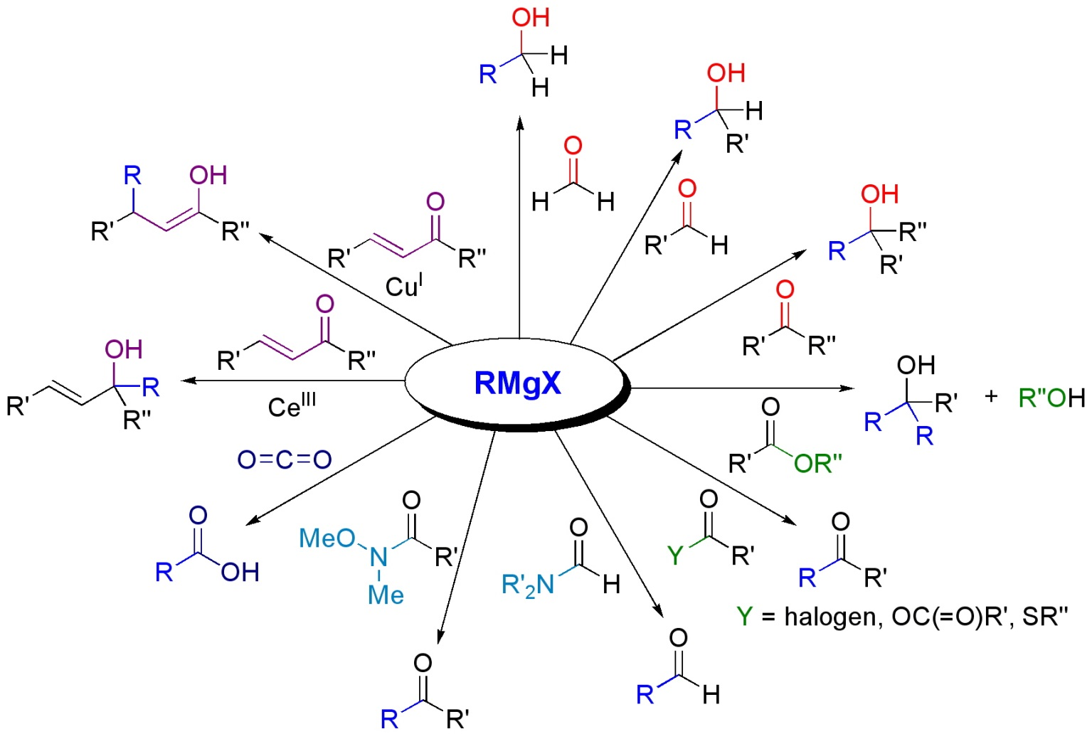

Slide 10
P-block organometallic compounds

Slide 11
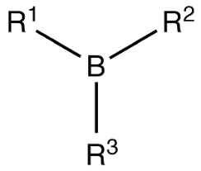
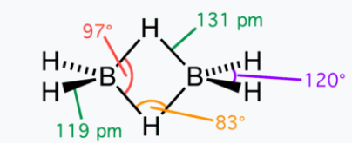
Organoboron Compounds
Organoborane or organoboron compounds are chemical compounds of boron and carbon that are organic derivatives of BH₃, for example trialkyl boranes. Organoboron chemistry or organoborane chemistry is the chemistry of these compounds
The C-B bond has low polarity (the difference in electronegativity 2.55 for carbon and 2.04 for boron), and therefore alkyl boron compounds are in general stable though easily oxidized.
In part because its lower electronegativity, boron often forms electron-deficient compounds, such as the triorganoboranes. Vinyl groups and aryl groups donate electrons and make boron less electrophilic and the C-B bond gains some double bond character.
Like the parent borane, diborane, organoboranes are classified in organic chemistry as strong electrophiles because boron is unable to gain a full octet of electrons. Unlike diborane however, most organoboranes do not form dimers.

Slide 12
BMe₃ is colorless, gaseous (b.p. -22 °C), and is monomeric. It is pyrophoric but not rapidly hydrolyzed by water. Alkylboranes can be synthesized by metathesis between BX₃ and organometallic compounds of metals with low electronegativity, such as RMgX or AlR₃.
Why dibutyl ether as a solvent: Has much lower vapor pressure than BMe₃ and as a result the separation by trap-to-trap distillation on a vacuum line is easy.
Also, there is a very weak association between BMe₃ and OBu₂ (Me₃B:OBu₂).
Although, trialkyl- and triarylboron compounds are mild Lewis acids, strong carbanion reagents lead to anions of the type [BR₄]⁻.

Slide 13
Organohaloboron compounds
Organohaloboron compounds are more reactive than simple trialkylboron compounds.
Preparation
Reactions:
(Protolysis reactions with ROH, R₂NH and other reagents)

Slide 14
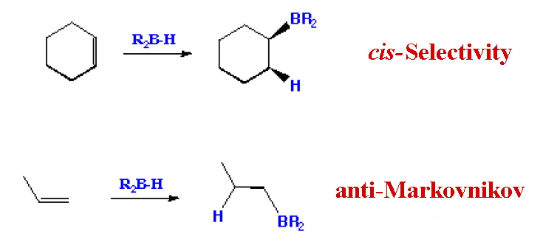
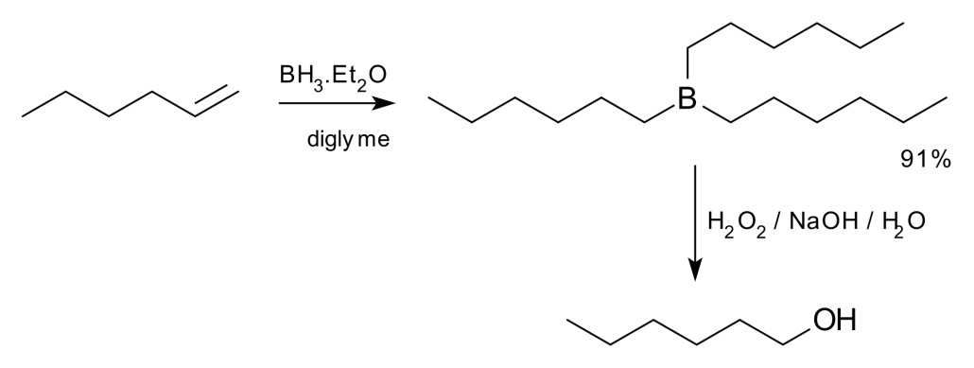
Hydroboration
The hydroboration-oxidation reaction is a two-step organic chemical reaction that converts an alkene into a neutral alcohol by the net addition of water across the double bond.
The hydrogen and hydroxyl group are added in a syn addition leading to cis stereochemistry. Hydroboration-oxidation is an anti-Markovnikov reaction, with the hydroxyl group attaching to the less-substituted carbon.
The reaction was first reported by Herbert C. Brown in the late 1950s and he received the Nobel Prize in Chemistry in 1979. Shown below is the original reaction described in 1957 where hex-1-ene is converted to hexanol.

Slide 15
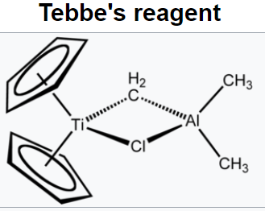
Organoaluminium compounds
Organoaluminium chemistry is the study of compounds containing bonds between carbon and aluminium bond.
The behavior of organoaluminium compounds can be understood in terms of the polarity of the C−Al bond and the high Lewis acidity of the three-coordinated species.
Industrially, these compounds are mainly used for the production of polyolefins.
With less bulky alkyl groups, dimerization occurs and one of the distinguishing features of alkyl bridge is the small Al-C-Al angle, which is ~ 75°.
It is one of the major themes within organometallic chemistry. Illustrative organoaluminium compounds are the dimer, trimethylaluminium, the monomer triisobutylaluminium, and the titanium-aluminium compound called Tebbe's reagent. C₁₃H₁₈AlClTi

Slide 16
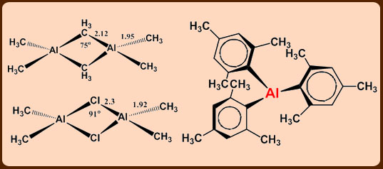
The 3c,2e bonds are very weak and tend to dissociate in the pure liquid which increases with increase in the bulkiness of the alkyl group.

Slide 17
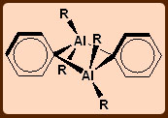
Perpendicular orientation of pheynl groups in Al₂Ph₆ Triphenylaluminium exists as a dimer with bridging η¹-phenyl groups lying in a plane perpendicular to the line joining the two Al atoms.
This structure is favored partly on steric grounds and partly by supplementation of the Al-C-Al bond by electron donation from the phenyl π-orbitals to the Al atoms.

Slide 18
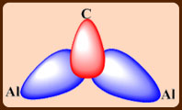
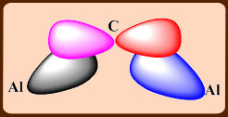
Tendency for bridging: X > Ph > alkyl
3c,2e bonds formed by a symmetric combination of Al and C orbitals
An additional interaction between the pπ orbital on C and an antisymmetric combination of Al orbitals.

Slide 19
Synthesis of Organoaluminium compounds
Laboratory scale preparations involves:
Commercial method:
Commercial method for ethylaluminium and higher homologs:
The reaction probably proceeds by the formation of a surface Al—H species that adds across the double bond of the alkene in a hydrometallation reaction.

Slide 21
Reactions
Alkylaluminum compounds are mild Lewis acids and form complexes with ethers, amines and anions. When heated, often β-hydrogen elimination is responsible for the decomposition of ethyl and higher alkylaluminium compounds. E.g. Al(^{i}C₄H₉)₃
Tendency towards bridging structure is: PR₂⁻> X⁻> H⁻> Ph⁻> R⁻
In hydrocarbon solution and in the solid state there is a tendency for R₃Al to dimerize; this is very dependent on the size of the R group, e.g. a dimer for Me but monomer for tert-butyl.
Me(t-Bu)₅Al₂ is found to be a dimer as well with the methyl group and 1 of the t-Bu groups in the bridging positions.
The bridging ability is found to be Me > Et > t-Bu and clearly the case above is not what would be predicted on purely statistical terms since there are 5 times as many t-Bu groups as Me groups and there are twice as many terminal positions as bridging positions so the methyl group might have been expected to fill a terminal position.

Slide 22
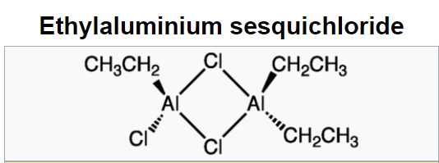
Many organoaluminium compounds are commercially available at quite reasonable prices so that is rarely necessary to have to prepare them in the laboratory.
Reaction of Al turnings with organic halides leads to the alkylaluminium sesqui-halides. The reaction is very exothermic. The sesqui-halides do not have sharp melting or boiling points because they are in fact equilibrium mixtures:
R₃Al₂X₃ sesqui-halides equilibria

Slide 23
It took almost 100 years before K. Ziegler discovered the synthetic and catalytic potential of organoaluminum compounds.
From an industrial viewpoint, the organic compounds of aluminium are probably the most important organometallic compounds.
The reasons for this include:
inexpensive synthesis from olefin + H₂ + Al (pressure).
R₃Al can dimerise olefins
higher alcohols (→ detergents) are made from R₃Al + CH₂=CH₂.
In combination with Ti and Zr compounds, R₃Al can polymerise ethylene to give polyethylene
Reactions with R₃Al proceed in hydrocarbons or even without solvent (unlike RMgX !).
Useful commercially for polymer synthesis catalysts

Slide 24
Karl Ziegler, who pioneered basic research in the field of organoaluminium compounds, developed a strikingly simple yet versatile process for the synthesis of organoaluminium compounds from inexpensive starting materials.
The Ziegler Direct Process allows the synthesis of triethylaluminium from aluminum metal, hydrogen and ethylene. The process involves the following:
2Al + 3H₂ + 6RHC=CH₂ → Al₂(CH₂CH₂R)₆ {R=H for (Et₃Al)₂}
The Ziegler-Natta polymerization catalysts were originally formed from Et₃Al with TiCl₄ and a schematic representation of the reactions at the heterogeneous surface is given below:

Slide 25
Ziegler Natta polymerisation

Slide 26
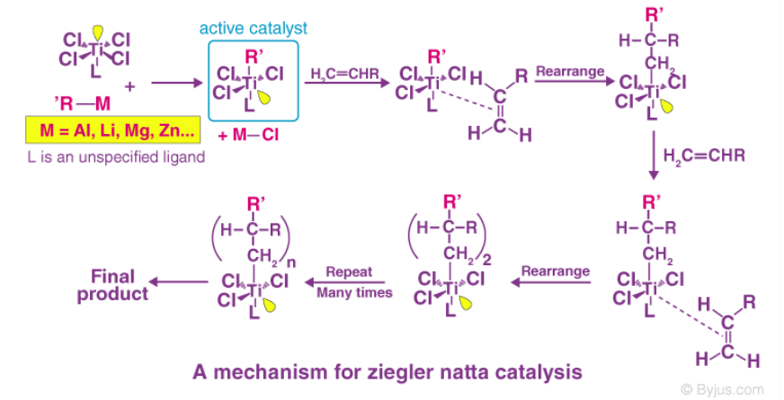

Slide 27
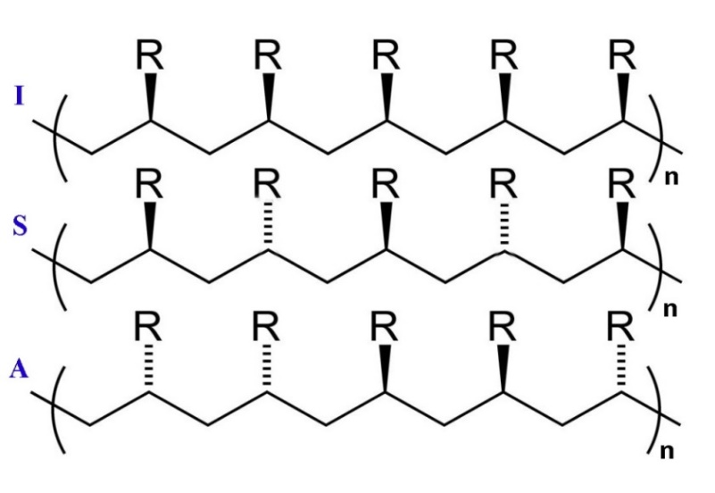
Polymerization of ethene to high-molecular mass polyethylene occurred at relatively low pressures and the polymers were stereoregular.
What this means is that isotactic polymers are formed where the R groups are all located on the same side of the carbon backbone.
The resulting product gives a crystalline material since packing is more regular. The other varieties of linear polymer are called syndiotactic and atactic and in the first the R groups are on alternate sides of the carbon backbone and in the latter they are randomly distributed
Isotactic, syndiotactic and atactic linear polymer chains

