Slide 1
Organometallic Chemistry
(CHEM 421)

Slide 2
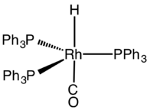
Introduction
Organometallic chemistry is the study of organometallic compounds, chemical compounds containing at least one chemical bond between a carbon atom of an organic molecule and a metal, including alkali, alkaline earth, and transition metals, and sometimes broadened to include metalloids like boron, silicon, and selenium, as well
Since many compounds without such bonds are chemically similar, an alternative may be compounds containing metal element bonds of a largely covalent character. Organometallic chemistry combines aspects of inorganic chemistry and organic chemistry.
Ferrocene
Tris(triphenylphosphine)rhodium carbonyl hydride

Slide 3
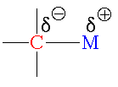
Organometallic compounds
Organometallic compounds (metal organyls, organometallics) are defined as materials which possess direct, more or less polar bonds M^{δ+}— C^{δ-} between metal and carbon atoms.
In addition to the traditional metals, lanthanides, actinides, and semimetals, elements such as boron, silicon, arsenic, and selenium are considered to form organometallic compounds, e.g. organoborane compounds such as triethylborane (Et₃B).
(Carbon always more electronegative compared to M)

Slide 4
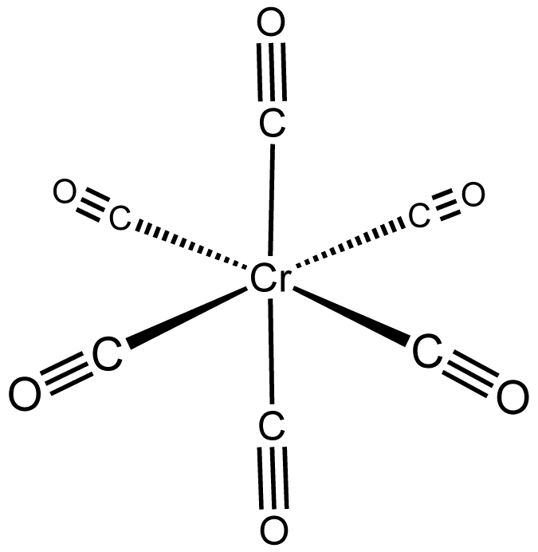
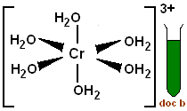
For Example
[Cr(H₂O)₆]³⁺ is a coordination complex, while Cr(CO)₆ is an organometallic compound which involve metal-carbon bond.
Both are octahedral, CO and H₂O are σ donor ligands; in addition, CO is a strong π acceptor (letter we will study about π acceptor)

Slide 5
Nomenclature of Organometallic Compounds
These compounds are named by first naming the organic group and then adding the metal name directly to the group name.
For Example
CH₃Na methylsodium
C₂H₅-Na ethylsodium
C₆H₅-Na phenylsodium
CH₃MgBr methylmagnesium bromide (This is an example of a Grignard reagent)
Compound that has a considerable ionic character names as a salt, or as for sodium naphthalide Na[C₁₀H₈].

Slide 6
Nomenclature of Organometallic Compounds
η^{n} (eta):
The term η is used to describe if the ligands can bind through more than one carbon atom (n), which is helpful to express the coordination mode of a ligand. If n = 1 then no need to write the 1 down.
μ_{n} (mu):
The term μ is used to describe the ligands that bridge more than one metal centre (n). If n = 1 then the ligand is not bridging! If n = 2 then we don’t need to write the 2 down.
6

Slide 7
Classification based on the nature of Metal-Carbon bond
There are four types of organometallic compounds based on the nature of M-C bond as below:
Ionic - with most Group 1 elements
Covalent - with many Group 12, 13, 14 and 15 elements
Electron deficient - with Li, Be, Mg, B, Al
Transition metal organometallic compounds
The below tables representing the type of organometallic compounds:

Slide 8
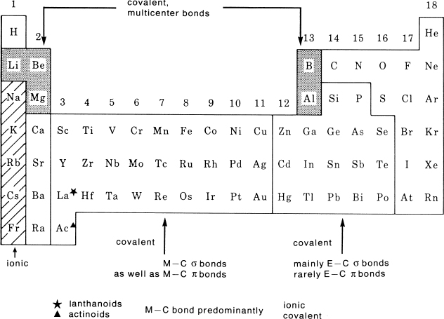

Slide 9
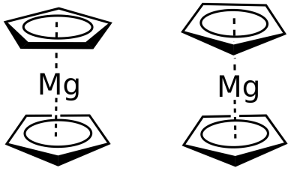
Ionic
Ionic organometallic compounds are generally formed from elements such as sodium, potassium etc. where the metals are considered electropositive.
If the organic groups are able to delocalise the negative charge over several carbon atoms then less electropositive elements like magnesium can also form ionic compounds, eg Cp₂Mg.
In this case the charge is considered to be delocalize over each of the five carbon atoms in each ring.
Cp₂Mg
Covalent
The simplest model of the M-C bond is where it consists of essentially a single covalent 2-electron bond. These compounds are often volatile and are comparable to typical organic compounds being soluble in organic solvents. For example of the covalent bonded organometallic compound is CH₃MgBr.

Slide 10
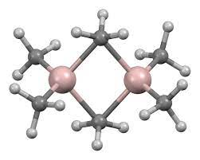
Electron deficient
Electron deficient organometallic compounds are generally associated with elements that have less than half-filled valence shells and are designated as such because of an insufficient number of valence electrons to allow all the atoms to be linked by traditional two-electron two-centre bonds.
The compounds often have bridged or polymeric structures. The methyl derivatives of Li, Be and Al are found to be 3-D polymers, linear chains and dimeric respectively and despite the increase in RMM of the monomeric unit there is actually an increase in volatility.
Compound | RMM of monomeric unit | Structure | Volatility
LiMe | 21.96 | 3D-polymer | infusible
BeMe₂ | 39.08 | Linear chain | sublimes at 473 K
AlMe₃ | 72.08 | Dimer | Melts at 288 K

Slide 11
π-Bonding
This is common with transition metals and zero-valent Lanthanides.
Ferrocene
bis-benzene chromium
bis-(1,3,5-Bu^{t}₃C₆H₃)-gadolinium

Slide 12
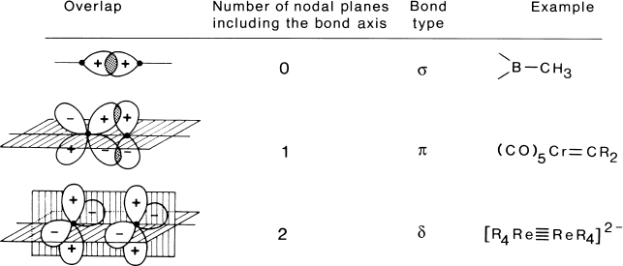
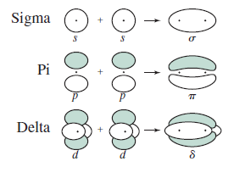
The designations σ, π, and δ bond are defined as follows:

Slide 13
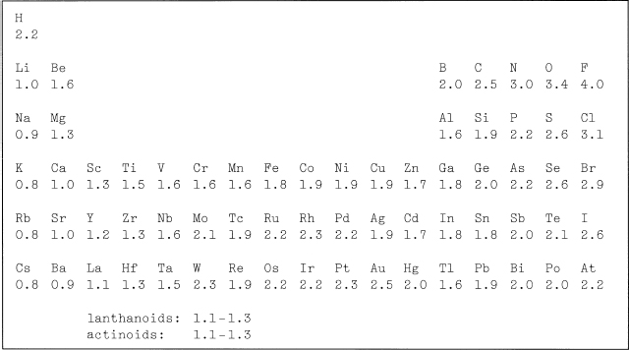
To evaluate the polarity of a bond, the electronegativity difference between the neighboring atoms is usually employed. The electronegativity values in the table below are based on the Pauling thermochemical method of determantion
Electronegativity values according to Pauling

Slide 14
Stability of Organometallic Compounds
The stability of organometallic compounds depend on the nature of the metal and organic ligand to which they are attached. The thermal stability generally decrease down a Group. This trend in stability is a consequence in part of the decrease in the bond strength of M-C going down within a group, except the d-block group which the stability and M-C bond strength increase going down a group.
Kinetic Stability
Calculations of free energy would suggest that many organometallic compounds should be unstable. However, kinetic stability needs to be considered as well since if there is no low activation energy pathway for a reaction to proceed then it may be very slow.

Slide 15
Stability to Oxidation
All organometallic compounds are expected to be thermodynamically unstable with respect to oxidation to give metal oxide, carbon dioxide and water. Some are spectacularly; so, being highly pyrophoric. In general organometallic compounds need to be handled under dry nitrogen or some other inert gas to avoid oxidation.
Stability to Hydrolysis
Hydrolysis of organometallic compounds often involves nucleophilic attack by water which is accentuated when there are low-lying empty orbitals on the metal atom. This is seen for Groups I, II and for Zn, Cd, Al, Ga etc and the speed of hydrolysis is dependent on the M-C bond polarity. For "Me₃Al" rapid attack occurs whereas Me₃B is unaffected at room temperature.

