Slide 1
Medical Genetics 453 CLS
May Alrashed, PhD

Slide 2
The cell

Slide 3
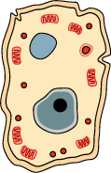
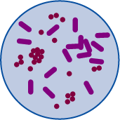
Eukaryotes vs. Prokaryotes
Eukaryotes (animals, plants, fungi, protists).
prokaryotes (bacteria) differ greatly in structure.

Slide 4
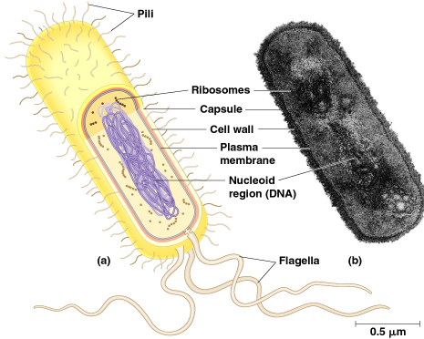
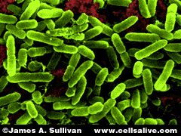
Prokaryotic Cell

Slide 5
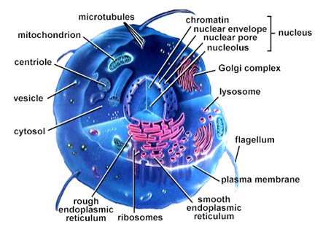
Eukaryotic Cell
Eukaryotes are generally more advanced than prokaryotes

Slide 6
Eukaryotic Cell
Eukaryotic cells are found in animals, plants, fungi and protists cell;
Cell with a true nucleus, where the genetic material is surrounded by a membrane;
Eukaryotic genome is more complex than that of prokaryotes and distributed among multiple chromosomes;
Eukaryotic DNA is linear;
Eukaryotic DNA is complexed with proteins called histones;
Numerous membrane-bound organelles;
Complex internal structure;
Cell division by mitosis.

Slide 7
Prokaryotic Cell
Unicellular organisms, found in all environments. These include bacteria and archaea;
Without a nucleus; no nuclear membrane (genetic material dispersed throughout cytoplasm;
No membrane-bound organelles;
Cell contains only one circular DNA molecule contained in the cytoplasm;
DNA is naked (no histone);
Simple internal structure
Cell division by simple binary fission.

Slide 9
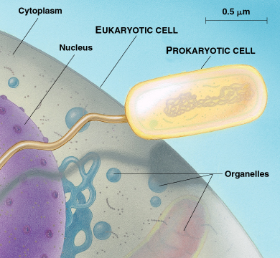
Structural Organization of Eukaryotic and Prokaryotic Cells

Slide 10
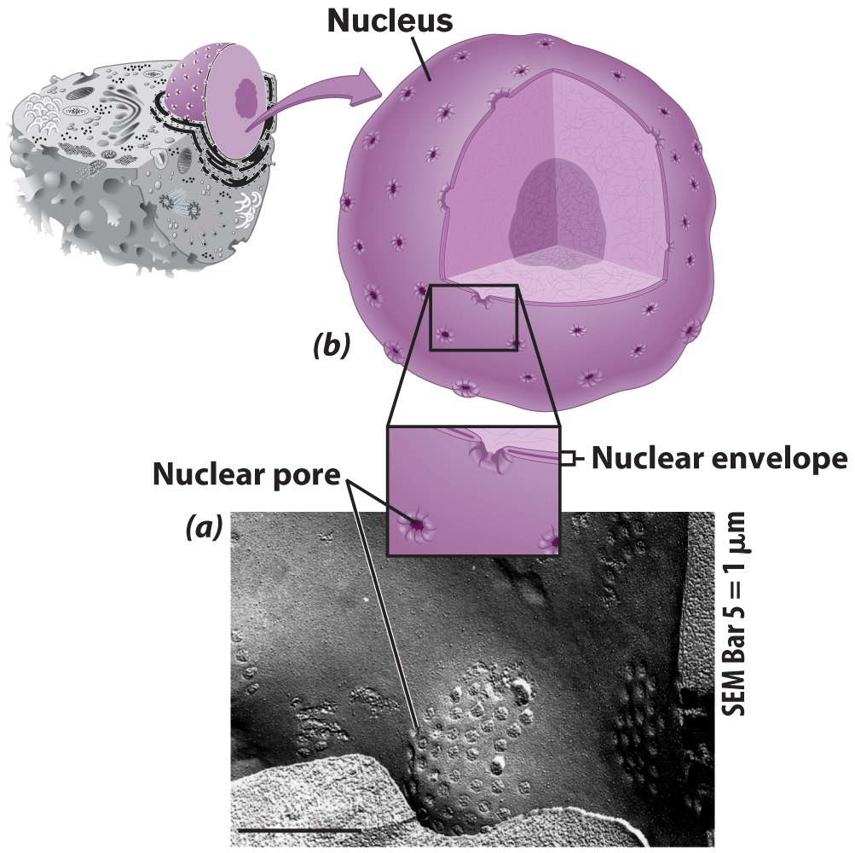
Nucleus
Control center of cell
Double membrane
Contains
Chromosomes
Nucleolus

Slide 11
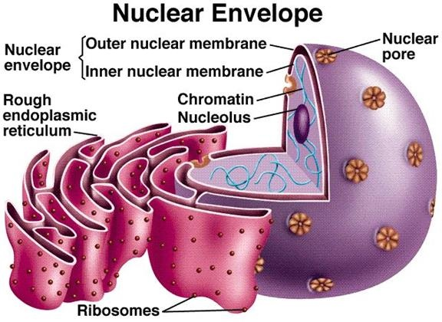
Components of Nucleus
Nuclear Envelope – pore riddled
Nucleoplasm – Fluid interior portion
Nucleolus – Dense cluster of RNA & Proteins – ribosomes
Chromatin – all DNA + Proteins
Adapted from http://biology4isc.weebly.com/nucleus.html

Slide 12
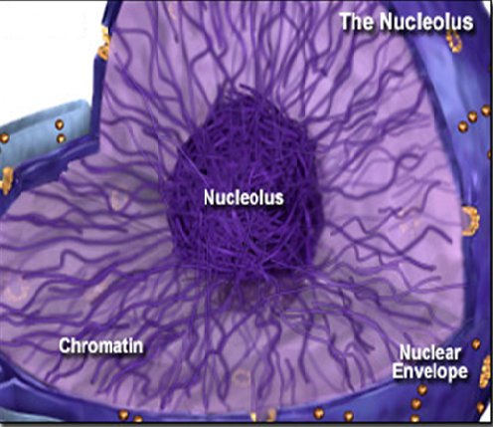
Nucleolus
Spherical body in all eukaryotic cells that disappear during cell division.
Associated with specific region in the chromosomes – called nucleolar organising region.
The size of the nucleolus is associated with synthetic activity of the cell. Functions: a)Synthesis of r-RNA. b)It helps in formation of ribosome subunits. c)Play an important role in cell division.

Slide 13
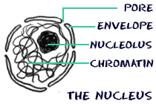
Chromatin & Chromosome
Nucleus contains thread like structures- chromatin
Chromatin A mass of genetic material composed of DNA and proteins that condense to form chromosomes.
Chromosome Is an organized structure of DNA and protein that is found in cells.
Chromatid Is the daughter strand of a duplicated chromosome that is joined by a single centromere.

Slide 14
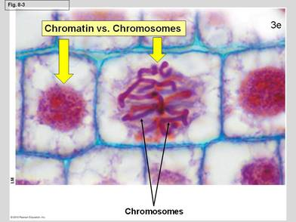
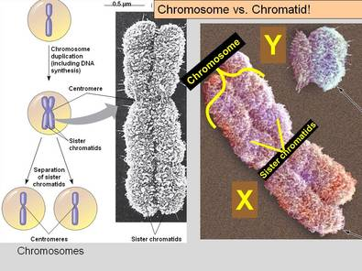

Slide 15
Chemical composition of Chromosome
Eukaryotic chromosomes: two broad components.
Nucleic acids: - DNA (primary nucleic acid) + small amt of RNA (transit to the cytoplasm)
Proteins:
Histones (basic pH) – core histones (H2A, H2B, H3 & H4), Linker histone (H1)
Non Histone proteins

Slide 16
Histones bind to negatively charged DNA – stability to the DNA •
Mixture of DNA & proteins – basic structural unit of chromosomes - chromatin fiber •
E/M examination of interphase chromatin – ellipsoidal beads joined by linker DNA known as Nucleosomes.

Slide 17
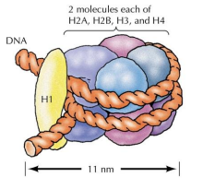
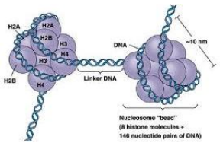
Nucleosome
Simplest packing of DNA strands
146 bp DNA wrapped around histone octamer
Octamer = 2 copies of 4 core histones
DNA length varies b/w species
Core DNA – DNA associated with histone octamer
Linker DNA – DNA b/w histone octamer – 8 to 114 bp

Slide 18
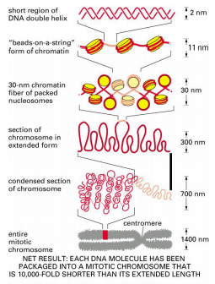
Model of packing of chromatin and the chromosome scaffold in metaphase chromosome

