Slide 1
Medical Genetics 453 CLS
May Alrashed, PhD

Slide 2
DNA structure and function

Slide 3
What is a chromosome?
Chromosome
Structure made of DNA and associated proteins
Carries part or all of a cell’s genetic information
A human body cell has 23 pairs of chromosomes
Diploid
Cells having two of each type of chromosome characteristic of the species (2n).

Slide 4
Types of Chromosomes
There are two types of eukaryotic chromosomes: autosomes and sex chromosomes
Autosomes
Paired chromosomes with the same length, shape, centromere location, and genes
Any chromosome other than a sex chromosome (Human- 22 pair)
Sex chromosomes
a pair of chromosomes that differ between males and females (XX or XY)

Slide 5
Chromosome Structure
Proteins organize DNA structurally
Allow chromosomes to pack tightly
Histone
Type of protein that structurally organizes eukaryotic chromosomes
Nucleosome
A length of DNA wound around a coil of histone proteins

Slide 6
Structure of a chromosome
Sister chromatid
One of two attached members of a duplicated eukaryotic chromosome
Centromere
Constricted region in a eukaryotic chromosome where sister chromatids are attached

Slide 7
DNA Structure
DNA consists of two molecules that are arranged into a ladder-like structure called a Double Helix.
A molecule of DNA is made up of millions of tiny subunits called Nucleotides.
Each nucleotide consists of:
Phosphate group
Pentose sugar
Nitrogenous base

Slide 8
Nucleotides
Phosphate
Nitrogenous
Base
Pentose
Sugar

Slide 9
Nucleotides
The phosphate and sugar form the backbone of the DNA molecule, whereas the bases form the “rungs”.

Slide 10
Nucleotides
There are four types of nitrogenous bases.
A
T
Adenine
Thymine
C
G
Cytosine
Guanine

Slide 11
Nucleotides
Each base will only bond with one other specific base.
Adenine (A)
Thymine (T)
Cytosine (C)
Guanine (G)
Because of this complementary base pairing, the order of the bases in one strand determines the order of the bases in the other strand.
Form a base pair.
Form a base pair.

Slide 12
A
T
C
G
T
A
C
G
A
T
G
C
T
A

Slide 13
DNA Structure
To crack the genetic code found in DNA we need to look at the sequence of bases.
The bases are arranged in triplets called codons.
A G G - C T C - A A G - T C C - T A G
T C C - G A G - T T C - A G G - A T C

Slide 14
DNA Structure
A gene is a section of DNA that codes for a protein.
Each unique gene has a unique sequence of bases.
This unique sequence of bases will code for the production of a unique protein.
It is these proteins and combination of proteins that give us a unique phenotype.

Slide 15
DNA
Gene
Protein
Trait

Slide 16
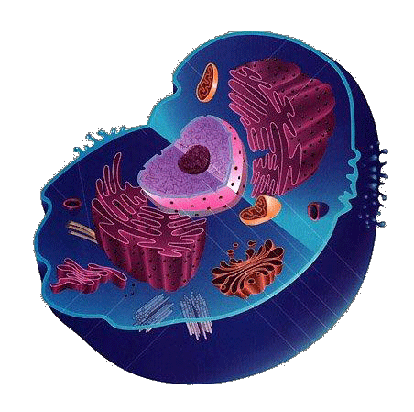
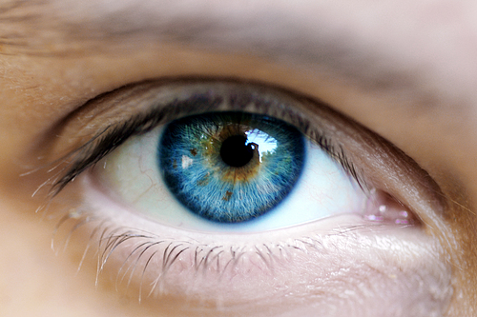
Your Task
Draw a flow chart to show how to get from:

Slide 17
DNA Replication and Repair
During DNA replication, the double-helix unwinds
DNA polymerase uses each strand as a template to assemble new, complementary strands of DNA from free nucleotides
DNA ligase (enzyme) seals any gaps to form a continuous strand

Slide 18
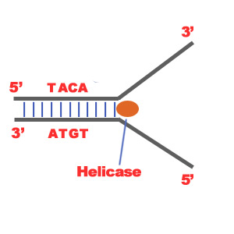
Steps of DNA Replication
1. First step is the breaking of hydrogen bonds between bases of the two antiparallel strands.
Helicase is the enzyme that splits the two strands.
The initiation point where the splitting starts is called "origin of replication".
The structure that is created is known as "Replication Fork".

Slide 19
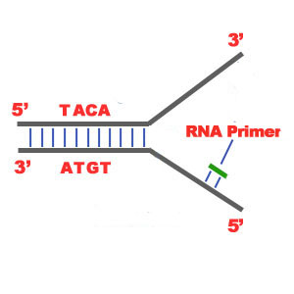
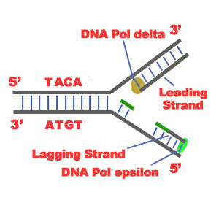
2. binding of RNA Primase in the the initiation point of the 3'-5' parent chain. RNA Primase can attract RNA nucleotides which bind to the DNA nucleotides of the 3'-5' strand due to the hydrogen bonds between the bases.
3. The elongation process is different for the 5'-3' and 3'-5' template.
a)5'-3' Template: The 3'-5' proceeding daughter strand that uses a 5'-3' template is called leading strand because DNA Polymerase ä can "read" the template and continuously adds nucleotides
b)3'-5'Template: The 3'-5' template cannot be "read" by DNA Polymerase ä. The replication of this template is complicated and the new strand is called lagging strand. In the lagging strand the RNA Primase adds more RNA Primers.

Slide 20
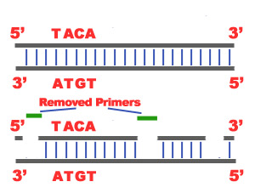
In the lagging strand the DNA Pol I -exonuclease- reads the fragments and removes the RNA Primers. The gaps are closed with the action of DNA Polymerase.
Each new double helix is consisted of one old and one new chain. so it is called semiconservative replication.

Slide 21
The last step of Replication is the Termination.
- the DNA Polymerase reaches the end of the strands. In the lagging strand, when the RNA primer is removed, it is not possible for the DNA Polymerase to seal the gap (because there is no primer). So, the end of the parental strand where the last primer binds isn't replicated. These ends of linear (chromosomal) DNA consists of noncoding DNA that contains repeat sequences and are called telomeres. As a result, a part of the telomere is removed in every cycle of DNA Replication.

Slide 22
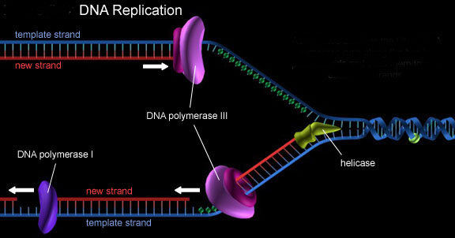
Mechanism of Replication

Slide 23
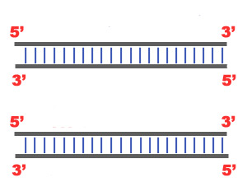
DNA Repair mechanism
Repair mechanism fixes possible errors caused during the replication. Enzymes like nucleases remove the wrong nucleotides and the DNA Polymerase fills the gaps.

