Slide 1
King Saud University College of Engineering IE – 462: “Industrial Information Systems” Fall – 2018 (1st Sem. 1439-40H)
Chapter 3
Data Modeling and Design – p2 – E-R Diagram
Prepared by: Ahmed M. El-Sherbeeny, PhD

Slide 2
Lesson Overview
Introduction – (p1)
E-R Diagram – (p2)
Case Studies – (p3)

Slide 3
Lesson Overview
E-R Diagram – (part-i)
Introduction to E-R Modeling
Entities
Attributes
Candidate Keys and Identifiers
Other Attribute Types
Relationships

Slide 4
Lesson Overview
E-R Diagram – (part-ii)
Conceptual Data Modeling and the E-R Model
Degree of a Relationship
Unary Relationships
Binary Relationships
Ternary Relationships
Cardinalities in Relationships
Minimum and Maximum Cardinalities
Naming and Defining Relationships
Associative Entities
Summary

Slide 5
Lesson Overview
E-R Diagram – (part-ii)
Supertypes and Subtypes
Business Rules

Slide 6
INTRODUCTION TO E-R MODELING

Slide 7
Introduction to E-R Modeling
Purpose of E-R modeling is to design a conceptual schema (model) of entities and their relationships for an organization/business
Entity-relationship data model (E-R model): detailed, logical representation of:
data entities
relationships, and
attributes; they represent properties of both the entities and their relationships

Slide 8
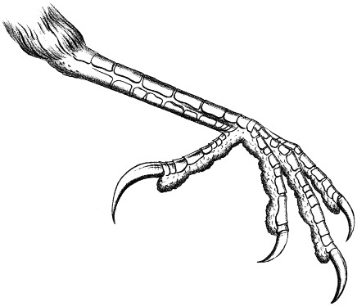
Introduction to E-R Modeling
Entity-relationship diagram (ERD):
graphical representation of an E-R model
utilizes several notations to show data in terms of the entities and relationships described by that data
notation mostly uses “crow’s foot” symbols
places data attribute names within entity rectangles
see next 2 slides for notations, which will be explained in detail in following sections
Notes:
Note, crow’s foot notation is used by many E-R drawing tools, including Microsoft Visio®

Slide 9
Sample E-R Diagram
Notes:
Note how this standard uses two verb phrases for a relationship name

Slide 10
Basic E-R Notation

Slide 11
Gathering Info. for Conceptual Data Modeling

Slide 12
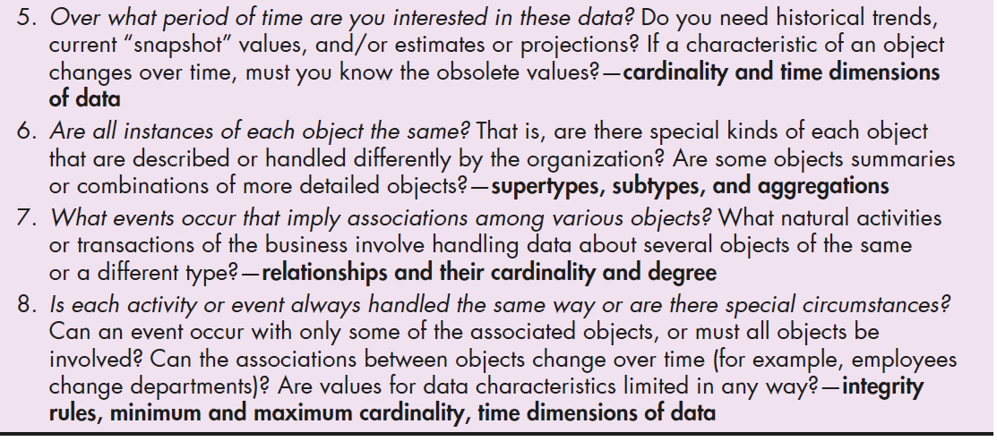
Gathering Info. for Conceptual Data Modeling

Slide 13
Entities

Slide 14
Entities
Entity:
Class of persons, places, objects, events, or concepts for which the organization wishes to maintain data
Represented by Q1 in Table 8-1
Each entity must have a unique identity that distinguishes it from each other entity

Slide 15
Entities
Examples of Entities (cont.):
Persons: agency, contractor, customer, department, division, employee, instructor, student, supplier
Places: sales region, building, room, branch office, campus, store, warehouse, state, shop floor
Objects: book, machine, part, product, raw material, software license, software package, tool, vehicle model
Events: application, award, cancellation, class, flight, order, registration, renewal, requisition, reservation, sale, trip, assignment
Concepts: account, block of time, bond, course, fund, qualification, stock, work center
Notes:
Note, for events: Event entity types should be named for the result of the event, not the activity or process of the event. e.g. the event of a project manager assigning an employee to work on a project results in an ASSIGNMENT

Slide 16
Entities
Entity Types vs. Entity Instances:
Important to distinguish between entity types and entity instances
Entity type (aka entity class or –simply– entity):
collection of entities that share common properties/characteristics
each entity type in an E-R model is given a name
name is placed inside a rectangle representing the entity
each entity is described just once in a data model
Notes:
Teaching Notes:
Prompt the students for additional examples. Have them classify their example(s).
Obtain a data model from a source other than the textbook. Ask the students to classify the entities.

Slide 17
Entities
Entity Types vs. Entity Instances (cont.):
Entity instance (aka instance):
a single occurrence of an entity
many instances of an entity type may be represented by data stored in the database
entity
Student ID | Last Name | First Name
2144 | Arnold | Betty
3122 | Taylor | John
3843 | Simmons | Lisa
9844 | Macy | Bill
2837 | Leath | Heather
2293 | Wrench | Tim
instance
Notes:
Teaching Notes
Substitute the name(s) of one or more of your students.
Be sure to explain that these are “instances” and that instances do NOT appear in the names of entity symbols.

Slide 18
Entities
Common Mistakes with Data Entities:
Many people confuse
data entities with sources/sinks or system outputs,
relationships with data flows
Avoid this problem with a simple rule:
true data entity will have many possible instances,
each instance has a distinguishing characteristic
Example below, “sorority expense system”:
do we need to keep track of data about the treasurer?
Notes:
Sorority: ناد لفتيات الجامعة; Answer to Q above is: No! Because there is only one treasurer; TREASURER data do not need to be kept

Slide 19
Entities
Naming Entity Types:
Should use all capital letters
e.g. EMPLOYEE
Should be named by a singular noun
e.g. CUSTOMER, STUDENT, or AUTOMOBILE
Use simple, concise nouns
e.g. use REGISTRATION instead of STUDENT REGISTRATION FOR CLASS
Name should be descriptive/specific to company
e.g. instead of just using ORDER, use PURCHASE ORDER (to distinguish between it and CUSTOMER ORDER)
Notes:
i.e. for last example here, a PURCHASE ORDER is used for orders placed with suppliers should be distinct from CUSTOMER ORDER for orders placed by customers

Slide 20
Attributes

Slide 21
Attributes
Attribute:
A named property or characteristic of an entity that is of interest to the organization
Represented by Q3 in Table 8-1
Some typical entity types and associated attributes:
STUDENT: Student_ID, Student_Name, Home_Address, Phone_Number, Major
AUTOMOBILE: Vehicle_ID, Color, Weight, Horsepower
EMPLOYEE: Employee_ID, Employee_Name, Payroll_Address, Skill
Notes:
Note, we will also later see that relationships may also have attributes

Slide 22
Attributes
Naming Attributes:
Use initial capital letter, followed by lowercase letters
Use nouns for names; e.g. Age
Use underscores to separate words (optional); e.g. Customer_ID, Product_Minimum_Price
Attribute name should be unique:
no 2 attributes of same entity type may have the same name
preferable no two attributes have the same name (i.e. across all entity types)
Follow a standard format for naming attributes:
e.g. using Student_GPA as opposed to GPA_of_Student
Notes:
Again, notation used here is similar to that used by many CASE and E-R drawing tools, such as Microsoft Visio
Note, Similar attributes of different entity types should use similar but distinguishing names; for example, the city of residence for faculty and students should be, respectively, Faculty_Residence_City_Name and Student_Residence_City_Name

Slide 23
Attributes
Using Attributes in E-R Diagram:
Place the name inside the rectangle for associated entity
We use different notations to distinguish between different types of attributes (to be discussed next)
Notes:
Again, notation used here is similar to that used by many CASE and E-R drawing tools, such as Microsoft Visio

Slide 24
Candidate Keys and Identifiers

Slide 25
Candidate Keys and Identifiers
Candidate Key (aka Primary key):
It’s an attribute (or combination of attributes) that uniquely identifies each instance of an entity type
Represented by Q2 in Table 8-1
e.g. candidate key for a STUDENT entity type might be Student_ID

Slide 26
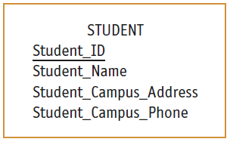
Candidate Keys and Identifiers
Identifiers:
Some entities may have > 1 possible candidate key; e.g. for EMPLOYEE data entity:
possible candidate key: Employee_ID
another possible candidate key: Employee_Name and Address (assuming no two employees with the same name live at the same address)
designer must choose one of the candidate keys as identifier thus:
Identifier: candidate key that has been selected as the unique, identifying characteristic for entity type
it is represented by placing a solid underline below identifier
Notes:
Can you see how that may happen “two employees with the same name live at the same address”? (e.g. two cousins with same name living at the same large house)

Slide 27
Candidate Keys and Identifiers
Criteria for Selecting Identifiers:
Choose a candidate key that will not change its value over life of each instance of the entity type
e.g. don’t pick identifier for EMPLOYEE: combination of Employee_Name and Payroll_Address
Choose candidate key so that, for each instance of the entity, the attribute is guaranteed to have:
valid values and
not be ‘null’ (note, special controls in data entry can eliminate possibility of errors, e.g. use of ‘*’)

Slide 28
Candidate Keys and Identifiers
Criteria for Selecting Identifiers (cont.):
Avoid so-called “intelligent identifiers”
e.g. first 2 digits of a key for a PART entity may indicate the warehouse location
note that such codes are often modified, and this would make primary key values invalid
Example here:
representation for a STUDENT entity type using E-R notation
STUDENT has:
a simple identifier, Student_ID, and
3 other simple attributes

Slide 29
Other Attribute Types

Slide 30
Other Attribute Types
Single-valued attribute:
attribute that may take one entry in each instance of that attribute
e.g. there is only 1 employee ID number to be entered in each instance of the attribute Employee_ID
Multi-valued attribute:
an attribute that may take on > 1 value for each entity instance
e.g. Skill is a multivalued attribute (since each employee can have > 1 skill)
special symbol indicates that it is multivalued: { }
Notes:
{: ‘curly brackets’

Slide 31
Other Attribute Types
Repeating group:
A set of two or more multi-valued attributes that are logically related
e.g. employee entity with multivalued attributes for data about each employee’s dependents:
data includes: dependent name, age, and relation to employee
dependents: spouse, child, parent, etc.
data are multivalued attributes about employee
we show this by using one set of curly brackets around the data that repeats together
we call this a repeating group

Slide 32
Other Attribute Types
Weak entity:
Second approach to representing a repeating group:
consider dependents as entities
we separate the repeating data into another entity, called a weak (or attributive) entity
weak entity is designated by:
rectangle with a double line border and
relationship to link the weak entity to its associated regular entity (using double line)

Slide 33
Other Attribute Types
Weak entity (cont.):
Examine example below:
use a weak entity, DEPENDENT
establish relationship between DEPENDENT and EMPLOYEE
crow’s foot next to DEPENDENT: there may be many DEPENDENTs for the same EMPLOYEE
identifier of DEPENDENT: dependent’s name + ID of the employee, or use a double underline for Dep_Name to designate it as a partial identifier
Notes:
show Dep_Name in the weak entity and use a double underline to designate it as a partial identifier

Slide 34
Weak and Strong Entities
E-R diagram uses a box to represent an entity set (PURCHASE_ORDER, PO_DETAIL, and VENDOR)
E-R diagrams distinguish between weak and strong entities
entity is weak if its existence is dependent on the existence of another entity
e.g. of this occurs in the case of PO_DETAIL: PO_DETAIL is dependent on the existence of PURCHASE_ORDER

Slide 35
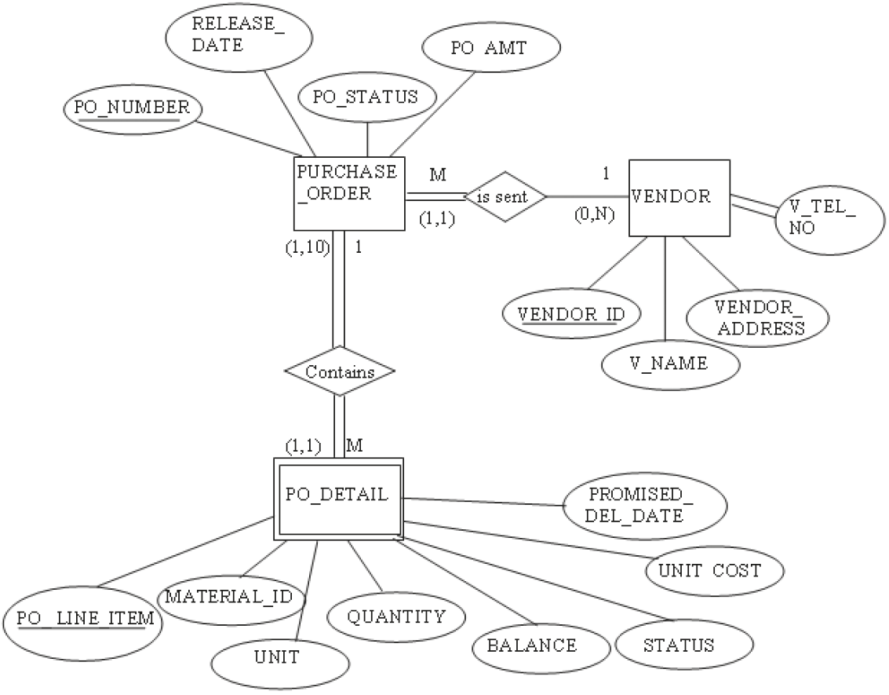
Weak and Strong Entities
Notes:
Obtained from course textbook: Modern Systems Analysis and Design. Joseph S. Valacich and Joey F. George. Pearson. Eighth Ed. 2017. Chapter 8.

Slide 36
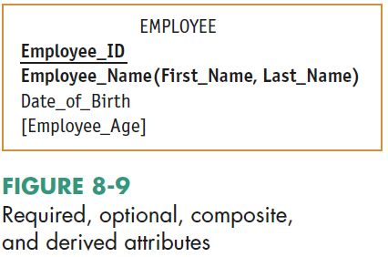
Other Attribute Types
Required attribute: an attribute that must have a value for every entity instance
shown in bold letters (list!)
Optional attribute: an attribute that may not have a value for every entity instance
shown in normal letters (list!)
Notes:
Answers:
- required attributes: Employee_ID, Employee_Name
- optional attributes: Date_of_Birth, Employee_Age

Slide 37
Other Attribute Types
Composite attribute: an attribute that has meaningful component parts
e.g. Name or Address
components are shown between brackets ( ) (list!)
Derived attribute: an attribute whose value can be computed from related attribute values
shown inside square brackets: [ ] (list!)
Notations for each attributes type is shown below
Notes:
Answers:
- composite attribute: Employee_Name
- derived attribute: Employee_Age since it can be computed from today’s date and Date_of_Birth

Slide 38
Relationships

Slide 39
Relationships
Relationship:
It is association between the instances of one or more entity types that is of interest to the organization
It is the ‘glue’ that holds together the various components of an E-R model
Represented by Questions 5, 7, and 8 in Table 8-1
Labeled with verb phrases since usually means that an event has occurred
Note, some standards use two verb phrases for a relationship name (so it can be read in two directions), while some only use one verb phrase
Notes:
Note, you should be able to work with either standard

Slide 40
Relationships
Relationship (cont.):
Consider example shown on next slide:
training department in a company wants to track which training courses employees have completed
this leads to a relationship called Completes between the EMPLOYEE and COURSE entity types
this is a many-to-many relationship:
each employee may complete >1 course
each course may be completed by >1 employee
we can use Completes relationship to determine:
courses a given employee has completed
identity of each employee who has completed a particular course

Slide 41
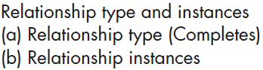
Notes:
Q: Melton has completed what course?; A: three courses (C++, COBOL, and Perl)
Q: SQL course has been completed by who?; A: Celko and Gosling

Slide 42
Videos to Watch
Entity Relationship Diagram (ERD) Tutorial - Part 1 https://youtu.be/QpdhBUYk7Kk
Entity Relationship Diagram (ERD) Tutorial - Part 2 https://youtu.be/-CuY5ADwn24
Entity-Relationship Diagrams (another system) https://youtu.be/c0_9Y8QAstg
Entity Relationship Diagram (ERD) Training Video https://youtu.be/-fQ-bRllhXc
Notes:
Last video is a detailed video and contains exercises on ERD’s

Slide 43
Sources
“Chapter 3: Database Modeling and Design”; Slides by Dr. Sabeur Kosantini (2017)
“Types of Database Management Systems” (2017) by Arjun Panwar, c-sharpcorner.com; Available at: https://www.c/sharpcorner.com/UploadFile/65fc13/types-of-database-management-systems/
Modern Systems Analysis and Design. Joseph S. Valacich and Joey F. George. Pearson. Eighth Ed. 2017. Chapter 8.
Design of Industrial Information Systems. Thomas Boucher, and Ali Yalcin. Academic Press. First Ed. 2006. Chapter 3.

