Slide 1
Boolean Algebra and Digital Logic

Slide 2
Lecture Overview
Boolean Algebra
Boolean Algebra is an algebra for the manipulation of objects that can take only one of two values, typically true or false.
Topics:
Boolean expressions
Complements
Simplification (reduction) of Boolean (Kmaps)
Functions Representing - Boolean functions

Slide 3
Lecture Overview
Logic Gates
Symbols for logic gates
Universal gates
Multiple-inputs gates
Digital Components
Digital circuits and Boolean algebra
Integrated circuits
Combinational Circuits
Typical combinational circuits
Adder (half adder, full adder, ripple carry adder)
Decoder
Multiplexer
Sequential Circuits
Clocks
Flip-Flops
Typical sequential circuits
Register
Counter

Slide 4
Boolean Expressions (1/5)
Boolean Algebra
Boolean variable: is a variable that can take only one of two values : 0 (false) or 1 (true).
Example: x, y, z, … where, for instance, “x” could be 0 or 1
Boolean expression: is a combination of Boolean variables and operators (AND, OR, NOT, …).
Example: x AND y, x OR y, …
Boolean function: typically has one or more input values and yields a result in the range {0,1}, based on these input values.
Example: F(x, y, z) = (x AND y) OR z

Slide 5
Boolean Expressions (2/5)
Boolean Algebra

Slide 6
Boolean Expressions (3/5)
Boolean Algebra
A Boolean operator can be described using a “truth table” that lists:
The inputs, with all the possible values of inputs
The resulting values of the operations for all possible combinations of these inputs
A Boolean function can also be described using a truth table.

Slide 7
Boolean Expressions (4/5)
Boolean Algebra
The truth table for AND
The truth table for OR
Inputs |  | Outputs
x | y | xy
0 | 0 | 0
0 | 1 | 0
1 | 0 | 0
1 | 1 | 1
Inputs |  | Outputs
x | y | x + y
0 | 0 | 0
0 | 1 | 1
1 | 0 | 1
1 | 1 | 1
The truth table for NOT
Inputs | Outputs
x | $$\overline{x }$$
0 | 1
1 | 0

Slide 8
Boolean Expressions (5/5)
Boolean Algebra

Slide 9
Complement (1/4)
Boolean Algebra

Slide 10
Complement (2/4)
Boolean Algebra

Slide 11
Complement (3/4)
Boolean Algebra

Slide 12
Complement (4/4)
Boolean Algebra

Slide 13
Boolean Simplifications
Boolean Algebra
Frequently, a Boolean expression is not in its simplest form
Recall from algebra that the expression
2x + 6x can be simplified to 8x
Boolean expressions can also be simplified
Two methods for simplification:
Using Boolean algebra identities (covered in other modules)
Using Karnaugh maps (these are dealt with in what follows)
This section presents an easy, systematic graphical method for visualizing and reducing Boolean expressions – Karnaugh Map or Kmap.

Slide 14
Kmaps and Terminology
Simplification of Boolean Functions
A Kmap is a matrix consisting of rows and columns that represent the output values of a Boolean function.
The output values placed in each cell are derived from the minterms of a Boolean function.
A minterm is a product term that contains all of the function’s variables exactly once, whether complemented or not complemented.
For example, the minterms for a function having the inputs x and y are:

Slide 15
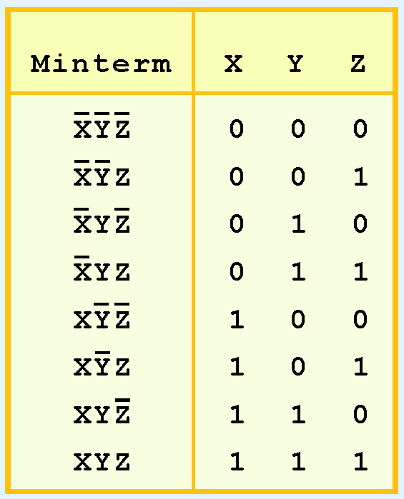
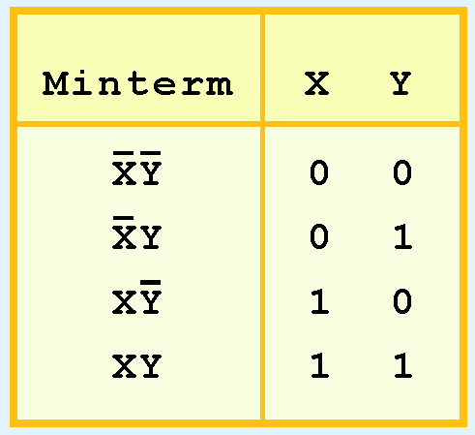
Kmaps and Terminology - Minterm
Simplification of Boolean Functions
Consider the Boolean function
Its minterms are:
Similarly, a function having three inputs, X, Y, Z, has the minterms:

Slide 16
Description of Kmaps
Simplification of Boolean Functions

Slide 17
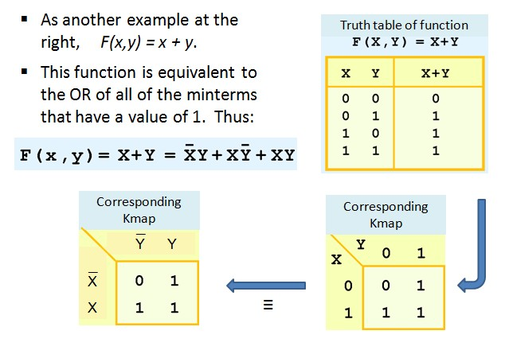
Description of Kmaps - Example
Simplification of Boolean Functions

Slide 18
Kmap Simplification for Two Variables (1/2)
Simplification of Boolean Functions

Slide 19
Kmap Simplification for Two Variables (2/2)
Simplification of Boolean Functions

Slide 20
Rules for Kmap Simplification
Simplification of Boolean Functions
The rules of Kmap simplification are:
Groupings can contain only 1s; no 0s.
Groups can be formed only at right angles; diagonal groups are not allowed.
The number of 1s in a group must be a power of 2 – even if it contains a single 1.
The groups must be made as large as possible.
Groups may overlap and wrap around the sides of the Kmap.
Use don’t care conditions when you can.

Slide 21
Kmap Simplification for Three Variables (1/6)
Simplification of Boolean Functions

Slide 22
Kmap Simplification for Three Variables (2/6)
Simplification of Boolean Functions

Slide 23
Kmap Simplification for Three Variables (3/6)
Simplification of Boolean Functions

Slide 24
Kmap Simplification for Three Variables (4/6)
Simplification of Boolean Functions

Slide 25
Kmap Simplification for Three Variables (5/6)
Simplification of Boolean Functions

Slide 26
Kmap Simplification for Three Variables – (6/6)
Simplification of Boolean Functions

Slide 27
Kmap Simplification for Four Variables
Simplification of Boolean Functions

Slide 28
Representing Boolean Functions (1/5)
Boolean Algebra
Two expressions that can be represented by the same truth table are considered logically equivalent.
In fact, there are an infinite number of Boolean expressions that are logically equivalent to one another.
To help eliminate potential confusion, logic canonical, or standardized, forms of Boolean functions are used:
The sum-of-products
The product-of-sums

Slide 29
Representing Boolean Functions (2/5)
Boolean Algebra
The sum-of-products: consists of ANDed variables (product terms) that are ORed together
Example: F₁(x,y,z) = xy + y$\overline{z}$ + xyz
The product-of-sums: consist of ORed variables (sum terms) that are ANDed together
Example: F₂(x,y,z) = (x + y)(x + $\overline{z}$)(y + $\overline{z}$)(y + z)
Note: The sum-of-products form is more common than the product-of-sums. It will hence be used exclusively in the sections that follow

Slide 30
Representing Boolean Functions (3/5)
Boolean Algebra
Any Boolean expression can be represented in sum-of-products form.
Any Boolean expression can also be represented as a truth table
So any truth table can also be represented in sum-of-products form
Question: How to generate a sum-of-products expression using the truth table for any Boolean expression?

Slide 31
Representing Boolean Functions (4/5)
Boolean Algebra
How to generate a sum-of-products expression using the truth table for any Boolean expression?
Search for the lines where the function outputs a “1”
For each of these lines, generate a product term of the input variables
If a variable (for instance “x”) is set to 1, take it as (“x”)
If a variable (for instance “y”) is set to 0, take its complement (“$\overline{y}$”)
Sum these products

Slide 32
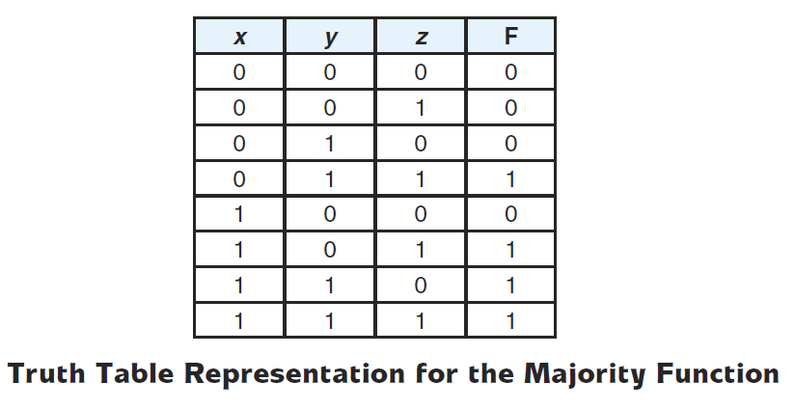
Representing Boolean Functions (5/5)
Boolean Algebra

Slide 33
Logic Gates – Introduction
Logic Gates
The logical operators, expressions and functions have been represented thus far in an abstract sense. In order to implement the logical operations in a computer we need digital circuits.
Physical components or digital circuits perform arithmetic operations or make choices in a computer.
What is a Gate?
A gate is a small, electronic device that computes various functions of two-valued signals (or more).
Each gate requires from one to six or more transistors.
If the basic physical component of a computer is the transistor, the basic logic element is the gate.

Slide 34
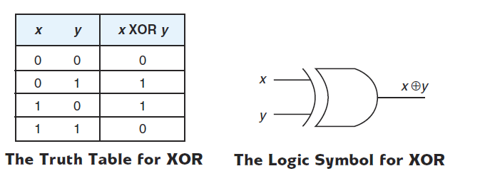
Logic Gates – Symbols for Logic Gates
Logic Gates
Boolean expression
( Exclusive OR )

Slide 35
Logic Gates – Universal Gates (1/3)
Logic Gates
¯
¯
¯
¯
¯
x y
¯
x + y = x y
¯
¯
¯
¯
¯
¯
¯
¯
x + y
x y = x + y

Slide 36
Logic Gates – Universal Gates (2/3)
Logic Gates
The NAND gate is commonly referred to as a universal gate
Any electronic circuit can be constructed using only NAND gates

Slide 37
Logic Gates – Universal Gates (3/3)
Logic Gates
Why not simply use the AND, OR, and NOT gates we already know exist?
For two reasons:
NAND gates are cheaper to build than the other gates
complex integrated circuits are often much easier to build using the same building blocks
Applying the duality principle, NOR is also a universal gate
In practice, NAND are used for implementing an expression in sum of-products form
In practice, NOR are used for implementing an expression in product-of-sums form

Slide 38
Logic Gates – Multiple Input Gates
Logic Gates
Gates could have multiple inputs
Also, sometimes it is useful to depict the output of a gate as Q along with its complement $\overline{Q }$

Slide 39
Digital Components – Introduction
Digital Components
A computer is built using connected collections of gates.
These collections of gates are often quite standard, resulting in a set of building blocks.
These building blocks are constructed using the basic AND, OR, and NOT operations.
In this part, we will discuss:
Digital circuits, and their relationship to Boolean expressions
The standard building blocks
Two different categories of such building blocks: Combinational logic and Sequential logic

Slide 40
Digital Components - Digital Circuits and Boolean Algebra
Digital Components

Slide 41
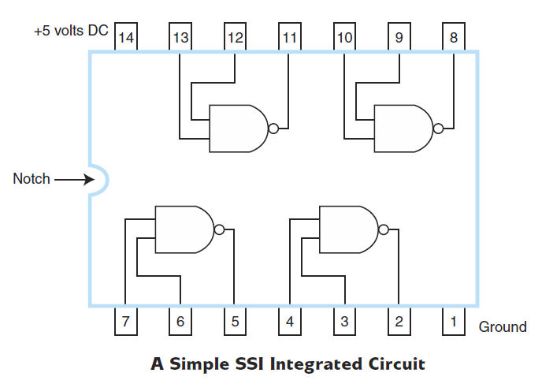
Digital Components - Integrated Circuits
Digital Components
Gates are manufactured in units called integrated circuits (ICs).
First ICs were SSI (small scale integration) chips and contained very few transistors (up to 100 transistors).
We now have ULSI (ultra large-scale integration) with more than 1 million electronic components per chip.
How many gates does this IC contain?
What is (are) the type(s) of these gates?

