Slide 1
Introduction to LINQ
Chapter 11

Slide 2
Introduction
Large amounts of data are often stored in a database—an organized collection of data.
A database management system (DBMS) provides mechanisms for storing, organizing, retrieving and modifying data contained in the database.
Today’s most popular database systems are relational databases.
A language called Structured Query Language (SQL) is an international standard used with relational databases to perform queries (that is, to request information that satisfies given criteria) and to manipulate data.

Slide 3
Introduction
For years, programs that accessed a relational database passed SQL queries as Strings to the database management system then processed the results.
Microsoft developed LINQ (Language Integrated Query) to enable you to write query expressions similar to SQL queries that retrieve information from a wide variety of data sources—not just relational databases—using a common syntax that is built into Visual Basic.

Slide 4
Introduction
We use LINQ to Objects to query the contents of arrays, selecting elements that satisfy a set of conditions—this is known as filtering.
We also use LINQ to Objects to perform common array manipulations such as sorting an array.
Figure 11.1 shows the types of LINQ queries.

Slide 5
Querying an Array of Primitive-Type Elements Using LINQ
Primitive types are the basic type of data
Byte, short, int, long, float, double, boolean, char
Primitive variables store primitive values.
LINQ allows you to look at collections of data, extract information and manipulate data.

Slide 6
Three Stages of a Query Operation
LINQ query operations consist of three actions:
Obtain the data source or sources.
Create the query.
Execute the query

Slide 7
' Data source.
Dim numbers() As Integer={0,1,2,3,4,5,6}
' Query creation.
Dim evensQuery = From num In numbers
Where num Mod 2 = 0
Select num
' Query execution.
For Each number In evensQuery
Console.Write(number & " ")
Next
Output:
0 2 4 6

Slide 8
Querying an Array of Primitive-Type Elements Using LINQ
Our first LINQ query begins with a From clause which specifies a range variable (num) and the data source to query (the array numbers).
The range variable represents each item in the data source, much like the control variable in a For Each…Next statement.
If the condition in the Where clause evaluates to True, the element is selected—that is, it’s included in the collection of Integers that represents the query results.
Here, the Integers in the array are included only if they’re divisible by 2.

Slide 9
Querying an Array of Primitive-Type Elements Using LINQ
For each item in the data source, the Select clause determines what value appears in the results.
In this case, it’s the Integer that the range variable currently represents.
The Select clause is usually placed at the end of the query for clarity, though it may be placed after the From clause and before other clauses, or omitted.
If omitted, the range variable is implicitly selected.
The Select clause can transform the selected items—for example, Select value * 2 in this example would have multiplied each selected value in the result by 2.

Slide 10
Querying an Array of Primitive-Type Elements Using LINQ
You can use a For Each…Next statement to iterate over the results of any LINQ query.

Slide 11
Querying an Array of Primitive-Type Elements Using LINQ
Sorting LINQ Query Results
The LINQ query in the above example selects the elements of the array values and returns an IEnumerable object containing a sorted copy of the elements.
Dim values() As Integer = {2,9,5,0,3,7,1,4,8,6}
Dim sorted =
From value In values
Order By value
Select value

Slide 12
Querying an Array of Primitive-Type Elements Using LINQ
The Order By clause sorts the query results in ascending order.
You can use the Descending modifier in the Order By clause to sort query results in descending order.
An Ascending modifier also exists but is rarely used, because it’s the default.
You can use the Order By clause only for values that can be compared to one another.
The Order By clause supports values of any type that implements the interface IComparable, such as the primitive numeric types and String.
Such types provide a CompareTo method.

Slide 13
Querying an Array of Reference-Type Elements Using LINQ
LINQ is not limited to querying arrays of primitive types.
It can be used with most data types.

Slide 14
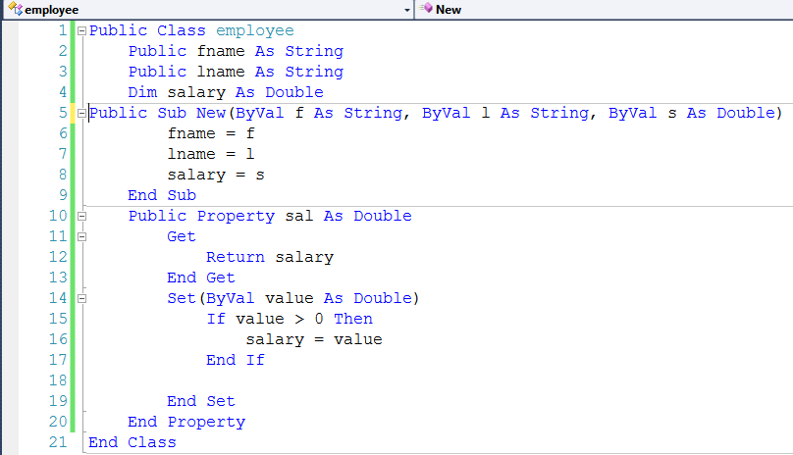
Example

Slide 15
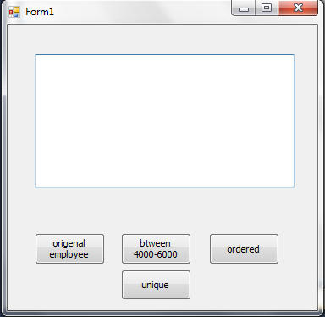
Example

Slide 16
Example

Slide 17
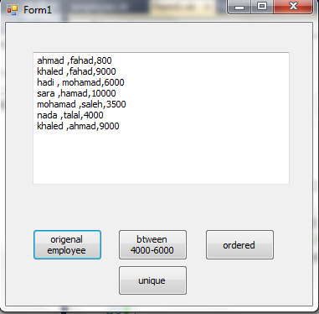
Example

Slide 18
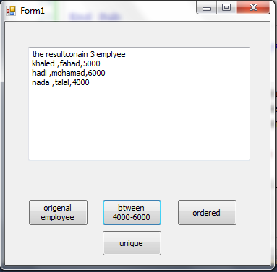
Example

Slide 19
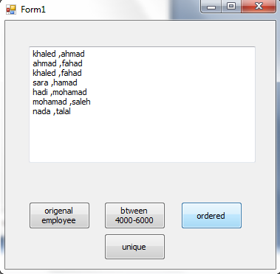
Example

Slide 20
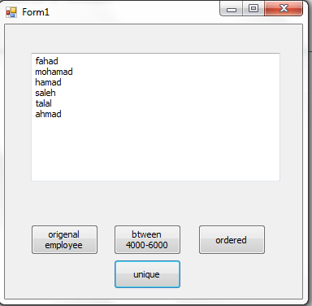
Example

Slide 21
Querying an Array of Reference-Type Elements Using LINQ
When you type the name of an IEnumerable object (such as an array or the result of a LINQ query) then type the dot (.) separator, the list of the methods and properties that can be used with that object are shown.
Some of the methods are so-called extension methods.
For example, if you have an array of Doubles called numbers and you want to calculate the average of its values, you can simply call the Average extension method, as in numbers.Average().
Some of IEnumerable’s 45 extension methods are shown in Fig. 11.5.

Slide 23
Deferred Execution and Transforming Query Results
LINQ uses a technique called deferred execution—a query executes only when you iterate over the results, not when the query is defined.
This allows you to create a query once and execute it many times.
If you make any changes to the data in a LINQ query’s data source, the next time you iterate over the query’s results, the query will process the current data in the data source.

Slide 24
Deferred Execution and Transforming Query Results
Figure 11.7 filters an array of Strings by searching for those that begin with "r".
Initially the array (lines 8–9) contains two such Strings.
Later in the program we modify the array then reexecute the LINQ query to demonstrate deferred execution.
This example also demonstrates how to transform the items that match the Where clause—in this case, each matching String is converted to uppercase in the query result.

Slide 25
