Slide 1
Barium enema
MEAAD AL0MUSINED

Slide 2
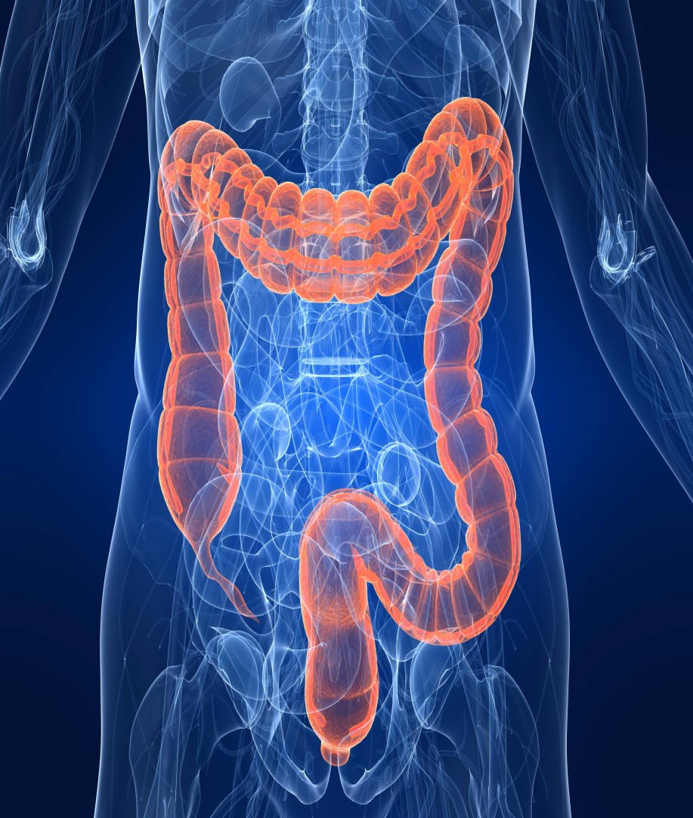
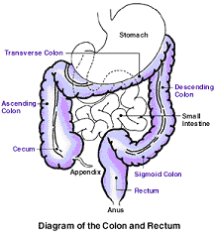
Anatomy

Slide 3
Large Bowel
The main function of the large bowel (also known as the large intestine) is to transport waste out of the body and to absorb water from the waste before it leaves. The large bowel connects with the small bowel to the north and freedom (open air) to the south.

Slide 4
Anatomy of the Large Bowel
The main components of the large bowel include the following:
cecum
appendix
colon
rectum
anal canal
anus

Slide 5
Barium enema
Definition:
It is a radiographic examination of the large intestine by using radio-opaque contrast media.
Methods of examination:
Double contrast.
Single contrast .

Slide 6
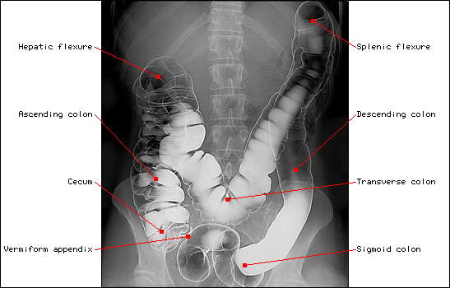
the Large Bowel

Slide 7
the Large Bowel
Splenic flexure
Hepatic flexure
Transverse colon
Aescending colon
Descending colon
Sigmoid colon
single contrast

Slide 8
Technique
Preliminary Film to:
Bowel preparation.
Complete obstruction, Perforation

Slide 9
Air Barium Distribution
Supine AP
Transverse c. filled with air
Prone
Transverse c. filled with ba

Slide 10
the Large Bowel
RPO
Splenic flexure descending colon appear open
LPO
Hepatic flexure ascending colon and rectosigmoid region appear open

Slide 11
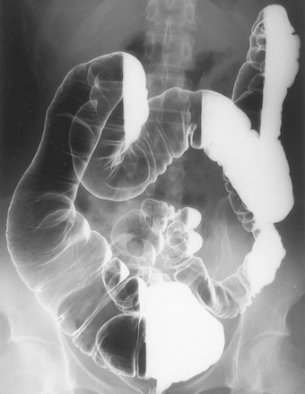
the Large Bowel
LT LAT Decubitus

Slide 12
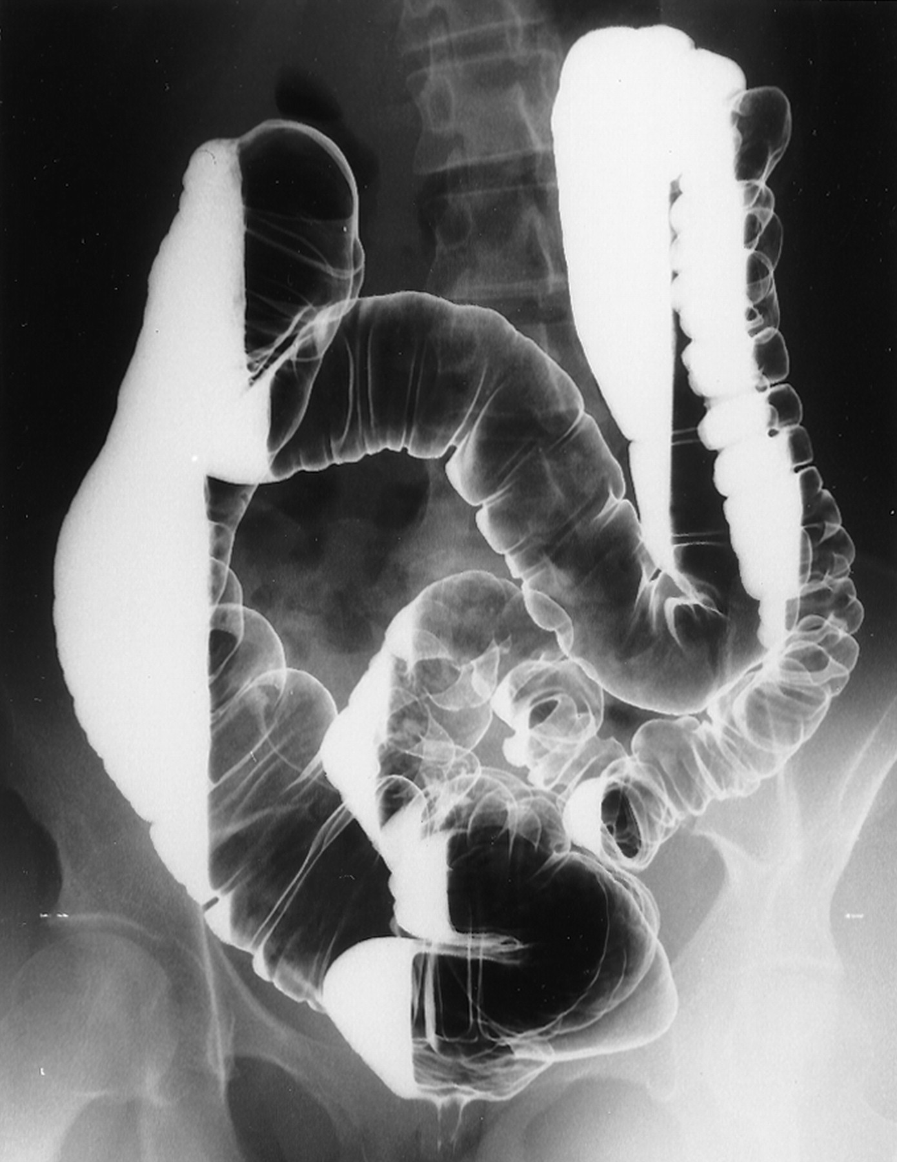
the Large Bowel
RT LAT Decubitus

Slide 13
Spot Film
Hepatic
Flexure
Splenic
Flexure

Slide 14
Thank you

